Slide 1

Deniable Functional Encryption
Angelo de Caro¹, Vincenzo Iovino², Adam O’Neill³
¹ IBM Research, Zurich
² University of Luxembourg
³ Georgetown University, USA
PKC 2016
Academia Sinica, Taipei, TAIWAN March 6-9, 2016

Slide 2








Deniable Encryption (explained to kids)
Grrr… Is there a man in the middle?!? I intercepted this encrypted msg, show me what is inside!
Ohhh… I am so sorry, will you ever forgive me?
How can you doubt my fidelity?! This is my SK, see with your own eyes…
We will see tonight…
See you tonight.
Adam
Your husband’s suit is ready. The
Laundress
See you tonight. Adam
= Setup(1^{λ})
Notes:
To figure out the reason of such limitation, I will first present a short overview of an emerging paradigm of the Internet that is CLOUD COMPUTING.
Nowadays many users, companies and governments are moving their data to the Cloud, and if you never heard about it be aware that if you own an android phone (like this) your contacts and emails are stored in the Cloud!
In cloud computing a user sends his data to the server, also called the Cloud.
Later another possibly different user can request to the Cloud to retrieve some data or perform some computation on the data stored in the Cloud.
If such user is authorized the Cloud returns the requested document or the result of the computation to the user.
In a Secure Cloud System a malicious user should not be able to leak any information that is not entitled to access.
We are not interested only in preventing an external attacker to leak information but we also want that internal users do not leak too much information: for instance, if the previous user is authorized to retrieve all emails with subject FinTech, he should not be able to retrieve emails with different subjects.
Moreover in this model the CLOUD is not trusted; in fact the CLOUD is usually third-party service, like google or yahoo, to which individual, companies or governements delegated their data and the Cloud has NOT to leak too much information.
It is not exaggeration to expect that in the near future a lot of sensitive information will be outsourced to the Cloud, and recently the City of Los Angeles announced plans to outsource all their data to Gooogle, the major cloud service.

Slide 3
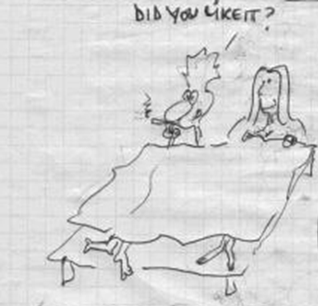
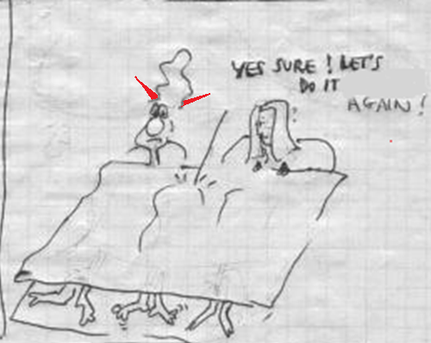
(during the night…)

Slide 4

Functional Encryption
PK
MSK
Token(f)=KeyGen(MSK,f)
f
Enc(msg)
Example: Email Filter
msg
msg=‘’From XXX To XXX Body XXX’’
f(msg)=
f(msg)
{
If From=‘’Adam’’ return Priority,
If From=‘’Bob’’ return Discard,
Else ….
Notes:
In more detail the setting of FE is the following.
There is a CA who sets-up a PK and a MSK. The PK is sent to Bob. Ant any point Alice can send a function f to the CA who returns her the Token for f. Later Bob holds a message m, encrypts it and sends it to Alice.
Now Alice holds the token for f, the encryption of m, and can combine them to compute f(m), the evaluation of the function f on the message m.
And the security should guarantee that this be the only information that Alice can compute.

Slide 5

Motivating Deniability for FE: Secure Routing
Encrypted package goes from Alice to Adam
Each router has a token for its routing table
With tokens routers can compute next hop
Router, I suspect that my wife is cheating on me. Can you tell me what is the next destination of this msg of hers that I intercepted?
Routers can not leak other information, e.g. final or previous hops in the path
Router has 6 possible next hops for the package
Adam’s message followed the pink one but the router gives to Bob a FSK that shows as next hop the green one
5

Slide 6
Our Results
Receiver-deniable FE for general functions BB from any FE
Receiver-deniable FE in the multi-distributional model
Relations between Sim-Security and Deniability
Efficient constructions

Slide 7


Functional Encryption: IND-Security
Adversary
Challenger
PK
f
PK
Token(f)=KeyGen(MSK,f)
MSK
m₀, m₁
Ct = Enc(m_{b})
b←$
f
Token(f)=KeyGen(MSK,f)
b’
Wins if b’=b
Constraint: Adversary cannot ask query for f s.t f(m₀) $≠$f(m₁)

Slide 8
Receiver-deniable FE
Receiver Deniability Games:
RealRecDenExp and FakeRecDenExp
RealRecDenExp
K₁(f, Ct*, x*):
Sk _{f}= KeyGen(Msk, f);
Output: Sk_{f}
FakeRecDenExp
K₂(f, Ct*, x*):
Sk _{f}= RecFake(Msk, Ct,* x*);
Output: Sk_{f}
Adv^{O1,O2,K}
Challenger
PK
Ct = Enc(PK, x; r);
Sk_{f} = RecFake(Msk,Ct,y);
f(y) = Dec(Ct,Sk_{f});
Ct = Enc(PK,x’; r);
f(x’) = Dec(Ct’, Sk_{f});
Msk
O₁(f,x,y):
Ct = Enc(PK,x;r);
Sk_{f}= KeyGen(Msk, f);
Output: (Ct,Sk_{f})
O₂(f,x,y):
Ct = Enc(PK, y; r);
Sk_{f} = RecFake(Msk, f, Ct, x);
Output: (Ct, Sk_{f})
(x*,y*)
Real: Ct* = Enc(x*;r)
Fake: Ct*=Enc(y*;r)
Constraints
1. No query (f, x, y) issued to O₁/O₂ and
at same time a query (f, Ct*, x) to K₁ /K₂;
2. For any query to oracle K₁/K₂ for f*,
there is no query f* to O₁/O₂;
3. For each f different from any of the f*
queried to O₁/O₂, it holds that f(x*)=f(y*).
view
Note: Adv has access to K(·,Ct*,x*) only after seeing Ct
~
Adversary’s view in RealExp with K=K₁
~
Adversary’s view in FakeExp with K=K₂

Slide 9
Multidistributional Receiver-deniable FE
MultiDist RecDen Games:
ReadMDRecExp and FakeMDRecExp
RealMDRecExp
K₁(f, Ct*, x*)
Sk_{f}= KeyGen(Msk, f);
Output: Sk_{f}
FakeMDRecExp
K₂(f, Ct*, x*)
(Sk_{f}, Fk_{f}) = DenKeyGen(Msk, f);
Sk_{f}= RecFake(Msk, Ct*, x*);
Output: Sk_{f}
Adversary^{O1,O2,K}
Challenger
(x*,y*)
Ct = Enc(PK, x; r);
(Sk_{f}, Fk_{f}) = DenKeyGen(Msk, f);
Sk_{f}’ = RecFake(Sk_{f}, Fk_{f ,}Ct, y);
f(y) = Dec(Ct, Sk_{f}’)
O₁(f,x,y)
Ct = Enc(PK,x;r);
Sk_{f}= KeyGen(Msk, f);
Output: (Ct,Sk_{f})
O₂(f,x,y)
Ct = Enc(PK, y; r);
(Sk_{f}, Fk_{f}) = DenKeyGen(Msk, f);
Sk_{f}= RecFake(Sk_{f}, Fk_{f}, Ct, x);
Output: (Ct, Sk_{f})
PK
Real: Ct* = Enc(x*;r)
Fake: Ct*=Enc(y*;r)
Constraints
1. No query (f, x, y) issued to O₁/O₂ and
at same time a query (f, Ct*, x) to K₁ /K₂;
2. For any query to oracle K₁/K₂ for f*,
there is no query f* to O₁/O₂;
3. For each f different from any of the f*
queried to O₁/O₂, it holds that f(x*)=f(y*).
view
Note: Adv has access to K(·,Ct*,x*) only after seeing Ct
~
Adversary’s view in RealMDRecExp with K=K₁
~
Adversary’s view in FakeMDRecExp with K=K₂

Slide 10
Starting point: DIJOPP13’s transform
Functionality in Normal Mode:
Functionality in Trapdoor Mode:
Token(C)
Enc(m)
Simulated Token
Simulated ciphertext
Decryption
Decryption
f(m)
f(m)

Slide 11
DIJOPP13’s transform (simplified)
IND-secure scheme:
Ciphertext | Token
msg | f
SIM-secure scheme:
 | Ciphertext | Token
 | [msg , flag , encryption key] | [f, encrypted output]
Normal mode | [msg,0,$] | [f,$]
Trapdoor mode | [0^{n},1,key] | [f , Enc_{key}(f(msg))]

Slide 12
Trapdoor circuit for RecDen (simplified)
Circuit Trap[C,t,z,t’,z’](x’):
(x,s)⬅ x’;
If F(s,t)=z return 1;
Else if F(s,t’)=z’ return 0;
Else return C(x);
Target Ciphertext Ct*=Enc(x,s)
Other Ciphertexts
Decryption
Decryption
1 if F_{s}(t)=z
0 if F_{s}(t’)=z’
C(x)

Slide 13
MultiDistRecDen (General Idea)
Token=(Trap2Tok, TCt), where Trap2Tok is a Token for a trapdoor circuit for a 2-FE
Link Trap2Tok and TCt: TCt encrypts z and trapdoor circuit embeds value t s.t. f(z)=t
Using Fake key = z compute fake TCt=Enc(z,Ct*,y) for target ciphertext Ct*=Enc(x) and feed Trap2Tok with (Ct*, TCt)
➔ Decrypt(Trap2Tok, Ct*,TCt)=C(y)

Slide 14

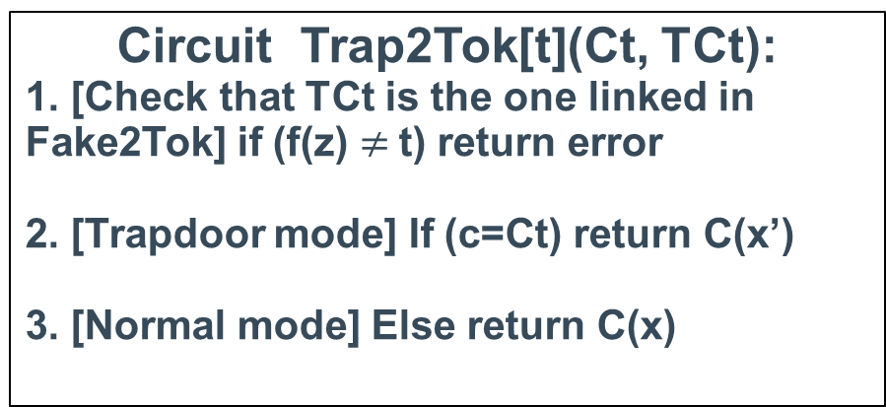
MultiDistRecDen Construction (simplified)
c=Ct ➔ Trapdoor mode
c$≠$Ct ➔ Normal mode
Tok(C)=(Trap2Tok[t], TCt=Enc(z, Ct, x’))
Tok(C)=(Trap2Tok[t], TCt=Enc(z, c, x’))
Ct =Enc(x)
Circuit Trap2Tok[t](Ct, TCt):
1. [Check that TCt is the one linked in Fake2Tok] if (f(z) $≠$t) return error
2. [Trapdoor mode] If (c=Ct) return C(x’)
3. [Normal mode] Else return C(x)
C(x’)
C(x)

Slide 15
Trapdoor circuit for MultiDistRecDen

Slide 16
Negative implications and Optimality of our results
(n_{c},n_{k})-receiver deniability = deny n_{c} ciphertexts and n_{k} tokens
(n_{c},n_{k})-receiver deniability ➔ (0,n_{c},n_{k})-Sim-security ➔ Impossible
Receiver deniability stronger: equivocable ciphertexts and tokens must decrypt correctly in the real system
SIM-secure FE impossibility ➔ (n_{c}, poly)-deniability is in fact optimal
➔ we achieve optimal parameters

Slide 17
Efficient construction for Boolean Formulae
RecDen IBE ⬅ lattice-based assumptions [OPW11]
RecDen Boolean Formulae Encryption ⬅ Inner-Product Encryption [This work]
Implement Boolean Formulae with Inner-Product Encryption
Implement equality with bitwise comparison
➔ To avoid exponential blowup we must bound the length of the variables s, r₀ and r₁ to be a constant t
➔ Decryption error non-negligible
Use parallel repetition to fix the issue

Slide 18





&
Vincenzo thanks FNR (Luxembourg) to fund his research and Gabriele Lenzini for the drawings in the 3rd slide

