Slide 1
Extended Nested Dual System Groups, Revisited
Junqing Gong | Shanghai Jiao Tong University
Jie Chen, Xiaolei Dong, Zhenfu Cao | East China Normal University
Shaohua Tang | South China University of Technology
PKC 2016

Slide 2
Overview

Slide 3





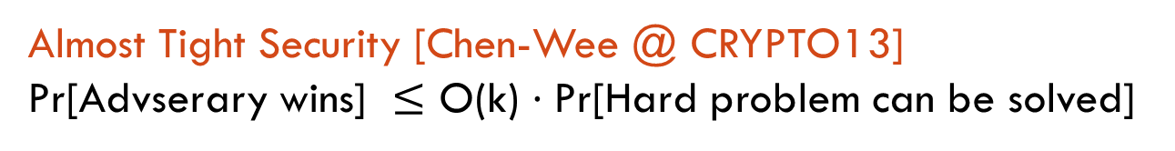
Identity Based Encryption
PP
…
Algorithms:
Setup(1^{k}) → (PP,MSK)
KeyGen(MSK,ID) →SK_{ID}
Enc(PP,ID,M) → CT
Dec(PP,SK,CT) → M
Q revealed keys
PP
PP
Security: IND-ID-CPA (Adaptive/Full)
CT
ID
SK_{ID}
Small group size &
Efficient realization
Almost Tight Security [Chen-Wee @ CRYPTO13]
Pr[Advserary wins] $≤$ O(k) $⋅$Pr[Hard problem can be solved]

Slide 4

Towards Multi-instance, Multi-ciphertext Setting
[Hofheinz-Koch-Striecks @ PKC15]
PP
…
Instance 1
GP
PP
PP
Instance 2
GP
…
…
…
…
Instance $μ$
GP

Slide 5
Our Results
More Efficient, generally
(shorter ct & faster algorithms)
Almost-tight Security | Composite-order Bilinear Group | Prime-order Bilinear Group
Standard (Single-instance, Single-ciphertext) | Chen-Wee13 | Chen-Wee13
Multi-instance, Multi-ciphertext (MIMC) | Hofheinz-Koch-Striecks15 | This work

Slide 6
Overview
Composite
&
Prime
Almost-tightly Secure IBE in SISC
Nested Dual System Group (NDSG)
NDSG implies IBE
SISC
NDSG from Bilinear Group
ENDSG from Bilinear Group
Extend NDSG
(ENDSG)
ENDSG implies IBE
MIMC
CW13
HKS15
Almost-tightly Secure IBE in MIMC
Composite only!

Slide 7
Overview
Require specific algebraic structure!
Nested Dual System Group (NDSG)
NDSG implies IBE
SISC
NDSG from Bilinear Group
ENDSG from Bilinear Group
Extend NDSG
(ENDSG)
ENDSG implies IBE
MIMC
CW13
HKS15
ENDSG from Prime order Bilinear Group
Revisit ENDSG
Revisited ENDSG implies IBE in MIMC
Revisited ENDSG in the Prime order Setting
Ours

Slide 8
Basic Prime-order Technique

Slide 9
Our Idea
Almost Tight Security | Composite-order Bilinear Group | Prime-order Bilinear Group
Single-instance, Single-ciphertext (SISC) | Chen-Wee13 | Chen-Wee13
Multi-instance, Multi-ciphertext (MIMC) | Hofheinz-Koch-Striecks15 | This work

Slide 10
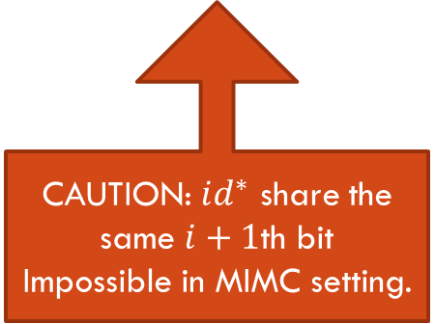






From CW13 to HKS15
Normal Space
Semi-functional Space
structural
structural
$$RF_{i}(id)$$
$$sk_{id}$$
$$RF_{i+1}(id)$$
Nested Hiding
structural
structural
CAUTION: $id^{∗}$ share the same $i+1$th bit
Impossible in MIMC setting.
$$RF_{i}(id^{∗})$$
$$ct_{id^{∗}}$$
$$RF_{i+1}(id^{∗})$$

Slide 11









From CW13 to HKS15
1. Additional SF Space
Normal Space
Semi-functional Space
$$∧$$
Semi-functional Space
$$∼$$
$$sk_{id}$$
structural
$${\hat{RF}}_{i}(id)$$
$${\tilde{RF}}_{i}(id)$$
2. Switching Ciphertext
structural
$${\hat{RF}}_{i}(id^{∗})$$
$$≈$$
$${\tilde{RF}}_{i}(id^{∗})$$
$$ct_{id^{∗}}$$
$$id^{∗}\left[i+1\right]=0$$
$$id^{∗}\left[i+1\right]=1$$
4. Tightness Preserving
3. Nested Hiding

Slide 12

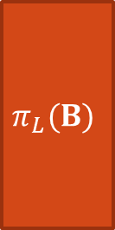
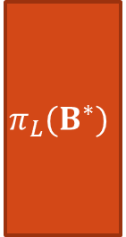



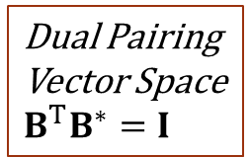
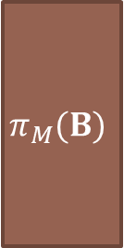
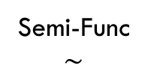
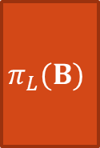



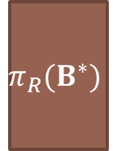
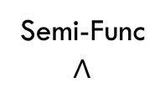


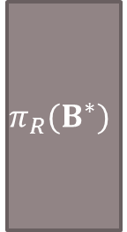
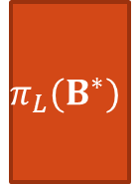
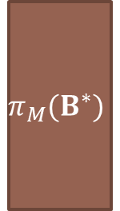

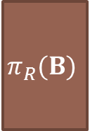

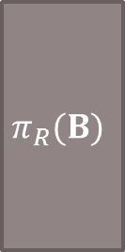
1. Additional SF Space
Semi-Func
$$∧$$
Semi-Func
$$∼$$
Dual Pairing
Vector Space
$$B^{T}B^{∗}=I$$
Normal
Normal
Semi-Func
$$d$$
$$d$$
$$d$$
$$d$$
$$d$$
$$π_{L}(B^{∗})$$
$$π_{M}(B^{∗})$$
$$π_{R}(B^{∗})$$
$$π_{L}(B^{∗})$$
$$π_{R}(B^{∗})$$
$$3d$$
$$sk_{id}$$
$$2d$$
$$π_{L}(B)$$
$$π_{R}(B)$$
$$π_{L}(B)$$
$$π_{M}(B)$$
$$π_{R}(B)$$
$$ct_{id^{∗}}$$
$$2d$$
$$3d$$

Slide 13
2. Switching Ciphertext
Semi-Func
$$∧$$
Semi-Func
$$∼$$
Normal
$$d$$
$$d$$
$$d$$
$$π_{L}(B^{∗})$$
$$π_{M}(B^{∗})$$
$$π_{R}(B^{∗})$$
$$3d$$
$$sk_{id}$$
$$π_{L}(B)$$
$$π_{M}(B)$$
$$π_{R}(B)$$
$$ct_{id^{∗}}$$
$$3d$$

Slide 14
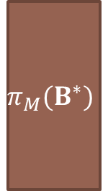
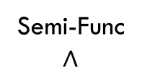
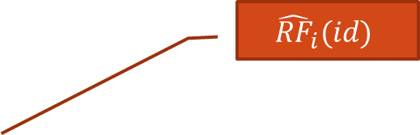



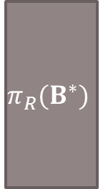



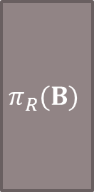



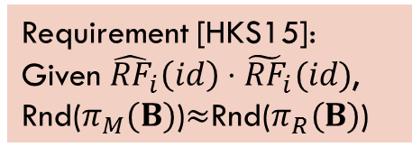


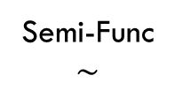
2. Switching Ciphertext
Semi-Func
$$∧$$
Semi-Func
$$∼$$
Normal
$$d$$
$$d$$
$$d$$
$${\hat{RF}}_{i}(id)$$
$$π_{L}(B^{∗})$$
$$π_{M}(B^{∗})$$
$$π_{R}(B^{∗})$$
$${\tilde{RF}}_{i}(id)$$
$$3d$$
$$sk_{id}$$
$d$-Lin
$$π_{L}(B)$$
$$π_{M}(B)$$
$$π_{R}(B)$$
$$ct_{id^{∗}}$$
Requirement [HKS15]:
Given ${\hat{RF}}_{i}\left(id\right)⋅{\tilde{RF}}_{i}(id)$,
Rnd($π_{M}(B)$)$≈$Rnd($π_{R}(B)$)
$$3d$$
$$≈$$

Slide 15
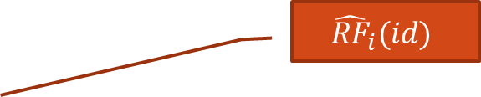

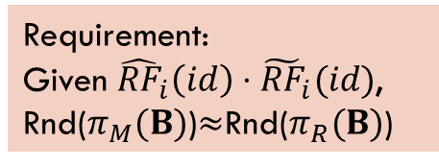
2. Switching Ciphertext
Semi-Func
$$∧$$
Semi-Func
$$∼$$
Normal
$$d$$
$$d$$
$$d$$
$${\hat{RF}}_{i}(id)$$
$$π_{L}(B^{∗})$$
$$π_{M}(B^{∗})$$
$$π_{R}(B^{∗})$$
$${\tilde{RF}}_{i}(id)$$
$$3d$$
$$sk_{id}$$
$d$-Lin
$$π_{L}(B)$$
$$π_{M}(B)$$
$$π_{R}(B)$$
$$ct_{id^{∗}}$$
Requirement:
Given ${\hat{RF}}_{i}\left(id\right)⋅{\tilde{RF}}_{i}(id)$,
Rnd($π_{M}(B)$)$≈$Rnd($π_{R}(B)$)
$$3d$$
$$≈$$

Slide 16









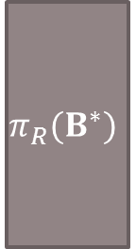




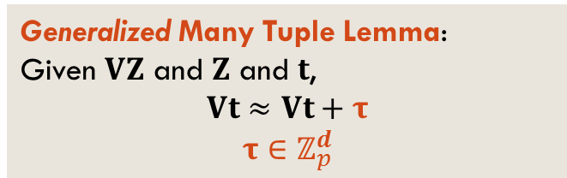
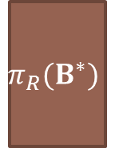





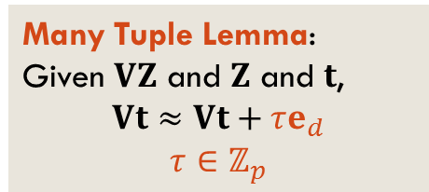




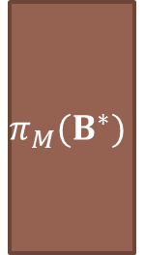

3. Nested Hiding
$$d$$
$$d$$
$$d$$
$$d$$
Two random functions have more
Entropy!
$$π_{L}(B^{∗})$$
$$π_{R}(B^{∗})$$
Generalized Many Tuple Lemma:
Given $VZ$ and $Z$ and $t$,
$$Vt≈Vt+τ$$
$$τ∈ℤ_{p}^{d}$$
$$d$$
$$2d$$
$$d$$
Update ${\hat{RF}}_{i}$
Update ${\tilde{RF}}_{i}$
Update $RF_{i}$
$$d$$
$$d$$
$$d$$
$$d$$
$$d$$
$$d$$
Many Tuple Lemma:
Given $VZ$ and $Z$ and $t$,
$$Vt≈Vt+τe_{d}$$
$$τ∈ℤ_{p}$$
$$π_{L}(B^{∗})$$
$$π_{M}(B^{∗})$$
$$π_{R}(B^{∗})$$
$$d$$
$$3d$$
$$d$$
$$d$$

Slide 17
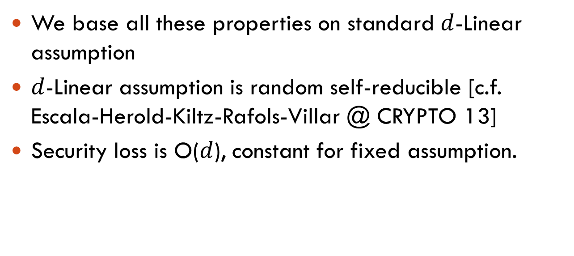
4. Preserving Tightness
We base all these properties on standard $d$-Linear assumption
$d$-Linear assumption is random self-reducible [c.f. Escala-Herold-Kiltz-Rafols-Villar @ CRYPTO 13]
Security loss is O($d$), constant for fixed assumption.

Slide 18
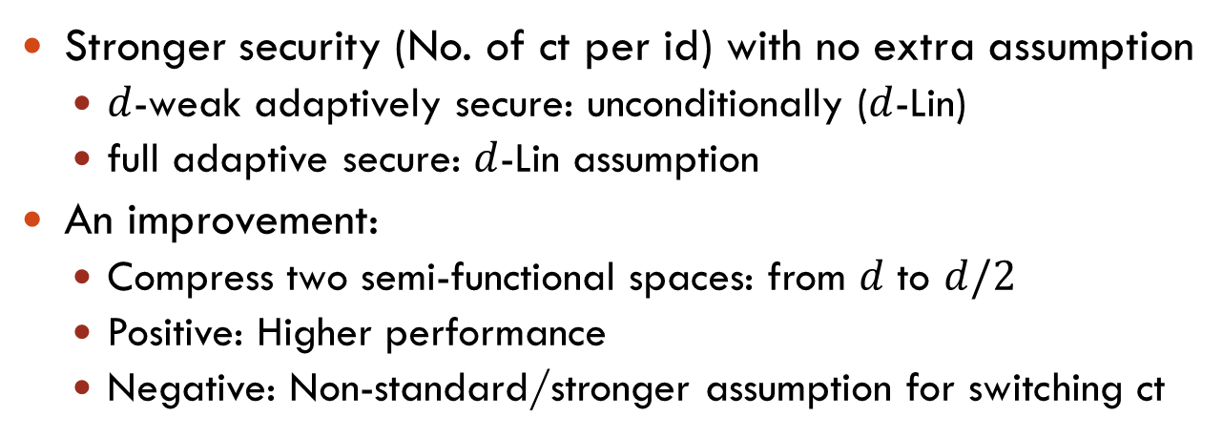
A Glance of other Results
Stronger security (No. of ct per id) with no extra assumption
  $d$-weak adaptively secure: unconditionally ($d$-Lin)
  full adaptive secure: $d$-Lin assumption
An improvement:
  Compress two semi-functional spaces: from $d$ to $d/2$
  Positive: Higher performance
  Negative: Non-standard/stronger assumption for switching ct
Open problem
Find an approach to achieve high performance under standard/weaker assumption !

Slide 19
An Independent Work on This Topic
Attrapadung-Hanaoka-Yamada @ AsiaCrypt15
  An elegant explanation of Chen-Wee’s proof idea [CW13] using Broadcast Encoding mechanism
  Generic construction for almost-tightly secure IBE in both composite- and prime-order groups
  Basic prime-order construction is similar to ours improvement
  More concrete results:
    Tight reduction with short public parameter
    Anonymous version
Our work is more general in terms of assumption.

Slide 20
The End
Any Question?

Slide 21



4. Preserving Tightness
Situation
Span(
)$≈$Span(
)
Span(
)$≈$Span(
)
……
Span(
)$≈$Span(
)

Slide 22









4. Preserving Tightness
Solution
Constant Loss
Span(
)$≈$Span(
)$≈$Span(
)$≈$Span(
)
Span(
)$≈$Span(
)$≈$Span(
)$≈$Span(
)
……
Span(
)$≈$Span(
)$≈$Span(
)$≈$Span(
)
Arise reduction loss proportional to the dimension of space

Slide 23


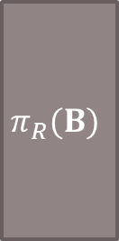

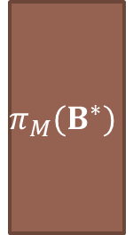
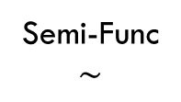
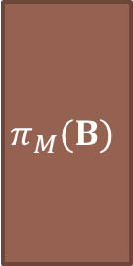


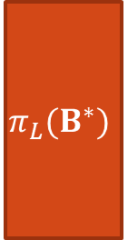
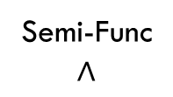


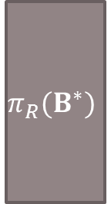



An Improvement
Used to hide message
Semi-Func
$$∧$$
Semi-Func
$$∼$$
Normal
$$d$$
$$d$$
$$d$$
$${\hat{RF}}_{i}(id)$$
$$π_{L}(B^{∗})$$
$$π_{M}(B^{∗})$$
$$π_{R}(B^{∗})$$
$${\tilde{RF}}_{i}(id)$$
$$3d$$
$$sk_{id}$$
$$π_{L}(B)$$
$$π_{M}(B)$$
$$π_{R}(B)$$
$$ct_{id^{∗}}$$
$$3d$$

Slide 24






An Improvement
Used to hide message!
Semi-Func
$$∧$$
Semi-Func
$$∼$$
Normal
$$d$$
$$/2$$
$$/2$$
$$d$$
$$d$$
$${\hat{RF}}_{i}(id)$$
$$π_{L}(B^{∗})$$
$$π_{M}(B^{∗})$$
$$π_{R}(B^{∗})$$
$${\tilde{RF}}_{i}(id)$$
$$3d$$
Positive:
Reduce dimension
High performance
$$2d$$
$$sk_{id}$$
Negative:
Non-standard/stronger
assumption
$$π_{L}(B)$$
$$π_{M}(B)$$
$$π_{R}(B)$$
$$ct_{id^{∗}}$$
$d$-Lin with Auxiliary Input
$$2d$$
$$≈$$
$$3d$$

