Slide 1
On the Practical Security of Inner Product
Functional Encryption
Shashank Agrawal (UIUC), Shweta Agrawal (IIT Delhi), Saikrishna Badrinarayanan (UCLA), Abishek Kumarasubramaniam (Google), Manoj Prabhakaran (UIUC), Amit Sahai (UCLA)
Shashank Agrawal (UIUC), Saikrishna Badrinarayanan (UCLA), Manoj Prabhakaran (UIUC)
Shweta Agrawal (IIT Delhi), Abishek Kumarasubramaniam (Google), Amit Sahai (UCLA)

Slide 2
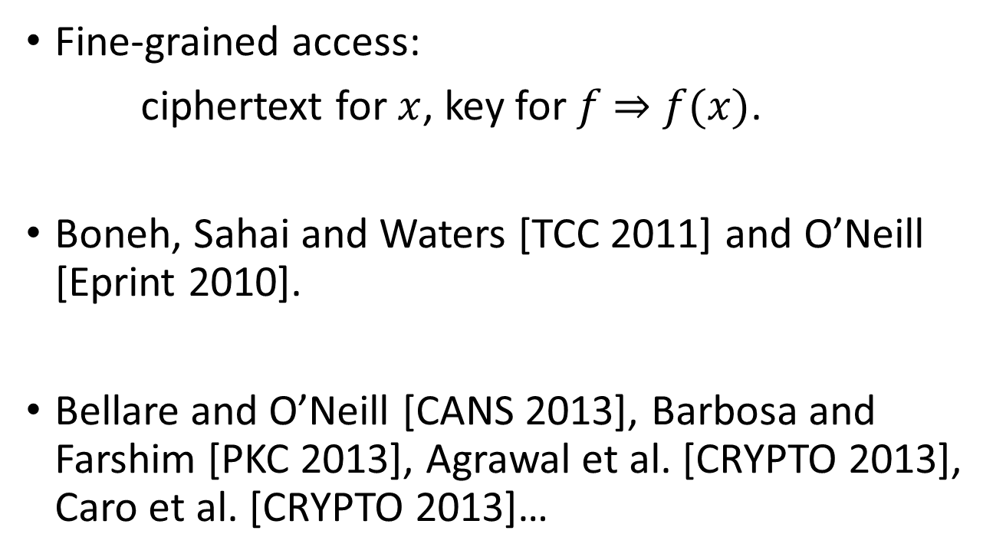
Functional Encryption
Fine-grained access:
ciphertext for $x$, key for $f$ $⇒$ $f(x)$.
Boneh, Sahai and Waters [TCC 2011] and O’Neill [Eprint 2010].
Bellare and O’Neill [CANS 2013], Barbosa and Farshim [PKC 2013], Agrawal et al. [CRYPTO 2013], Caro et al. [CRYPTO 2013]…
Notes:
These works discussed the subtleties involved in defining a security model for FE that captures meaningful real world security. Since then
there has been considerable research focus on understanding what security means for FE and whether it can be achieved.
While there has been considerable progress in defining meaningful security models for FE, existing definitions do not capture a number of real world usage scenarios that will likely arise in practice.

Slide 3
Important questions
  Can we hide the function?
  Learn only function’s output?
  Keys after ciphertexts?
Notes:
- keyword searching on encrypted data, where the keywords being searched for are sensitive and must remain hidden.
- For example, if the function has some computational hiding properties, can we guarantee that the FE scheme does not leak any additional information beyond the function output?
- Can an adversary break FE schemes where it can ask for keys after receiving ciphertexts? In real world applications, it is very likely that an adversary can receive authorized decryption keys even after it obtains the ciphertext that it is trying to break. For example, in searchable encryption, the decryption key corresponding to a search would only be given out after the encrypted database is publicly available. Can one guarantee that an attacker who obtains an arbitrary interleaving of ciphertexts and keys, can learn nothing beyond the legitimate function values?

Slide 4
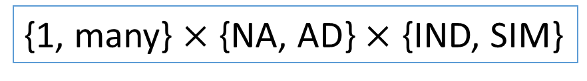
Security definitions
Indistinguishability
Simulation
distinguish encryptions
simulate view using
function values
Adaptive vs non-adaptive
One vs many
{1, many} $×$ {NA, AD} $×$ {IND, SIM}
Notes:
- without getting a secret key that decrypts the ciphertexts to distinct values
- which captures whether the adversary's queries to the key derivation oracle may or may not depend on the challenge ciphertext

Slide 5
Standard model woes
  Can we hide the function?
[BRS13a, BRS13b]
Indistinguishability
  Learn only function’s output?
[BSW11]

Slide 6
Standard model woes
Simulation
Many-AD-SIM
1-NA-SIM
Impossible for IBE [BSW11]
Not possible for PRFs [AGVW13]
Notes:
[15] showed that many-AD-SIM is impossible even for very simple functionalities. A weakening of AD-SIM, namely NA-SIM [43] does not capture scenarios where users may obtain keys after obtaining new third-party-generated ciphertexts. Despite this severe restriction on usage, NA-SIM was also shown to be impossible [6], seemingly ruling out security for even those usage scenarios that are captured.

Slide 7
Tricky situation
Indistinguishability
Simulation
Not good enough
Too strong
Should we be content with achieving a weaker notion of security?

Slide 8
Two approaches
“In-between” IND and SIM
[AGVW13, BF13, AAP15]
address as many usage scenarios as we can
but consider attacks that are practically feasible
Notes:
However, it is extremely hard (if not impossible) to control the nature of usage scenarios that arise in practice. A second direction is to ex-
amine whether it is possible to address as many usage scenarios as we can, but restrict ourselves to analyzing security only against classes of attacks that are known to be practically feasible. This is the approach we take in this work.

Slide 9
This work
Strong UC-style definition of security.
Secure scheme for inner-product predicates.
  Concrete security analysis.
  Obfuscation for hyper-plane membership.
Generic group model (GGM).

Slide 10
DEFINITIONS

Slide 11
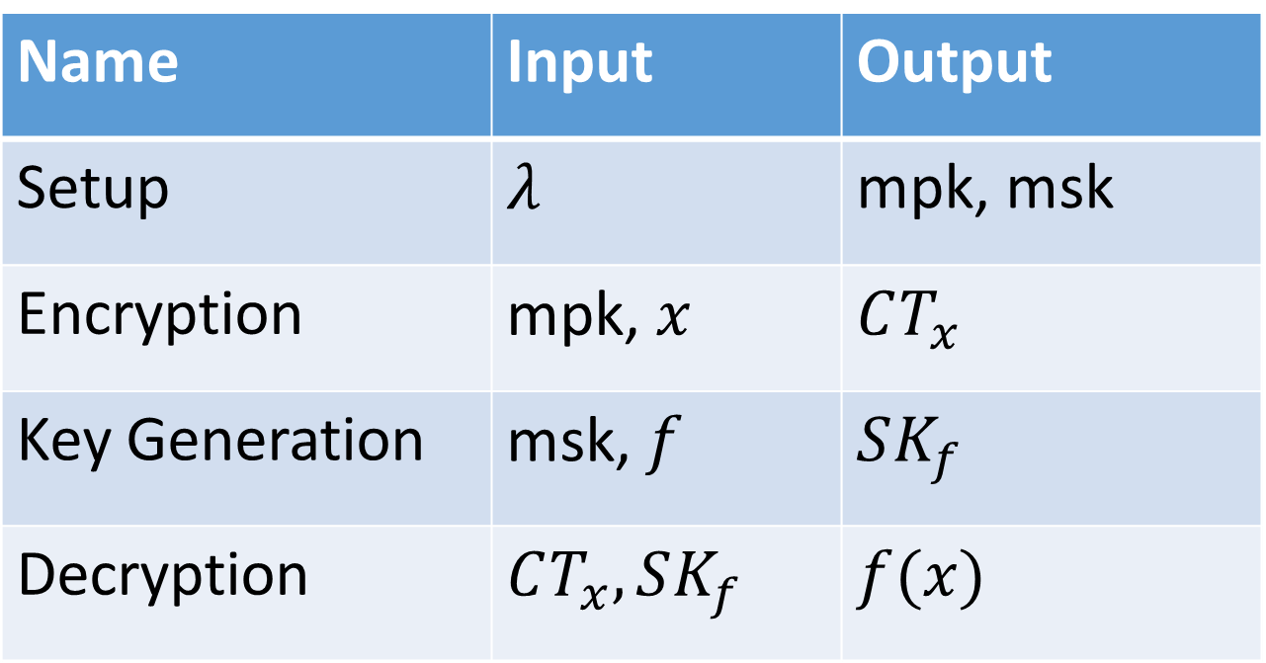
Functional Encryption
Name | Input | Output
Setup | $$λ$$ | mpk, msk
Encryption | mpk, $x$ | $$CT_{x}$$
Key Generation | msk, $f$ | $$SK_{f}$$
Decryption | $$CT_{x}, SK_{f}$$ | $$f(x)$$

Slide 12


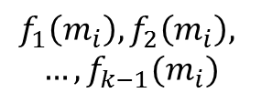












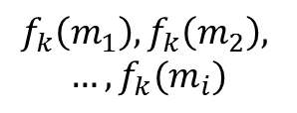




Real World
Ideal World
$$VIEW_{REAL}(1^{λ})$$
$$VIEW_{IDEAL}(1^{λ})$$
MSK, MPK
$$m_{1},m_{2},…,m_{i−1}$$
$$,m_{i}$$
MPK
$$f_{1},f_{2},…,f_{k−1}$$
$${,f}_{k}$$
$$Enc (m_{1})$$
$$f_{1}\left(m_{i}\right), f_{2}\left(m_{i}\right),$$
$$…, f_{k−1}(m_{i})$$
$$…, Enc(m_{i})$$
$$SK_{f_{1}}$$
$$f_{k}\left(m_{1}\right), f_{k}\left(m_{2}\right),$$
$$…,f_{k}(m_{i})$$
$$…,SK_{f_{k}}$$
System Admin
Adversary
Oracle
Simulator
$$m_{1}$$
$$…, m_{i}$$
$$m_{i}$$
$$f_{1}$$
$${…,f}_{k}$$
$$f_{k}$$
Switch to PK mode
Switch to PK mode
Environment
Environment
$$∀ Adv ∃ Sim ∀ Env, VIEW_{REAL}\left(1^{λ}\right)≈VIEW_{IDEAL}(1^{λ})$$
Notes:
The real-world consists of an adversary A, a system administrator Sys and external environment Env, which encompasses all external key hold-
ers and encryptors.

Slide 13
Highlights
Clean and intuitive definition.
Both public and private key settings.
All the desirable features:
  Can we hide the function?
  Learn only function’s output?
  Keys after ciphertexts?

Slide 14
But, wait!
Simulation based security impossible to achieve.
Yes, but in standard model.
Generic group model, captures a large class of real-world attacks.
Notes:
While simulation based security has been shown impossible to achieve even for data privacy alone, we will show that the stronger denition presented above can be achieved against a large class of real world attacks, namely generic attacks.

Slide 15
GENERIC GROUP MODEL

Slide 16
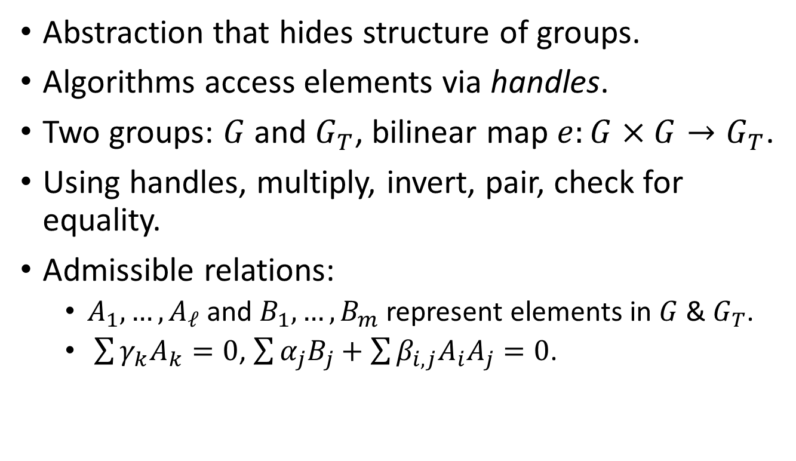
Generic group model
Abstraction that hides structure of groups.
Algorithms access elements via handles.
Two groups: $G$ and $G_{T}$, bilinear map $e:G×G→G_{T}$.
Using handles, multiply, invert, pair, check for equality.
Admissible relations:
  $A_{1},…, A_{ℓ}$ and $B_{1},…, B_{m}$ represent elements in $G$ & $G_{T}$.
  $\sum{γ_{k}A_{k}}=0$, $\sum{α_{j}B_{j}+\sum{β_{i,j}A_{i}A_{j}=0}}$.
Notes:
- The generic group model [40,48] provides a method by which to study the security of algorithms that act oblivious of particular group representations. All
algorithms obtain access to elements of the group via random \handles" (of sufficient length) and remain unaware of their actual representations.
- Given this restricted way in which an adversary is allowed to access the groups G; GT , he is only able to compute certain relations between elements which we call Admissible Relations

Slide 17
Bypassing impossibility
Adversary performs group operations via generic group oracle which simulator can control.
Simulator keeps track of queries.
Learn what adversary is doing.
Carefully program the oracle to behave like the real world.
Notes:
At a high level, the simulator keeps track of the queries requested by the adversary, uses these queries to learn what the adversary is doing, and carefully programming the oracle to maintain the requisite relations between group elements to behave like the real world in the view of the adversary.

Slide 18
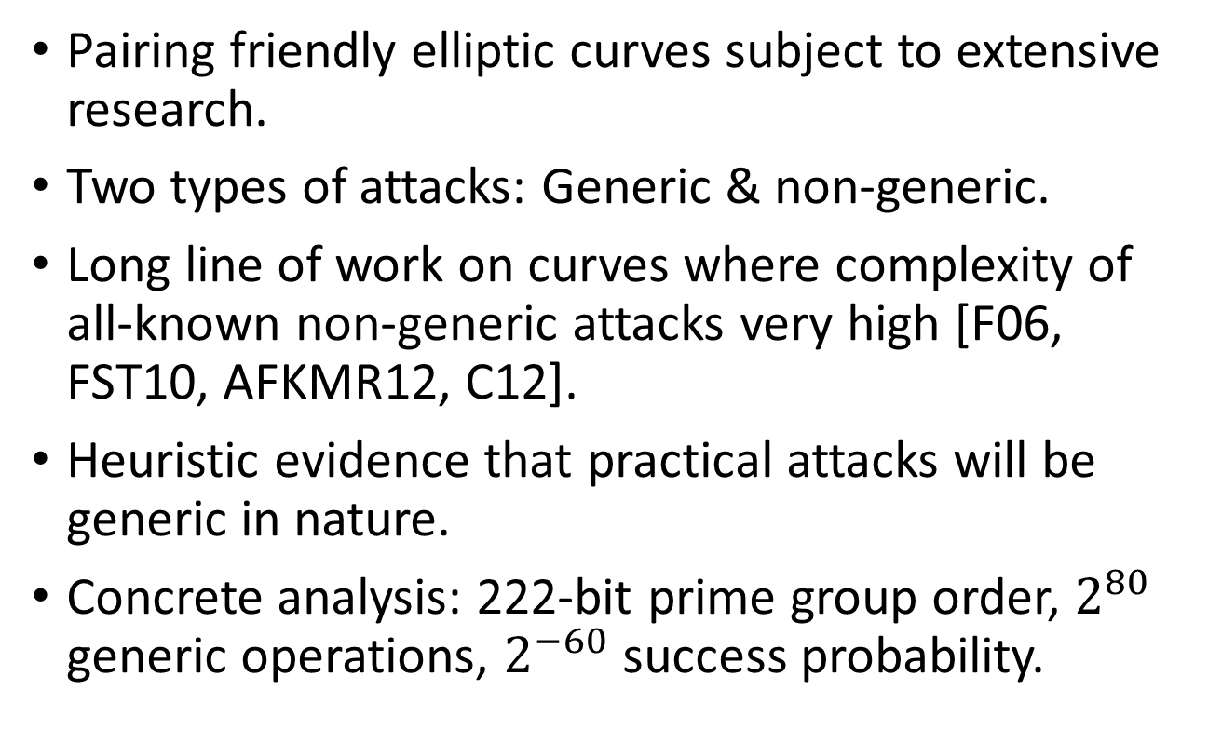
On the assumption
Pairing friendly elliptic curves subject to extensive research.
Two types of attacks: Generic & non-generic.
Long line of work on curves where complexity of all-known non-generic attacks very high [F06, FST10, AFKMR12, C12].
Heuristic evidence that practical attacks will be generic in nature.
Concrete analysis: 222-bit prime group order, $2^{80}$ generic operations, $2^{−60}$ success probability.
Notes:
Due to its importance and wide applicability, much research effort has been focused on studying the complexity of generic and non-generic attacks on pairing-friendly elliptic curves. By now, there is a long line of work [24,23,8,22] focused on constructing pairing friendly elliptic curves where the complexity of all known non-generic attacks is extremely high. If such elliptic curves are used to build cryptographic schemes, there is strong heuristic evidence that the only successful practically feasible attacks will be generic in nature. We stress that we will work with elliptic curve groups of prime order, and so factoring-based attacks will not be relevant.

Slide 19
CONSTRUCTION

Slide 20
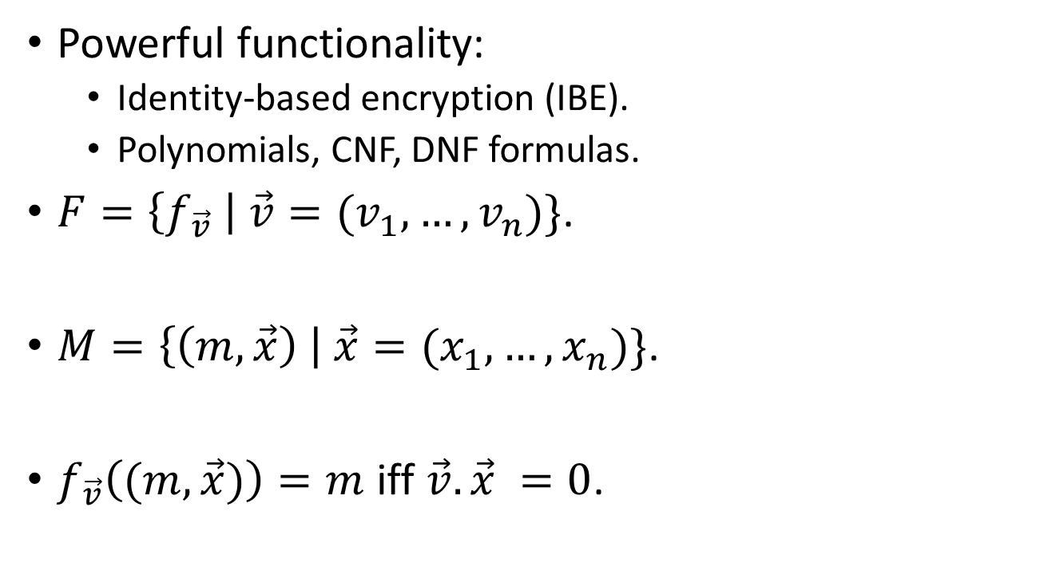
Inner-product Predicate [KSW08]
Powerful functionality:
  Identity-based encryption (IBE).
  Polynomials, CNF, DNF formulas.
$F=\left\{f_{\vec{v}} \right| \vec{v}=(v_{1},…, v_{n})\}$.
$M=\left\{\left(m,\vec{x}\right) \right| \vec{x}=(x_{1}, …, x_{n})\}$.
$f_{\vec{v}}\left((m, \vec{x})\right)=m$ iff $\vec{v}.\vec{x} =0$.

Slide 21
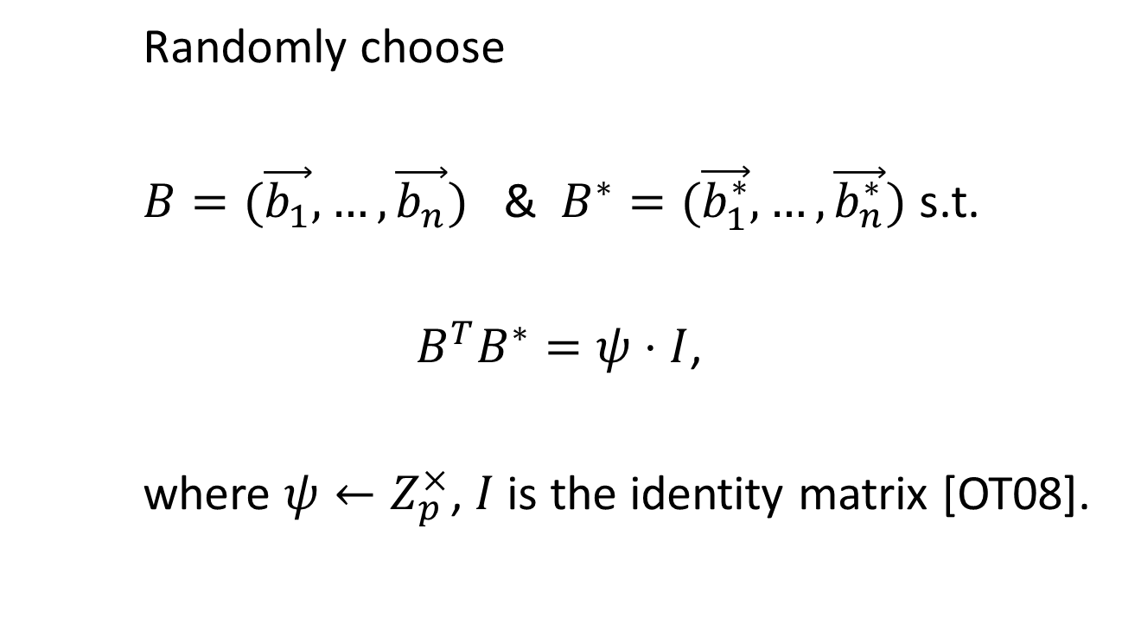
Dual Pairing Vector Spaces
Randomly choose
$B=(\vec{b_{1}}, …, \vec{b_{n}})$ & $B^{∗}=(\vec{b_{1}^{∗}}, …, \vec{b_{n}^{∗}})$ s.t.
$B^{T}B^{∗}=ψ⋅I$,
where $ψ←Z_{p}^{×}$, $I$ is the identity matrix [OT08].

Slide 22
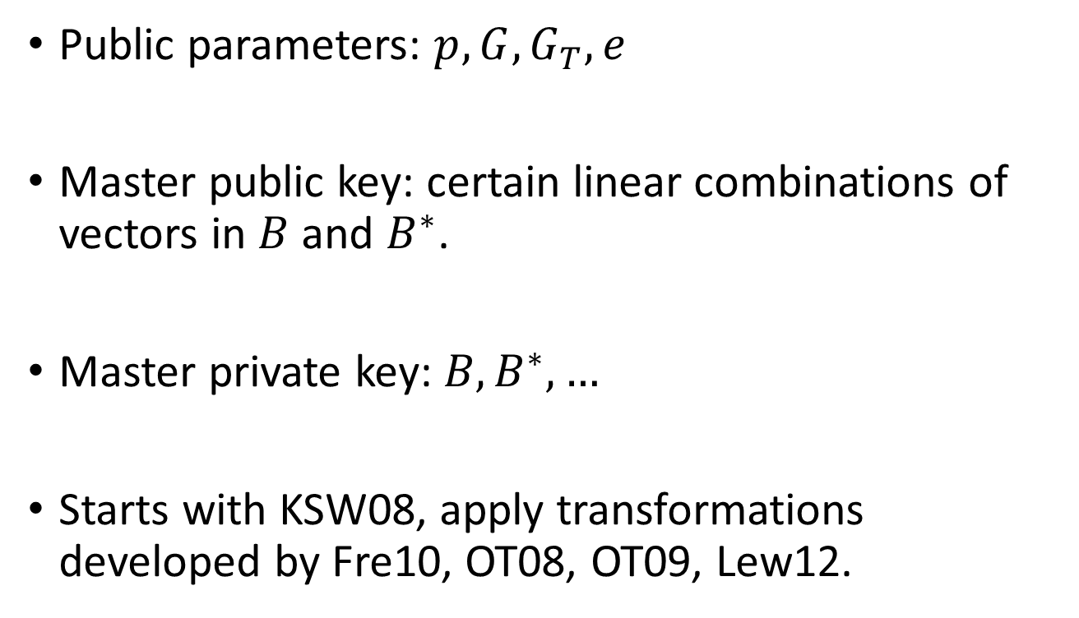
Construction
Public parameters: $p, G, G_{T},e$
Master public key: certain linear combinations of vectors in $B$ and $B^{∗}$.
Master private key: $B, B^{∗},…$
Starts with KSW08, apply transformations developed by Fre10, OT08, OT09, Lew12.

Slide 23
Conclusion
An FE scheme for inner-product predicates strongly secure under the generic group model.
Use other meaningful abstractions like ROM.
Design schemes for other functionalities like IBE, ABE, etc.

Slide 24
Thank you.

