Slide 1
Adaptive Proofs of Knowledge in the Random Oracle Model
21. PKC 2015
Marc Fischlin
joint work with David Bernhard, Bogdan Warinschi

Slide 2


(Interactive) Proofs of Knowledge
theorem
interactive
proof
(malicious)
prover
extractor
witness
extraction usually
through rewinding

Slide 3
[Fiat-Shamir]
Non-interactive Proofs of Knowledge
in the Random Oracle (RO) Model…
RO
RO
*
non-interactive
(malicious)
prover
extractor
…still require rewinding for extraction

Slide 4
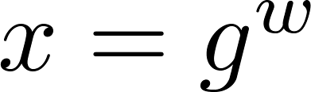
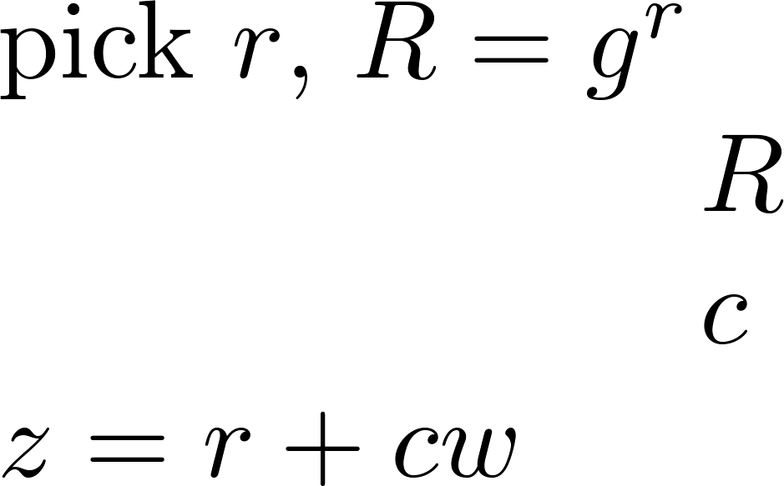

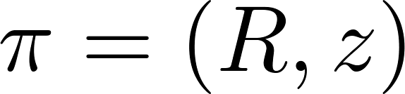

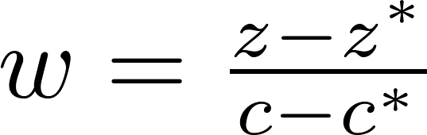
Extraction is easy in the RO model…
[Pointcheval-Stern]
Example: Fiat-Shamir-Schnorr signatures
RO
RO*

Slide 5
Extraction is easy in the RO model…
…or is it?

Slide 6

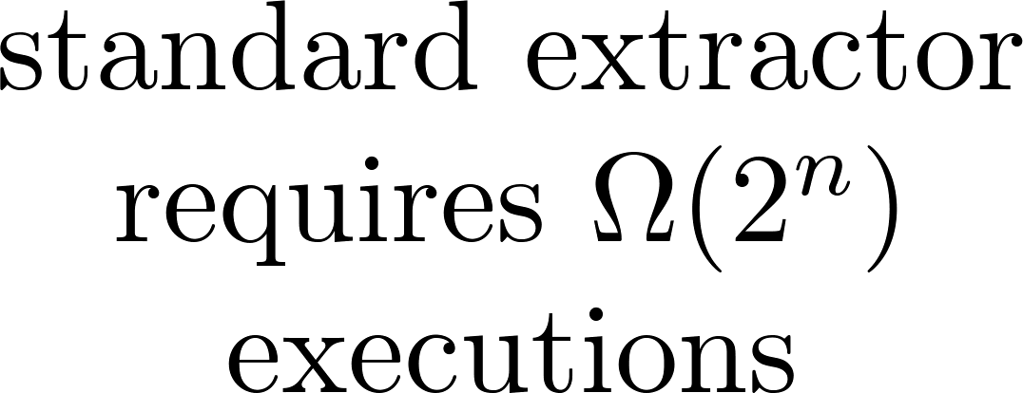



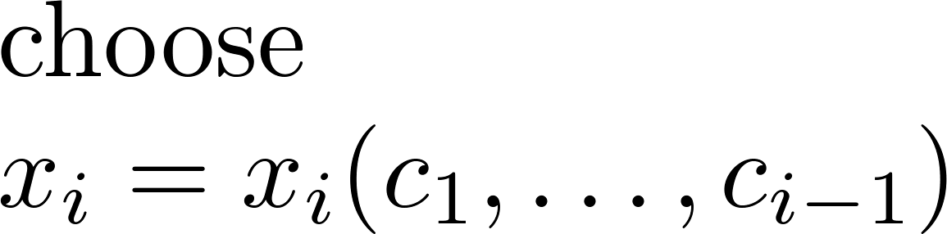






adaptive zero-knowledge proofs of knowledge
in random oracle model (ROM)
[Shoup-Gennaro] adversary
RO
RO
RO
…

Slide 7




simulation-sound
adaptive zero-knowledge proofs of knowledge in the ROM
?
needs to program RO
RO
needs to program RO
ZK simulator
extractor

Slide 8
This work here:
Model for simulation-sound adaptive ZK PoKs in ROM
Show that one can work with it
Show that one can achieve it
Discuss that some approaches fail

Slide 9
main execution (non-rewinding)
RO
list of queries
RO
same coins
local branches
adversary wins if extractor at some point fails to compute witness
∀ PPT adversaries ∃ extractor: Pr [ adversary wins ] is negligible

Slide 10
Result #1 (applicability):
CPA-secure encryption
+
simulation-sound adaptive zero-knowledge
proof of knowledge in ROM
⇓
CCA-secure encryption in ROM
„I know message and
randomness encrypted
under CPA scheme“
so far: common reference string model [Groth, Chase-Lysanskaya, Dodis et al.]

Slide 11
Result #2 (feasibility):
Fischlin‘s transformation with straightline extractor
for ∑ protocols with special soundness
is
simulation-sound adaptive
zero-knowledge proof of knowledge in the ROM
so far: only shown for adaptive scenario in [Fischlin]

Slide 12
RO
RO
Idea:
straightline extractor in Fischlin‘s scheme
only needs hash queries of adversary

Slide 13
Result #3 (limitations):
Fiat-Shamir-Schnorr transformation
is not adaptive proof of knowledge
under one-more DL assumption
(for black-box extractors).
so far: certain extractor strategy fails [Shoup-Gennaro]
here: any efficient extractor strategy fails

Slide 14
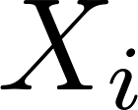
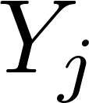

One-More-DL Problem
[Bellare et al.]
A
Ch
DL
output more solutions
to challenges than DL queries

Slide 15
RO
Ch
RO
DL
Metareduction
output more solutions to challenges than DL queries

Slide 16
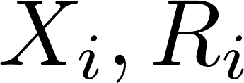
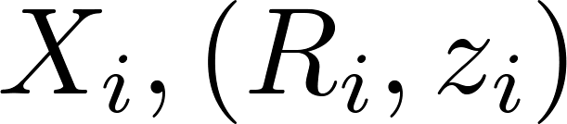
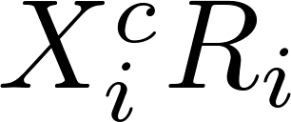
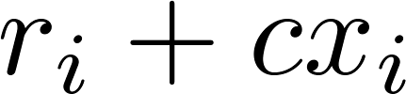
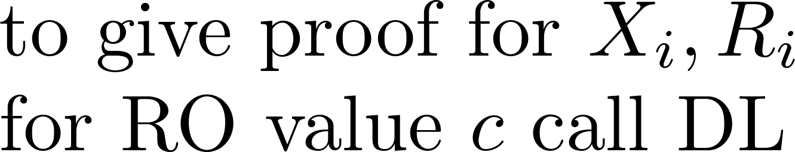
RO
Ch
RO
DL
Metareduction
use [Shoup-Gennaro]
adversary here
output more solutions to challenges than DL queries

Slide 17
Ch
RO
DL
make at most 2 calls
to DL for each
Metareduction
use [Shoup-Gennaro]
adversary here
if extractor requires less than 2 executions to extract
for some , then metareduction solves OMDL problem
output more solutions to challenges than DL queries

Slide 18

Final step in the proof (not here):
If extractor requires 2 executions to extract for each
then Shoup-Gennaro adversary
forces exponential number of executions
combinatorial, via execution tree

Slide 19
Take-home Message

Slide 20
RO
RO
CPA + ss-adaptive PoK ⇒ CCA in ROM
Fischlin‘s transformation is an example for ss-adaptive PoK
Fiat-Shamir transformation in general is (presumably) not

