Slide 1
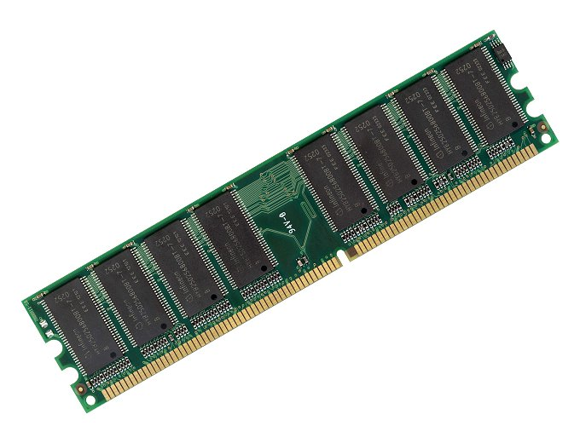
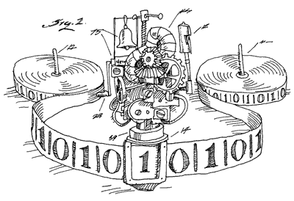
Succinct Garbling and its Applications
Sanjam Garg
University of California at Berkeley
Nir Bitansky, Huijia Lin, Rafael Pass, Sidharth Telang

Slide 2
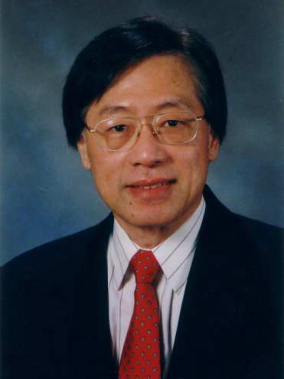
Garbled Circuits [Yao82]
Tons of Applications
Constant-round secure computation [Yao82,BMR90,…]
Private Simultaneous Messages protocols [FKN94,…]
Parallel Cryptography [AIK05,…]
One time programs [GKR08,…]
Verifiable computation [GGP10,…]
Functional Encryption [SS10,…]
KDM-secure encryption [BHHI10,…]
Bootstrapping obfuscators [App13, CLTV15, BGLPT15,…]

Slide 3


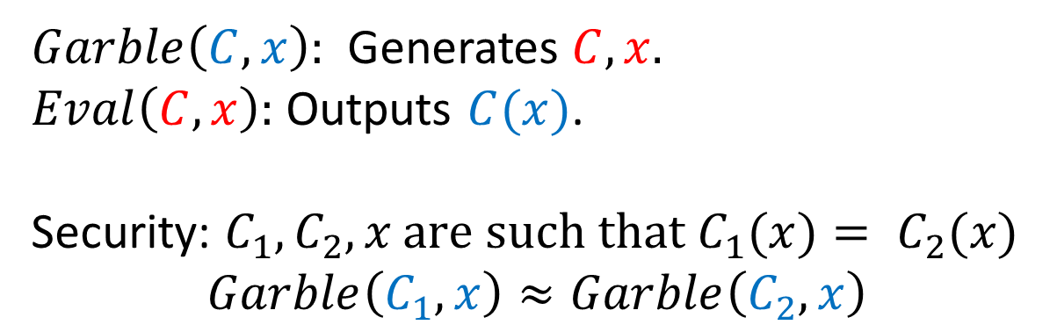



What are Garbled Circuits?
$$C, x$$
$$C, x$$
$$C(x)$$
Alice Bob
$Garble\left(C, x\right):$ Generates $C, x.$
$Eval\left(C, x\right):$ Outputs $C(x)$.
Security: ${C_{1}, C_{2},x \text{are} \text{such} \text{that} C}_{1}(x)= C_{2}(x)$
$$Garble\left(C_{1}, x\right)≈Garble\left(C_{2}, x\right)$$

Slide 4
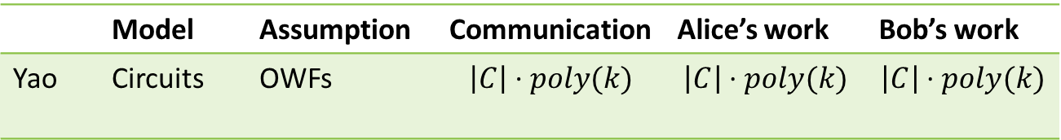
What are Garbled Circuits?
$$C, x$$
$$C, x$$
$$C(x)$$
Alice Bob
 | Model | Assumption | Communication | Alice’s work | Bob’s work
Yao | Circuits | OWFs | $$\left|C\right|⋅poly(k)$$ | $$\left|C\right|⋅poly(k)$$ | $$\left|C\right|⋅poly(k)$$
Can not hope to do much better than this for circuits!

Slide 5

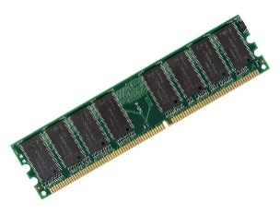

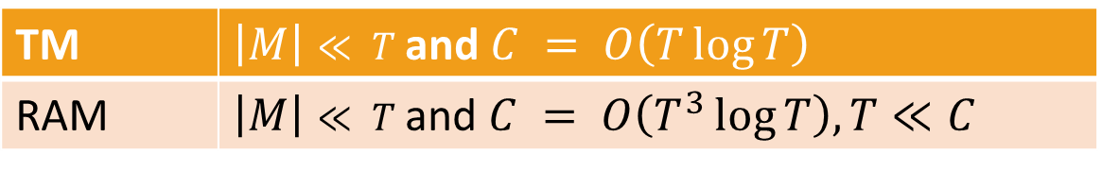


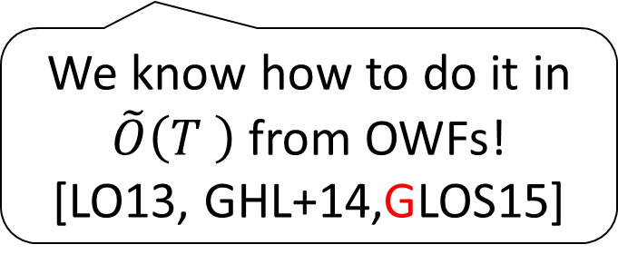

What about TM/RAM?
$$T$$
$$M$$
$$C$$
TM | $\left|M\right|≪ T$and $C = O\left(T\log{T}\right)$
RAM | $\left|M\right|≪ T$and $C = O\left(T^{3}\log{T}\right), T≪C$
We know how to do it in $\tilde{O}\left(T \right)$ from OWFs!
[LO13, GHL+14,GLOS15]
Description Size – $\left|M\right|$
Running Time – $T$
Circuit Representation – $C$

Slide 6
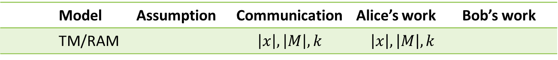



Defining: Succinct Garbling
$$M, x$$
$$M, x$$
$$M(x)$$
Alice Bob
 | Model | Assumption | Communication | Alice’s work | Bob’s work
 | TM/RAM |  | $$\left|x\right|,\left|M\right|,k$$ | $$\left|x\right|,\left|M\right|, k$$

Slide 7
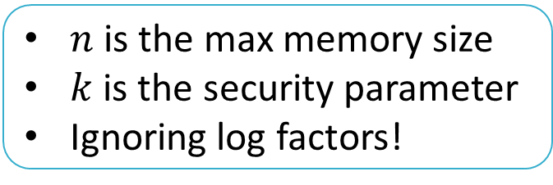
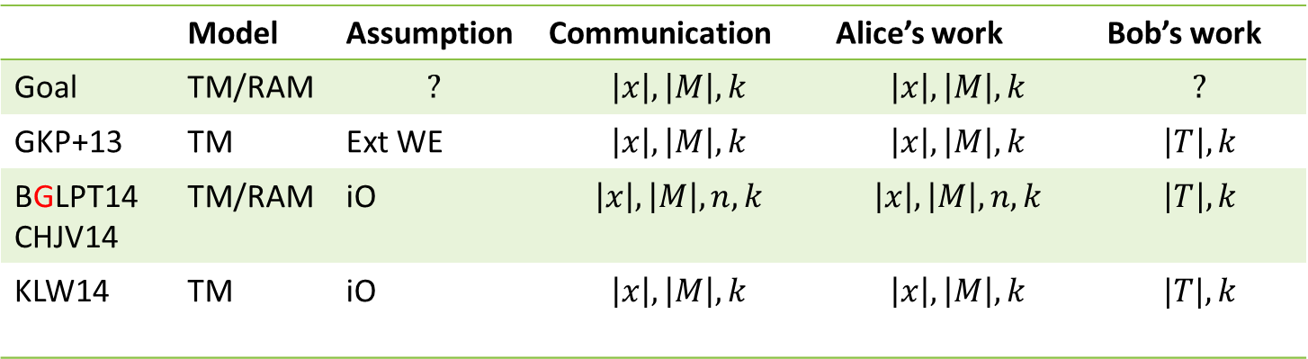
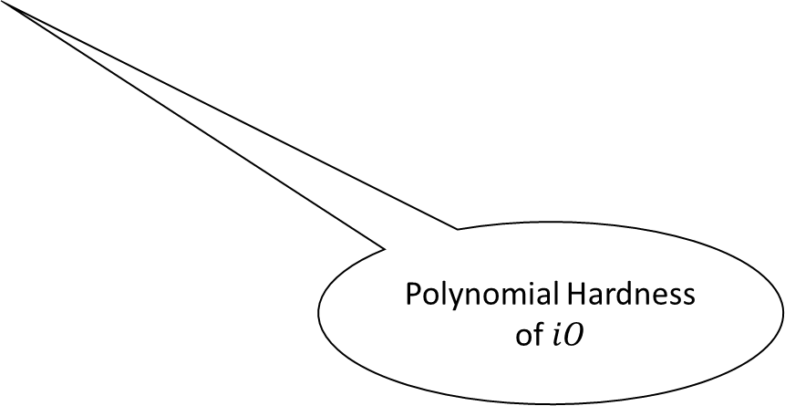
Results on Succinct Garbling
Implausibility [GGHW14]
 | Model | Assumption | Communication | Alice’s work | Bob’s work
Goal | TM/RAM | $$?$$ | $$\left|x\right|,\left|M\right|, k$$ | $$\left|x\right|,\left|M\right|, k$$ | $$?$$
GKP+13 | TM | Ext WE | $$\left|x\right|,\left|M\right|, k$$ | $$\left|x\right|,\left|M\right|, k$$ | $$\left|T\right|,k$$
BGLPT14 CHJV14 | TM/RAM | iO | $$\left|x\right|,\left|M\right|, n, k$$ | $$\left|x\right|,\left|M\right|, n, k$$ | $$\left|T\right|,k$$
KLW14 | TM | iO | $$\left|x\right|,\left|M\right|, k$$ | $$\left|x\right|,\left|M\right|, k$$ | $$|T|, k$$
Polynomial Hardness of $iO$
$n$ is the max memory size
$k$ is the security parameter
Ignoring log factors!

Slide 8
Applications
Secure Computation with low computation cost for one party

Slide 9
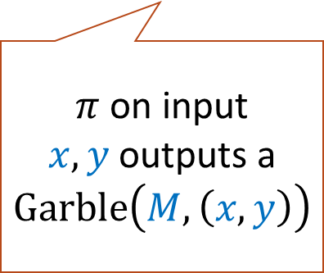





Application 1: MPC with unbalanced load
$$x$$
$$M$$
$$y$$
$$π$$
$π$ on input $x, y$outputs a $Garble\left(M,\left(x,y\right)\right)$
$$M(x,y)$$
Alice Bob
Alice’s work grows with the description size of the machine M and not with its running time. The idea builds on [IK00, IK02]

Slide 10

Applications
Secure Computation with low computation cost for one party
$iO$ for TM/RAM
  Requires sub-exponential $iO$

Slide 11

Application 2: $iO$ for TM/RAM

Slide 12
Obfuscation - Informal
Obfuscation aims to make computer programs ``unintelligible’’ without affecting their functionality.
P
O(P)
Alice Bob

Slide 13

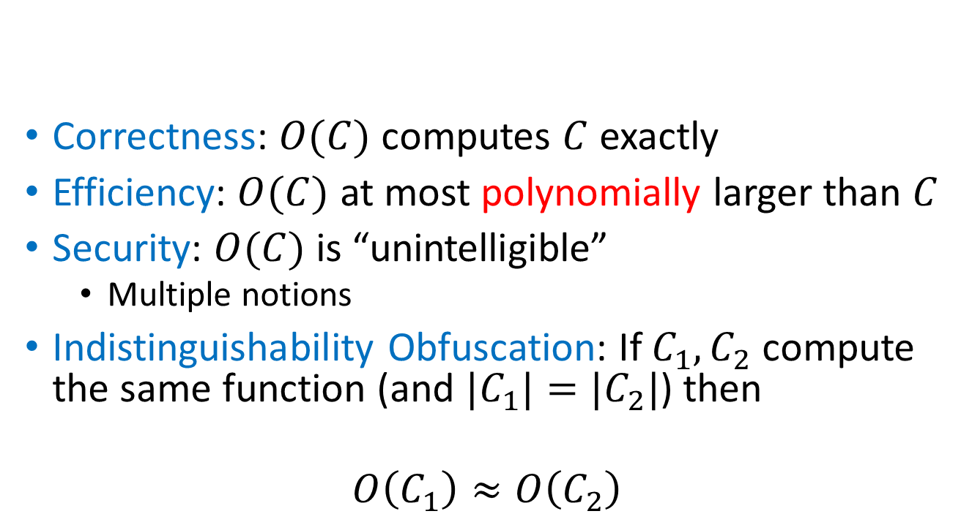

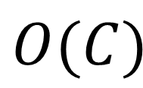
Indistinguishability Obfuscation [B+01, GR07]
$$O$$
Correctness: $O(C)$ computes $C$ exactly
Efficiency: $O(C)$ at most polynomially larger than $C$
Security: $O(C)$ is “unintelligible”
  Multiple notions
Indistinguishability Obfuscation: If $C_{1},C_{2}$ compute the same function (and ${|C}_{1}|=|C_{2}|$) then
$$O\left(C_{1}\right)≈O\left(C_{2}\right)$$
$$C$$
$$O(C)$$

Slide 14
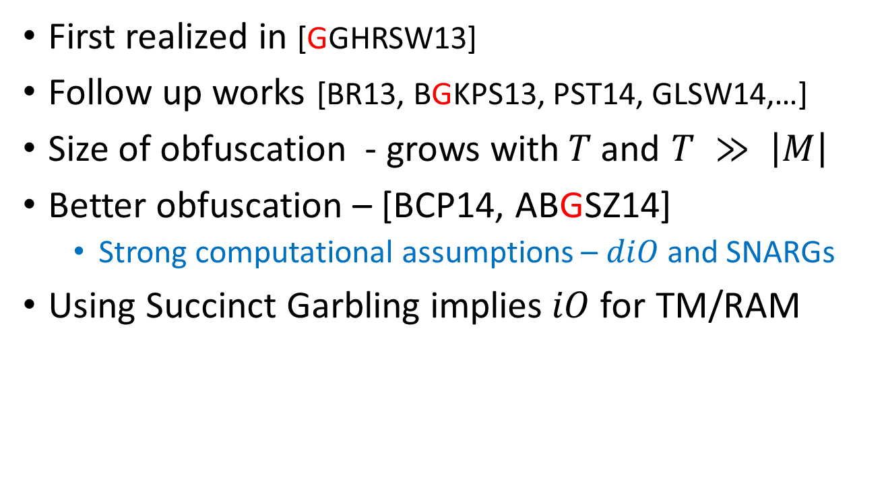

Positive results on $iO$
First realized in [GGHRSW13]
Follow up works [BR13, BGKPS13, PST14, GLSW14,…]
Size of obfuscation - grows with$T$and $T ≫ \left|M\right|$
Better obfuscation – [BCP14, ABGSZ14]
  Strong computational assumptions – $diO$and SNARGs
Using Succinct Garbling implies$iO$for TM/RAM
Runs in input specific run-time [GKPVZ13] !

Slide 15
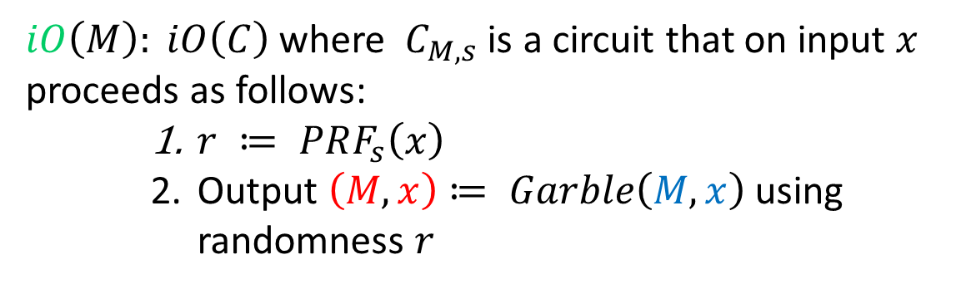
Application 2: $iO$ for TM/RAM
$iO\left(M\right): iO\left(C\right)$where $C_{M,s}$ is a circuit that on input $x$ proceeds as follows:
    $r ≔ PRF_{s}\left(x\right)$
    Output $\left(M, x\right)≔ Garble\left(M, x\right)$ using randomness $r$
Heuristic approach for this [Applebaum13] and proof from sub-exponential security by [CLTV15]

Slide 16
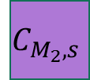
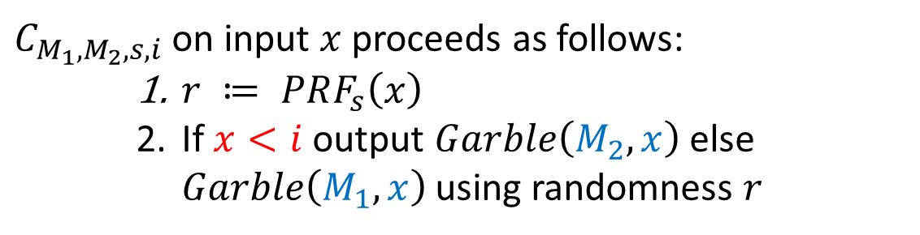
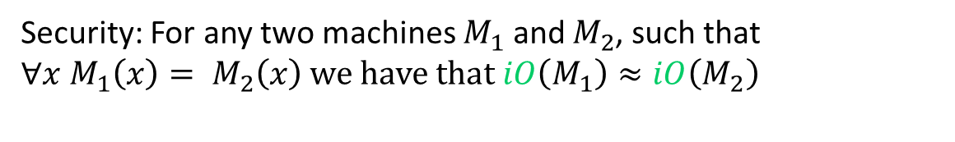


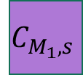





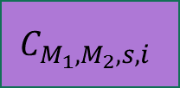

Application 2: $iO$ for TM/RAM
Security: For any two machines $M_{1}$ and $M_{2}$, such that $∀x M_{1}\left(x\right)= M_{2}\left(x\right)$ we have that $iO\left(M_{1}\right)≈iO\left(M_{2}\right)$
$$M_{1}$$
$$≈$$
$$M_{2}$$
$$C_{M_{1},s}$$
$$…$$
$$C_{M_{1},M_{2}, s, i}$$
$$…$$
$$C_{M_{2},s}$$
$$H_{0}$$
$$H_{i}$$
$$H_{2^{\left|x\right|}}$$
$C_{M_{1},M_{2}, s, i}$on input $x$ proceeds as follows:
    $r ≔ PRF_{s}\left(x\right)$
    If $x<i$output $Garble\left(M_{2}, x\right)$ else $Garble\left(M_{1}, x\right)$ using randomness $r$

Slide 17
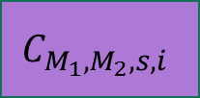

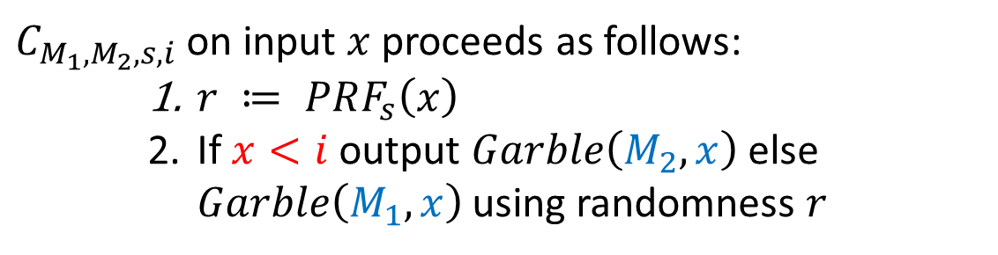


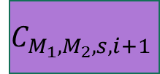
Application 2: $iO$ for TM/RAM
Puncturing [SW14]
$$C_{M_{1},M_{2}, s, i}$$
$$≈$$
$$C_{M_{1},M_{2}, s, i+1}$$
$$H_{i}$$
$$H_{i+1}$$
$C_{M_{1},M_{2}, s, i}$on input $x$ proceeds as follows:
    $r ≔ PRF_{s}\left(x\right)$
    If $x<i$output $Garble\left(M_{2}, x\right)$ else $Garble\left(M_{1}, x\right)$ using randomness $r$

Slide 18
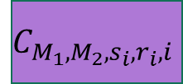
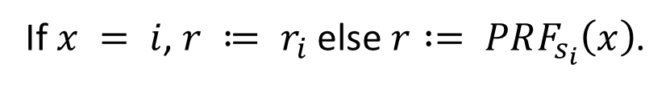


Application 2: $iO$ for TM/RAM
Puncturing [SW14]
$$C_{M_{1},M_{2}, s, i}$$
$$≈$$
$$C_{M_{1},M_{2}, s, i+1}$$
$$H_{i}$$
random at punctured
$$H_{i+1}$$
puncture
$$C_{M_{1},M_{2}, s_{i},r_{i}, i}$$
$$C_{M_{1},M_{2}, s_{i},r_{i}, i}$$
Random
$$C_{M_{1},M_{2}, s_{i},r_{i}, i}$$
$C_{M_{1},M_{2}, s, i}$on input $x$ proceeds as follows:
    $r ≔ PRF_{s}\left(x\right)$
    If $x<i$output $Garble\left(M_{2}, x\right)$ else $Garble\left(M_{1}, x\right)$ using randomness $r$
If $x = i$, $r ≔ r_{i}$ else $r := PRF_{s_{i}}\left(x\right)$.

Slide 19

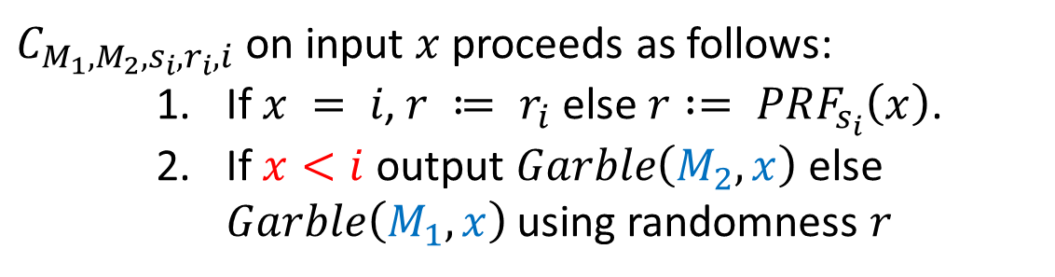



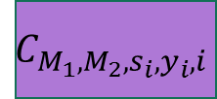

Application 2: $iO$ for TM/RAM
Puncturing [SW14]
$$C_{M_{1},M_{2}, s, i}$$
$$≈$$
$$C_{M_{1},M_{2}, s, i+1}$$
$$H_{i}$$
random at punctured
$$H_{i+1}$$
puncture
hardcode
change hardcoded
$$C_{M_{1},M_{2}, s_{i},r_{i}, i}$$
$$C_{M_{1},M_{2}, s_{i},r_{i}, i}$$
$$C_{M_{1},M_{2}, s_{i},y_{i}, i}$$
$$C_{M_{1},M_{2}, s_{i},y_{i}, i}$$
Random
$$y_{i}=Garble\left(M_{1},x\right)$$
$$y_{i}=Garble\left(M_{2},x\right)$$
$C_{M_{1},M_{2}, s_{i},r_{i}, i}$on input $x$ proceeds as follows:
    $\text{If} x = i\text{, }r ≔ r_{i} \text{else} r := PRF_{s_{i}}\left(x\right)\text{.}$
    If $x<i$output $Garble\left(M_{2}, x\right)$ else $Garble\left(M_{1}, x\right)$ using randomness $r$
    $\text{If} x = i$ then output $y_{i}$.

Slide 20

Application 2: $iO$ for TM/RAM
Puncturing [SW14]
$$C_{M_{1},M_{2}, s, i}$$
$$≈$$
$$C_{M_{1},M_{2}, s, i+1}$$
$$H_{i}$$
random at punctured
$$H_{i+1}$$
puncture
hardcode
change hardcoded
$$C_{M_{1},M_{2}, s_{i},r_{i}, i}$$
$$C_{M_{1},M_{2}, s_{i},r_{i}, i}$$
$$C_{M_{1},M_{2}, s_{i},y_{i}, i}$$
$$C_{M_{1},M_{2}, s_{i},y_{i}, i}$$
Random
$$y_{i}=Garble\left(M_{2},x\right)$$
Reverse hybrids to get to $H_{i+1}$
  Assuming sub-exponential $iO$: Succinct garbling implies succinct $iO$.

Slide 21
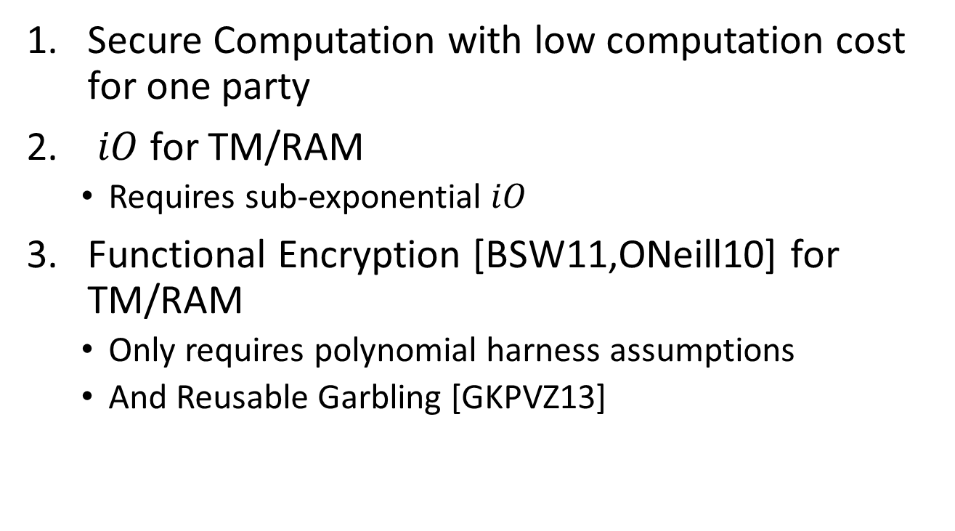
Applications
Secure Computation with low computation cost for one party
$iO$ for TM/RAM
  Requires sub-exponential $iO$
Functional Encryption [BSW11,ONeill10] for TM/RAM
  Only requires polynomial harness assumptions
  And Reusable Garbling [GKPVZ13]

Slide 22








Application 3: FE for TM/RAM
[SW06,…,O’Neil10,BSW11,GGHRSW13,BCP14,ABGSZ14…]
Prior Work: Limited to circuits [GGHRSW13] or needed strong assumptions [BCP14,ABGSZ14].
MSK
PK
Key Authority
Succinct Garbling enables succinct functional encryption.
$$Enc\left(x\right)$$
SK
SK’
$$f_{1}$$
$$f_{2}$$
$$f_{1}(x)$$
$$f_{2}(x)$$

Slide 23


Application 3: FE for TM/RAM
[SW06,…,O’Neil10,BSW11,GGHRSW13,BCP14,ABGSZ14…]
Take a functional encryption for circuits and make it output the succinct garbling.
MSK
PK
Key Authority
SK
SK’
$$f_{1}$$
$$f_{2}$$
$$f_{1}(x)$$
$$f_{2}(x)$$
$$Garble(f_{1}, x)$$
$$Garble(f_{2}, x)$$

Slide 24
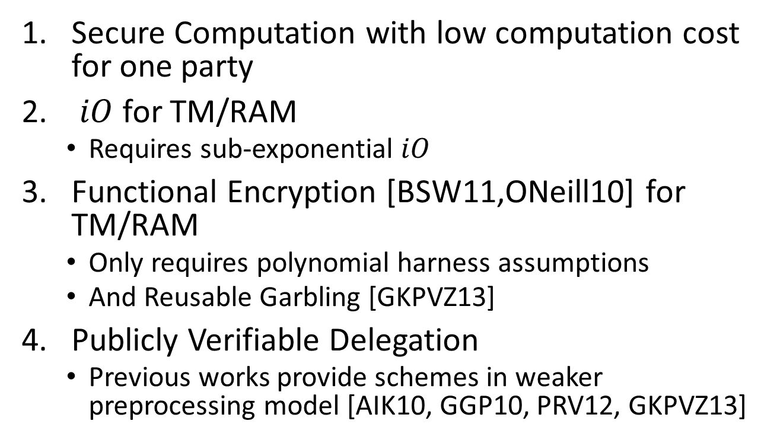
Applications
Secure Computation with low computation cost for one party
$iO$ for TM/RAM
  Requires sub-exponential $iO$
Functional Encryption [BSW11,ONeill10] for TM/RAM
  Only requires polynomial harness assumptions
  And Reusable Garbling [GKPVZ13]
Publicly Verifiable Delegation
  Previous works provide schemes in weaker preprocessing model [AIK10, GGP10, PRV12, GKPVZ13]
Previous results needed diO [BCP14, ABGSZ14], for which implausibility was shown in [GGHW14]

Slide 25
How do we do it?

Slide 26
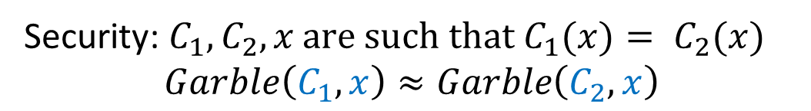
Yao’s Garbled circuits
Security: ${C_{1}, C_{2},x \text{are} \text{such} \text{that} C}_{1}(x)= C_{2}(x)$
$$Garble\left(C_{1}, x\right)≈Garble\left(C_{2}, x\right)$$

Slide 27
Yao’s Garbled circuits
Key Point: Garbling per gate only needs 6 keys!
Security: ${C_{1}, C_{2},x \text{are} \text{such} \text{that} C}_{1}(x)= C_{2}(x)$
$$Garble\left(C_{1}, x\right)≈Garble\left(C_{2}, x\right)$$

Slide 28

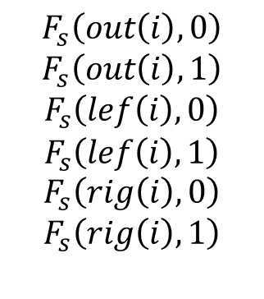
Garbling Turing Machines
Sample s – the seed of a PRF.
$$i$$
$$F_{s}\left(out\left(i\right),0\right)$$
$$F_{s}\left(out\left(i\right),1\right)$$
$$F_{s}\left(lef\left(i\right),0\right)$$
$$F_{s}\left(lef\left(i\right),1\right)$$
$$F_{s}\left(rig\left(i\right),0\right)$$
$$F_{s}\left(rig\left(i\right),1\right)$$
Similarly for input wires.

Slide 29
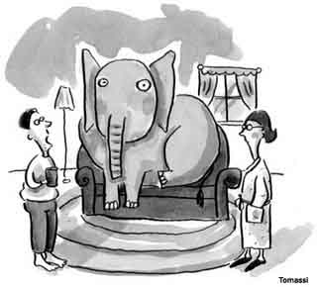
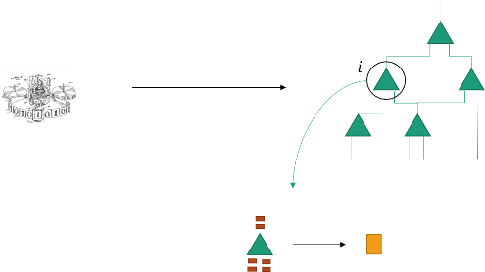





Garbing Turing Machines
$x$
$x,s$
$$∕$$
Bounded
Memory
Heuristic Solution
$x$
$$i$$
Same works for RAM programs using garbled RAM [LO13,GHLORW14,GLOS15]!

Slide 30

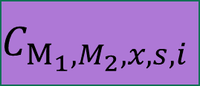
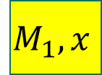

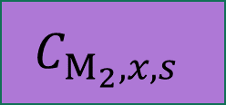

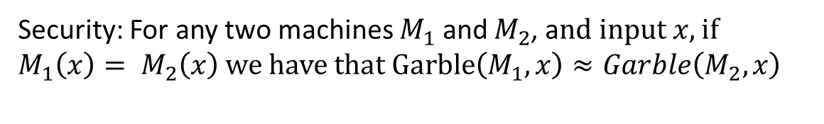


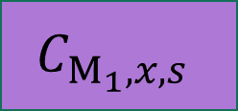



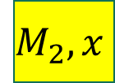


Bounded Memory Security Proof via Puncturing
Need to remember all the wires across the layer in arguing security.
Security: For any two machines $M_{1}$ and $M_{2}$, a$nd input x,$if
$M_{1}\left(x\right)= M_{2}\left(x\right)$ we have that $Garble\left(M_{1},x\right)≈Garble\left(M_{2},x\right)$
$$M_{1},x$$
$$≈$$
$$M_{2},x$$
$$C_{M_{1},x,s}$$
$$…$$
$$C_{M_{1},M_{2},x,s,i}$$
$$…$$
$$C_{M_{2},x,s}$$
$$H_{0}$$
$$H_{i}$$
$$H_{d}$$
$$M_{1}$$
$$M_{1}$$
$$M_{2}$$
$$M_{2}$$

Slide 31






Bounded Memory Security Proof via Puncturing
$$H_{i}$$
$$H_{i+1}$$
$$M_{1}$$
$$M_{1}$$
$$M_{2}$$
$$M_{2}$$
Puncture, replace random, hardcode, change hardcoded, make pseudo-random, un-puncture

Slide 32

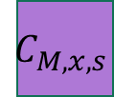
Extending to unbounded memory for Turning Machines [KLW14]
$x$
$$C_{M,x,s}$$

Slide 33
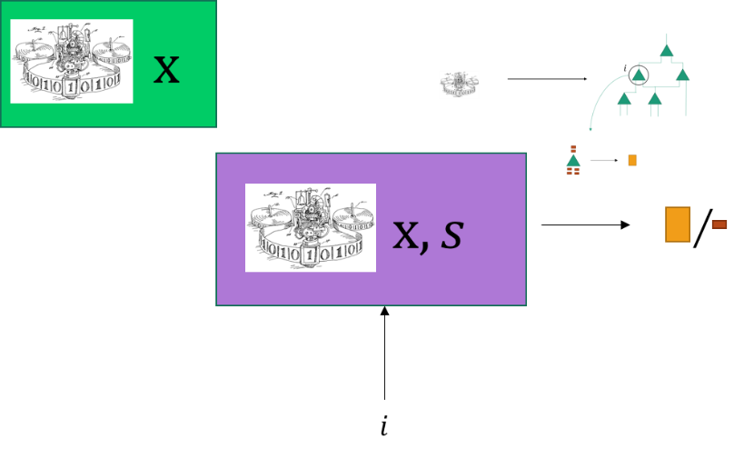
Conclusion and Future Work
Succinct Garbling and Succinct Obfuscation
  Bounded memory for TM and RAM [BGLPT14, CHJV14]
  Unbounded memory for TM [KLW14]
Open problems
  Unbounded memory for RAM
  Simpler constructions?

Slide 34

Thank You!

