Slide 1
Enhanced Chosen-Ciphertext Security and Applications
eill
Adam O’Neill
Georgetown University
Joint work with Dana Dachman-Soled (Univ. of Maryland), Georg Fuchsbauer (IST Austria), and Payman Mohassel (Univ. of Calgary)

Slide 2
Outline
The talk will consist of three parts:
  Definitions. Randomness-recovering PKE and enhanced chosen-ciphertext (ECCA) security.
  Constructions. Achieving ECCA security from adaptive trapdoor functions.
  Applications. Public-key encryption with non-interactive opening (time permitting).

Slide 3
Part 1: ECCA Security

Slide 4
Randomness Recovery
In encryption, we typically think of decryption as a way for the receiver to recover a sender’s message.
In a randomness-recovering scheme, the receiver is able to recover a sender’s random coins as well.

Slide 5
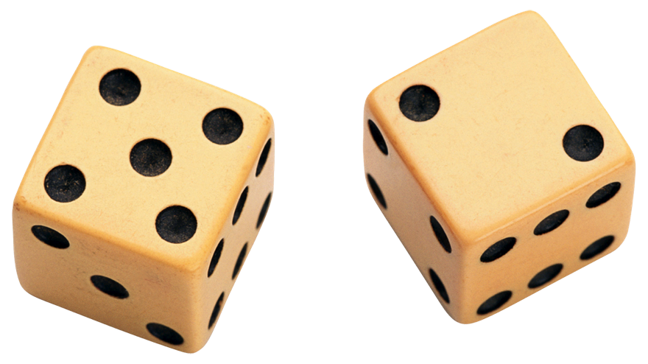
Randomness-Recovering PKE
A randomness-recovering public-key encryption (RR-PKE) scheme consists of four algorithms:

Slide 6
Rec and Uniquness
We require that .
We say that randomness recovery is unique if in addition .
Some applications of RR-PKE require uniqueness, for others (e.g. PKENO) non-unique is OK as long as there is no decryption error.

Slide 7

Chosen-Ciphertext Security [RS’91]
Require
Repeats!
Hard to guess b

Slide 8
Enhanced CCA security
Require
Repeats!
Hard to guess b

Slide 9
CCA does not imply ECCA
Theorem. Let be a CCA-secure RR-PKE scheme. Then there is a modified scheme that remains CCA-secure but is not ECCA-secure.
Proof idea:
To prove CCA-security switch c* to encrypt 1; now, assuming no decryption error, it’s impossible to make Dec’ return sk!

Slide 10
CCA does not imply ECCA
Theorem. Let be a CCA-secure RR-PKE scheme. Then there is a modified scheme that remains CCA-secure but is not ECCA-secure.
Motivates finding new (or existing) constructions that can be proven ECCA-secure!

Slide 11
Part 2: Constructions

Slide 12
Trapdoor Functions
A trapdoor function generator is such that
where describes a function on k-bits and its inverse.

Slide 13
One-Wayness
Hard to guess x

Slide 14
Adaptive One-Wayness
Introduced by [KMO’10]
  Constructions from lossy [PW’08] and correlated-product [RS’09] TDFs.
  Implies CCA-secure PKE.
Require
Repeats!
Hard to guess x

Slide 15
ECCA from ATDFs
Theorem. ATDFs implies (unique) ECCA-secure RR-PKE.
Previously [KMO’10] constructed CCA-secure PKE from ATDFs, so let’s start there.
The approach of [KMO’10] is as follows:
  First construct a “one-bit” CCA-secure scheme from ATDFs.
  Then compile the “one-bit” scheme to a “many-bit” scheme using [MS’09].

Slide 16
“Naïve” One-Bit CCA Scheme
Let be a TDF generator with hardcore bit . Define the one-bit encryption algorithm via:
Hardcore bit
But trivially malleable no matter what is assumed about the hardcore bit ☹

Slide 17
One-Bit CCA Scheme [KMO’10]
Let be a TDF generator with hardcore bit . Define the one-bit encryption algorithm via:
Rejection sampling
But this approach is not sufficient for us because:
  It gives non-unique randomness recovery ☹
  [MS’09] compiler preserves neither randomness recovery nor “enhanced” security ☹

Slide 18
Detectable CCA [HLW’12]
CCA security relative to a relation R on ciphertexts.
Require
AND
[HLW’12] (building on [MS’09]) shows that any DCCA-secure scheme (for a “suitable” relation R) can be compiled into a CCA-secure scheme.
Repeats!
Hard to guess b

Slide 19
Making it Work with DCCA
We now construct ECCA (uniquely) RR-PKE from ATDFs in three steps:
  Show the “naïve” one-bit scheme is (1) randomness-recovering and (2) “enhanced” DCCA-secure.
  Get a multi-bit “enhanced” DCCA-secure RR-PKE scheme by showing (1) and (2) are preserved under parallel composition.
  Finally, show the compiler of [HLW’12] also preserves both (1) and (2) while boosting DCCA to CCA security.

Slide 20
Part 3: Applications

Slide 21


PKENO [DT’08, DHKT’08…]
Allows a receiver to non-interactively prove a ciphertext c decrypts to a claimed message m.
Suggestion of [DT’08]: use RR-PKE where the recovered coins are the proof.
We observe that security of this suggestion fundamentally requires ECCA-security!
Our techniques lead to the first secure (and even efficient) instantiations.

Slide 22
Conclusion
We gave definitions, constructions, and applications of enhanced CCA (ECCA) security.
Not covered (see paper):
  Using ECCA to prove equivalence of tag-based and standard ATDFs.
  Efficient constructions of ECCA and PKENO.
Open problems:
  Relation between ATDFs and TDFs.
  Other ECCA-secure constructions (e.g. using non-black-box assumptions?)

Slide 23
Thanks! adam@cs.georgetown.edu

