Slide 1


Online/Offline
Attribute-Based Encryption
Susan Hohenberger
Brent Waters
Presented by Shai Halevi
Notes:
test

Slide 2





Access Control by Encryption
Idea: Need secret key to access data
PK
SK

Slide 3
Rethinking Encryption
OR
Problem: Disconnect between policy
and mechanism
Internal
Affairs
AND
Undercover
Central
Who matches this? Am I allowed to know?
What if they join later?

Slide 4

Attribute-Based Encryption [SW05,GPSW06,…]
Public Parameters
MSK
Authority
Functionality: output message if f(S) = true
S is not hidden
CT: S (set of attributes)
Key: f
SK
4

Slide 5
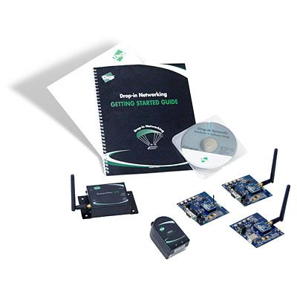
Costs of Encryption
Typical cost ~ 1-3 exponentiations per attribute (KP-ABE)
Problems:
Bursty encryption periods
Low power devices
5

Slide 6
Can we move most of the encryption costs offline?

Slide 7


Online/Offline ABE
Offline:
Intermediate Ciphertext (IT)
ABE Key Encapsulation Mechanism (KEM)
Online:
Attribute set S
Ciphertext
7

Slide 8
Some Prior Online/Offline Work
Signatures: EGM96, ST01, …
IBE: GMC08, …
Also in other contexts such as Multi-party computation
8

Slide 9
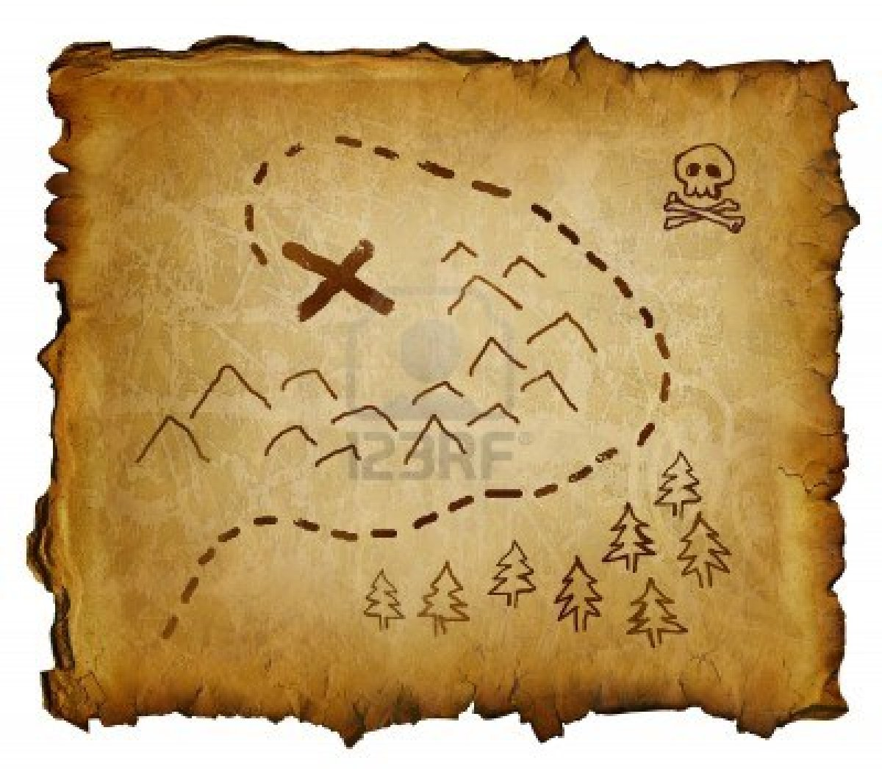
The rest of the talk
Warmup with IBE
(2) Our Online/Offline Construction
(3) “Pooling” for better efficiency
9

Slide 10
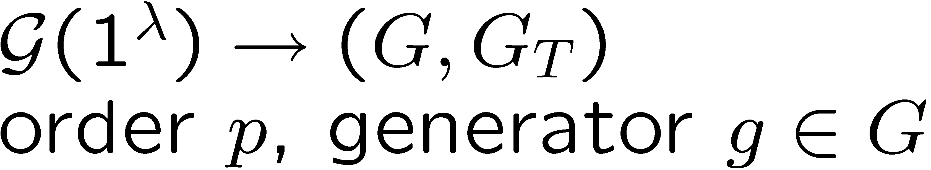
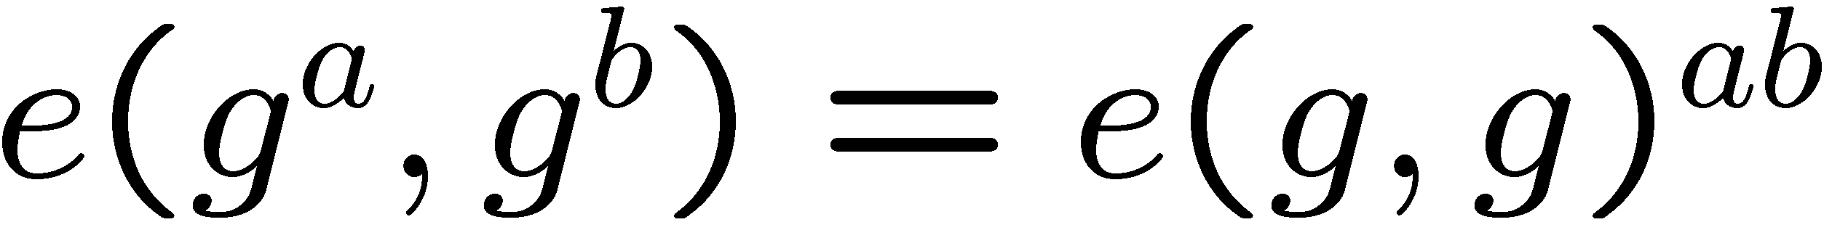
Brief Background on Bilinear maps
High Level: single multiplication
10

Slide 11
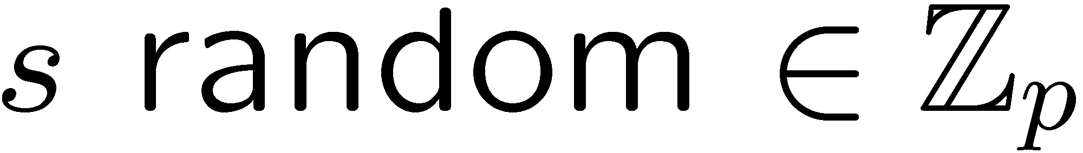
Structure Matters
Difficulty of online/offline on Boneh-Franklin IBE
CT:

Slide 12
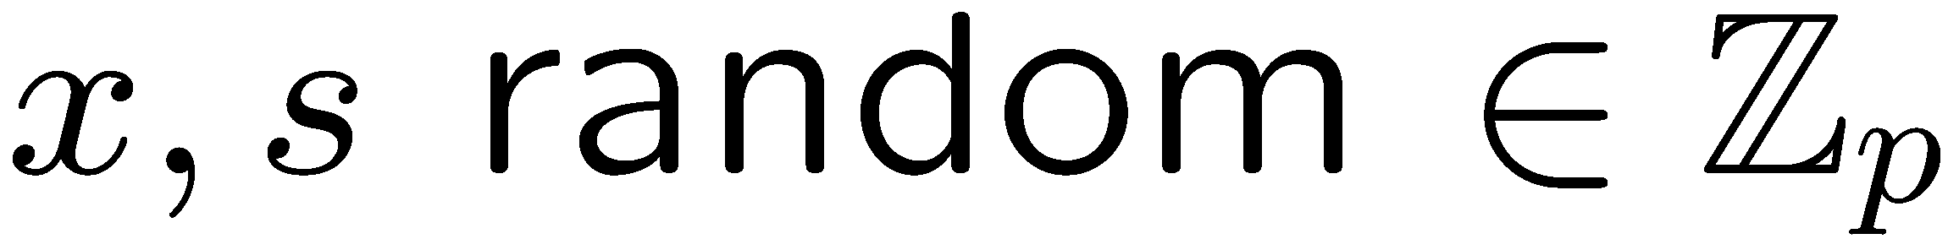
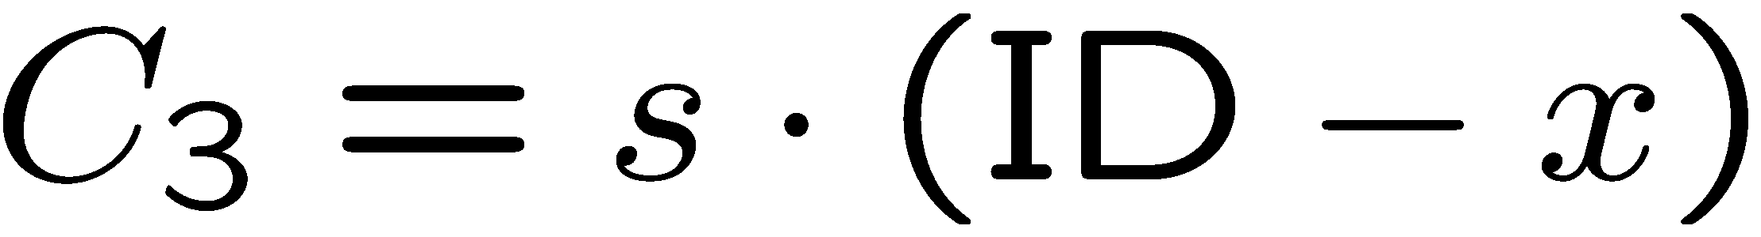
IBE Warmup (Boneh-Boyen04 ish)
Offline:
Online (ID):
“Correction Factor”
KeyGen(ID):
Decrypt:
12

Slide 13
Challenges for ABE
Many ABE systems do not have right structure (e.g. GPSW06)
More complex access policies
Use Rouselakis-Waters 2013
13

Slide 14

System Setup

Slide 15

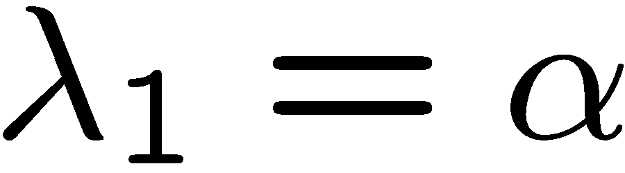
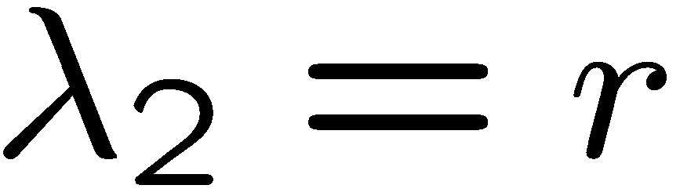
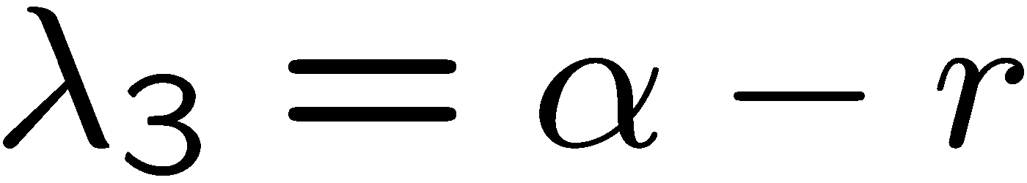
Key Generation
Share a according to formula
Generate key components
OR
AND

Slide 16
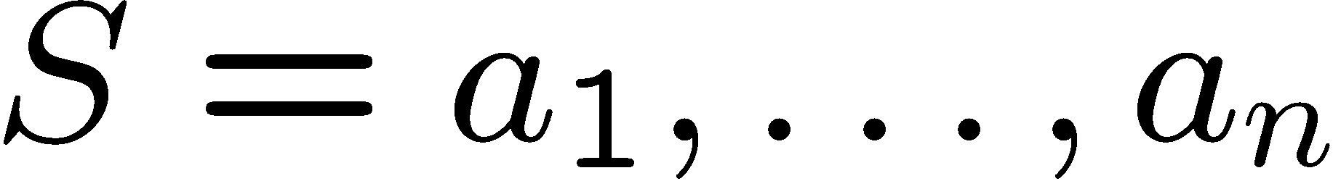
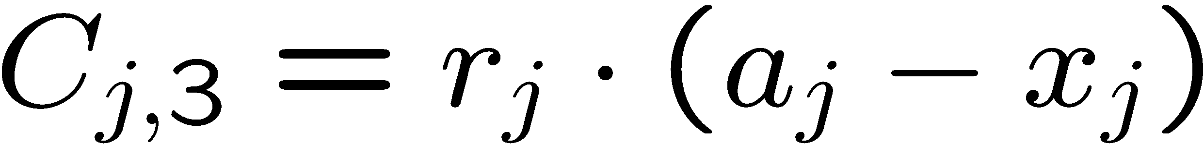
Encryption
Offline:
Online ( ):
System uses n attributes per CT (address later)
16

Slide 17
Decryption & Proof
Decryption:
Brings together CT randomness and key shares
Uses correction factor per node
Details in paper.
Proof: Reduce to security of RW13 ABE scheme

Slide 18
Extensions
Pooling: Flexible number of attributes per ciphertext
Online/Offline Key Gen:
Matches CP-ABE
18

Slide 19
Thank you

