Slide 1
Fine-Tuning Groth-Sahai Proofs
Alex Escala
Scytl Secure Electronic Voting
Jens Groth
University College London

Slide 2
Non-interactive zero-knowledge proofs
Common reference string
Statement
π
Completeness: Prover can prove true statements
Soundness: Prover cannot prove false statements
Zero-knowledge: Proofs does not reveal anything else

Slide 3
NIZK proofs
Statement: Here is a ciphertext and a document. The ciphertext contains a digital signature on the document.
 | Circuit SAT | Pratical pairing-based statements
Inefficient
Efficient
1 GB
Statistical sampling techniques
Groth 2006
1 KB
Groth-Ostrovsky-
Sahai 2012 (2006)
Groth-Sahai 2012 (2008)
Further reduction of size
More efficient computation

Slide 4
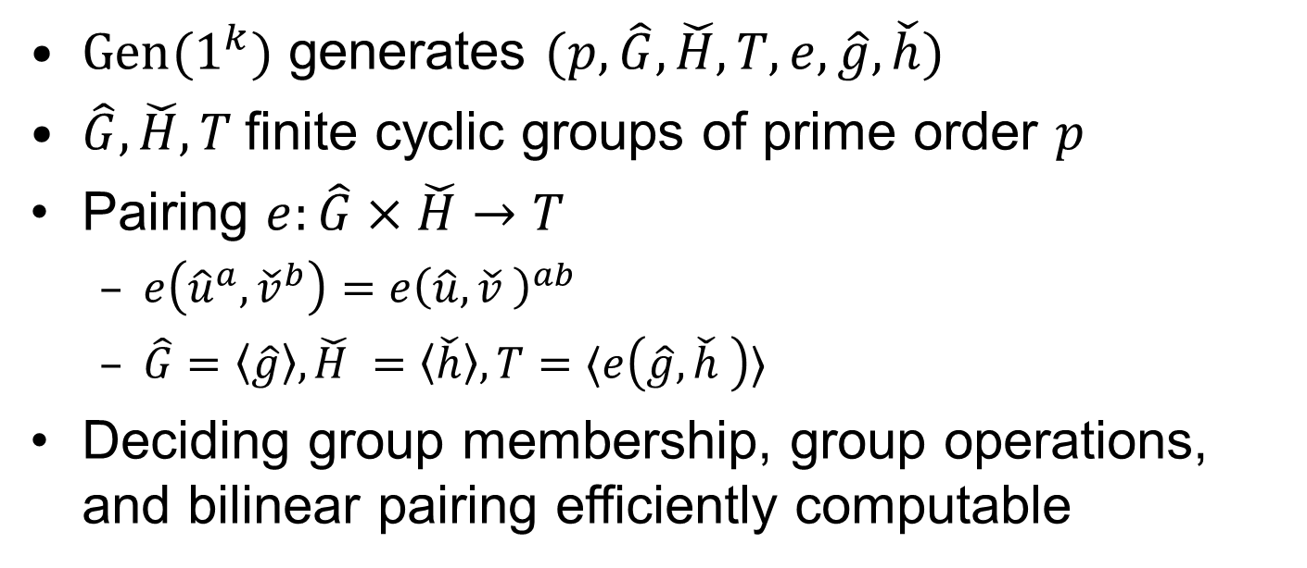
Prime order bilinear groups
$Gen(1^{k})$ generates $(p,\hat{G},\check{H},T,e,\hat{g},\check{h})$
$\hat{G},\check{H},T$finite cyclic groups of prime order $p$
Pairing $e:\hat{G}×\check{H}→T$
  $e\left({\hat{u}}^{a},{\check{v}}^{b}\right)=e{\left(\hat{u},\check{v} \right)}^{ab}$
  $\hat{G}=〈\hat{g}〉,\check{H} =〈\check{h}〉, T=〈e\left(\hat{g},\check{h} \right)〉$
Deciding group membership, group operations, and bilinear pairing efficiently computable

Slide 5
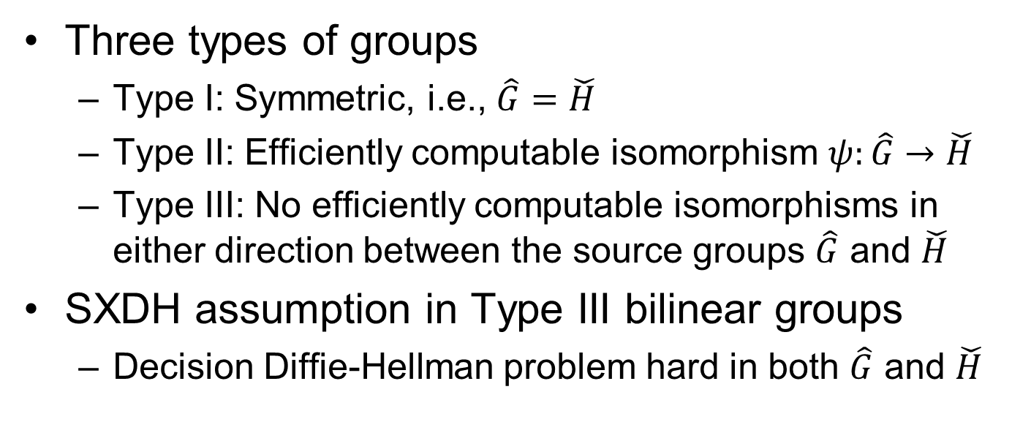
SXDH bilinear groups
Three types of groups
  Type I: Symmetric, i.e., $\hat{G}=\check{H}$
  Type II: Efficiently computable isomorphism $ψ:\hat{G}→\check{H}$
  Type III: No efficiently computable isomorphisms in either direction between the source groups $\hat{G}$ and $\check{H}$
SXDH assumption in Type III bilinear groups
  Decision Diffie-Hellman problem hard in both $\hat{G}$ and $\check{H}$

Slide 6
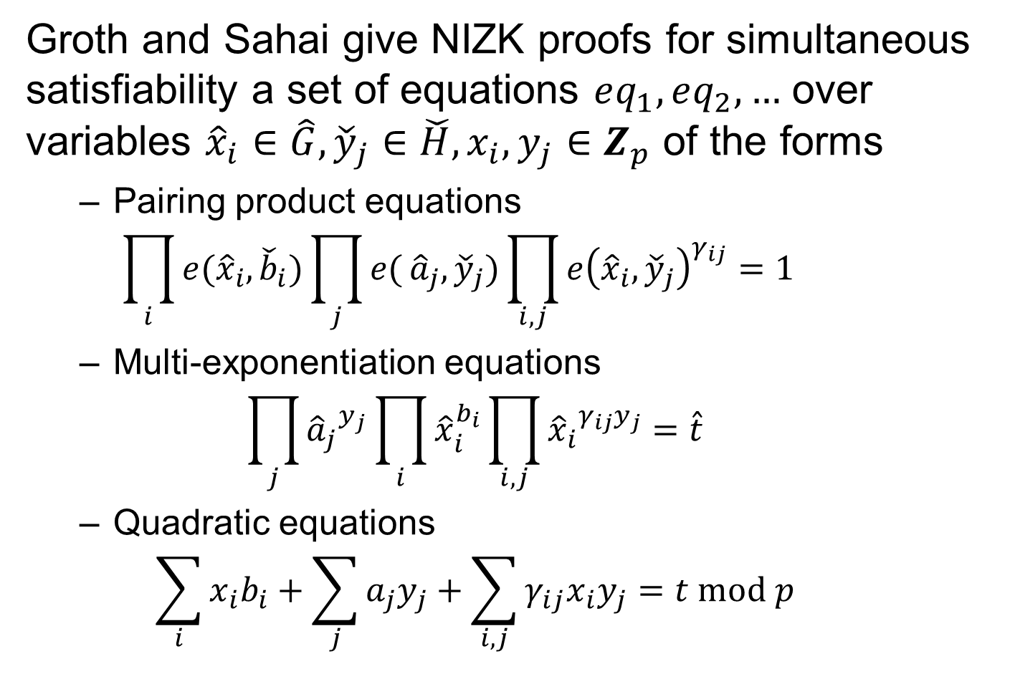
Groth and Sahai give NIZK proofs for simultaneous satisfiability a set of equations $eq_{1},eq_{2},…$ over variables ${\hat{x}}_{i}∈\hat{G},{\check{y}}_{j}∈\check{H},x_{i},y_{j}∈Z_{p}$ of the forms
  Pairing product equations
  $\prod_{i}{e({\hat{x}}_{i},{\check{b}}_{i})}\prod_{j}{e(}{\hat{a}}_{j},{\check{y}}_{j})\prod_{i,j}{e{\left({\hat{x}}_{i},{\check{y}}_{j}\right)}_{}^{γ_{ij}}}=1$
  Multi-exponentiation equations
  $\prod_{j}{{{\hat{a}}_{j}}_{}^{y_{j}}}\prod_{i}{{\hat{x}}_{i}^{b_{i}}}\prod_{i,j}{{{\hat{x}}_{i}}_{}^{γ_{ij}y_{j}}}=\hat{t}$
  Quadratic equations
  $\sum_{i}{x_{i}b_{i}}+\sum_{j}{a_{j}y_{j}+\sum_{i,j}{γ_{ij}x_{i}y_{j}}}=t mod p$

Slide 7
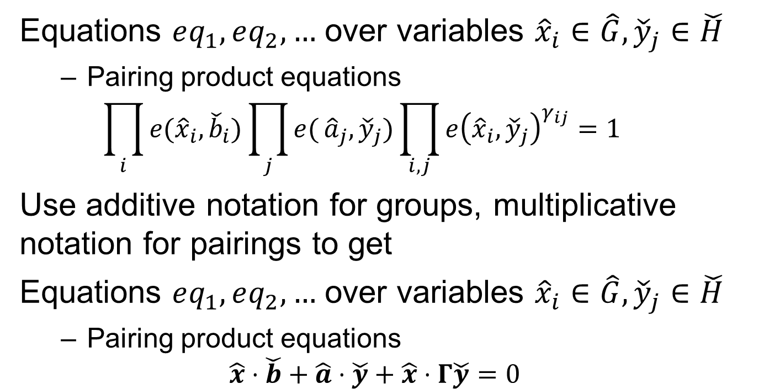
Linear algebra notation
Equations $eq_{1},eq_{2},…$ over variables ${\hat{x}}_{i}∈\hat{G},{\check{y}}_{j}∈\check{H}$
  Pairing product equations
  $\prod_{i}{e({\hat{x}}_{i},{\check{b}}_{i})}\prod_{j}{e(}{\hat{a}}_{j},{\check{y}}_{j})\prod_{i,j}{e{\left({\hat{x}}_{i},{\check{y}}_{j}\right)}_{}^{γ_{ij}}}=1$
Use additive notation for groups, multiplicative notation for pairings to get
Equations $eq_{1},eq_{2},…$ over variables ${\hat{x}}_{i}∈\hat{G},{\check{y}}_{j}∈\check{H}$
  Pairing product equations
  $\hat{x}⋅\check{b}+\hat{a}⋅\check{y}+\hat{x}⋅Γ\check{y}=0$

Slide 8
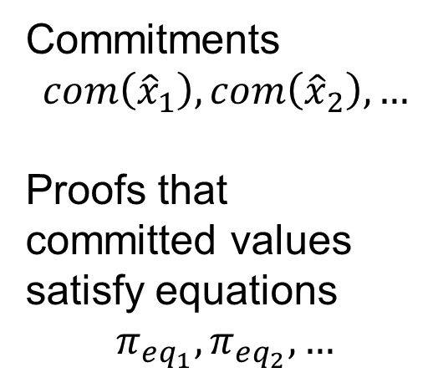
Groth-Sahai proofs
Commitments
$$com\left({\hat{x}}_{1}\right), com\left({\hat{x}}_{2}\right),…$$
Proofs that committed values satisfy equations
$$π_{eq_{1}},π_{eq_{2}},…$$

Slide 9





Commit-and-prove system [Kil90,CLOS02,Fuc11]
$$com\left({\hat{x}}_{1}\right)$$
$$com\left({\check{y}}_{1}\right)$$
$$π_{eq_{1}}$$
$$com\left({\hat{x}}_{2}\right)$$
$$π_{eq_{2}}$$

Slide 10
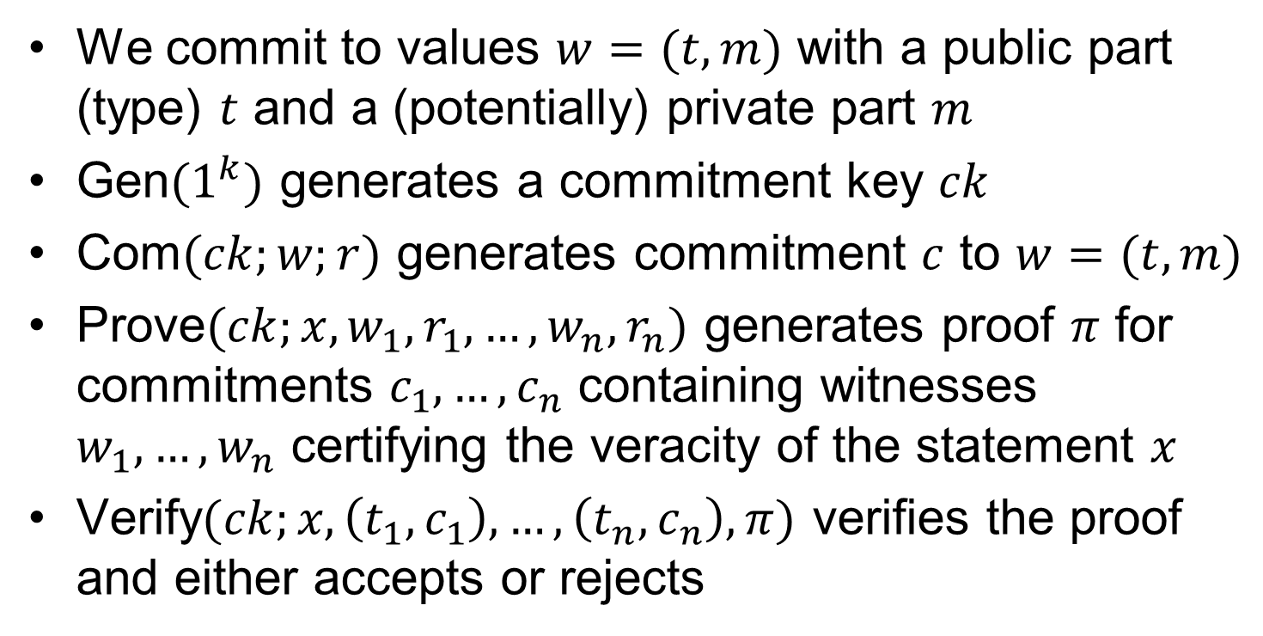
Type-based commit-and-prove system
We commit to values $w=(t,m)$ with a public part (type) $t$ and a (potentially) private part $m$
Gen$(1^{k})$ generates a commitment key $ck$
Com$(ck;w;r)$ generates commitment $c$ to $w=(t,m)$
Prove$(ck;x,w_{1},r_{1},…,w_{n},r_{n})$ generates proof $π$ for commitments $c_{1},…,c_{n}$ containing witnesses $w_{1},…,w_{n}$ certifying the veracity of the statement $x$
Verify$(ck;x,\left(t_{1},c_{1}\right),…,\left(t_{n},c_{n}\right),π)$ verifies the proof and either accepts or rejects

Slide 11
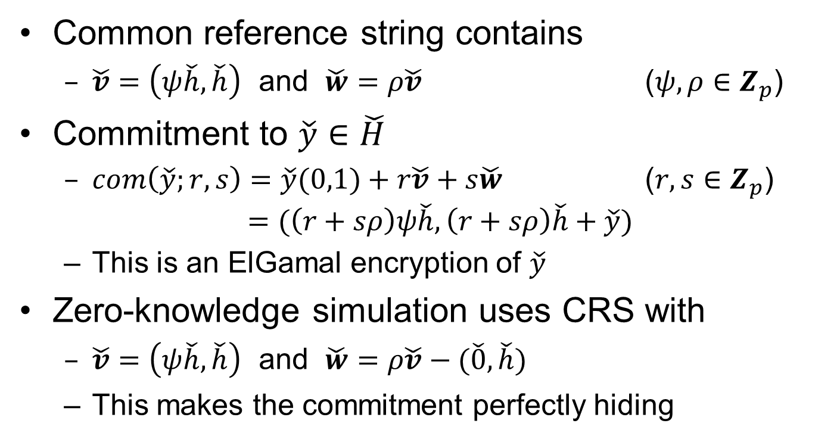

Commitments to elements in $\check{H}$
Common reference string contains
  $\check{v}=\left(ψ\check{h},\check{h}\right)$ and $\check{w}=ρ\check{v}$ ($ψ,ρ∈Z_{p}$)
Commitment to $\check{y}∈\check{H}$
  $com\left(\check{y};r,s\right)=\check{y}(0,1)+r\check{v}+s\check{w}$ ($r,s∈Z_{p}$)
  $=(\left(r+sρ\right)ψ\check{h},\left(r+sρ\right)\check{h}+\check{y})$
  This is an ElGamal encryption of $\check{y}$
Zero-knowledge simulation uses CRS with
  $\check{v}=\left(ψ\check{h},\check{h}\right)$ and $\check{w}=ρ\check{v}−(\check{0},\check{h})$
  This makes the commitment perfectly hiding

Slide 12
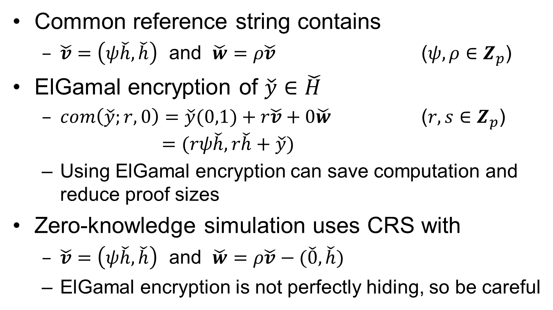

ElGamal encryption of elements in $\check{H}$
Common reference string contains
  $\check{v}=\left(ψ\check{h},\check{h}\right)$ and $\check{w}=ρ\check{v}$ ($ψ,ρ∈Z_{p}$)
ElGamal encryption of $\check{y}∈\check{H}$
  $com\left(\check{y};r,0\right)=\check{y}(0,1)+r\check{v}+0\check{w}$ ($r,s∈Z_{p}$)
  $=(rψ\check{h}, r\check{h}+\check{y})$
  Using ElGamal encryption can save computation and reduce proof sizes
Zero-knowledge simulation uses CRS with
  $\check{v}=\left(ψ\check{h},\check{h}\right)$ and $\check{w}=ρ\check{v}−(\check{0},\check{h})$
  ElGamal encryption is not perfectly hiding, so be careful

Slide 13
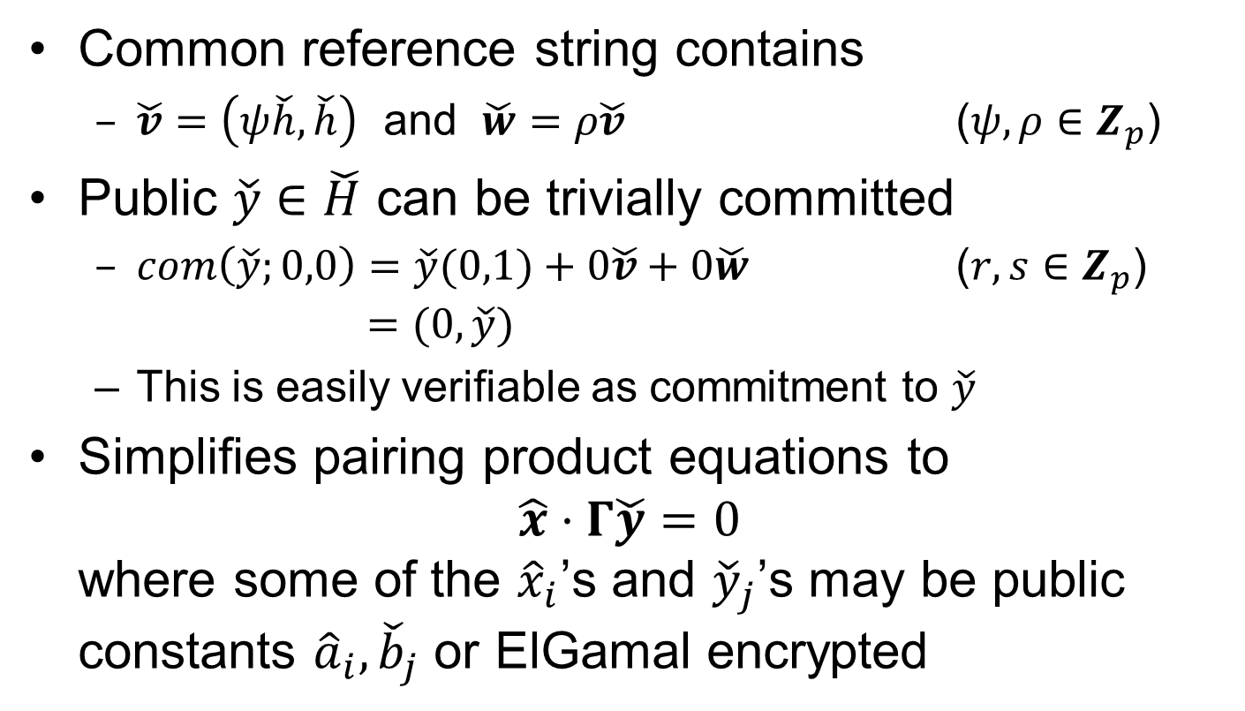

Public constants in $\check{H}$
Common reference string contains
  $\check{v}=\left(ψ\check{h},\check{h}\right)$ and $\check{w}=ρ\check{v}$ ($ψ,ρ∈Z_{p}$)
Public $\check{y}∈\check{H}$ can be trivially committed
  $com\left(\check{y};0,0\right)=\check{y}(0,1)+0\check{v}+0\check{w}$ ($r,s∈Z_{p}$)
  $=(0, \check{y})$
  This is easily verifiable as commitment to $\check{y}$
Simplifies pairing product equations to
$\hat{x}⋅Γ\check{y}=0$
where some of the ${\hat{x}}_{i}$’s and ${\check{y}}_{j}$’s may be public constants ${\hat{a}}_{i},{\check{b}}_{j}$ or ElGamal encrypted

Slide 14
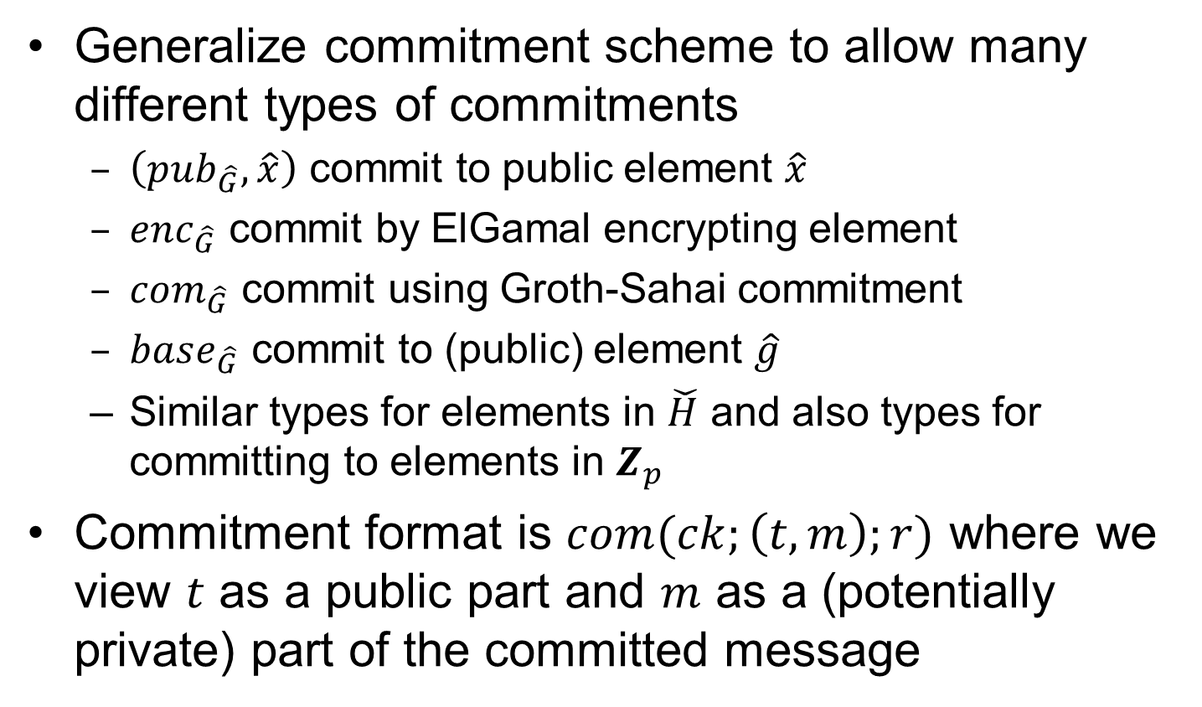
Type-based commitments
Generalize commitment scheme to allow many different types of commitments
  $\left(pub_{\hat{G}},\hat{x}\right)$ commit to public element $\hat{x}$
  $enc_{\hat{G}}$ commit by ElGamal encrypting element
  $com_{\hat{G}}$ commit using Groth-Sahai commitment
  $base_{\hat{G}}$ commit to (public) element $\hat{g}$
  Similar types for elements in $\check{H}$ and also types for committing to elements in $Z_{p}$
Commitment format is $com(ck;\left(t,m\right);r)$ where we view $t$ as a public part and $m$ as a (potentially private) part of the committed message

Slide 15
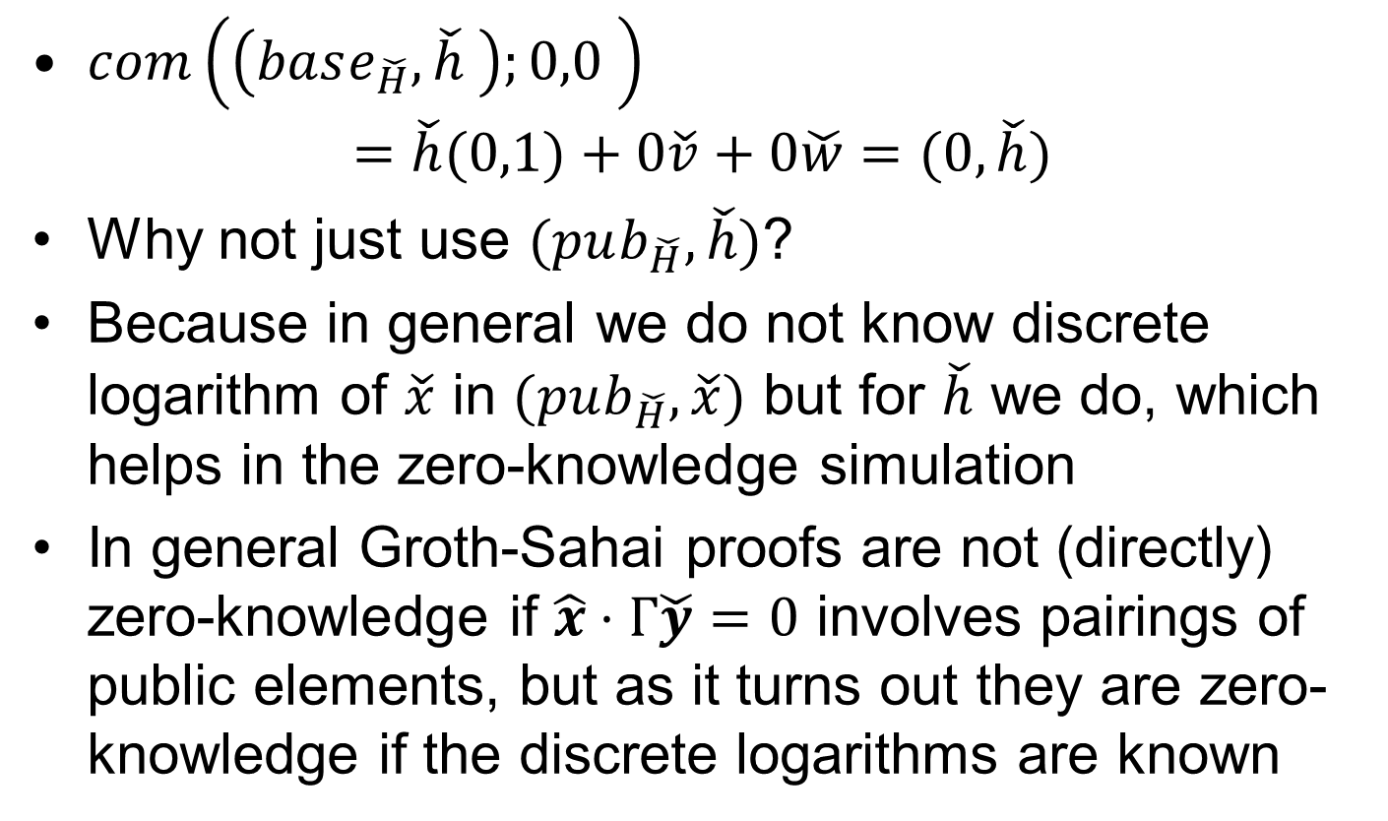
The base type
$com\left(\left(base_{\check{H}},\check{h} \right);0,0 \right)$
$=\check{h}(0,1)+0\check{v}+0\check{w}=(0,\check{h})$
Why not just use $(pub_{\check{H}},\check{h})$?
Because in general we do not know discrete logarithm of $\check{x}$ in $(pub_{\check{H}},\check{x})$ but for $\check{h}$ we do, which helps in the zero-knowledge simulation
In general Groth-Sahai proofs are not (directly) zero-knowledge if $\hat{x}⋅Γ\check{y}=0$ involves pairings of public elements, but as it turns out they are zero-knowledge if the discrete logarithms are known

Slide 16
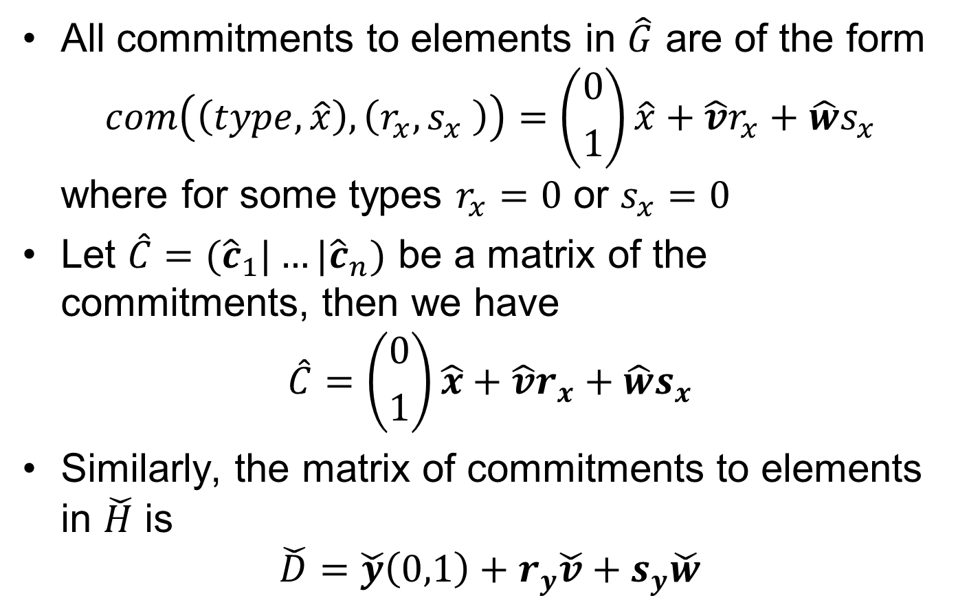
Commitments
All commitments to elements in $\hat{G}$ are of the form
$com\left(\left(type,\hat{x}\right),\left(r_{x},s_{x} \right)\right)=\left({0 \atop 1}\right)\hat{x}+\hat{v}r_{x}+\hat{w}s_{x}$
where for some types $r_{x}=0$ or $s_{x}=0$
Let $\hat{C}=({\hat{c}}_{1}|…|{\hat{c}}_{n})$ be a matrix of the commitments, then we have
$$\hat{C}=\left({0 \atop 1}\right)\hat{x}+\hat{v}r_{x}+\hat{w}s_{x}$$
Similarly, the matrix of commitments to elements in $\check{H}$ is
$$\check{D}=\check{y}\left(0,1\right)+r_{y}\check{v}+s_{y}\check{w}$$

Slide 17
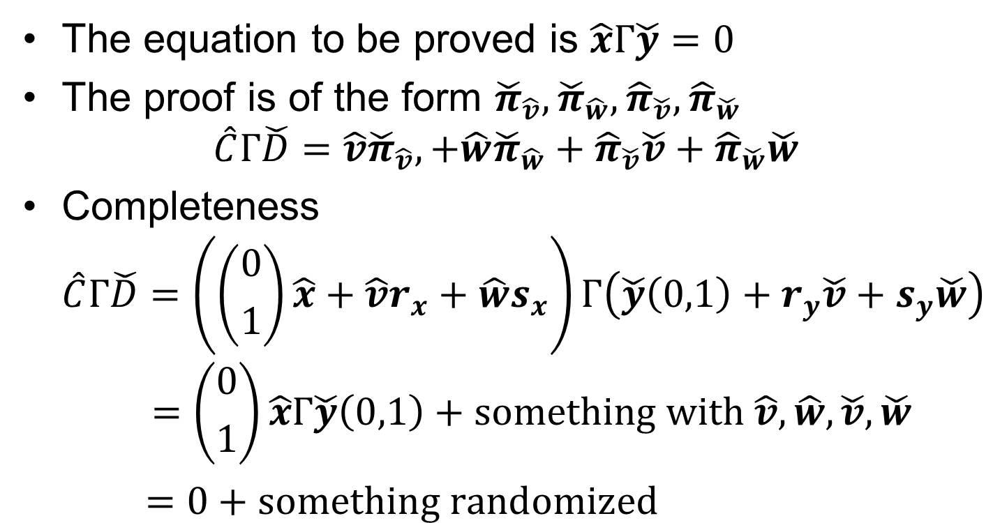
Proofs
The equation to be proved is $\hat{x}Γ\check{y}=0$
The proof is of the form ${\check{π}}_{\hat{v}}, {\check{π}}_{\hat{w}},{\hat{π}}_{\check{v}},{\hat{π}}_{\check{w}}$
$$\hat{C}Γ\check{D}=\hat{v}{\check{π}}_{\hat{v}},+\hat{w}{\check{π}}_{\hat{w}}+{\hat{π}}_{\check{v}}\check{v}+{\hat{π}}_{\check{w}}\check{w}$$
Completeness
$\hat{C}Γ\check{D}=\left(\left({0 \atop 1}\right)\hat{x}+\hat{v}r_{x}+\hat{w}s_{x}\right)Γ\left(\check{y}\left(0,1\right)+r_{y}\check{v}+s_{y}\check{w}\right)$
$=\left({0 \atop 1}\right)\hat{x}Γ\check{y}\left(0,1\right)+something with \hat{v},\hat{w},\check{v},\check{w}$
$=0+something randomized$

Slide 18
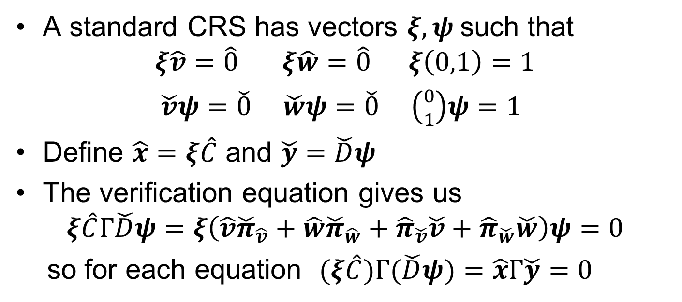
Soundness
A standard CRS has vectors $ξ,ψ$such that
$$ξ\hat{v}=\hat{0} ξ\hat{w}=\hat{0} ξ\left(0,1\right)=1$$
$\check{v}ψ=\check{0} \check{w}ψ=\check{0} \left({0 \atop 1}\right)ψ=1$
Define $\hat{x}=ξ\hat{C}$ and $\check{y}=\check{D}ψ$
The verification equation gives us
$$ξ\hat{C}Γ\check{D}ψ=ξ\left(\hat{v}{\check{π}}_{\hat{v}}+\hat{w}{\check{π}}_{\hat{w}}+{\hat{π}}_{\check{v}}\check{v}+{\hat{π}}_{\check{w}}\check{w}\right)ψ=0$$
so for each equation $(ξ\hat{C})Γ(\check{D}ψ)=\hat{x}Γ\check{y}=0$

Slide 19
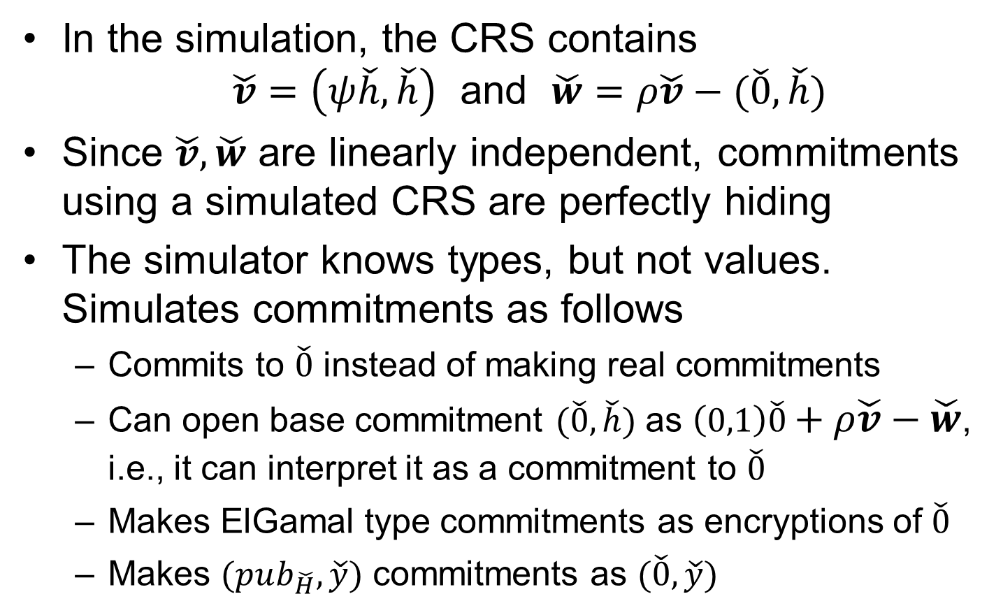
Zero-knowledge simulation for commitments
  In the simulation, the CRS contains
  $\check{v}=\left(ψ\check{h},\check{h}\right)$ and $\check{w}=ρ\check{v}−(\check{0},\check{h})$
Since $\check{v},\check{w}$ are linearly independent, commitments using a simulated CRS are perfectly hiding
The simulator knows types, but not values. Simulates commitments as follows
  Commits to $\check{0}$ instead of making real commitments
  Can open base commitment $(\check{0},\check{h})$ as $\left(0,1\right)\check{0}+ρ\check{v}−\check{w}$, i.e., it can interpret it as a commitment to $\check{0}$
  Makes ElGamal type commitments as encryptions of $\check{0}$
  Makes $(pub_{\check{H}},\check{y})$ commitments as $(\check{0},\check{y})$

Slide 20
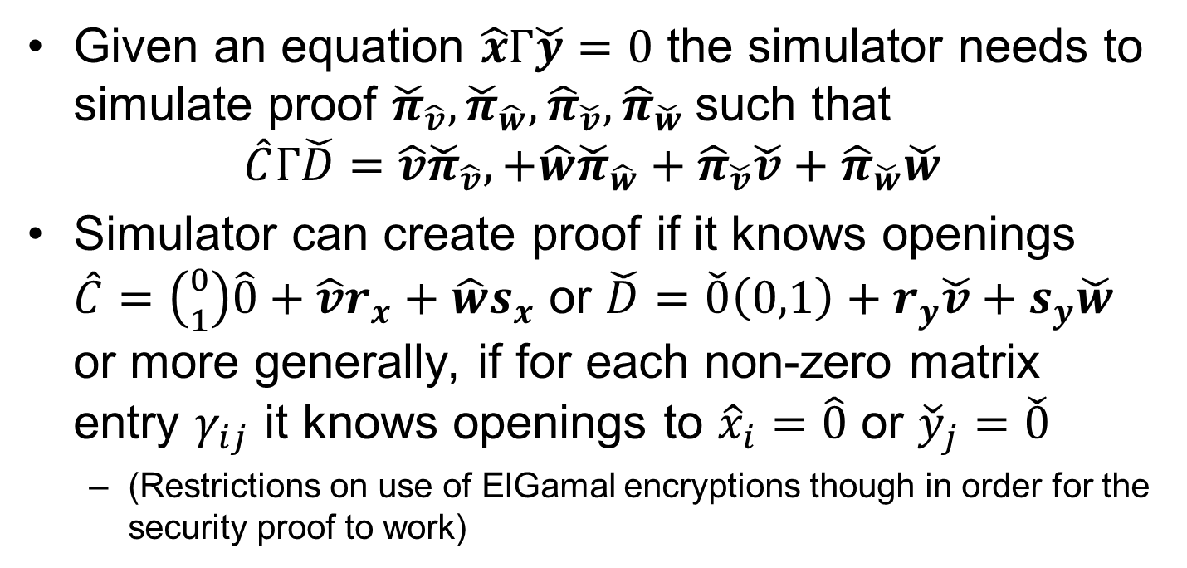
Zero-knowledge simulation for proofs
Given an equation $\hat{x}Γ\check{y}=0$ the simulator needs to simulate proof ${\check{π}}_{\hat{v}}, {\check{π}}_{\hat{w}},{\hat{π}}_{\check{v}},{\hat{π}}_{\check{w}}$ such that
$$\hat{C}Γ\check{D}=\hat{v}{\check{π}}_{\hat{v}},+\hat{w}{\check{π}}_{\hat{w}}+{\hat{π}}_{\check{v}}\check{v}+{\hat{π}}_{\check{w}}\check{w}$$
Simulator can create proof if it knows openings
$\hat{C}=\left({0 \atop 1}\right)\hat{0}+\hat{v}r_{x}+\hat{w}s_{x}$ or $\check{D}=$ $\check{0}\left(0,1\right)+r_{y}\check{v}+s_{y}\check{w}$
or more generally, if for each non-zero matrix entry $γ_{ij}$ it knows openings to ${\hat{x}}_{i}=\hat{0}$ or ${\check{y}}_{j}=\check{0}$
  (Restrictions on use of ElGamal encryptions though in order for the security proof to work)

Slide 21

Prover-chosen common reference string
Common reference string
Faster computation at the cost of sending a separate CRS and proving it is correct
  Good trade-off when many proofs to the same verifiers
I will use this CRS
$$pk, π_{pk}$$

Slide 22
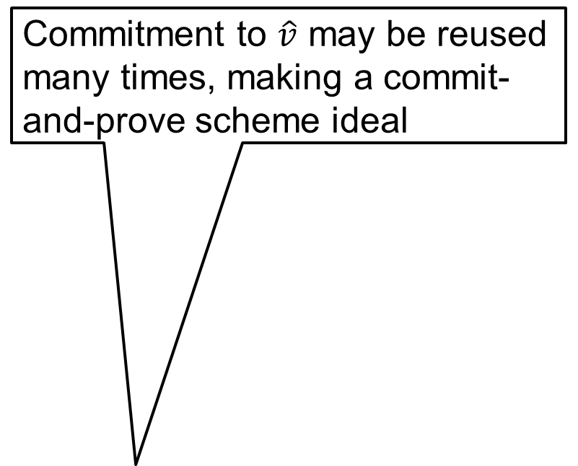

Conclusion
Size: Reduced from 16 to 6 group elements ~63%
Computation: Reduced ~40%
Commitment to $\hat{v}$ may be reused many times, making a commit-and-prove scheme ideal
Working in the SXDH setting we have fine-tuned Groth-Sahai proofs as follows
  Simplified notation
  Generalized to type-based commit-and-prove schemes
  Enabled the use of ElGamal encryption
  Allowed pairings of base elements $\hat{g},\check{h}$ in equations
  Permitted the prover to choose her own CRS
Weak Boneh-Boyen signatures
  $\left(\hat{v}+m\hat{g}\right)⋅\check{σ}=\hat{g}⋅\check{h}$
Save a couple of group elements in each proof by using ElGamal encryption
We can handle base elements directly
Prover can reduce computation by using own key

