Slide 1
On Minimal Assumptions for Sender-Deniable Public Key Encryption
Dana Dachman-Soled
University of Maryland

Slide 2


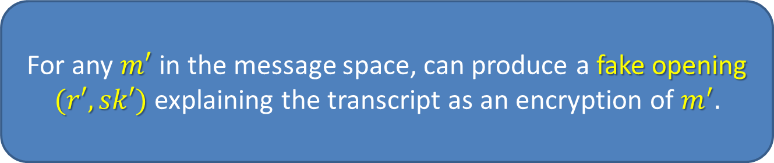


Deniable Public Key Encryption
[Canetti, Dwork, Naor, Ostrovsky, 97]
$$pk$$
$$c=Enc_{pk}(m;r)$$
Sender
Receiver
s$k$
Outputs: $Dec_{sk}\left(c\right)=m$
For any $m′$ in the message space, can produce a fake opening $(r′, sk′)$ explaining the transcript as an encryption of $m^{′}.$

Slide 3
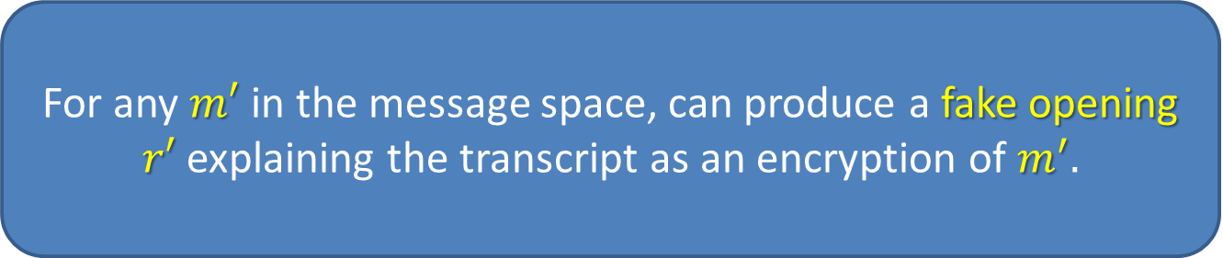
Sender-Deniable Public Key Encryption
[Canetti, Dwork, Naor, Ostrovsky, 97]
$$pk$$
$$c=Enc_{pk}(m;r)$$
Sender
Receiver
s$k$
Outputs: $Dec_{sk}\left(c\right)=m$
Analogous definition for Receiver-Deniable Public Key Encryption
For any $m′$ in the message space, can produce a fake opening $r′$ explaining the transcript as an encryption of $m^{′}.$
Applications:
After the fact incoercibility
Adaptive security

Slide 4
What is known?
Receiver-Deniable PKE and thus Deniable PKE is impossible [Bendlin, Nielsen, Nordholt, Orlandi, 11].
Sender-Deniable encryption with weak security from standard assumptions [Canetti, Dwork, Naor, Ostrovsky, 97].
Bi-Deniable encryption in the multi-distributional model constructed by [O’Neill, Peikert, Waters, 11]
[Sahai, Waters 14] achieve Sender-Deniable public key encryption from indistinguishability obfuscation (IO).
  Non-black box use of underlying primitives.
  Requires strong assumptions (FHE + multilinear maps).

Slide 5
Our Goal
Understand minimal assumptions necessary for sender-deniable public key encryption.
Necessity of non-black-box techniques.
Is there a black-box construction of sender-deniable public key encryption from simulatable public key encryption?

Slide 6
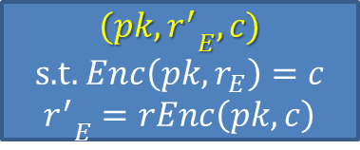



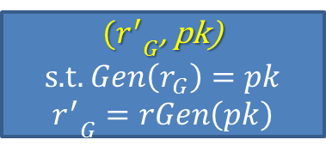
Underlying primitive we consider
Simulatable Public Key Encryption
Algorithms $(oGen, rGen), (oEnc, rEnc)$
${(r}_{G}, pk)$
s.t. $oGen\left(r_{G}\right)=pk$
${(r_{}^{′}}_{G}$, pk)
s.t. $Gen\left(r_{G}\right)=pk$
$${r_{}^{′}}_{G}=rGen\left(pk\right)$$
$$≈$$
“Oblivious”
(${pk, r}_{E}, c)$
s.t. $oEnc\left(pk,r_{E}\right)=c$
${{(pk, r}_{}^{′}}_{E}, c)$
s.t. $Enc\left({pk,r}_{E}\right)=c$
$${r_{}^{′}}_{E}=rEnc\left(pk, c\right)$$
Intuition: Can generate a public key/ciphertext honestly and claim that it was generated obliviously.
Why this primitive? Simulatable PKE is sufficient for related primitives:
Bi-deniable encryption in the multi-distributional model [OPW11]
1/poly-secure sender-deniable encryption [CDNO97]
Non-committing encryption [CFGN96].

Slide 7


Weak Sender-Deniable PKEfrom Simulatable PKE
Simplification of [CDNO97] construction:
$$E_{pk}(0^{k})$$
Obliv.
Obliv
Obliv
$$E_{pk}(0^{k})$$
Obliv.
$$E_{pk}(0^{k})$$
Obliv
Obliv
. . .
k ciphertexts
To encrypt a 0, set odd number of ciphertexts to oblivious.
To encrypt a 1, set an even number of ciphertexts to oblivious.
To deny, lie and say that an honestly generated ciphertext was generated obliviously.
Problem: Cannot lie and claim that an obliviously generated ciphertext was generated non-obliviously.
Only achieves O(k) security, where k is the number of queries made by encryption.
Polynomial security: Real and Fake openings can be distinguished with 1/poly advantage
Super-polynomial security: Real and Fake openings can only be distinguished with negligible advantage

Slide 8
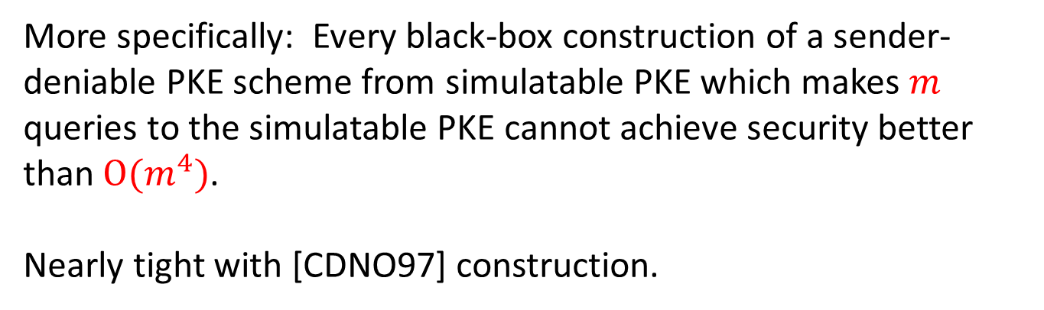
Our Results
Theorem: There is no black-box construction of sender-deniable public key encryption with super-polynomial security from simulatable public key encryption.
More specifically: Every black-box construction of a sender-deniable PKE scheme from simulatable PKE which makes $m$ queries to the simulatable PKE cannot achieve security better than $O(m^{4})$.
Nearly tight with [CDNO97] construction.

Slide 9
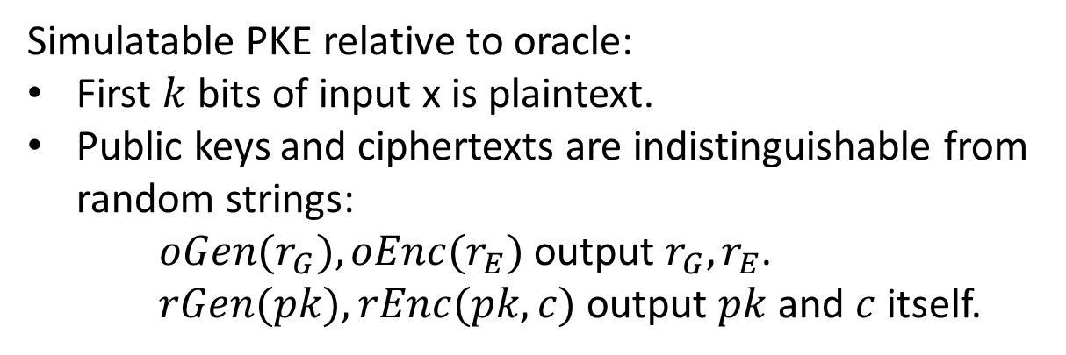
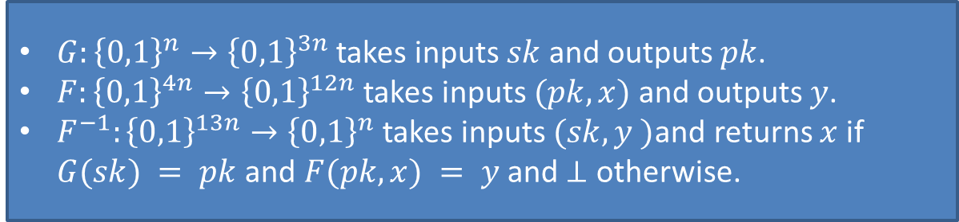

Some Proof Intuition
Oracle separation: Oracle relative to which Simulatable PKE exists, Sender-Deniable PKE does not exist.
Our oracle:
Important: random string is unlikely to be in the range of $G$ or $F\left(pk, ∗\right).$
$G:{\left\{0,1\right\}}^{n}→{\left\{0,1\right\}}^{3n}$ takes inputs $sk$ and outputs $pk$.
$F:{\left\{0,1\right\}}^{4n}→{\left\{0,1\right\}}^{12n}$ takes inputs $(pk, x)$ and outputs $y$.
$F^{−1}:{\left\{0,1\right\}}^{13n}→{\left\{0,1\right\}}^{n}$ takes inputs $(sk, y )$and returns $x$ if $G(sk) = pk$ and $F(pk,x) = y$ and $⊥$ otherwise.
Simulatable PKE relative to oracle:
First $k$ bits of input x is plaintext.
Public keys and ciphertexts are indistinguishable from random strings:
$oGen(r_{G}), oEnc(r_{E})$output $r_{G}, r_{E}$.
$rGen(pk), rEnc(pk, c)$output $pk$ and $c$ itself.

Slide 10
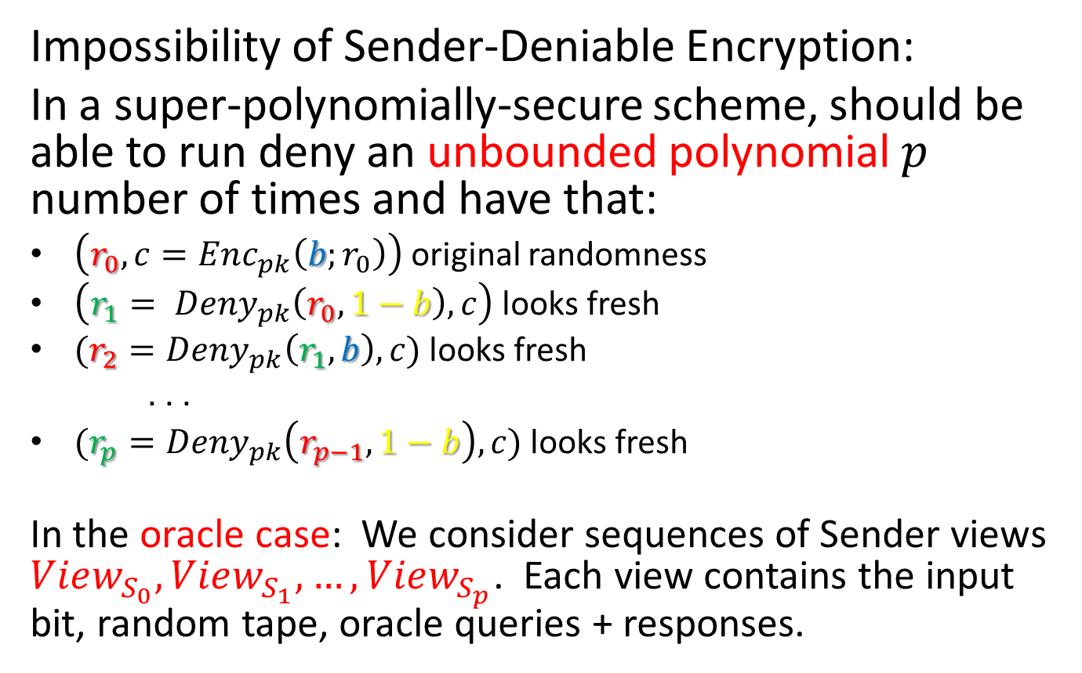
Some Proof Intuition
Impossibility of Sender-Deniable Encryption:
In a super-polynomially-secure scheme, should be able to run deny an unbounded polynomial $p$ number of times and have that:
$\left(r_{0}, c=Enc_{pk}\left(b;r_{0}\right)\right)$ original randomness
$\left(r_{1}= Deny_{pk}\left(r_{0}, 1−b\right), c\right)$looks fresh
$(r_{2}=Deny_{pk}\left(r_{1}, b\right), c)$ looks fresh
. . .
$(r_{p}=Deny_{pk}\left(r_{p−1}, 1−b\right), c)$ looks fresh
In the oracle case: We consider sequences of Sender views $View_{S_{0}}, View_{S_{1}}, …, View_{S_{p}}$. Each view contains the input bit, random tape, oracle queries + responses.

Slide 11
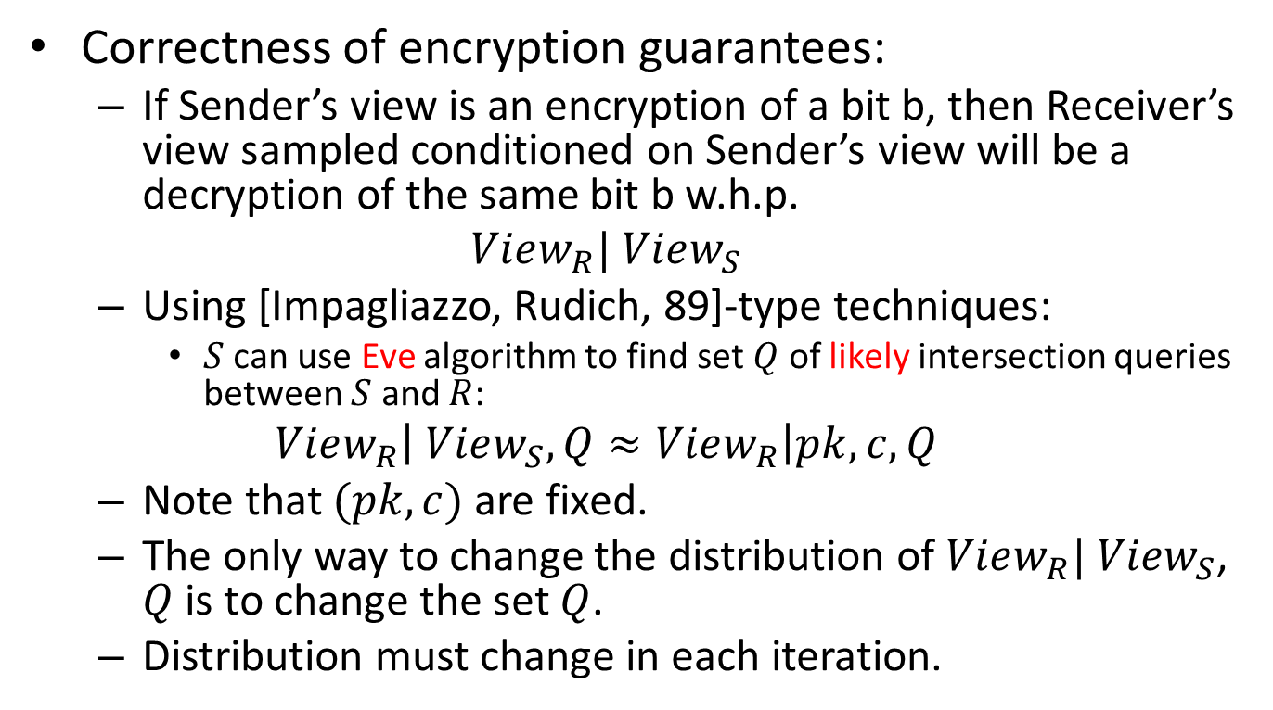
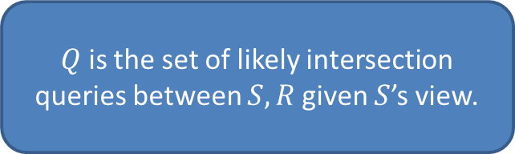
Some Proof Intuition
Correctness of encryption guarantees:
  If Sender’s view is an encryption of a bit b, then Receiver’s view sampled conditioned on Sender’s view will be a decryption of the same bit b w.h.p.
  $$View_{R}| View_{S}$$
  Using [Impagliazzo, Rudich, 89]-type techniques:
    $S$ can use Eve algorithm to find set $Q$ of likely intersection queries between $S$ and $R$:
  $$View_{R}\left| View_{S}, Q≈View_{R}\right|pk, c, Q$$
  Note that $(pk, c)$ are fixed.
  The only way to change the distribution of $View_{R}| View_{S}$, $Q$ is to change the set $Q$.
  Distribution must change in each iteration.
$Q$ is the set of likely intersection queries between $S, R$given $S$’s view.

Slide 12
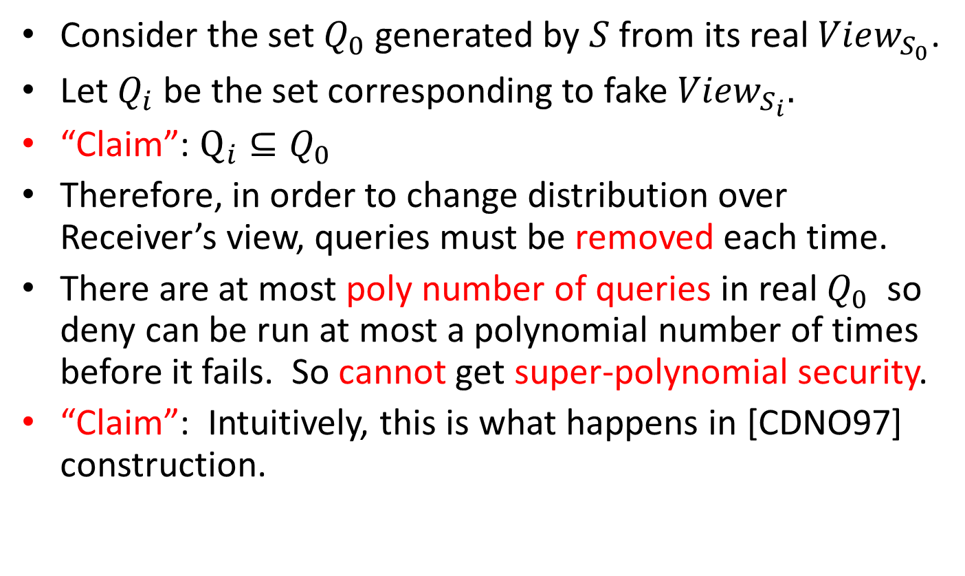
A First Attempt
Consider the set $Q_{0}$ generated by $S$ from its real $View_{S_{0}}$.
Let $Q_{i}$ be the set corresponding to fake $View_{S_{i}}.$
“Claim”: $Q_{i}⊆Q_{0}$
Therefore, in order to change distribution over Receiver’s view, queries must be removed each time.
There are at most poly number of queries in real $Q_{0}$ so deny can be run at most a polynomial number of times before it fails. So cannot get super-polynomial security.
“Claim”: Intuitively, this is what happens in [CDNO97] construction.

Slide 13
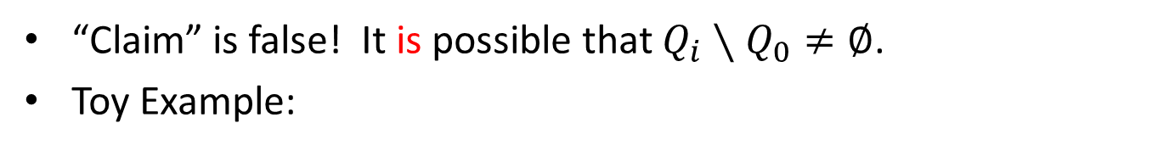


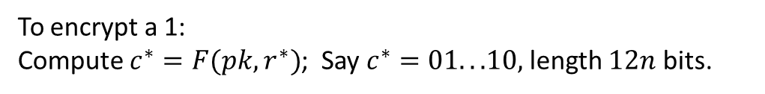
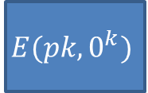
Problem
“Claim” is false! It is possible that ${Q_{i}∖Q}_{0}≠∅$.
Toy Example:
12n encryptions
To encrypt a 0:
$$E(pk,0^{k})$$
$$E(pk,0^{k})$$
$$E(pk,0^{k})$$
$$E(pk,0^{k})$$
To encrypt a 1:
Compute $c^{∗}=F(pk,r^{∗})$; Say $c^{∗}=01. . .10,$length $12n$ bits.
$$E(pk,0^{k})$$
Obliv
Obliv
$$E(pk,0^{k})$$
Decrypt: Decrypt 12n ciphertexts. If they all output $0^{k}$, output 0.
Otherwise, compute $c^{∗}$ and decrypt to get $r^{∗}$. Output 1.
Note: In 0 case, intersection queries will consist of $0^{k};r_{i}$.
In 1 case, intersection queries will contain $r^{∗}$.

Slide 14
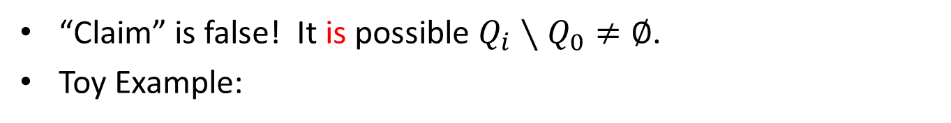

Problem
“Claim” is false! It is possible ${Q_{i}∖Q}_{0}≠∅$.
Toy Example:
Can claim an encryption of 0 is an encryption of 1:
In the process will add an arbitrary query to set of intersection queries.
$$E(pk,0^{k})$$
$$E(pk,0^{k})$$
$$E(pk,0^{k})$$
$$E(pk,0^{k})$$
Compute $c^{∗}=F(pk, r^{∗})$; Say $c^{∗}=01. . .10$
$$E(pk,0^{k})$$
Obliv
Obliv
$$E(pk,0^{k})$$
Note: Intersection queries now include, $r^{∗}$.

Slide 15
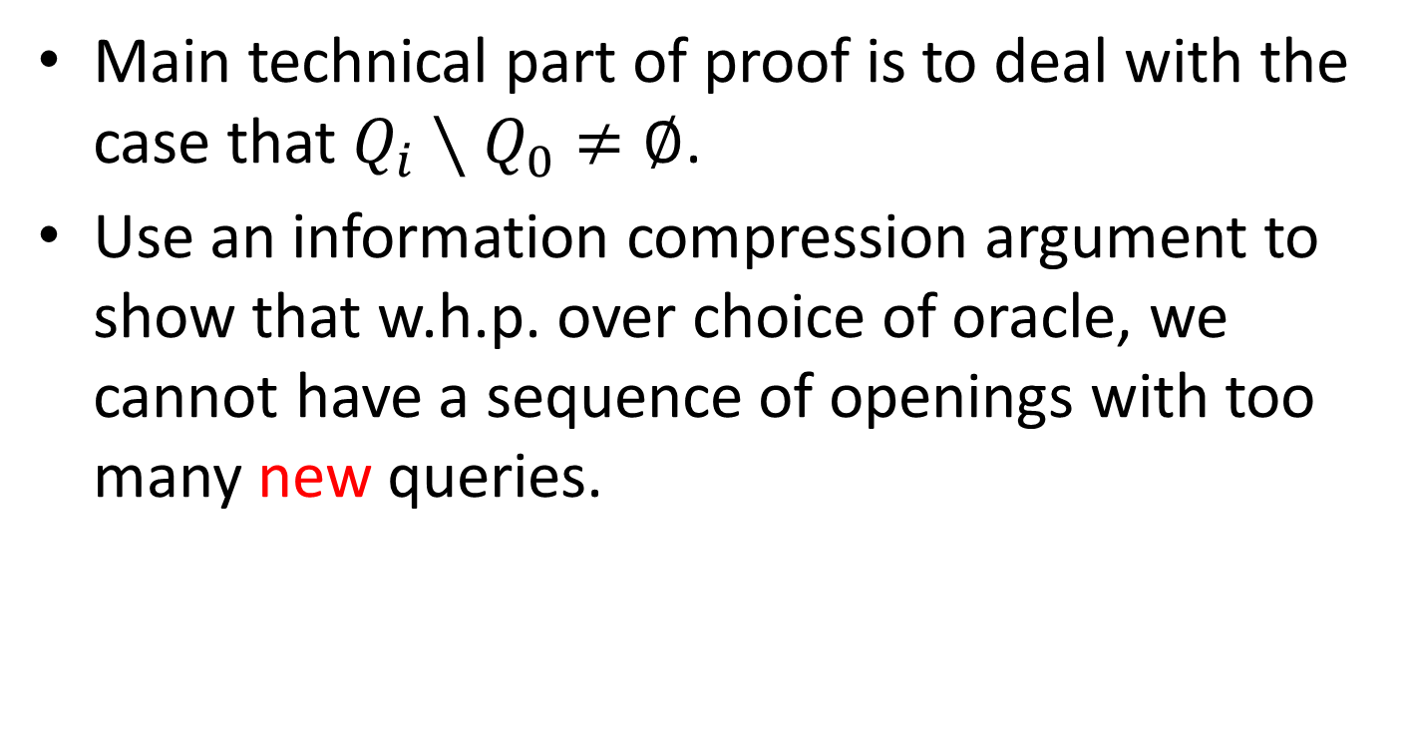
Some Proof Intuition
  Main technical part of proof is to deal with the case that ${Q_{i}∖Q}_{0}≠∅$.
Use an information compression argument to show that w.h.p. over choice of oracle, we cannot have a sequence of openings with too many new queries.

Slide 16
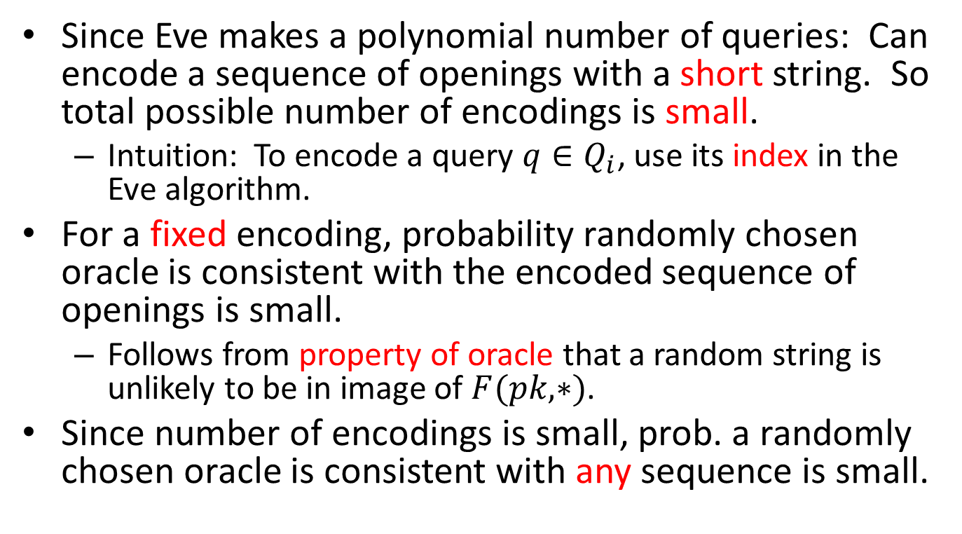
Some Proof Intuition
Since Eve makes a polynomial number of queries: Can encode a sequence of openings with a short string. So total possible number of encodings is small.
  Intuition: To encode a query $q∈Q_{i}$, use its index in the Eve algorithm.
For a fixed encoding, probability randomly chosen oracle is consistent with the encoded sequence of openings is small.
  Follows from property of oracle that a random string is unlikely to be in image of $F(pk, ∗)$.
Since number of encodings is small, prob. a randomly chosen oracle is consistent with any sequence is small.

Slide 17
Open Problems
Extend impossibility result to trapdoor permutations.
Extend impossibility results to multiple round encryption schemes.
Construct sender-deniable public key encryption without relying on IO?

Slide 18
Thank you!

