Slide 1
A Black-Box Construction of a CCA2 Encryption Scheme from a Plaintext Aware (sPA1) Encryption Scheme
Dana Dachman-Soled
University of Maryland

Slide 2
CPA, CCA1 and CCA2

Slide 3



CPA, CCA1 and CCA2
CPA-secure Public Key Encryption
$$≈$$
$$pk, Enc_{pk}(m_{0})$$
$$pk, Enc_{pk}(m_{1})$$

Slide 4




CPA, CCA1 and CCA2
CCA1-secure Public Key Encryption
$$sk$$
$$≈$$
$$sk$$
$$pk$$
$$pk, Enc_{pk}(m_{0})$$
$$pk$$
$$pk, Enc_{pk}(m_{1})$$

Slide 5


CPA, CCA1 and CCA2
CCA2-secure Public Key Encryption
$$sk$$
$$≈$$
$$sk$$
$$c≠c^{∗}$$
$$c≠c^{∗}$$
$$pk$$
$$pk, Enc_{pk}(m_{0})$$
$$pk$$
$$pk, Enc_{pk}(m_{1})$$

Slide 6
Does CPA Security Imply CCA Security?
[Naor, Yung 90], [Dolev, Dwork, Naor, 00]
  CPA + NIZK -> CCA1 and CCA2
Partial black-box separation
  [Gertner, Malkin, Myers, 07] no “shielding” construction of CCA1 from CPA.
Question remains open!
  Even whether CCA1 -> CCA2 is not known.
  Long line of work showing black-box constructions of CCA2 encryption from lower level primitives.
    [Peikert, Waters 11], [Rosen, Segev, 10], [Kiltz, Mohassel, O’Neill, 10]. . .
  Our work continues this line of research.

Slide 7
Our Results
Note: Construction is black-box, but reduction makes non-black-box use of the CCA2 adversary.
[Myers, Sergi, shelat, 12]: Black-box construction of cNM-CCA1-secure encryption from the same assumptions.
Our contribution: Extend to full CCA2 setting.
Construction of a CCA2 scheme from encryption schemes with “weaker” security and no additional assumptions.
Theorem: There is a black-box construction of CCA2-secure encryption from plaintext aware (sPA1) and weakly simulatable public key encryption.

Slide 8
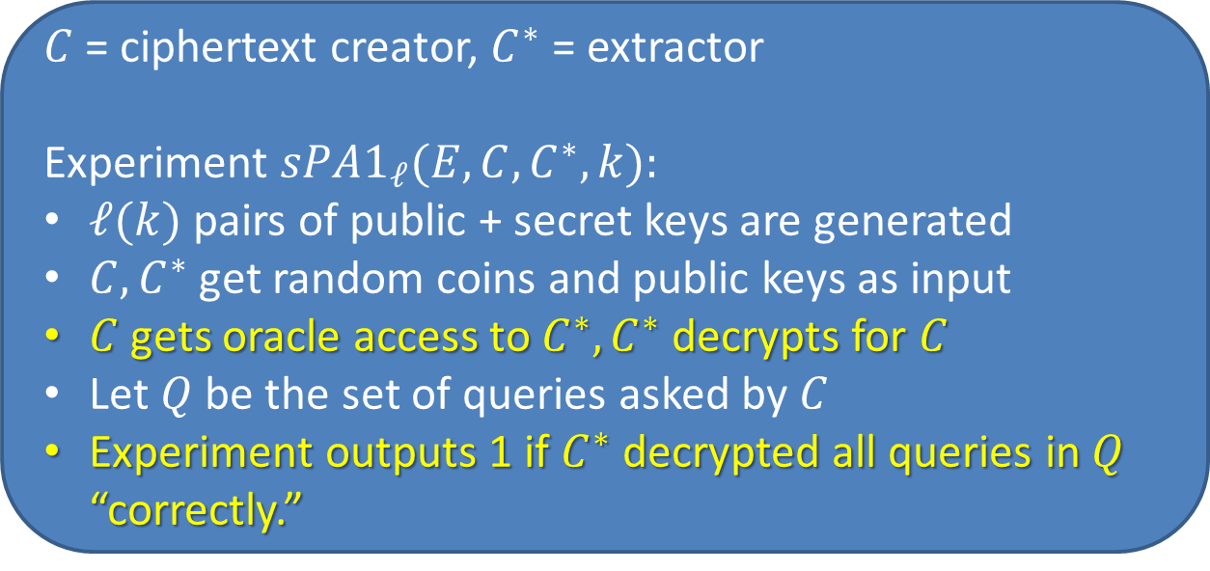
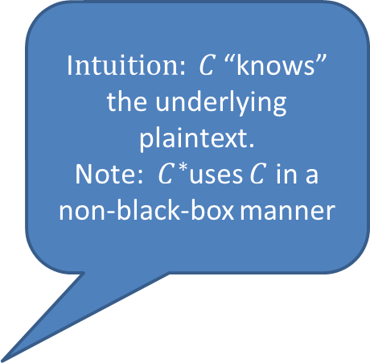
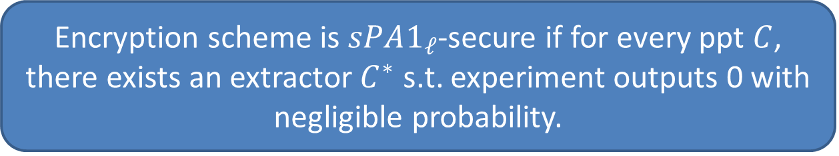
Our Assumptions—Plaintext Awareness
I$ntuition: C$ “knows” the underlying plaintext.
Note: $C^{∗}$uses $C$ in a non-black-box manner
$C$ = ciphertext creator, $C^{∗}$ = extractor
Experiment $sPA1_{ℓ}(E, C, C^{∗}, k):$
$ℓ(k)$ pairs of public + secret keys are generated
$C, C^{∗}$ get random coins and public keys as input
$C$ gets oracle access to $C^{∗}, C^{∗}$ decrypts for $C$
Let $Q$ be the set of queries asked by $C$
Experiment outputs 1 if $C^{∗}$ decrypted all queries in $Q$ “correctly.”
Note: No auxiliary input
Encryption scheme is $sPA1_{ℓ}$-secure if for every ppt $C$, there exists an extractor $C^{∗}$ s.t. experiment outputs 0 with negligible probability.

Slide 9
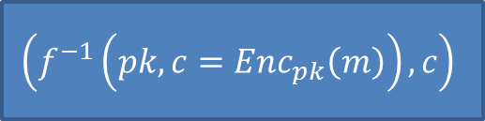
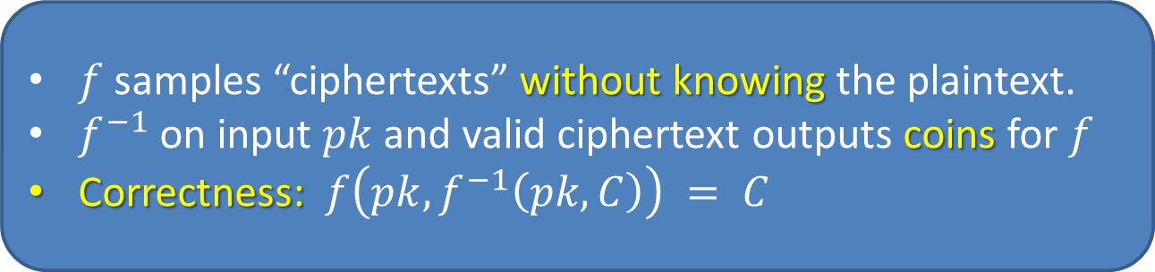


Our Assumptions—Weak Simulatability
$f$ samples “ciphertexts” without knowing the plaintext.
$f^{−1}$ on input $pk$and valid ciphertext outputs coins for $f$
Correctness: $f\left(pk, f^{−1}\left(pk,C\right)\right) = C$
$$\left(f^{−1}\left(pk, c=Enc_{pk}\left(m\right)\right), c\right)$$
$$≈$$
$$\left(r, f\left(pk, r\right)\right)$$
Candidate constructions satisfying both assumptions ([MSs12]):
Damgard Elgamal Encryption scheme (DEG)
Cramer-Shoup lite (CS-lite)

Slide 10
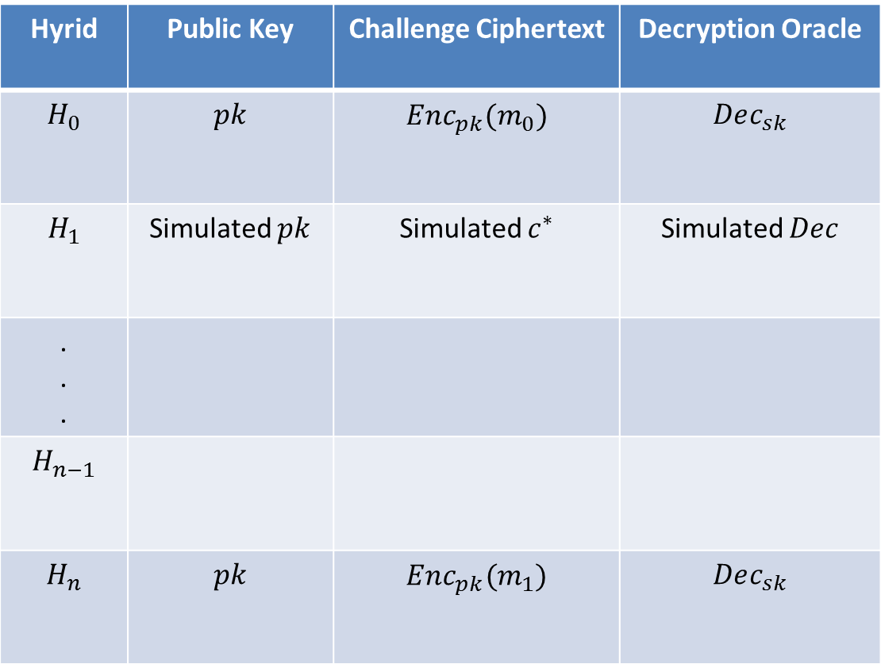
Overview: CCA Proof Strategies
Hyrid | Public Key | Challenge Ciphertext | Decryption Oracle
$$H_{0}$$ | $$pk$$ | $$Enc_{pk}(m_{0})$$ | $$Dec_{sk}$$
$$H_{1}$$ | Simulated $pk$ | Simulated $c^{∗}$ | Simulated $Dec$
. . .
$$H_{n−1}$$
$$H_{n}$$ | $$pk$$ | $$Enc_{pk}(m_{1})$$ | $$Dec_{sk}$$
PPT adversary cannot distinguish consecutive hybrids.
Main Challenge: Constructing the simulated decryption oracle
To reduce to security of underlying encryption scheme, must simulate decryption oracle without knowing secret key.

Slide 11
CCA1 from Plaintext Awareness?
Trivial: Plaintext Aware scheme is itself CCA1-secure!
  To simulate the decryption oracle without knowing the secret key, use the Extractor.

Slide 12
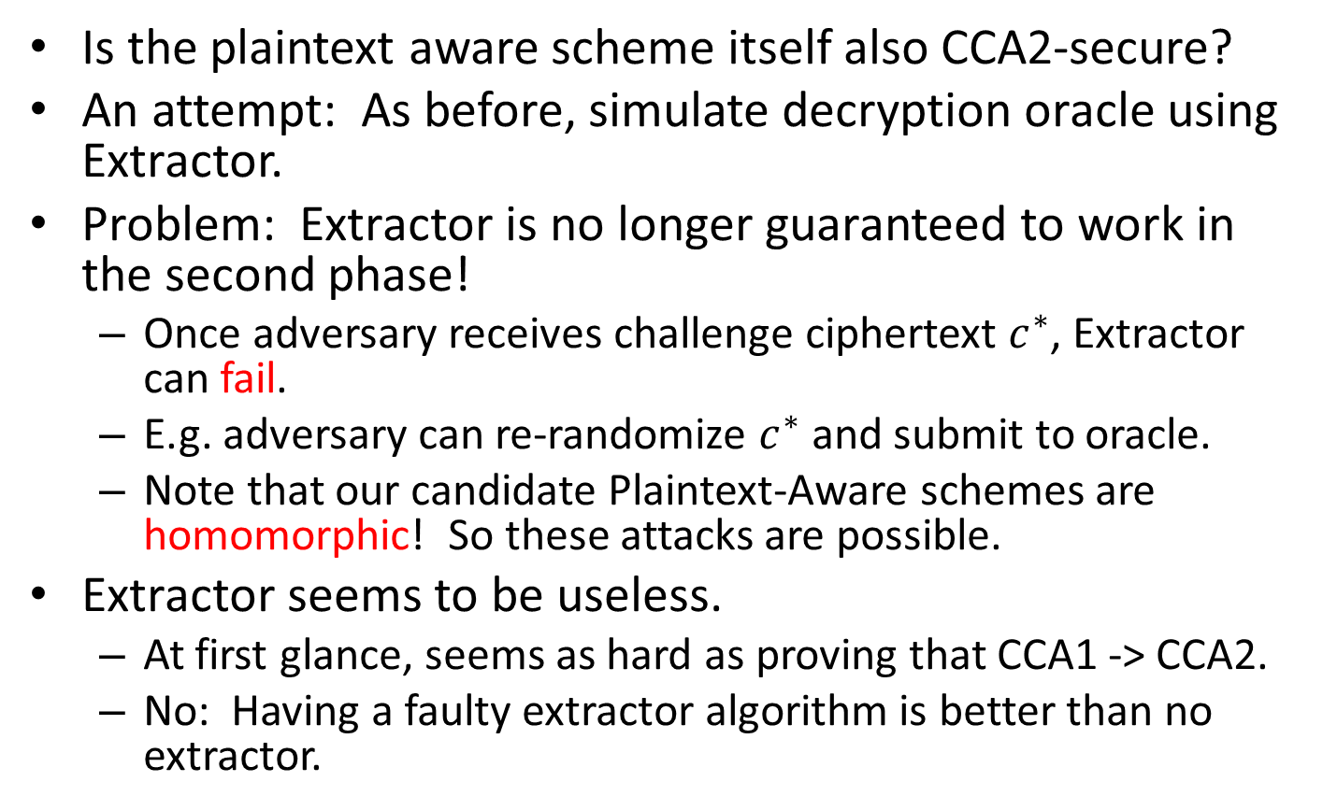
CCA2 from Plaintext Awareness?
Is the plaintext aware scheme itself also CCA2-secure?
An attempt: As before, simulate decryption oracle using Extractor.
Problem: Extractor is no longer guaranteed to work in the second phase!
  Once adversary receives challenge ciphertext $c^{∗}$, Extractor can fail.
  E.g. adversary can re-randomize $c^{∗}$ and submit to oracle.
  Note that our candidate Plaintext-Aware schemes are homomorphic! So these attacks are possible.
Extractor seems to be useless.
  At first glance, seems as hard as proving that CCA1 -> CCA2.
  No: Having a faulty extractor algorithm is better than no extractor.

Slide 13

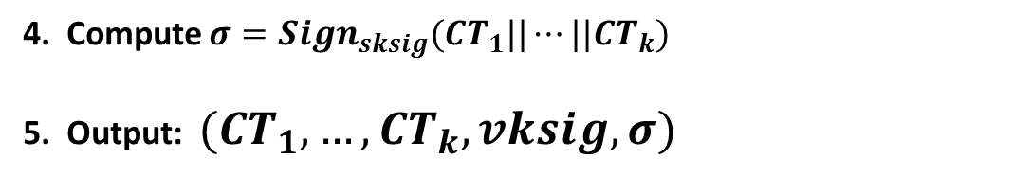
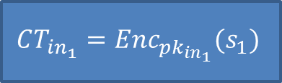
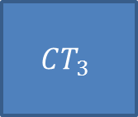
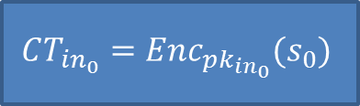

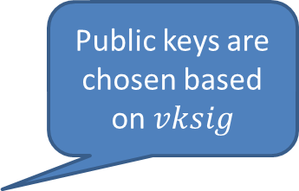
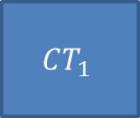
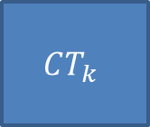

Our Construction
Combines techniques from [Hohenberger, Lewko, Waters 12] and [Myers, Sergi, shelat 12]
1. Generate $(vksig, sksig)$ for one-time signature scheme
2. Inner ciphertexts:
$$CT_{in_{0}}=Enc_{pk_{in_{0}}}(s_{0})$$
$$CT_{in_{1}}=Enc_{pk_{in_{1}}}(s_{1})$$
Public keys are chosen based on $vksig$
$$s_{0}⊕s_{1}=(m||r)$$
$$r_{1}, …r_{k}=prg(r)$$
3. Outer ciphertexts:
$$CT_{1}$$
$$CT_{2}$$
$$CT_{3}$$
$$CT_{k}$$
. . .
$k$ encryptions of $CT_{in_{0}}||CT_{in_{1}}$under $p{k_{i}^{}}^{vksig_{i}}$ and randomness $r_{i}$
4. Compute $σ=Sign_{sksig}(CT_{1}||⋯||CT_{k})$
5. Output: $(CT_{1}, …,CT_{k}, vksig, σ)$

Slide 14
Proof Intuition
Idea: Use extractor to simulate oracle even in the CCA2 case.
Now the extractor may answer incorrectly after the adversary receives the challenge ciphertext.
Call this event BadExtEvent

Slide 15
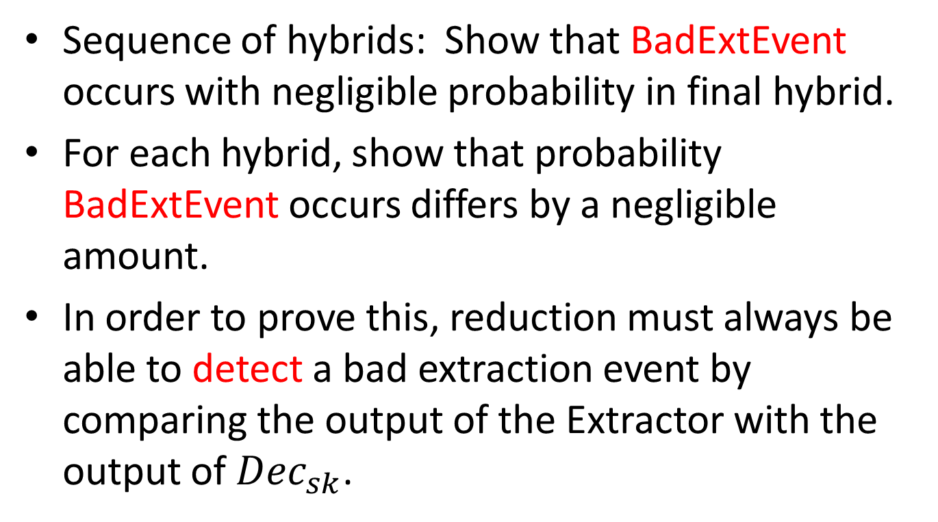
Proof Intuition
Sequence of hybrids: Show that BadExtEvent occurs with negligible probability in final hybrid.
For each hybrid, show that probability BadExtEvent occurs differs by a negligible amount.
In order to prove this, reduction must always be able to detect a bad extraction event by comparing the output of the Extractor with the output of $Dec_{sk}$.

Slide 16

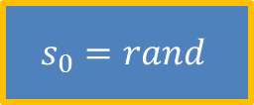


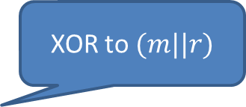
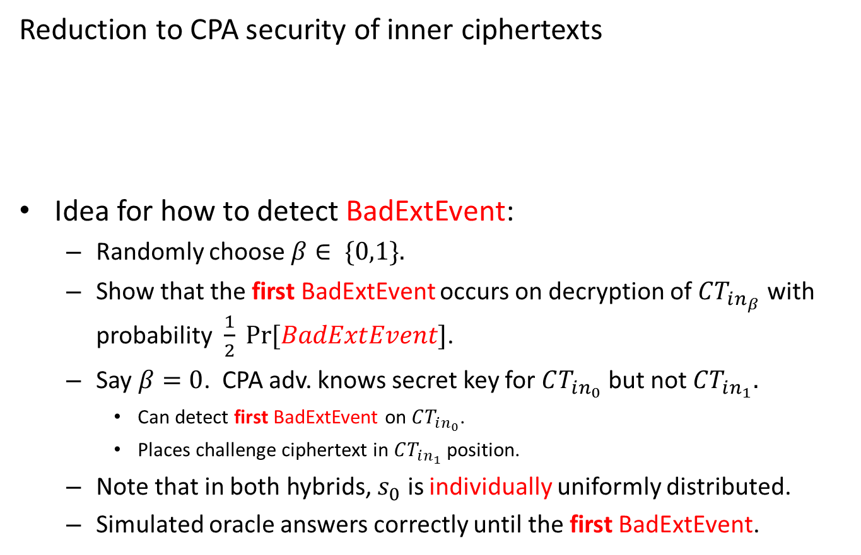
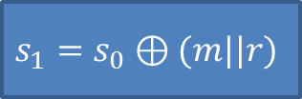






Hard Case:
Detecting BadExtEvent in CPA hybrid
XOR to random
XOR to $(m||r)$
Reduction to CPA security of inner ciphertexts
Idea for how to detect BadExtEvent:
  Randomly choose $β∈ \{0,1\}.$
  Show that the first BadExtEvent occurs on decryption of $CT_{in_{β}}$ with probability $\frac{1}{2} Pr⁡[BadExtEvent]$.
  Say $β=0$. CPA adv. knows secret key for $CT_{in_{0}}$ but not $CT_{in_{1}}.$
    Can detect first BadExtEvent on $CT_{in_{0}}$.
    Places challenge ciphertext in $CT_{in_{1}}$ position.
  Note that in both hybrids, $s_{0}$ is individually uniformly distributed.
  Simulated oracle answers correctly until the first BadExtEvent.
$$s_{0}=rand$$
$$≈$$
$$s_{0}=rand$$
$$s_{1}=rand$$
$$s_{0}=rand$$
$$s_{0}=rand$$
$${s_{1}=s}_{0}⊕(m||r)$$
$$C{T_{in_{0}}^{}}^{∗}$$
$$C{T_{in_{1}}^{}}^{∗}$$
$$C{T_{in_{0}}^{}}^{∗}$$
$$C{T_{in_{1}}^{}}^{∗}$$

Slide 17
Future Directions
Can high-level proof techniques be useful for constructing CCA2 from CCA1?
  Non-black-box use of the adversary.
  Detecting a “bad event” without fully simulating the decryption oracle.
Can we reduce the underlying assumptions of our construction?

Slide 18
Thank you!

