Slide 1
Efficient Public-Key Distance Bounding
Handan kılınç and Serge vaudenay

Slide 2
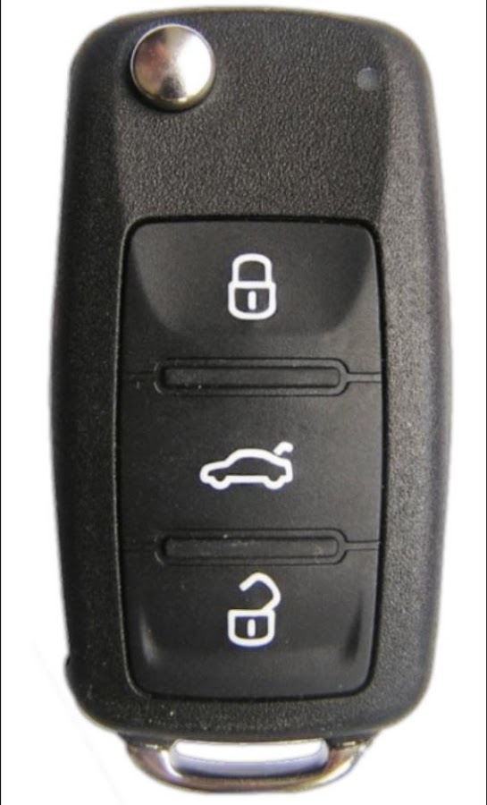
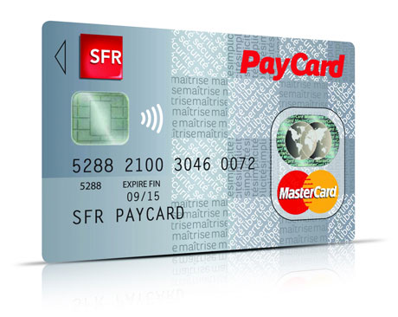
Introduction

Slide 3
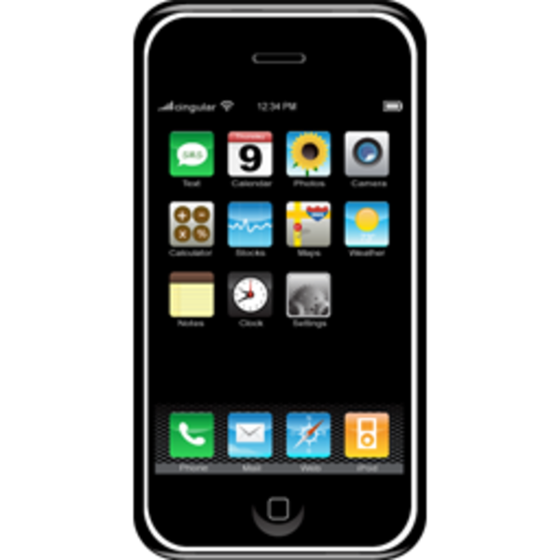
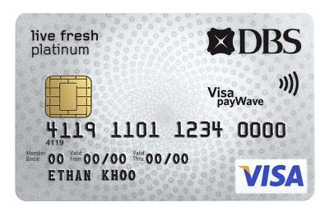
Relay Attack
Cartman
(Adversary)
Cartman
(Adversary)
Butters
(Victim)
Cartman’s Friend

Slide 4
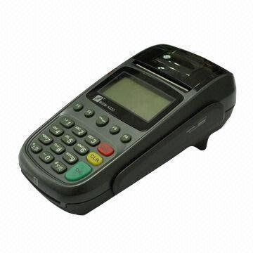
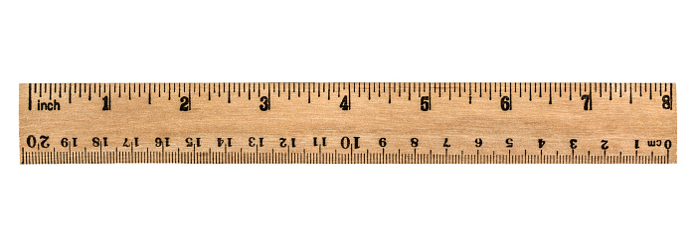
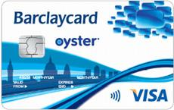
Distance Bounding
Introduced by Brands and Chaum
Verifier
Prover
The prover authenticates and proves its proximity to the verifier.

Slide 5
Distance Bounding
Symmetric Distance Bounding: The prover and verifier share a secret
Public-key Distance Bounding: The prover has the public-key of the verifier The verifier has the public-key of the prover

Slide 6
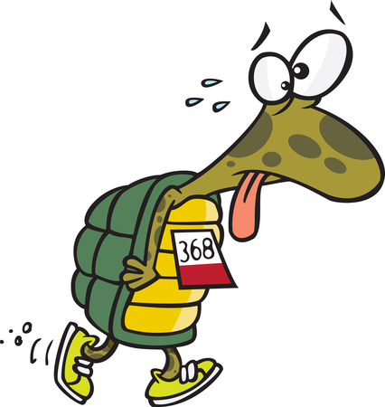
Problems in Public-key DB
Slower than symmetric key operations
Limited computational resources on the devices
Construct an efficient and secure public-key distance bounding

Slide 7
Formal Definitions for Security and Privacy
Weak Authenticated Key Agreement
Our Protocols: Eff-pkDB and Eff-pkDB private
Conclusion

Slide 8
Public-key Distance Bounding
Global Value: B (distance bound)
Key Generation Algorithms
Verifier Algorithm
Prover Algorithm
$$K_{V}$$
$$K_{P}$$
$$V(sk_{V}, pk_{V})$$
$P(sk_{P},pk_{P},pk_{V}$)
($sk_{V},pk_{V})$
$$(sk_{P},pk_{P})$$
$$Out_{V}$$
$Out_{V}$ = 0, reject
$Out_{V}$ = 1, accept

Slide 9
Man-in-the-middle (MiM) Security Honest and far-away prover and adversary
$$K_{P} → (sk_{P},pk_{P}),K_{V} → (sk_{V} ,pk_{V} )$$
$pk_{P}$, $pk_{V}$
A
If $Out_{V_{i}}$ = 1 and $pk_{P}$
A wins
negligible
$$P_{i}$$
B
$$P$$
A
A
$$V$$
$$V_{1}$$
A
…
$$V_{2}$$
$$V_{i}$$
$$V_{n}$$
A
A
$$P_{1}$$
$$P_{n}$$

Slide 10
Distance Fraud (DF) Security Malicious and far-away prover
$$K_{V} → (sk_{V} ,pk_{V} )$$
$$pk_{V}$$
A = P genkeys($pk_{V}$)→$(sk_{P},pk_{P})$
If $Out_{V_{i}}$ = 1 and $pk_{P}$
P wins
negligible
$$P_{i}$$
B
$$P$$
$$V$$
$$V_{1}$$
$$P_{2}$$
…
$$V_{2}$$
$$V_{i}$$
$$V_{n}$$
$$P_{1}$$
$$P_{n}$$

Slide 11
Distance Hijacking (DH) Security Malicious and far-away prover and honest and close prover
$$K_{V} → \left(sk_{V} ,pk_{V} \right)$$
$$K_{P} → (sk_{P′},pk_{P′})$$
$$pk_{V}, pk_{P′}$$
A = P genkeys($pk_{V},pk_{P′}$)→($sk_{P},pk_{P})$
If $Out_{V_{i}}$ = 1 and $pk_{P}$
P wins
negligible
$$P_{i}$$
B
$$P$$
$$P_{1}^{′}$$
$$P_{i}^{′}$$
$$V$$
$$V_{1}$$
$$P_{2}$$
…
$$V_{2}$$
$$V_{i}$$
$$V_{n}$$
$$P_{n}^{′}$$
$$P’$$
$$P_{1}$$
$$P_{n}$$

Slide 12
Strong Privacy (HPVP Model)
$P_{1},P_{2},…,P_{n}$ and A
A can corrupt the provers: learns the secret keys of the provers.
As a challenge, A picks two provers $P_{i},P_{j}$.
Challenger picks one of them as a virtual tag and gives the virtual prover to A.
A can send messages to the virtual tag.
A can send messages to the verifier.
If A can recognize the virtual tag, then he wins the game.
A DB protocol is strong private if A wins the above game with a negligible advantage.

Slide 13
An Overview of Our Protocol
Verifier
Prover
$${sk}_{V},pk_{V}$$
$${sk}_{P},pk_{P}, pk_{V}$$
KA | Efficiency | Security
MQV | 2.5 | No proof
HMQV | 2.5 | CK
KEA+ | 3 | CK
NAXOS | 4 | eCK
CMQV | 3 | eCK
Agree on a key s with using
Key Agreement (KA) Protocol
Run a symmetric-key DB with s
What kind of security properties do we need for the key agreement protocol to have MiM, DF and DH secure and strong private DB protocol?

Slide 14
Formal Definitions for Security and Privacy
Weak Authenticated Key Agreement
Our Protocols: Eff-pkDB and Eff-pkDB private
Conclusion

Slide 15
Authenticated Key Agreement (one pass)
$${sk}_{A},pk_{A}, pk_{B}$$
$${sk}_{B},pk_{B}, pk_{A}$$
$$N$$
$N←D(1^{n})$
$$B({sk}_{B},pk_{B},pk_{A},N)$$
$$A({sk}_{A},pk_{A},pk_{B},N)$$
$$s$$
$$s$$

Slide 16
Decisional-Authenticated Key Agreement (D-AKA)
Challenger
Adversary
Generate $\left({sk}_{A}, pk_{A}\right), \left(sk_{B},pk_{B}\right)$
Pick $s_{1}$
Pick $b∈\{0,1\}$
$s_{b}$,$N, pk_{B},pk_{A}$
$$pk_{A}$$
${Oracle}_{B}$(.)
N$←D(1^{n})$
run B$({sk}_{B},pk_{B},.,N)$
It can access the oracles except $(pk_{B},N)$
$$N,s_{0}$$
$$b^{′}$$
${Oracle}_{A}$(.,.)
$A({sk}_{A},pk_{A},.,.)$
If $b^{′}=b$
It wins

Slide 17
D-AKA Privacy Game
Challenger
Adversary
Generate $\left({sk}_{A}, pk_{A}\right), \left(sk_{B_{1}},pk_{B_{1}}\right)$
Pick $b∈\{0,1\}$
$N←D(1^{n})$,
$s=B(s{k_{B}}_{b},p{k_{B}}_{b},pk_{A},N)$
$$pk_{A},s{k_{B}}_{1}, p{k_{B}}_{1}$$
$$s{k_{B}}_{0},p{k_{B}}_{0}$$
$$s$$
Pick $s{k_{B}}_{0},p{k_{B}}_{0}$
${Oracle}_{A}$(.,.)
$A({sk}_{A},pk_{A},.,.)$
$$b^{′}$$
If $b^{′}=b$
It wins

Slide 18
Nonce-DH D-AKA secure and private key agreement protocol
Public parameter $G$ order of $q$ and $g∈G$
$${sk}_{A}∈ ℤ_{q}$$
$$pk_{A}=g^{sk_{A}}$$
$${sk}_{A},pk_{A}, pk_{B}$$
$${sk}_{B},pk_{B}, pk_{A}$$
$${sk}_{B}∈ ℤ_{q}$$
$$pk_{B}=g^{sk_{B}}$$
$$N$$
KA | Efficiency | Security
MQV | 2.5 | No proof
HMQV | 2.5 | CK
KEA+ | 3 | CK
NAXOS | 4 | eCK
CMQV | 3 | eCK
Nonce-DH | 1 | D-AKA
Pick $N∈{\left\{0,1\right\}}^{ℓ}$
$$s=H(g,pk_{B},pk_{A}, pk_{A}^{sk_{B}},N)$$
$$s=H(g,pk_{B},pk_{A}, pk_{B}^{sk_{A}},N)$$
Nonce-DH is D-AKA secure and private in the random oracle model
assuming that Gap Diffie-Hellman problem is hard.

Slide 19
Formal Definitions for Security and Privacy
Weak Authenticated Key Agreement
Our Protocols: Eff-pkDB and Eff-pkDB private
Conclusion

Slide 20
Eff-pkDB
Verifier
Prover
$${sk}_{V},pk_{V}$$
$${sk}_{P},pk_{P}, pk_{V}$$
$$N, pk_{P}$$
$$s=A({sk}_{V},pk_{V},pk_{P},N)$$
$N←D(1^{n})$
$$s=B({sk}_{P},pk_{P},pk_{V},N)$$
symDB($s$)
Out

Slide 21
Security of Eff-pkDB
MiM Security: If symDB is multi-verifier OT-MiM secure and the key agreement protocol is D-AKA secure, the Eff-pkDB is MiM-secure.
DF Security: If symDB is OT-DF-secure, then Eff-pkDB is DF-secure.
DH security: If symDB is OT-MiM-secure, OT-DH-secure and if the key agreement protocol is D-AKA secure then Eff-pkDB is DH-secure.

Slide 22
Strong-Private variant of Eff-pkDB
Verifier
Prover
$${sk}_{V},pk_{V}$$
${sk}_{P},pk_{P}, pk_{V}$= ($pk_{V_{1}},pk_{V_{2}})$
$$e$$
$$N,pk_{P}=Dec_{sk_{V_{1}}}(e)$$
$$s=A\left({sk}_{V},pk_{V},pk_{P},N\right)$$
$pk_{P}$ is private output
$N←D(1^{n})$
$e=Enc_{pk_{V_{1}}}\left(N,pk_{P}\right)$
$s=B({sk}_{P},pk_{P},pk_{V},N)$
symDB($s$)
Out
22

Slide 23
Strong-privacy of the variant of Eff-pkDB
Assuming the key agreement protocol is D-AKA-private and the cryptosystem is IND-CCA secure, then the variant of Eff-pkDB is strong private in HPVP model.

Slide 24
An instance of Eff-pkDB Nonce-DH+OTDB
$${sk}_{V}∈ ℤ_{q}$$
$$pk_{V}=g^{sk_{V}}$$
$${sk}_{V},pk_{V}, pk_{P}$$
Public parameter $G$ order of $q$ and $g∈G$
$${sk}_{P},pk_{P}, pk_{V}$$
$${sk}_{P}∈ ℤ_{q}$$
$$pk_{P}=g^{sk_{P}}$$
$N$, $pk_{P}$
$$s=H\left(g,pk_{P},pk_{V}, pk_{P}^{sk_{V}},N\right)$$
pick $N_{V}∈{\left\{0,1\right\}}^{2n}$
$a=N_{V}⨁s$
start timer
end timer
check if $∀i rtt_{i}<2B$ and
$r_{i}$is correct
Pick $N∈{\left\{0,1\right\}}^{ℓ}$
$$s=H\left(g,pk_{P},pk_{V}, pk_{V}^{sk_{P}},N\right)$$
$a=N_{V}⨁s$
$r_{i}=a_{2i+c_{i}}$
$$N_{V}$$
for $i = 0$to $n$
$$c_{i}$$
$$r_{i}$$
Out

Slide 25
Formal Definitions for Security and Privacy
Weak Authenticated Key Agreement
Our Protocols: Eff-pkDB and Eff-pkDB private
Conclusion

Slide 26
Conclusion
Protocol | Security | Privacy | PK Operation | Number of Computations
Brands-Chaum | MiM, DF | No privacy | 1 commitment, 1 signature | 1 EC multiplication, 2 hashing, 1 modular inversion, 1 random string selection
HPO (Hermans et al.) | MiM, DF | Weak |  | 4 EC multiplication, 2 random string selections, 2 mappings
PrivDB (Vaudenay) | MiM, DF, DH | Strong | 1 signature, 1 IND-CCA encryption | 3 EC multiplication, 2 hashing, 2 random string selections, 1 symmetric key encryption, 1 modular inversion, 1mapping, 1 MAC
ProProx (Vaudenay) | MiM, DF, DH, TF | No Privacy | n+1 commitment, n ZK proofs
eProProx (Vaudenay) | MiM, DF, DH, TF | Strong | 1 encryption, n+1 commitments, n ZK proofs
Eff-pkDB | MiM, DF, DH | No Privacy | 1 D-AKA secure KA protocol | 1 EC multiplication, 2 hashing, 1 random string selection,
Private Variant of Eff-pkDB | MiM, DF, DH | Strong | 1 IND-CCA encryption, 1 D-AKA secure KA protocol | 3 EC multiplication, 2 hashing, 2 random string selections, 1 symmetric key encryption, 1 MAC
* ECDSA for the signature scheme and ECIES for the IND-CCA secure encryption scheme

Slide 27
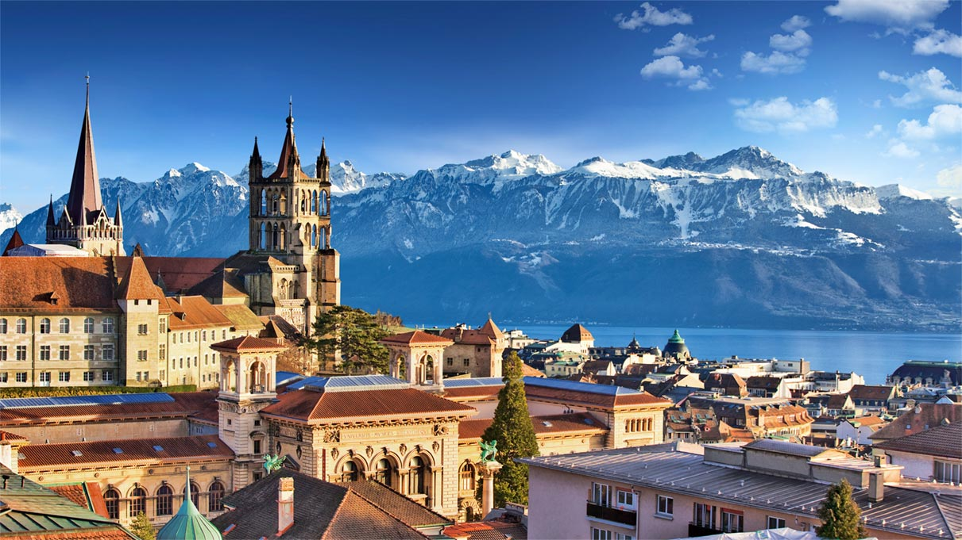
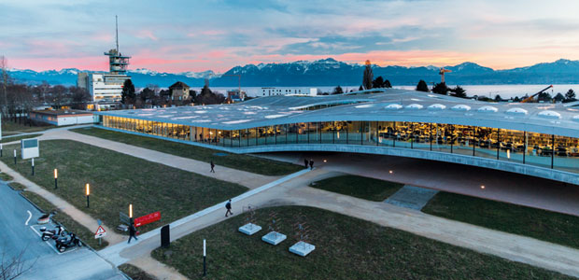
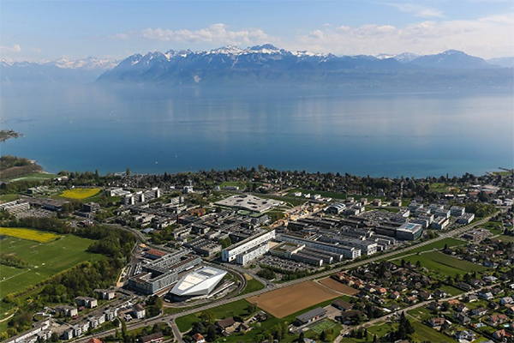
LASEC-EPFL is searching for post-docs
Contact: job_lasec@epfl.ch

