Slide 1

More Powerful and Reliable Second-level
Statistical Randomness Tests
for NIST SP 800-22
Speaker: ShuangYi Zhu
Notes:
Hello, everyone! My name is zhushuangyi， from institute ['ɪnstɪ.tju:t] of information engineering, Chinese Academy [ə'kædəmi] of Sciences(CAS).
I am honored to have the chance to be here.
Our paper's title is More Powerful and Reliable Second-level Statistical Randomness Tests for NIST SP 800-22.
I do this work with the help of my teacher 马原，林璟锵 and 荆继武.

Slide 2

Outline
Background
  Hypothesis test
  NIST SP 800-22
Contents and contributions
  Problem of P-values
  A new metric Q-value and its advantages
  Some experiments
Conclusion
Notes:
My talk will be divided into the following three parts.
Background
contents and contributions
Conclusion

Slide 3
Background
RNGs play an important role in many cryptographic applications
Statistical tests are widely employed to assess the quality of the RNG outputs.
  “Black-box” test , know nothing about the generator.
The National Institute of Standards and Technology (NIST) SP 800-22 test suite is one of the most commonly used statistical test suite.
Notes:
As we all known, Random Number Generators(RNGs) paly an important role in many cryptographic ['krɪptəʊ'græfɪk] applications .
Statistical tests are widely employed to assess the quality of the RNG outputs, which is a kind of black-box test.
The NIST SP 800-22 test suite is one of the most commonly used statistical test suite.
In FIPS and AIS, only basic tests are included, and the required data amount is only 20000 bits. That is, these test suites only test one block of 20000 bits, while NIST performs two-level tests for multiple long blocks by assessing the passing ratio and the uniformity of P-values, thus has much higher detectability

Slide 4

NIST SP 800-22
Null Hypothesis: the RNG outputs are random.
NIST SP 800-22 test suite consists of 15 test items
The whole sequence is divided into N sequence blocks, Compute a statistic and a P-value for each sequence block in each test item.
Compare P-value with the significance level $α$.
  If P-value$≥$ $α$, this block passes the test
  If P-value $<$ $α$, this block fails the test
Then do first-level test and second-level test.
Notes:
When we start a statistical test. First we have to make a null hypothesis.
And then we analysis the data through statistical methods under the null hypothesis. Finally we decide to accept or reject the null hypothesis .
In this test suite, the null hypothesis is : the RNG outputs have perfect randomness.
There are 15 test items to verify the null hypothesis from different aspects.
The whole sequence are divided into N sequence blocks,
In each test item, we calculate a statistic and a P-value for each block.
Then we compare P-value with the significance level $α$.
If one’s P-value is larger or equal to$α$, we think this block pass this test item.
If not, we draw the opposite conclusion
Then we do the first-level test and second-level test.

Slide 5
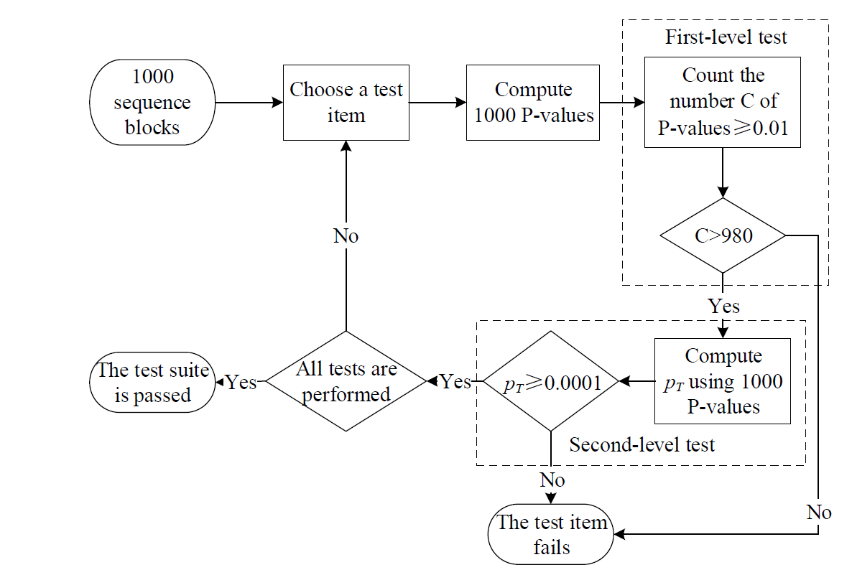
Test procedure
Notes:
next I will give a introduction of the test procedure.
First，lets assume that the whole sequences are divided into 1000 sequence blocks.
Then choose a test item and compute one thousand P-values.
With these P-values, do the first and second-level tests.
The first-level test check the pass rate of the 1000 blocks.
The second-level test check the uniformity of these 1000 P-values by calculate a new P-value called PT from these 1000 P-values.
If Pt is less than one ten thousandth. The second-level test fails.
If any one fails, the RNG is considered not good.

Slide 6
NIST SP 800-22
Test item type
  Binomial distribution based type (binomial-based test )
    Frequency Test
    Runs Test
    Spectral Test
    …
  Chi-square distribution based type (Chi-square-based test )
    Frequency Test within a Block
    Test for Longest Run of Ones in a Block
    Binary Matrix Rank Test
    …
Notes:
Here I should add that each test item has its own test statistic.
According to their statistics’ distribution, these test items are divided into two types: Binomial distribution based type and Chi-square distribution based type.
Our contribution is about the binomial-based type.

Slide 7
Our contribution
P-value of the binomial-based tests are unqualified for the second-level test.
We propose a new metric Q-value for the second-level tests to replace the original P-value, only for binomial-based tests.
We prove that using Q-value for the second-level tests increases the test capability.
We do experiments to confirm our conclusion.
Notes:
Now I will talk about our contribution.
we find that the P-values derived from the binomial-based tests are unqualified for the second-level tests,
though they are proper to be used for the first-level tests.
we propose a new metric called Q-value to replace
the original P-value without any extra modication.
We prove that using Q-value for the second-level tests increases the test capability.
And in the end We do experiments to confirm our conclusion.

Slide 8

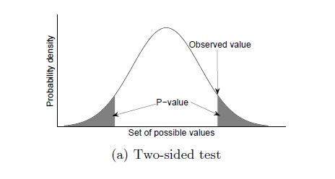
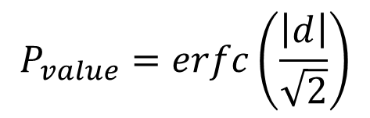
Why P-value is unqualified
statistic value d of binomial-based test obeys a standard normal distribution.
$$P_{value}=erfc\left(\frac{\left|d\right|}{\sqrt{2}}\right)$$
Notes:
Next I will show you Why P-value is unqualified for binomial-based test.
Since the statistic d of binomial-based test obey a standard normal distribution, the P-value is showed in the figure and compute using the absolute value of d.
The problem comes from using absolute value.

Slide 9
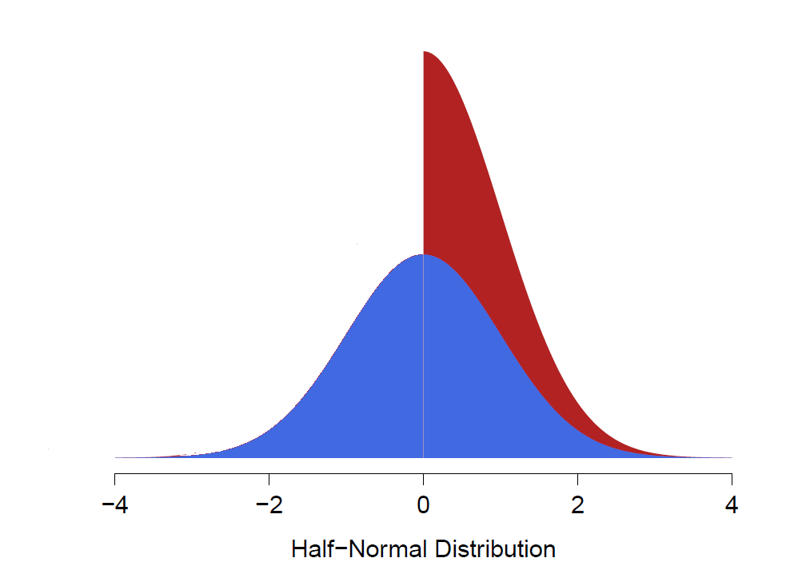
Why P-value is unqualified
P-value obeys an uniform distribution on [0，1]
State 1
|d| obeys Half-Normal Distribution
State 2
d obeys a standard normal distribution
State 3
Tested sequence has good randomness
State 4
Notes:
To better understand this problem , I show the logical relationship of four states about binomial-based test.
State 1 means P-value obeys an uniform distribution on 0 to 1.
State 2 means the absolute value of d obeys Half-Normal Distribution.
Well the Half-Normal Distribution is showed in the figure, the red one is Half-Normal Distribution and the blue one is standard normal distribution.
State 3 means d obeys a standard normal distribution.
State 4 means Tested sequence have good randomness that is our Null Hypothesis.
We can see that state 1 and 2 are equal. State 3 and 4 are equal.
But State 2 and 3 are not equal. This is the problem.

Slide 10

Why P-value is unqualified
We construct a biased sequence which can pass the NIST test suite.
Steps:
  1. Generate a random bit sequence which can pass the
  test suite. For example, use the Blum-Blum-Shub generator.
  2. Perform the Frequency Test, calculate the statistic ${d }_{i}$ of the $i^{th}$ block (i = 1,…,N). For each i, if ${d }_{i}$ is less than zero (i.e., 0's are more than 1's), perform a bitwise NOT (negation) on the sequence block; otherwise, keep the block unchanged.
The processed sequence is significantly biased, as the number of “1” is larger than that of “0” in all blocks.
Notes:
now I will give an example to show how this problem affects testing.
We construct a biased sequence which can passes the NIST test suite, in following steps.
1. Generate a random bit sequence which can pass the
test suite. For example, use the Blum-Blum-Shub generator (BBS) which
is acknowledged as a good PRNG.
2. For each block, if the number of 0's is more than that of 1's, perform a bitwise NOT
(negation) on this block; otherwise, keep the block unchanged.
It is obvious that the processed sequence is significantly biased, as the number of “1” is larger than that of “0” in all blocks.

Slide 11
Why P-value is unqualified
However, the processed sequence still has a very high probability to pass the test suite due to “0" and “1" have equal roles in the evaluation of randomness.
Test whose P-values keep unchanged
Block Frequency Test
Cumulative Sums Test
Runs Test
Spectral Test
Universal Test
Approximate Entropy Test
Serial Tests Test
Notes:
However, the processed biased sequence ,still has a very high probability to pass the test suite ,due to “0" and “1" have equal roles in the evaluation of randomness

Slide 12
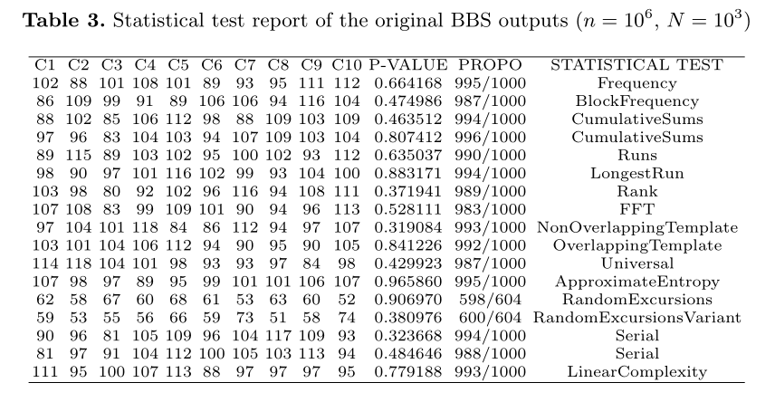
Why P-value is unqualified
Notes:
This table is the original BBS outputs test report from our paper,
note that all pt is larger than one ten thousandth.
we can see that the original outputs pass all the tests.

Slide 13
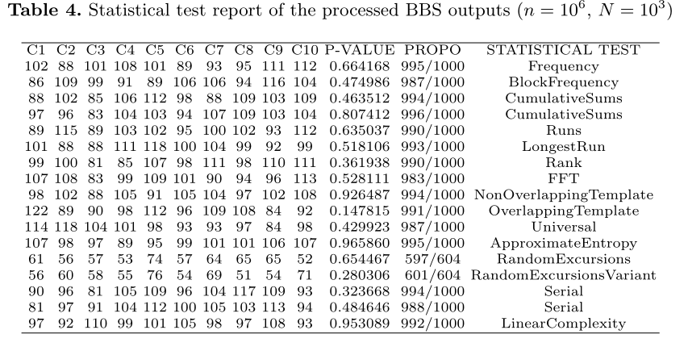
Why P-value is unqualified
Notes:
And this table is the report of the processed BBS outputs.
We can see that it also pass the test suite, though it’s biased.

Slide 14

Q-value
We propose a new metric Q-value to address this problem.
What is Q-value.
  ${Q }_{value}=1−Φ\left(d\right)=\frac{1}{2}erfc\left(\frac{d}{\sqrt{2}}\right)$
  $P_{value}=erfc\left(\frac{\left|d\right|}{\sqrt{2}}\right)$
The other test procedures keep unchanged.
Notes:
We propose a new metric Q-value to address this problem.
Q-value is derived directly from statistic d.
This is very natural since the problem comes from using the absolute value,
so we abandon absolute value.
We check the uniformity of Q-values instead of P-values.
The other test procedures keep unchanged.

Slide 15
Q-value
New logical relationship
Q-value obeys an uniform distribution on [0，1]
State 1
d obeys a standard normal distribution
State 2
Tested sequence has good randomness
State 3
Notes:
Then the new logical relationship become this.
All the states are eaqual.
So the problem is solved.

Slide 16
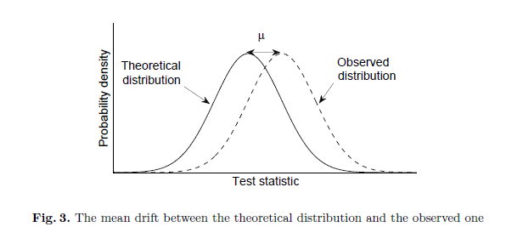
Improvement of test capability
Q-value based second-level test is more powerful than the P-value based one to detect a mean drift of the statistic.
We choose Kullback-Leibler divergence (KLD) and total variation distance (TVD) as the measurements of the sensitivity.
Notes:
And further more we find the Q-value improve the testing capability.
For example, Sometimes the observed distribution of statistic d is inconsistent with the theoretical one.
,there exists a mean drift like the figure shows.
Either an error in the computation formula or flawed data can cause a mean drift.
We find that Q-value based second-level test is more powerful than the P-value based one to detect this mean drift.
We choose Kullback.-Leibler divergence (KLD) and total variation distance (TVD) as the measurements of the sensitivity

Slide 17



Improvement of test capability
$f\left(x\right)$: PDF of standard normal distribution.
$f_{μ}\left(x\right):$PDF of standard normal distribution with a mean drift µ
$g\left(x\right):$PDF of Half-Normal distribution
$g_{μ}\left(x\right)$:PDF of Half-Normal distribution with a mean drift µ
KLD:
TVD:
Notes:
Here is some definition:
And the computation formula of KLD and TVD.

Slide 18
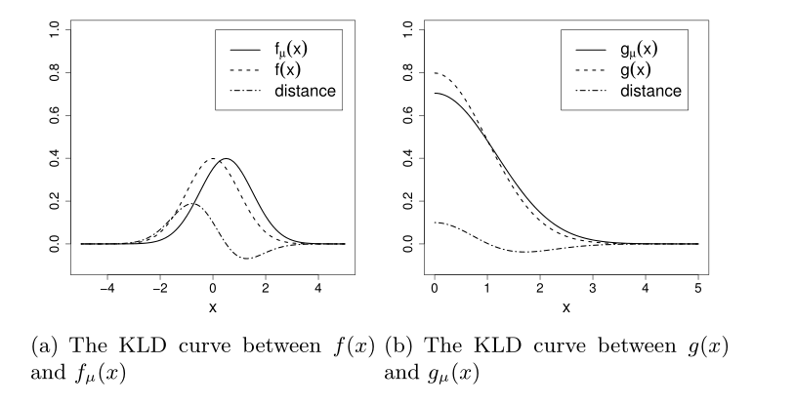
KLD
Notes:
When use the KLD as the measurement,
We can see from the picture that the gap between f(x) and fu(x) is larger than that between g(x) and gu(x).

Slide 19
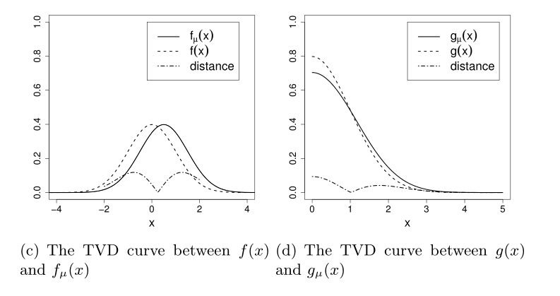
TVD
Notes:
TVD has the same result.
So we can say Q-value is more sensitive to the mean drift.

Slide 20
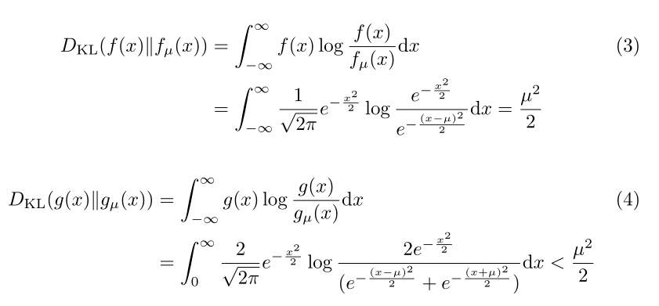
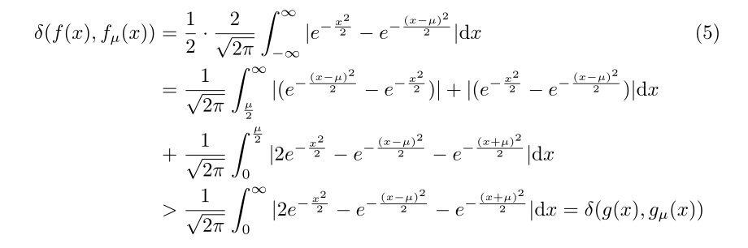
Improvement of test capability
Notes:
We have proved it in theory.
Here we just skip the details.

Slide 21
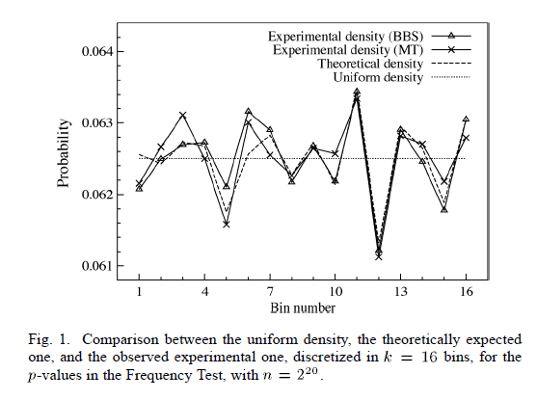
Actual Distribution
When n is infinite, P-values obey uniform distribution.
But in fact, n is limited, so the actual distribution of P-values is discrete..
Notes:
Another improvement is about the actual distribution.
When n is infinite, P-values obey uniform distribution.
But in fact, n is limited, so the actual distribution of P-values is discrete.
Next I will illustrate this.
All the following figures are from Frequency test.
In this figure, the dotted line is the PDF of uniform distribution,
The dashed line is that of theoretical actual distribution.
The other lines are experiment data.
From this figure we can see, there exists difference between uniform distribution and actual distribution.
And the experiment data confirm this.

Slide 22
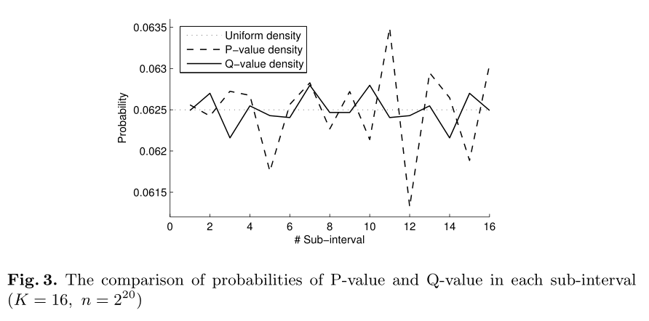
Actual Distribution
Q-value based second-level tests also have actual distribution. But it’s closer to uniform distribution than P-value based one.
Notes:
Q-value also have actual distribution.
And we find it’s closer to uniform distribution than P-value.
In this figure,
the solid line represents the actual distribution of Q-value, and the dashed line represents that of P-value.
We can see that the Q-value one is closer to the uniform distribution.

Slide 23
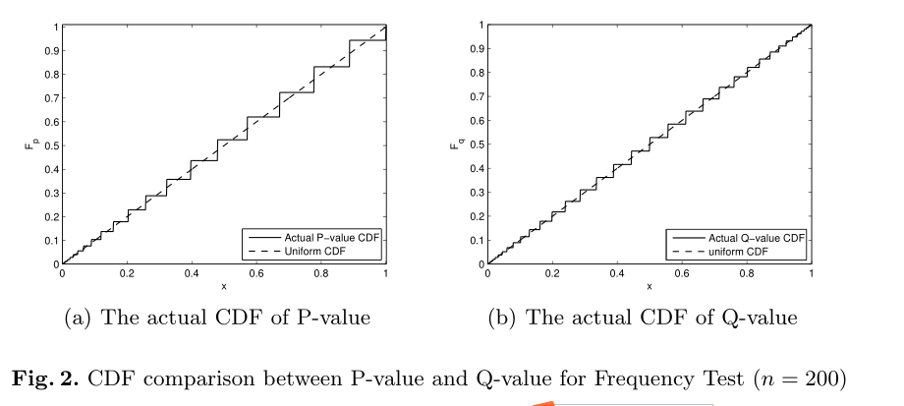
Actual Distribution
Compare between CDF
Notes:
In order to see the difference clearly, we compare the cumulative distribution functions between P-value and Q-value with the parameter n equals 200.
Which means one block only have 200 bits
It is obvious that the Q-value one is smoother.

Slide 24
Experiment on PRNG
We do the Q-value based test on the following PRNGs
      Blum Blum Shub Generator (BBS)
  Linear Congruential Generator (LCG)
  Modular Exponentiation Generator (MODEXPG)
  Micall-Schnorr Generator (MSG)
Test parameters: n = 10^6， N=1000 (recommended in NIST)
The seed of PRNG is the default value in NIST test suite
Notes:
Next is about some experiments to confirm our discovery.
We do the Q-value based test on the following PRNGs.
And the results support our conclusion.
Because of time constraint, I skip over this part.
The seed of PRNG is the default value in NIST test suite.

Slide 25
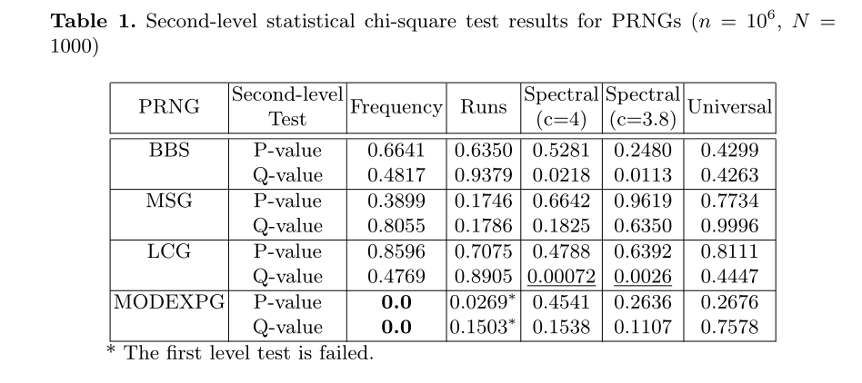

Experiment on PRNG
Notes:
For MODEXPG, the Frequency Test fails either for P-value and Q-value.
For BBS, MSG and LCG, all test are passed for both P-value and Q-value.
However, the Q-value's result of LCG in the Spectral Test becomes very small (0.0007), which indicates that the test statistics are not well consistent with the standard normal distribution.

Slide 26
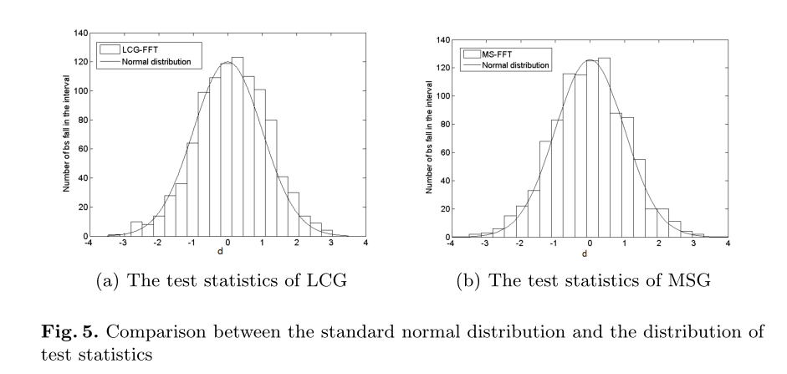
Compare with normal distribution
Notes:
In order to find the reason, we compare the distribution of test statistics with standard normal distribution.
We find the distribution of LCG drift to the right. This explain why the result is very small.
And For MSG, the distribution has better consistency with the standard normal distribution.

Slide 27
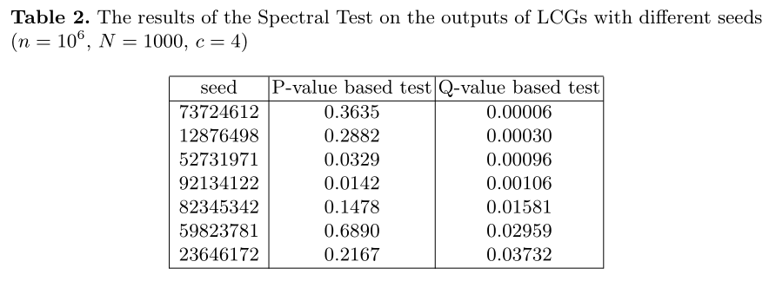
LCG with different seeds
Notes:
We test the LCG with different seeds to confirm this discovery.
We find the Q-value based test results are almost very small.

Slide 28
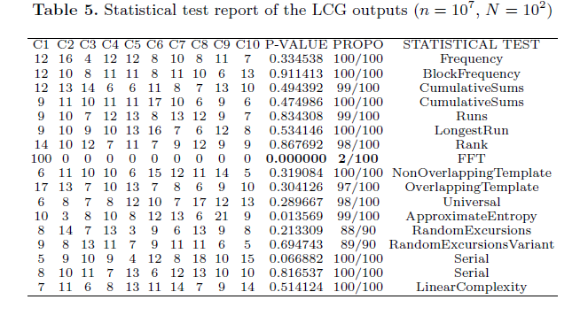
Using longer block
Notes:
Using longer block can increase the testing capability.
So we set n as ten billion to test the same sequence from LCG.
And we can see that the tested sequence fails the FFT test (that is Spectral test).

Slide 29
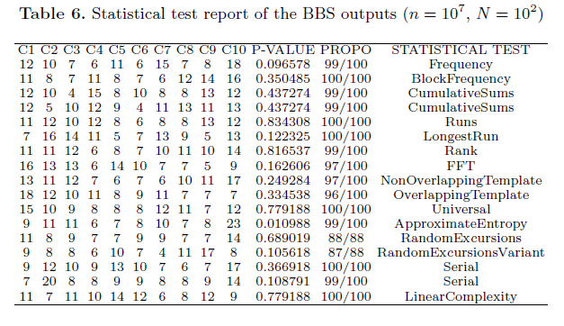
Using longer block
Notes:
For comparison, we also set n as ten billion to test the sequence from BBS.
and the test is still passed.
So we can confirm that the Q-value-based test improve the test capability.

Slide 30
Conclusion
We find the flaw in P-value based second-level test and
provide Q-value based one to replace.
We prove the rationality of Q-value.
We prove Q-value increase the test capability.
  We prove that the Q-value based second-level test is more sensitive to the mean drift.
  We calculate the actual distribution of Q-value and find it is closer to the uniform distribution.
We test the PRNGs' outputs to confirm our discovery.

Slide 31

Thanks !
Notes:
Thank you, That's all and more details are in the paper.
And, all questions are welcome.

