Slide 1
Nonlinear Invariant Attack
Practical Attack on Full SCREAM, iSCREAM, and Midori64
December 4--8, 2016 @Asiacrypt2016
Yosuke Todo^{1,3}, Gregor Leander², Yu Sasaki¹
1: NTT Secure Platform Laboratories, Japan
2: Ruhr-Universität Bochum, Germany
3: Kobe University, Japan
Notes:
Name: Position: My research topics.

Slide 2
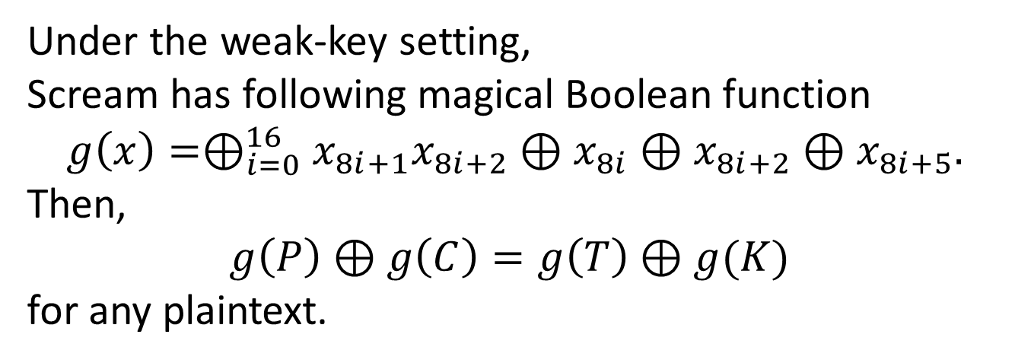
What happened by new attack?
Secret key (K) and tweak(T)
Plaintex (P)
Ciphertext (C)
Under the weak-key setting,
Scream has following magical Boolean function
$$g\left(x\right)=⊕_{i=0}^{16}x_{8i+1}x_{8i+2}⊕x_{8i}⊕x_{8i+2}⊕x_{8i+5}.$$
Then,
$g\left(P\right)⊕g\left(C\right)=g\left(T\right)⊕g(K)$
for any plaintext.

Slide 3
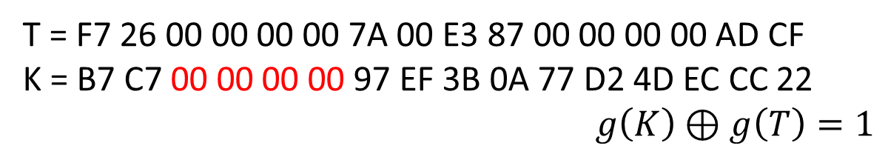
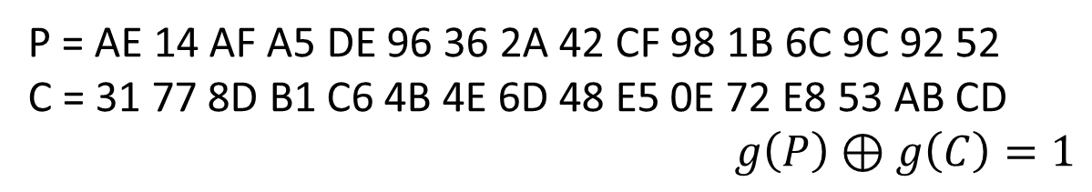
What happened by new attack?
Secret key (K) and tweak(T)
Plaintex (P)
Ciphertext (C)
Example
T = F7 26 00 00 00 00 7A 00 E3 87 00 00 00 00 AD CF
K = B7 C7 00 00 00 00 97 EF 3B 0A 77 D2 4D EC CC 22
$g\left(K\right)⊕g\left(T\right)=1$
P = AE 14 AF A5 DE 96 36 2A 42 CF 98 1B 6C 9C 92 52
C = 31 77 8D B1 C6 4B 4E 6D 48 E5 0E 72 E8 53 AB CD
$g\left(P\right)⊕g\left(C\right)=1$

Slide 4
Overview of nonlinear invariant attack
Nonlinear Invariant Attack
New type of attacks.
Nonlinear approximation is used under the weak-key setting.
Practical, i.e., ciphertext-only message recovery attack under reasonable assumptions.
Application to
SCREAM CAESAR 2nd round candidate
iSCREAM CAESAR 1st round candidate
Midori64 Proposal of Asiacrypt2015

Slide 5
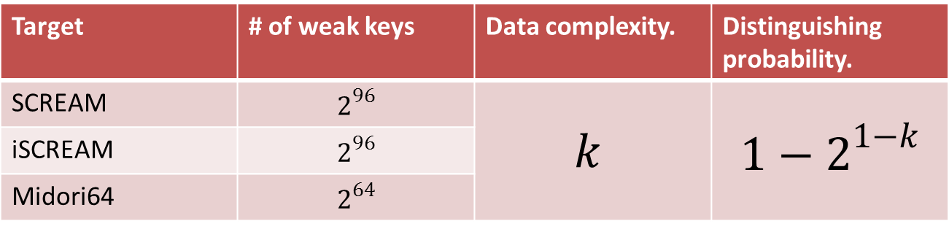
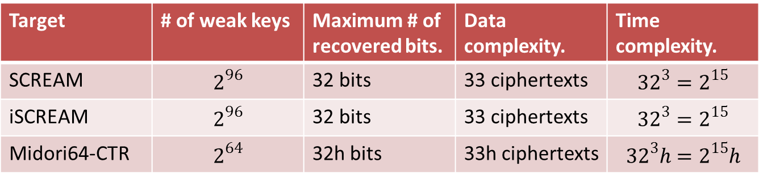
Summary of results
Distinguishing attack under known-plaintext setting.
Target | # of weak keys | Data complexity. | Distinguishing probability.
SCREAM | $$2^{96}$$ | $$k$$ | $${1−2}^{1−k}$$
iSCREAM | $$2^{96}$$
Midori64 | $$2^{64}$$
The distinguishing attack incidentally recovers 1 bit of secret key.
Message-recovery attack under ciphertext-only setting.
Target | # of weak keys | Maximum # of recovered bits. | Data complexity. | Time complexity.
SCREAM | $$2^{96}$$ | 32 bits | 33 ciphertexts | $${32}^{3}=2^{15}$$
iSCREAM | $$2^{96}$$ | 32 bits | 33 ciphertexts | $${32}^{3}=2^{15}$$
Midori64-CTR | $$2^{64}$$ | 32h bits | 33h ciphertexts | $${32}^{3}h=2^{15}h$$
$h$ is the number of blocks in the mode of operations.

Slide 6
Outline
Nonlinear invariant attack.
  Related works.
  Distinguishing attack.
Practical attack.
  What’s happened if vulnerable ciphers are used in well-known mode of operations?
How to find nonlinear invariant.
  Nonlinear invariant for KSP round functions.
Practical attack on full SCREAM.

Slide 7
Two streams join in new attacks
Linear attack
[Matsui 1993]
Nonlinear attack
[Harpes et al. 1995]
Invariant subspace attack
[Leander et al. 2011]
Nonlinear invariant attack [Todo et al. 2016]

Slide 8
Stream from linear attacks
Linear attack
[Matsui 1993]
Nonlinear attack
[Harpes et al. 1995]
Invariant subspace attack
[Leander et al. 2011]
Nonlinear invariant attack [Todo et al. 2016]

Slide 9

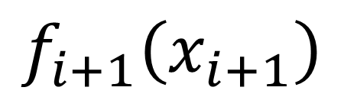
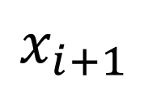
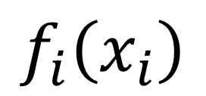
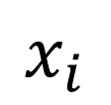
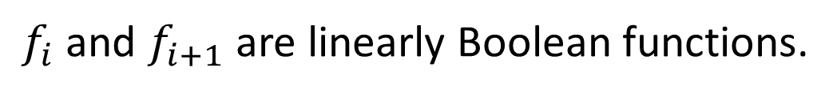

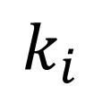
Linear attack [Matsui 93]
Key-alternating structure.
$$k_{i}$$
F
$$x_{i}$$
$$x_{i+1}$$
$$f_{i}\left(x_{i}\right)$$
$$f_{i}\left(x_{i}\right)⊕f_{i+1}\left(x_{i+1}\right)≈const$$
$$f_{i+1}\left(x_{i+1}\right)$$
with high probability.
next-round
$f_{i}$ and $f_{i+1}$ are linearly Boolean functions.

Slide 10
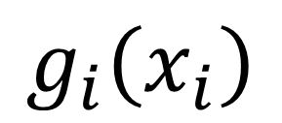
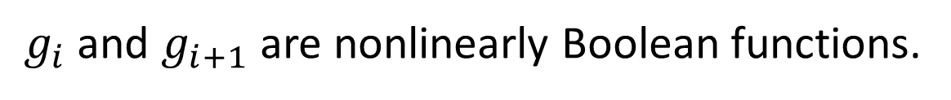

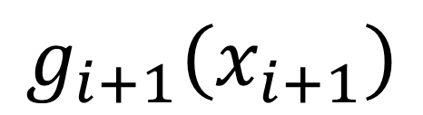
Nonlinear attack [Harpes et al.95]
Key-alternating structure.
$$k_{i}$$
F
$$x_{i}$$
$$x_{i+1}$$
$$g_{i}\left(x_{i}\right)$$
$$g_{i}\left(x_{i}\right)⊕g_{i+1}\left(x_{i+1}\right)≈const$$
$$g_{i+1}\left(x_{i+1}\right)$$
with high probability.
$g_{i}$ and $g_{i+1}$ are nonlinearly Boolean functions.
Notes:
The actual propagation of nonlinear mask depends on the specific value of the state.
Therefore, we cannot join nonlinear masks for two rounds.

Slide 11

Insurmountable problem
Key-alternating structure.
The probability for next round depends on the specific value.
$$k_{i}$$
F
$$x_{i}$$
$$x_{i+1}$$
$$g_{i}\left(x_{i}\right)$$
$$g_{i}\left(x_{i}\right)⊕g_{i+1}\left(x_{i+1}\right)≈const$$
$$g_{i+1}\left(x_{i+1}\right)$$
with high probability.
next-round
We cannot join nonlinear masks for two rounds.
Notes:
The actual propagation of nonlinear mask depends on the specific value of the state.

Slide 12

Nonlinear invariant attack
Key-alternating structure.
Alternatively, we limit the space of round keys.
$$k_{i}$$
F
$$x_{i}$$
$$x_{i+1}$$
$$g_{i}\left(x_{i}\right)$$
$$g_{i}\left(x_{i}\right)⊕g_{i+1}\left(x_{i+1}\right)=const$$
$$g_{i+1}\left(x_{i+1}\right)$$
with probability one.
next-round
$g_{i}$ and $g_{i+1}$ are nonlinearly Boolean functions.

Slide 13
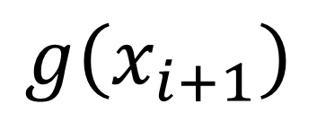
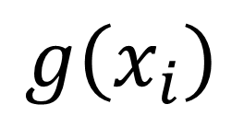

Appropriate nonlinear invariant
Key-alternating structure.
Alternatively, we limit the space of secret keys.
$$k_{i}$$
F
$$x_{i}$$
$$x_{i+1}$$
$$g\left(x_{i}\right)$$
$$g\left(x_{i}\right)⊕g\left(x_{i+1}\right)=const$$
$$g\left(x_{i+1}\right)$$
with probability one.
next-round
This property is preserved in any number of rounds,
if all round keys are weak.
Notes:
But, it troubles us to search for the list of nonlinear invariants. If gi is equal to gi+1, it’s trivially to hold this property with arbitrary number of rounds when all round keys are weak.

Slide 14
Stream from linear attacks
Linear attack
[Matsui 1993]
Nonlinear attack
[Harpes et al. 1995]
Invariant subspace attack
[Leander et al. 2011]
Nonlinear invariant attack [Todo et al. 2016]

Slide 15
Invariant subspace attacks
Key-alternating structure.
weak keys.
$$k_{i}$$
F
$$x_{i}$$
$$x_{i+1}$$
key-add
F
U+a
U+a
U+b
next-round

Slide 16






Nonlinear invariant attack
Key-alternating structure.
weak keys.
$$k_{i}$$
F
$$x_{i}$$
$$x_{i+1}$$
key-add
F
$$g→0$$
$$g→0$$
$$g→0$$
$$g→1$$
$$g→1$$
$$g→1$$
next-round

Slide 17
We don’t need to choose plaintexts
Key-alternating structure.
weak keys.
$$k_{i}$$
F
$$x_{i}$$
$$x_{i+1}$$
key-add
F
$$g→0$$
$$g→0$$
$$g→0$$
$$g→1$$
$$g→1$$
$$g→1$$
next-round
Notes:
The map turns over depending on the function F and key XORing.

Slide 18

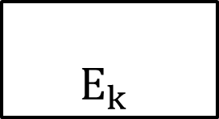


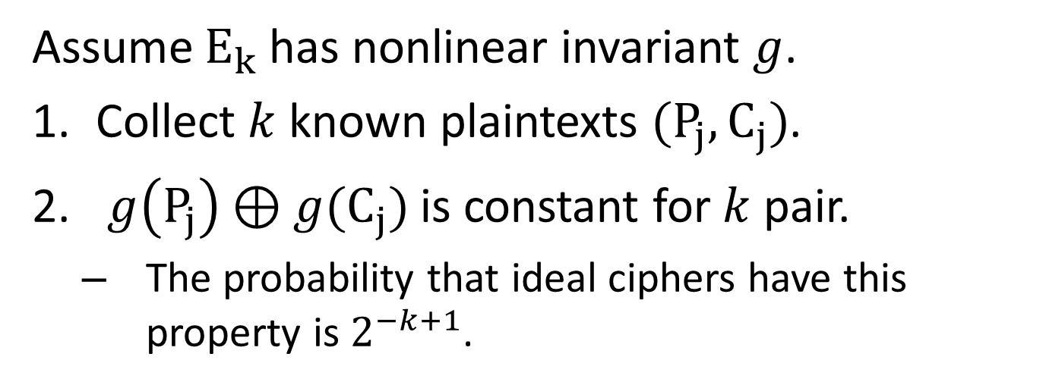
Distinguishing attacks
$$k$$
$$E_{k}$$
$$P_{j}$$
$$C_{j}$$
Assume $E_{k}$ has nonlinear invariant $g$.
Collect $k$ known plaintexts $(P_{j},C_{j})$.
$g\left(P_{j}\right)⊕g(C_{j})$ is constant for $k$ pair.
  The probability that ideal ciphers have this property is $2^{−k+1}$.

Slide 19
Outline
Nonlinear invariant attack.
  Related works.
  Distinguishing attack.
Practical attack.
  What’s happened if vulnerable ciphers are used in well-known mode of operations?
How to find nonlinear invariant.
  Nonlinear invariant for KSP round functions.
Practical attack on full SCREAM.

Slide 20
Attack assumptions
strong
Chosen-plaintext attacks (CPA)
is natural assumption for cryptographers.
is debatable in practical case.
Assumption.
Known-plaintext attacks (KPA)
is weaker assumption than CPA.
sometimes holds in practical case.
Ciphertext-only attacks (COA)
is unlikely to happen for cryptographers.
is information-theoretically impossible w/o assumptions.
causes non-negligible risks in practical use.
weak
Notes:
We use several attack assumptions. CPA is natural attack assumption for cryptographers, and if the target cipher is broken under this assumption, we call this cipher is broken. But, the feasibility is debatable in the practical case. KPA is weaker assumption than CPA and sometimes holds in practical case. Clearly, ciphertext-only attack is very weak assumption. And it’s unlikely to happen for cryptographers because it’s information-theoretically impossible w/o assumption. But if possible, it cases non-negligible risks in practical use.

Slide 21



Our attack assumptions
Attackers can collect multiple ciphertext blocks whose original message is the same but the IV is different.
Then, we can recover the part of message.
$$E_{k,IV1}$$
Ciphertext block
$$E_{k,IV2}$$
Plaintext
block
$$E_{k,IV3}$$
Ciphertext block
Ciphertext block

Slide 22
Is this assumption practical?
It’s very difficult questions because it depends on applications.
We believe it’s more practical than KPA.
Example of vulnerable application.
  Application sometimes sends the ciphertext of a password for the authentication. And, attackers know the behavior of the application.

Slide 23



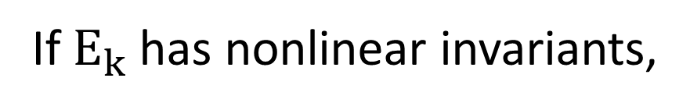


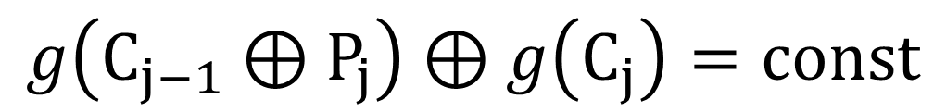

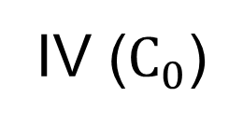


CBC mode
$$P_{1}$$
$$P_{2}$$
$$P_{3}$$
$$P_{h}$$
IV ($C_{0}$)
E
E
E
E
K
K
K
K
$$C_{1}$$
$$C_{2}$$
$$C_{3}$$
$$C_{h}$$
If $E_{k}$ has nonlinear invariants,
$$g\left(C_{j−1}⊕P_{j}\right)⊕g\left(C_{j}\right)=const$$

Slide 24
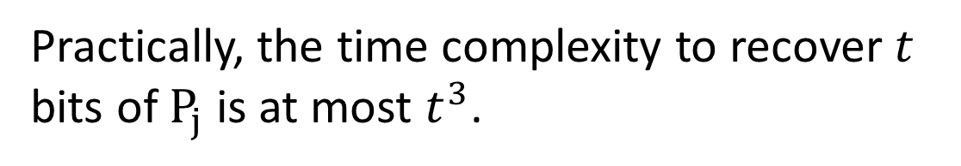
Message recovery attack
$$P_{1}$$
$$P_{2}$$
$$P_{3}$$
$$P_{h}$$
IV ($C_{0}$)
E
E
E
E
K
K
K
K
$$C_{1}$$
$$C_{2}$$
$$C_{3}$$
$$C_{h}$$
If $E_{k}$ has nonlinear invariants,
$$g\left(C_{j−1}⊕P_{j}\right)⊕g\left(C_{j}\right)=const$$
known
guess
known
Practically, the time complexity to recover $t$ bits of $P_{j}$ is at most $t^{3}$.

Slide 25
Outline
Nonlinear invariant attack.
  Related works.
  Distinguishing attack.
Practical attack.
  What’s happened if vulnerable ciphers are used in well-known mode of operations?
How to find nonlinear invariant.
  Nonlinear invariant for KSP round functions.
Practical attack on full SCREAM.

Slide 26
How to find nonlinear invariants
Assume that KSP-type round function.
S
S
L
S
S

Slide 27

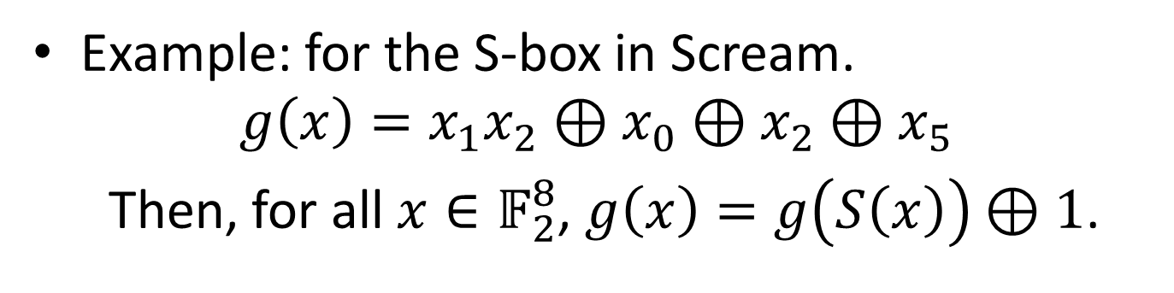
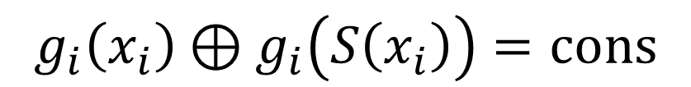



Nonlinear invariants for S-box
$$x_{1}$$
S
$$g_{i}\left(x_{i}\right)⊕g_{i}\left(S\left(x_{i}\right)\right)=cons$$
$$x_{2}$$
S
The size of S-box is generally small. So, it’s not difficult to find nonlinear invariant for one S-box.
L
$$x_{3}$$
S
$$x_{4}$$
S
Example: for the S-box in Scream.
$$g\left(x\right)=x_{1}x_{2}⊕x_{0}⊕x_{2}⊕x_{5}$$
Then, for all $x∈𝔽_{2}^{8}$, $g\left(x\right)=g\left(S\left(x\right)\right)⊕1$.

Slide 28
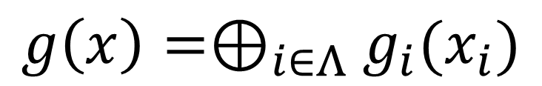
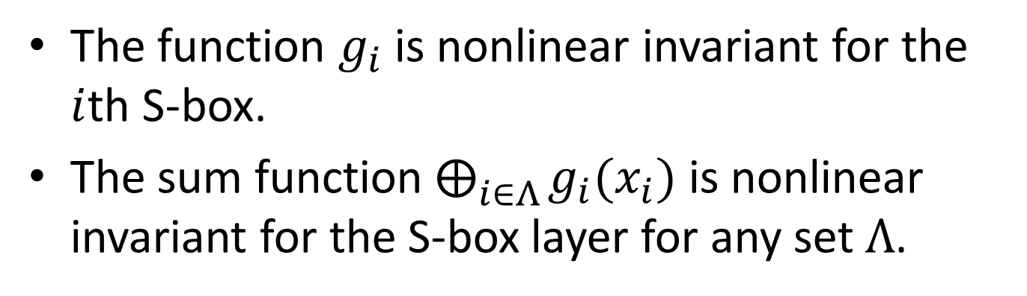
Nonlinear invariants for S-box layer
$$x_{1}$$
S
$$g_{i}\left(x_{i}\right)⊕g_{i}\left(S\left(x_{i}\right)\right)=cons$$
$$x_{2}$$
S
L
$$g\left(x\right)=⊕_{i∈Λ}g_{i}(x_{i})$$
$$x_{3}$$
S
$$x_{4}$$
S
The function $g_{i}$ is nonlinear invariant for the $i$th S-box.
The sum function $⨁_{i∈Λ}{g_{i}(x_{i})}$ is nonlinear invariant for the S-box layer for any set $Λ$.

Slide 29
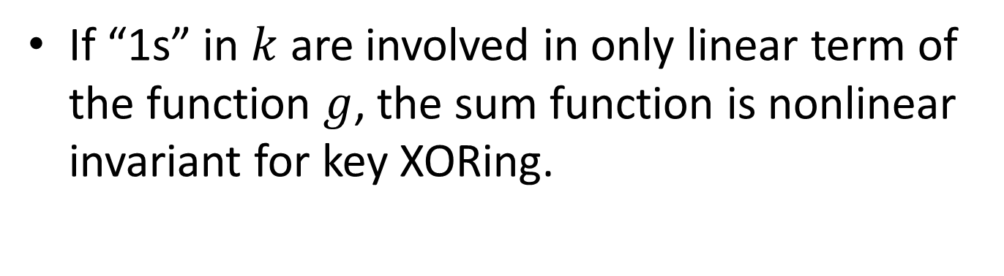
Nonlinear invariants for key XORing
$$x_{1}$$
S
$$g_{i}\left(x_{i}\right)⊕g_{i}\left(S\left(x_{i}\right)\right)=cons$$
$$x_{2}$$
S
L
$$g\left(x\right)=⊕_{i∈Λ}g_{i}(x_{i})$$
$$x_{3}$$
S
$$x_{4}$$
S
If “1s” in $k$ are involved in only linear term of the function $g$, the sum function is nonlinear invariant for key XORing.

Slide 30
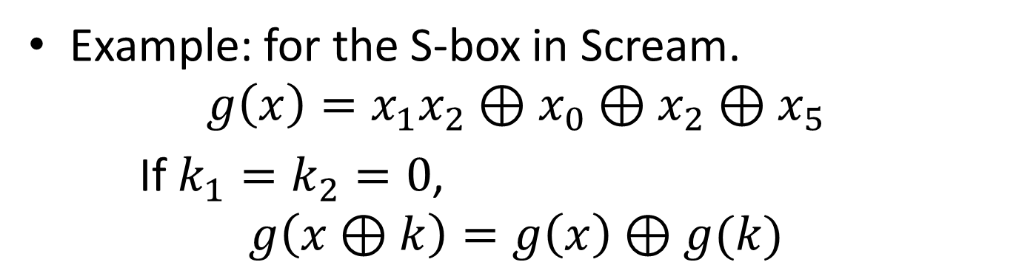
Nonlinear invariants for key XORing
$$x_{1}$$
S
$$g_{i}\left(x_{i}\right)⊕g_{i}\left(S\left(x_{i}\right)\right)=cons$$
$$x_{2}$$
S
L
$$g\left(x\right)=⊕_{i∈Λ}g_{i}(x_{i})$$
$$x_{3}$$
S
$$x_{4}$$
S
Example: for the S-box in Scream.
$$g\left(x\right)=x_{1}x_{2}⊕x_{0}⊕x_{2}⊕x_{5}$$
If $k_{1}=k_{2}=0$,
$$g\left(x⊕k\right)=g\left(x\right)⊕g(k)$$

Slide 31
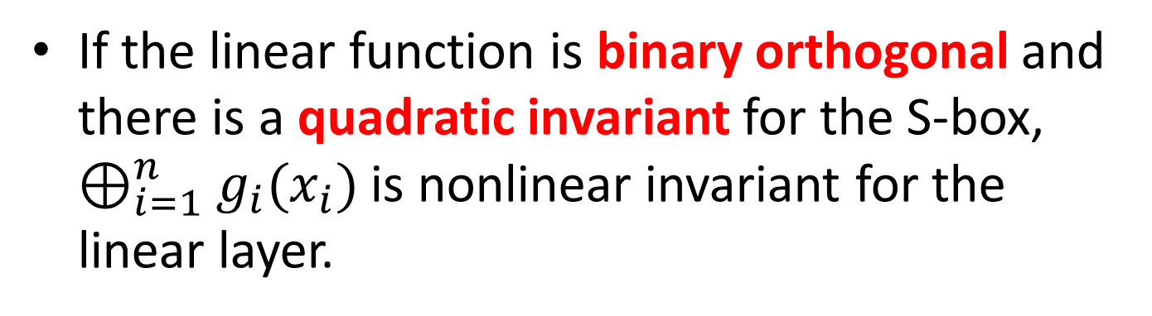
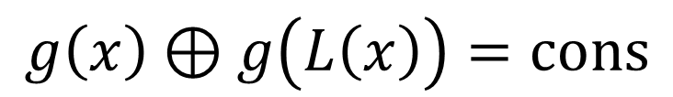
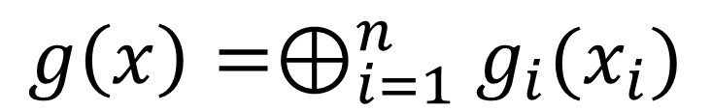
Nonlinear invariant for linear layer
$$x_{1}$$
S
$$g\left(x\right)⊕g\left(L\left(x\right)\right)=cons$$
$$x_{2}$$
S
L
$$g\left(x\right)=⊕_{i=1}^{n}g_{i}(x_{i})$$
$$x_{3}$$
S
$$x_{4}$$
S
If the linear function is binary orthogonal and there is a quadratic invariant for the S-box, $⊕_{i=1}^{n}g_{i}(x_{i})$ is nonlinear invariant for the linear layer.

Slide 32



Why binary orthogonal is weak?
When $g$ is quadratic and $M$ is binary orthogonal, we can exploit the invariance of Inner product.
$$g\left(L(x)\right)=⊕_{i=1}^{m}⊕_{j=1}^{m}γ_{i,j}〈{M\tilde{x}}_{i},{M\tilde{x}}_{j}〉$$
$=⊕_{i=1}^{m}⊕_{j=1}^{m}γ_{i,j}〈{\tilde{x}}_{i},{\tilde{x}}_{j}〉=g\left(x\right)$
Linear
$${\tilde{x}}_{i}$$
S-box
$$x_{i}$$
Notes:
The use of the orthogonal matrix is not rare because it’s very useful to get the dual property between differential and linear cryptanalyses.

Slide 33
Outline
Nonlinear invariant attack.
  Related works.
  Distinguishing attack.
Practical attack.
  What’s happened if vulnerable ciphers are used in well-known mode of operations?
How to find nonlinear invariant.
  Nonlinear invariant for KSP round functions.
Practical attack on full SCREAM.

Slide 34
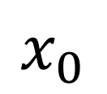
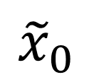
SCREAM
SCREAM perfectly follows our assumption.
  Orthogonal for duality of differential and linear.
  The nonlinear term is applied to 2nd and 3rd rows.
  The round constant is XORed with only 1st row.
  All round keys are the same as the secret key.
Linear
$${\tilde{x}}_{0}$$
S-box
$$x_{0}$$

Slide 35
Application to SCREAM AE
SCREAM authenticated encryption.
P
P
P
P
0
1
m
-2
m
-1
T
E
T
E
T
E
T
E
0
K
1
K
m
-2
K
m
-1
K
C
C
C
P
0
1
m
-2
m
-1
C
m
-1

Slide 36
Application to SCREAM AE
SCREAM authenticated encryption.
P
P
P
P
0
1
m
-2
m
-1
T
E
T
E
T
E
T
E
0
K
1
K
m
-2
K
m
-1
K
C
C
C
P
0
1
m
-2
m
-1
C
m
-1
$$g\left(|P_{m−1}|\right)⊕g\left(P_{m−1}⊕C_{m−1}\right)=const$$
known
guess
known

Slide 37
Conclusion
Proposal of nonlinear invariant attack.
How to find nonlinear invariants.
Application to Scream, iScream, and Midori64.
  We can recover the 32bits of message in the last block on SCREAM (iSCREAM) AEs.
  We can recover the 32bits of message in every block on CBC, CTR, CFB, OFB modes underlying Midori64.

