Slide 1






Multiparty Computation with Low Communication, Computation and Interaction via Threshold FHE
 | Bar-Ilan University | Gilad Asharov
 | UCLA | Abhishek Jain
 | NYU | Adriana López-Alt
 | Tel-Aviv University | Eran Tromer
 | University of Toronto | Vinod Vaikuntanathan
 | IBM Research | Daniel Wichs

Slide 2



2-Party Computation Using FHE
(semi-honest)
a
y = f(a,b)
b
A=Encrypt(a)
Y=Eval(f,A,B)
Y
Charlie
Sally
y

Slide 3
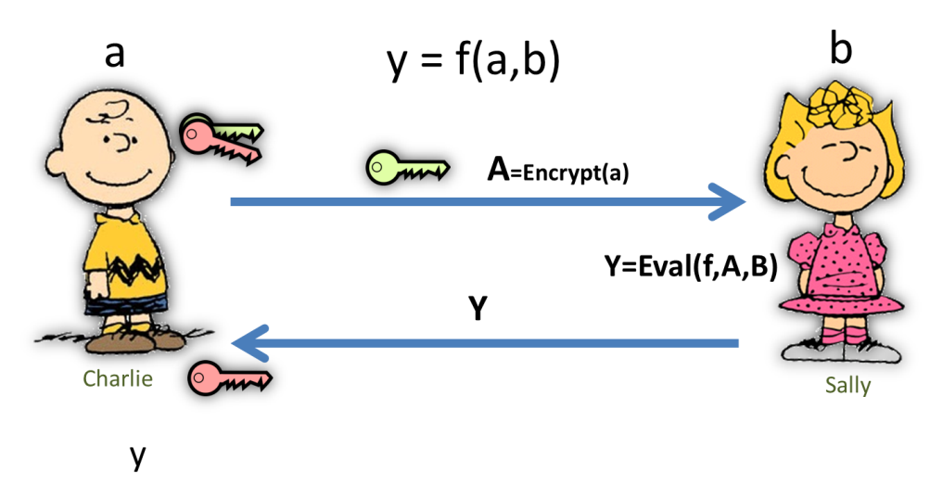
Advantages
Low round complexity
Low communication complexity
  Independent of the function f
  Independent of Sally’s input b
Low computation
  Charlie’s work is independent of f
A simple template
Can we get all these advantages in the multiparty case?

Slide 4


Threshold Key Generation
Key Generation

Slide 5

Threshold Key Generation
Key Generation

Slide 6
Input Encryption
a
b
A=Enc(a)
B=Enc(b)
A
B
C
D
C=Enc(c)
D=Enc(d)
c
d

Slide 7
Homomorphic Evaluation
A
B
C
D
A
B
C
D
Homomorphic Evaluation
Homomorphic Evaluation
Y
Y
Y
Y
Homomorphic Evaluation
Homomorphic Evaluation
A
B
C
D
A
B
C
D

Slide 8
Delegate to a Cloud
A
B
C
D
Homomorphic Evaluation
Y

Slide 9
Threshold Decryption
Y
Y
Dec
Y
Y

Slide 10
Threshold Decryption
m
m
Dec
m
m

Slide 11
MPC with Threshold FHE
Threshold Key Gen
Encrypt and Evaluate
Threshold Decryption

Slide 12
MPC with TFHE
Threshold Key Gen
Encrypt and Evaluate
Threshold Decryption
Threshold KeyGen and Threshold Dec can be implemented using generic MPC
Advantages:
  Low communication complexity (even in malicious)
  The homomorphic evaluation can be delegated / only one party
Disadvantages:
  Needs generic MPC techniques
  Round complexity can be high
Notes:
say in words: can't teach it in a class without teaching GMW first

Slide 13
Our Main Results
Threshold Key Gen
Encrypt and Evaluate
Threshold Decryption
Threshold KeyGen and Threshold Dec algebraically [BV11b, BGV12] (based on LWE)
Advantages:
  Low communication complexity (even in malicious)
  The homomorphic evaluation can be delegated / only one party
  Simple: there is no need for generic MPC protocol
  Extremely low round complexity
    Only 3 broadcast rounds (CRS model)
    2 rounds reusable PKI – optimal(!)
Notes:
say in words: can't teach it in a class without teaching GMW first

Slide 14
Our Main Results
(malicious)
Threshold Key Gen
Encrypt and Evaluate
Threshold Decryption
Threshold KeyGen and Threshold Dec algebraically [BV11b, BGV12] (based on LWE)
Advantages:
  Low communication complexity (even in malicious)
  The homomorphic evaluation can be delegated / only one party (assuming cs poofs / SNARGs)
  Simple: there is no need for generic MPC protocol
  Extremely low round complexity
    Only 3 broadcast rounds (CRS model)
    2 rounds reusable PKI – optimal(!)
  UC security (assuming UC-NIZK)
Notes:
say in words: can't teach it in a class without teaching GMW first

Slide 15
Related Work
[CramerDamgardNielsen01]– MPC using threshold HE
[Gentry09] – MPC using threshold FHE
[BendlinDamgard10] – threshold version for LWE
[KatzOstrovsky04] – lower bound of 5 rounds for MPC in the plain model
[MyersSergishelat11] – threshold version of [vDGHV10]

Slide 16


The LWE Assumption [Regev05]
  $\left(a_{i},b_{i}\right)←ℤ_{q}^{n+1}$
  $$\left(a_{i},b_{i}\right)$$
$s←ℤ_{q}^{n}$
$a_{i}$ $←$ $ℤ_{q}^{n}$
$e_{i}$ “small”
$b_{i}≔ 〈a_{i}, s〉+ e_{i}$
$$\left(a_{i},b_{i}\right)$$
Distribution 1
Distribution 2
also secure if q is odd and we choose noise to be small and even (2e instead e)

Slide 17
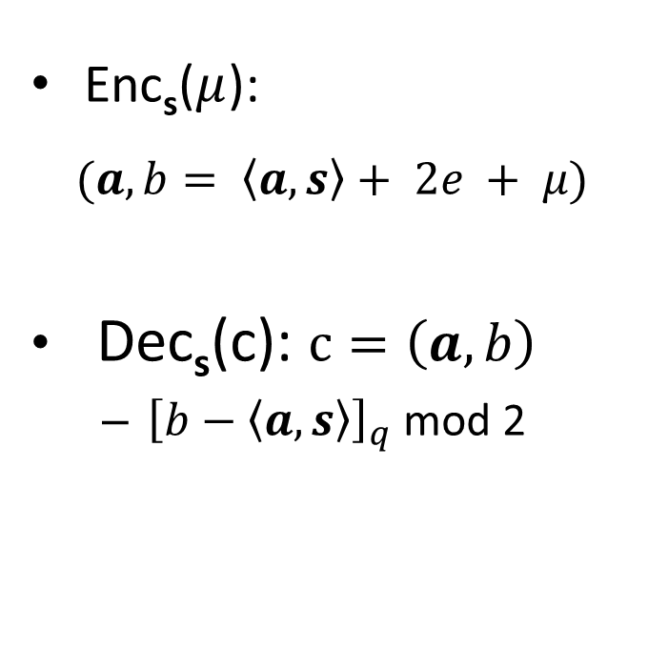
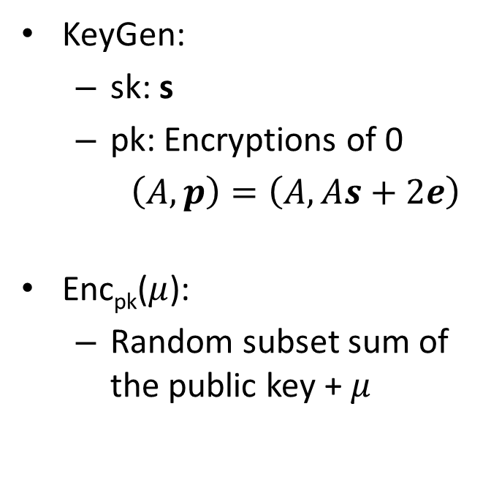
Basic LWE-Based Encryption
Enc_{s}($μ$):
$$(a,b= 〈a, s〉+ 2e + μ)$$
Dec_{s}(c): $c=\left(a,b\right)$
  ${\left[b−〈a, s〉\right]}_{q}$mod 2
KeyGen:
  sk: s
  pk: Encryptions of 0
  $\left(A,p\right)=\left(A,As+2e\right)$
Enc_{pk}($μ$):
  Random subset sum of the public key + $μ$
Symmetric Key
Public Key

Slide 18
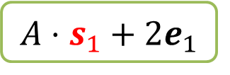
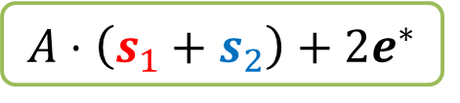
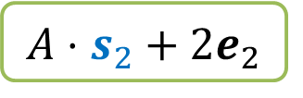
Key-Homomorphic Properties of the Basic Scheme
Two public keys, same “coefficient” A
$$A⋅s_{1}+2e_{1}$$
$$A⋅s_{2}+2e_{2}$$
$$A⋅\left(s_{1}+s_{2}\right)+2e^{∗}$$
A new public key with secret key: s₁+s₂, coefficient A
(almost the same as El-Gammal)

Slide 19
Threshold Key Generation
A
s₁
s₂
(A,p₁) = As₁+2e₁
(A,p₂) = As₂+2e₂
(A,p₃) = As₃+2e₃
(A,p₄) = As₄+2e₄
s₃
s₄

Slide 20
Threshold Key Generation
A
s₁
s₂
(A,p₁) = As₁+2e₁
(A,p₂) = As₂+2e₂
(A,p₃) = As₃+2e₃
(A,p₄) = As₄+2e₄
s₃
s₄

Slide 21
Threshold Key Generation
A
s₁
s₂
(A,p₁) = As₁+2e₁
(A,p₂) = As₂+2e₂
(A,p*)
(A,p₃) = As₃+2e₃
(A,p*)
(A,p₄) = As₄+2e₄
(A,p*)
(A,p*) = As*+2e*
(A,p*)
Joint secret key: s*=s₁+s₂+s₃+s₄
Joint public key: p*=p₁+p₂+p₃+p₄
s₃
s₄

Slide 22

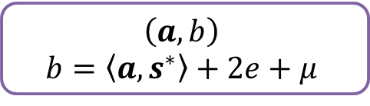




Threshold Decryption
$$\left(a,b\right)$$
$$b=〈a,s^{∗}〉+2e+μ$$
(${\left[b−〈a,s^{∗}〉\right]}_{q}$mod 2)
s₁
s₂
$$〈a,s_{1}〉+2e_{1}$$
$$〈a,s_{2}〉+2e_{2}$$
$$〈a,s_{3}〉+2e_{3}$$
$$〈a,s_{4}〉+2e_{4}$$
s₃
s₄

Slide 23
Threshold Decryption
$$\left(a,b\right)$$
$$b=〈a,s^{∗}〉+2e+μ$$
(${\left[b−〈a,s^{∗}〉\right]}_{q}$mod 2)
s₁
s₂
$$〈a,s_{1}〉+2e_{1}$$
$$〈a,s_{2}〉+2e_{2}$$
$$〈a,s_{3}〉+2e_{3}$$
$$〈a,s_{4}〉+2e_{4}$$
s₃
s₄

Slide 24







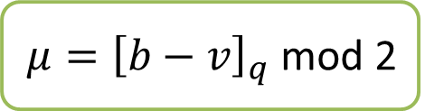



Threshold Decryption
$$\left(a,b\right)$$
$$b=〈a,s^{∗}〉+2e+μ$$
(${\left[b−〈a,s^{∗}〉\right]}_{q}$mod 2)
s₁
$$〈a,s_{1}〉+2e_{1}$$
s₂
$$〈a,s_{2}〉+2e_{2}$$
$$〈a,s_{3}〉+2e_{3}$$
$$μ$$
$$〈a,s_{4}〉+2e_{4}$$
$$μ$$
$$v=$$
$$〈a,s^{∗}〉+2e^{∗}$$
$$μ$$
$$μ$$
$μ={\left[b−v\right]}_{q}$mod 2
s₃
s₄
Notes:
say in words that this also reveals something about "e" and not just "u". Can get around it by making the errors e1,...,e4 much
larger to "drown out" the noise "e".

Slide 25

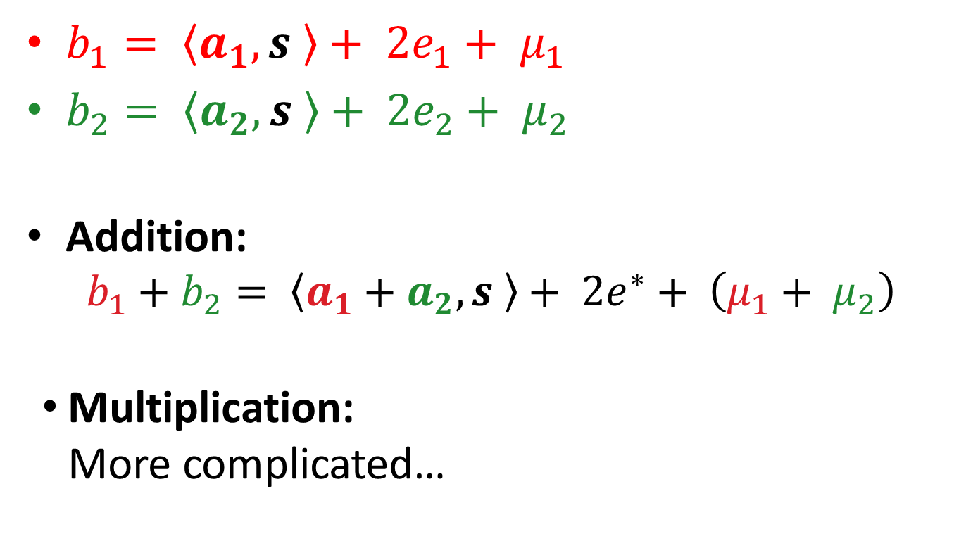
Basic LWE-Based Encryption – Homomorphism
$b_{1}= 〈a_{1}, s 〉+ 2e_{1}+ μ_{1}$
$b_{2}= 〈a_{2}, s 〉+ 2e_{2}+ μ_{2}$
Addition:
$b_{1}+b_{2}= 〈a_{1}+a_{2}, s 〉+ 2e^{∗}+ \left(μ_{1}+ μ_{2}\right)$
Multiplication:
More complicated…

Slide 26

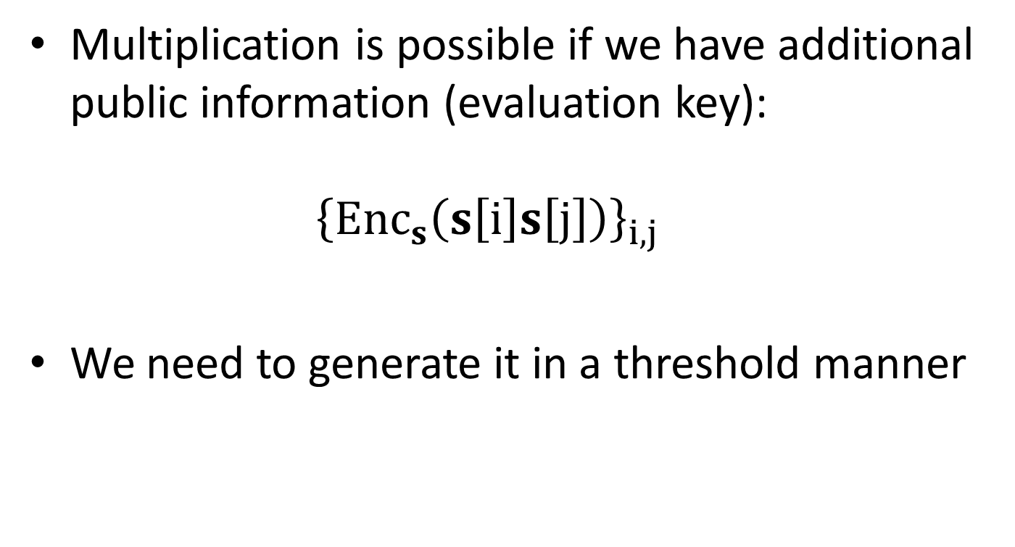
FHE From LWE [BV11b],[BGV12]
Multiplication is possible if we have additional public information (evaluation key):
${\left\{Enc_{s}\left(s\left[i\right]s\left[j\right]\right)\right\}}_{i,j}$
We need to generate it in a threshold manner
Simplified!

Slide 27
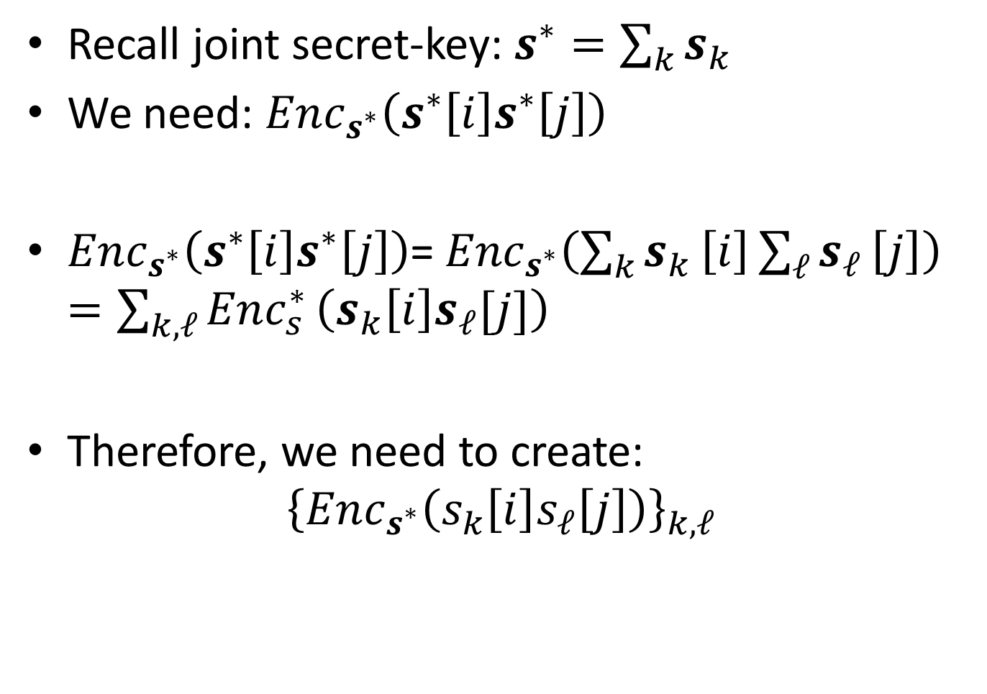
Evaluation Key
Recall joint secret-key: $s^{∗}=\sum_{k}{s_{k}}$
We need: $Enc_{s^{∗}}\left(s^{∗}\left[i\right]s^{∗}\left[j\right]\right)$
$Enc_{s^{∗}}\left(s^{∗}\left[i\right]s^{∗}\left[j\right]\right)$=$Enc_{s^{∗}}\left(\sum_{k}{s_{k}}\left[i\right]\sum_{ℓ}{s_{ℓ}}\left[j\right]\right)=\sum_{k,ℓ}{Enc_{s}^{∗}}\left(s_{k}\left[i\right]s_{ℓ}[j]\right)$
Therefore, we need to create:
${\left\{Enc_{s^{∗}}\left(s_{k}\left[i\right]s_{ℓ}\left[j\right]\right)\right\}}_{k,ℓ}$

Slide 28









Threshold KeyGen –Round 2
s₁
s₂
$$Enc_{s^{∗}}(s_{1}\left[1\right])$$
$$Enc_{s^{∗}}(s_{2}\left[1\right])$$
…
…
$$Enc_{s^{∗}}(s_{1}\left[n\right])$$
$$Enc_{s^{∗}}(s_{2}\left[n\right])$$
$$Enc_{s^{∗}}(s_{3}\left[1\right])$$
$$Enc_{s^{∗}}(s_{4}\left[1\right])$$
…
…
$$Enc_{s^{∗}}(s_{3}\left[n\right])$$
$$Enc_{s^{∗}}(s_{4}\left[n\right])$$
s₃
s₄

Slide 29








Threshold KeyGen – End Of Round 2
s₁
$$Enc_{s^{∗}}(s_{1}\left[1\right])$$
…
$$Enc_{s^{∗}}(s_{1}\left[n\right])$$
s₂
$$Enc_{s^{∗}}(s_{2}\left[1\right])$$
…
$$Enc_{s^{∗}}(s_{2}\left[n\right])$$
$$Enc_{s^{∗}}(s_{3}\left[1\right])$$
…
$$Enc_{s^{∗}}(s_{3}\left[n\right])$$
$$Enc_{s^{∗}}(s_{4}\left[1\right])$$
…
$$Enc_{s^{∗}}(s_{4}\left[n\right])$$
s₃
s₄

Slide 30










Threshold KeyGen – Round 3
s₁
$$Enc_{s^{∗}}(s_{1}\left[1\right])$$
…
$$Enc_{s^{∗}}(s_{1}\left[n\right])$$
s₂
$$Enc_{s^{∗}}(s_{2}\left[1\right])$$
…
$$Enc_{s^{∗}}(s_{2}\left[n\right])$$
$$Enc_{s^{∗}}(s_{3}\left[1\right])$$
…
$$Enc_{s^{∗}}(s_{3}\left[n\right])$$
$$Enc_{s^{∗}}(s_{k}\left[i\right]s_{1}[1])$$
$$Enc_{s^{∗}}(s_{k}\left[i\right]s_{2}[1])$$
…
$$Enc_{s^{∗}}(s_{4}\left[1\right])$$
…
$$Enc_{s^{∗}}(s_{4}\left[n\right])$$
…
$$Enc_{s^{∗}}(s_{k}\left[i\right]s_{1}[n])$$
$$Enc_{s^{∗}}(s_{k}\left[i\right]s_{2}[n])$$
$$Enc_{s^{∗}}(s_{k}\left[i\right])$$
$$Enc_{s^{∗}}(s_{k}\left[i\right]s_{3}[1])$$
$$Enc_{s^{∗}}(s_{k}\left[i\right]s_{4}[1])$$
…
…
$$Enc_{s^{∗}}(s_{k}\left[i\right]s_{ℓ}[j])$$
$$Enc_{s^{∗}}(s_{k}\left[i\right]s_{3}[n])$$
$$Enc_{s^{∗}}(s_{k}\left[i\right]s_{4}[n])$$
s₃
s₄

Slide 31
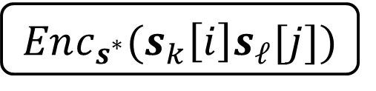
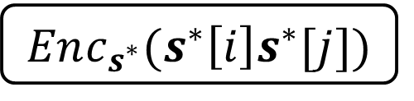
Threshold KeyGen – End Of Round 3
s₁
s₂
$$Enc_{s^{∗}}(s_{k}\left[i\right]s_{ℓ}[j])$$
$$Enc_{s^{∗}}(s^{∗}\left[i\right]s^{∗}[j])$$
s₃
s₄

Slide 32
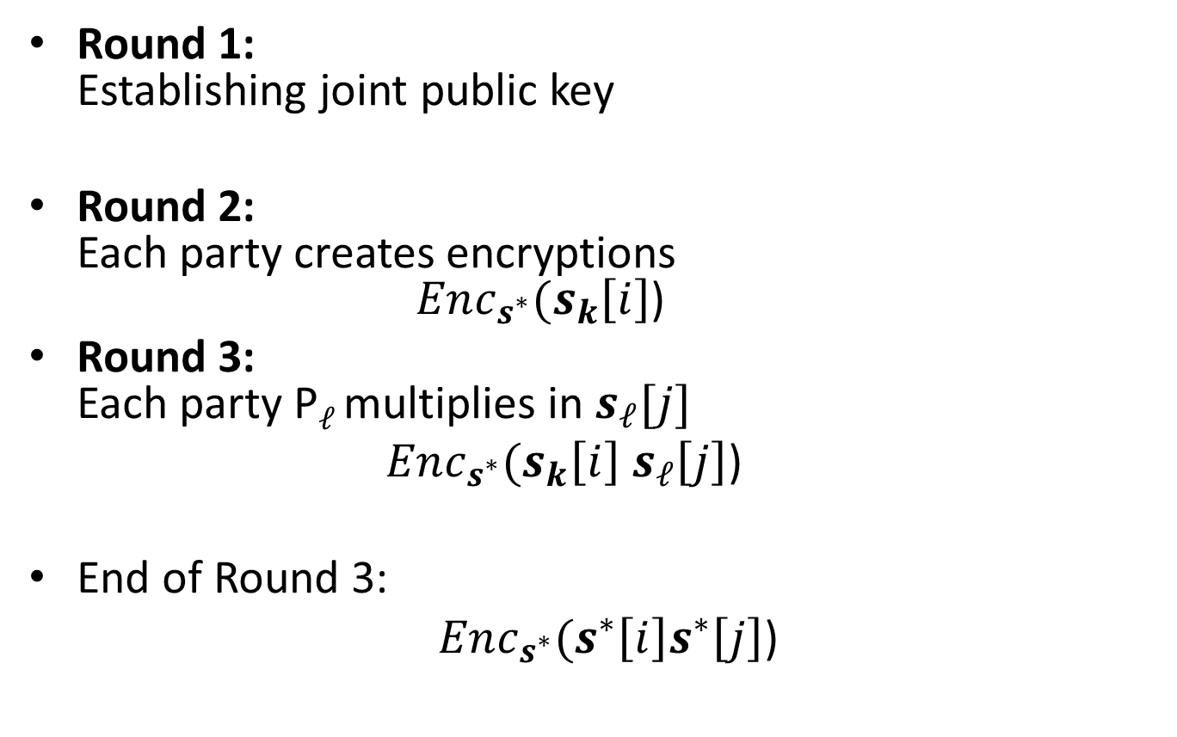
Threshold FHE - KeyGen
Round 1:
Establishing joint public key
Round 2:
Each party creates encryptions
$Enc_{s^{∗}}(s_{k}\left[i\right]$)
Round 3:
Each party P$ℓ$ multiplies in $s_{ℓ}[j]$
$Enc_{s^{∗}}(s_{k}\left[i\right]$ $s_{ℓ}\left[j\right]$)
End of Round 3:
$Enc_{s_{}^{∗}}(s^{∗}\left[i\right]s^{∗}\left[j\right]$)
one round!

Slide 33
The MPC Protocol
Threshold KeyGen (2 rounds)
  Round 1: Creates public key
  Round 2: Creates evaluation key
The parties encrypt their inputs (sent concurrently with round 2 of KeyGen)
Threshold Dec (1 round)

Slide 34
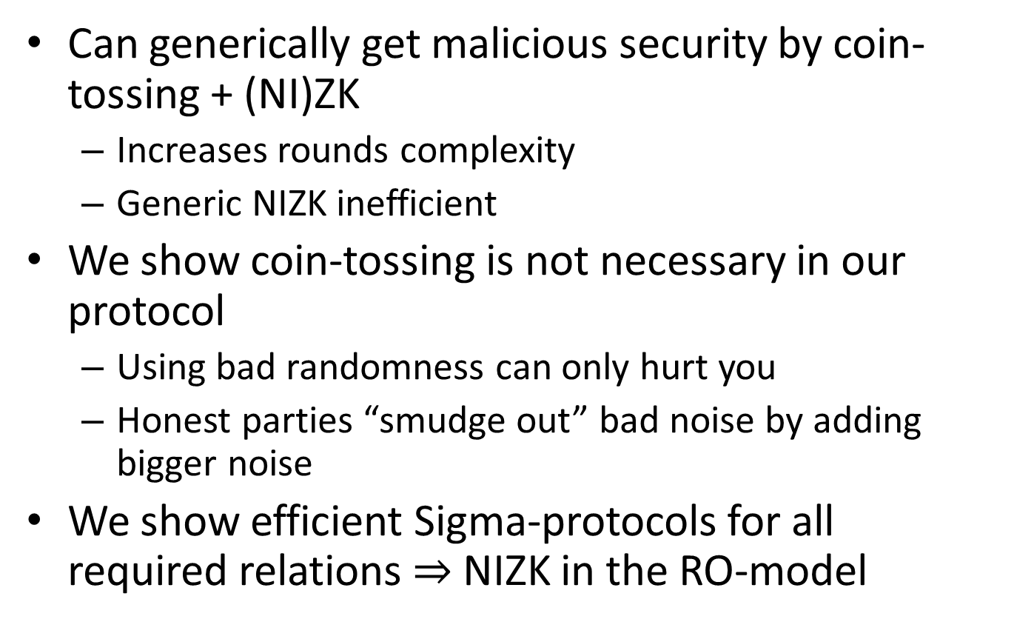
Malicious
Can generically get malicious security by coin-tossing + (NI)ZK
  Increases rounds complexity
  Generic NIZK inefficient
We show coin-tossing is not necessary in our protocol
  Using bad randomness can only hurt you
  Honest parties “smudge out” bad noise by adding bigger noise
We show efficient Sigma-protocols for all required relations $⇒$ NIZK in the RO-model

Slide 35
Conclusion
TFHE based on LWE
  In the paper: Ring – LWE
3 Rounds MPC
2 Rounds in reusable PKI - optimal(!)
Low Communication Complexity
Easy to delegate
Thank You!

