Slide 1
Group to Group Commitments Do Not Shrink
Masayuki ABE
Kristiyan Haralambiev
Miyako Ohkubo

Slide 2
Contents
Introduction for Structure-Preserving Schemes
  Motivation
  State of the Art
Structure-Preserving Commitments (SPC)
  Lower Bounds
    size(commitment) >= size(message)
    #(verification equations) >= 2 in Type-I groups
  Upper Bounds
    constructions with optimal expansion factor
Notes:
My talk begins with introduction to structure-preserving primitives.
Structure-preserving primitives are building blocks for modular protocol design.
So they include standard cryptographic primitives like encryption, signatures, proof systems and so on.
This work concerns the efficiency of structure preserving signatures.
First we give lower bounds about the size of the commitment and the number of verification equations.
Then we show upper bounds that match to the lower bound in terms of expansion factor.

Slide 3
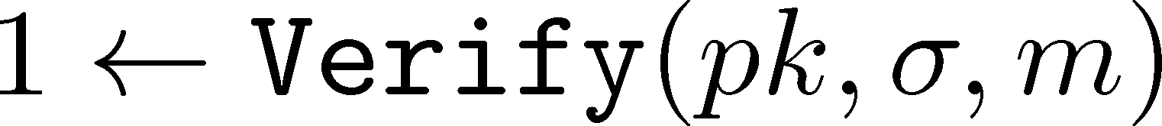
Modular Protocol Design
Combination of Building Blocks
  Encryption, Signatures, Commitments, etc..
Zero-knowledge Proof System
  ex) Proving possession of a valid signature without showing it.
Extra Requirements
  Non-interactive, Proof of knowledge
Notes:
When you design cryptographic protocols, a general approach is to combine several building blocks such as encryption, signatures, commitments and so on,
and apply zero-knowledge proofs to hide some part of the data.
For instance, you are often asked to prove possession of a valid signature without showing it.
So you prove in zero-knowledge that the verification equation is satisfied by the witness you have.

Slide 4
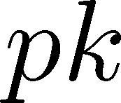




NIZK in Theory
Translate “Verify” function
into a circuit. Then prove the correctness of I/O at every gate by NIZK.
Very powerful tool. But not practical.

Slide 5
Practical NIZK
Groth-Sahai Proof System [GS08]
  Currently the only practical Non-Interactive Proof system.
  Works on bilinear groups.
  A Witness Indistinguishable Proof System (NIWI) for quadratic relations among witnesses.
  A Proof of Knowledge for relations represented by pairing product equations. (see next page)

Slide 6
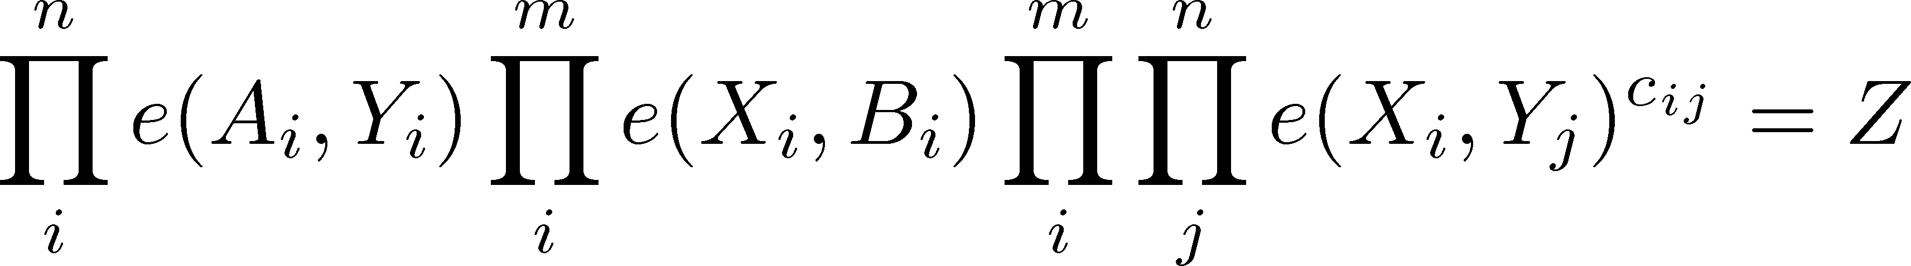

Pairing Product Equation
Z=1 for ZK
witnesses must be base group elements for PoK
Bilinear Groups

Slide 7
Structure-Preserving Schemes
Cryptographic schemes such as signatures, encryption, commitments, etc...
  constructed over bilinear groups, and
  public objects such as public-keys, messages, signatures, commitments, de-commitments, ciphertexts, and etc., are group elements, and
  relevant verifications such as signature verification, correct decryption, correct decommitment, evaluate pairing product equations.

Slide 8
Structure-Preserving Schemes
Proof System
  NIWI: [GS08]
  GS with Extra Properties: [BCCKLS09,Fuc11,CKLM12]
Signature Schemes
  Constructions: [Gro06, GH08, CLY09, AFGHO10, AHO10, AGHO11, CK11]
  Bounds: [AGHO11, AGH11]
CCA2 Public-Key Encryption
  [CKH11]
Commitment Schemes
  Constructions: [Gro09, CLY09, AFGHO10, AHO10]

Slide 9
Structure-Preserving Commitments (SPC)

Slide 10
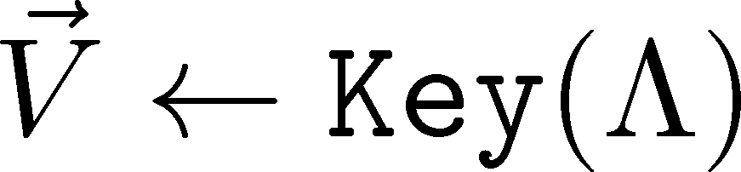

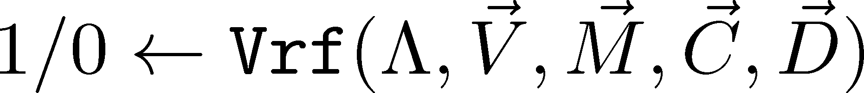
Syntax
vector of group elements
from the base group (Strict-SPC)
evaluates pairing product equations

Slide 11
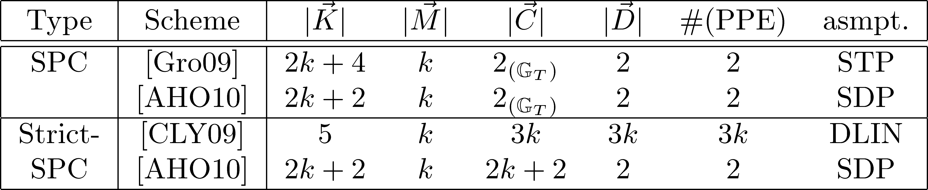
SPC in the Literature
Question:
Can Strict-SPC be shrinking?

Slide 12
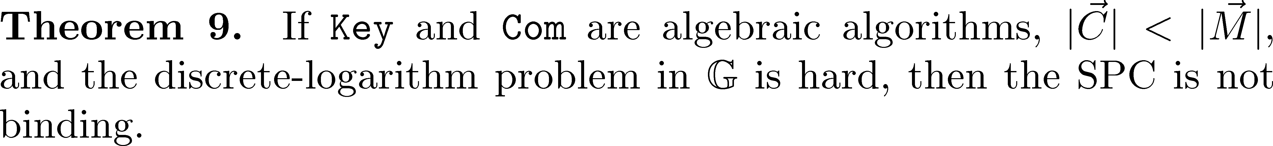
Impossibility Result (1)
The theorem holds for type-III groups as well.

Slide 13
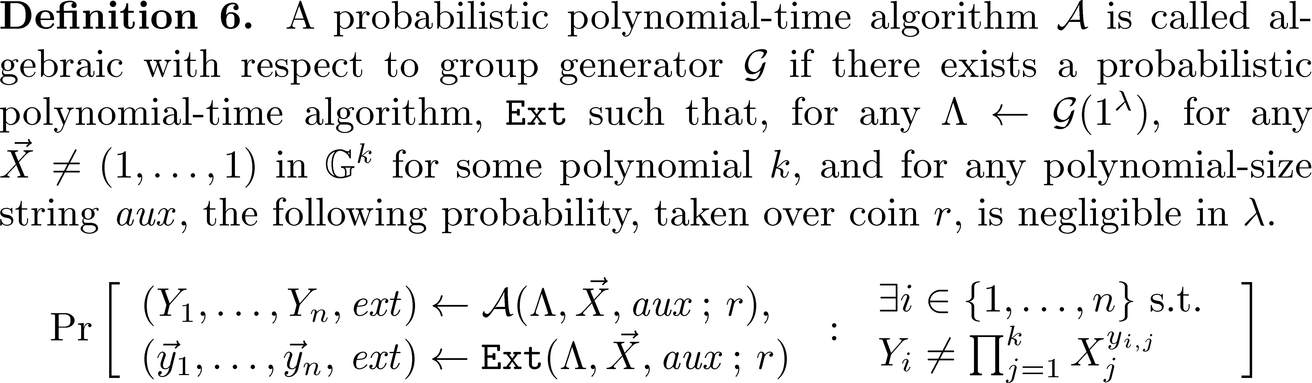
Algebraic Algorithm

Slide 14
Alg.Alg. is not KEA
Algebraic Algorithms
  Class of Reduction / Construction
  Often used for showing separation
  Considered as “not overly restrictive”
  Positive consequence if avoided
Knowledge of Exponent Assumption
  Assumption on adversaries
  Often used in security proofs for specific constructions
  Often criticized as too strong since it is not falsifiable
  Negative impact if not hold

Slide 15









Proof Intuition (1/3)

Slide 16



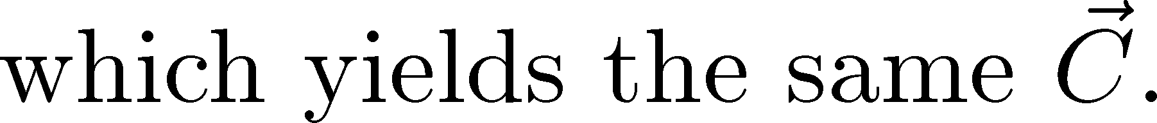
Proof Intuition (2/3)

Slide 17
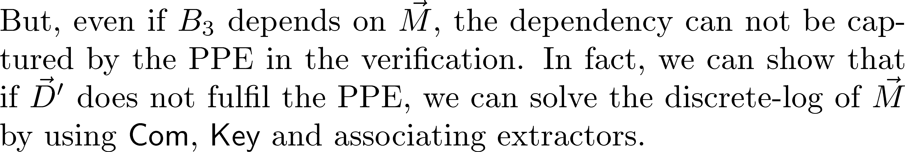
Proof Intuition (3/3)

Slide 18
Impossibility Result (2)

Slide 19
Optimal Constructions

Slide 20
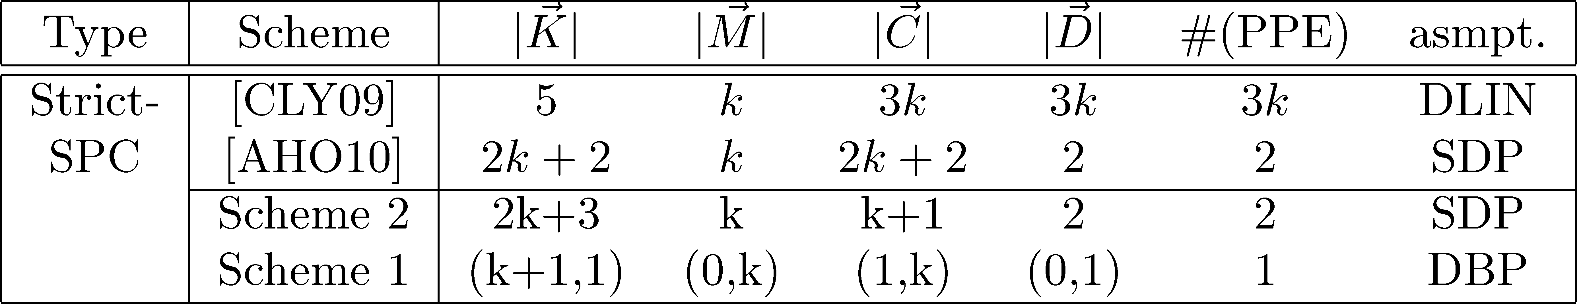
Two New Strict-SPCs
All schemes are homomorphic and trapdoor as well as previous schemes.

Slide 21
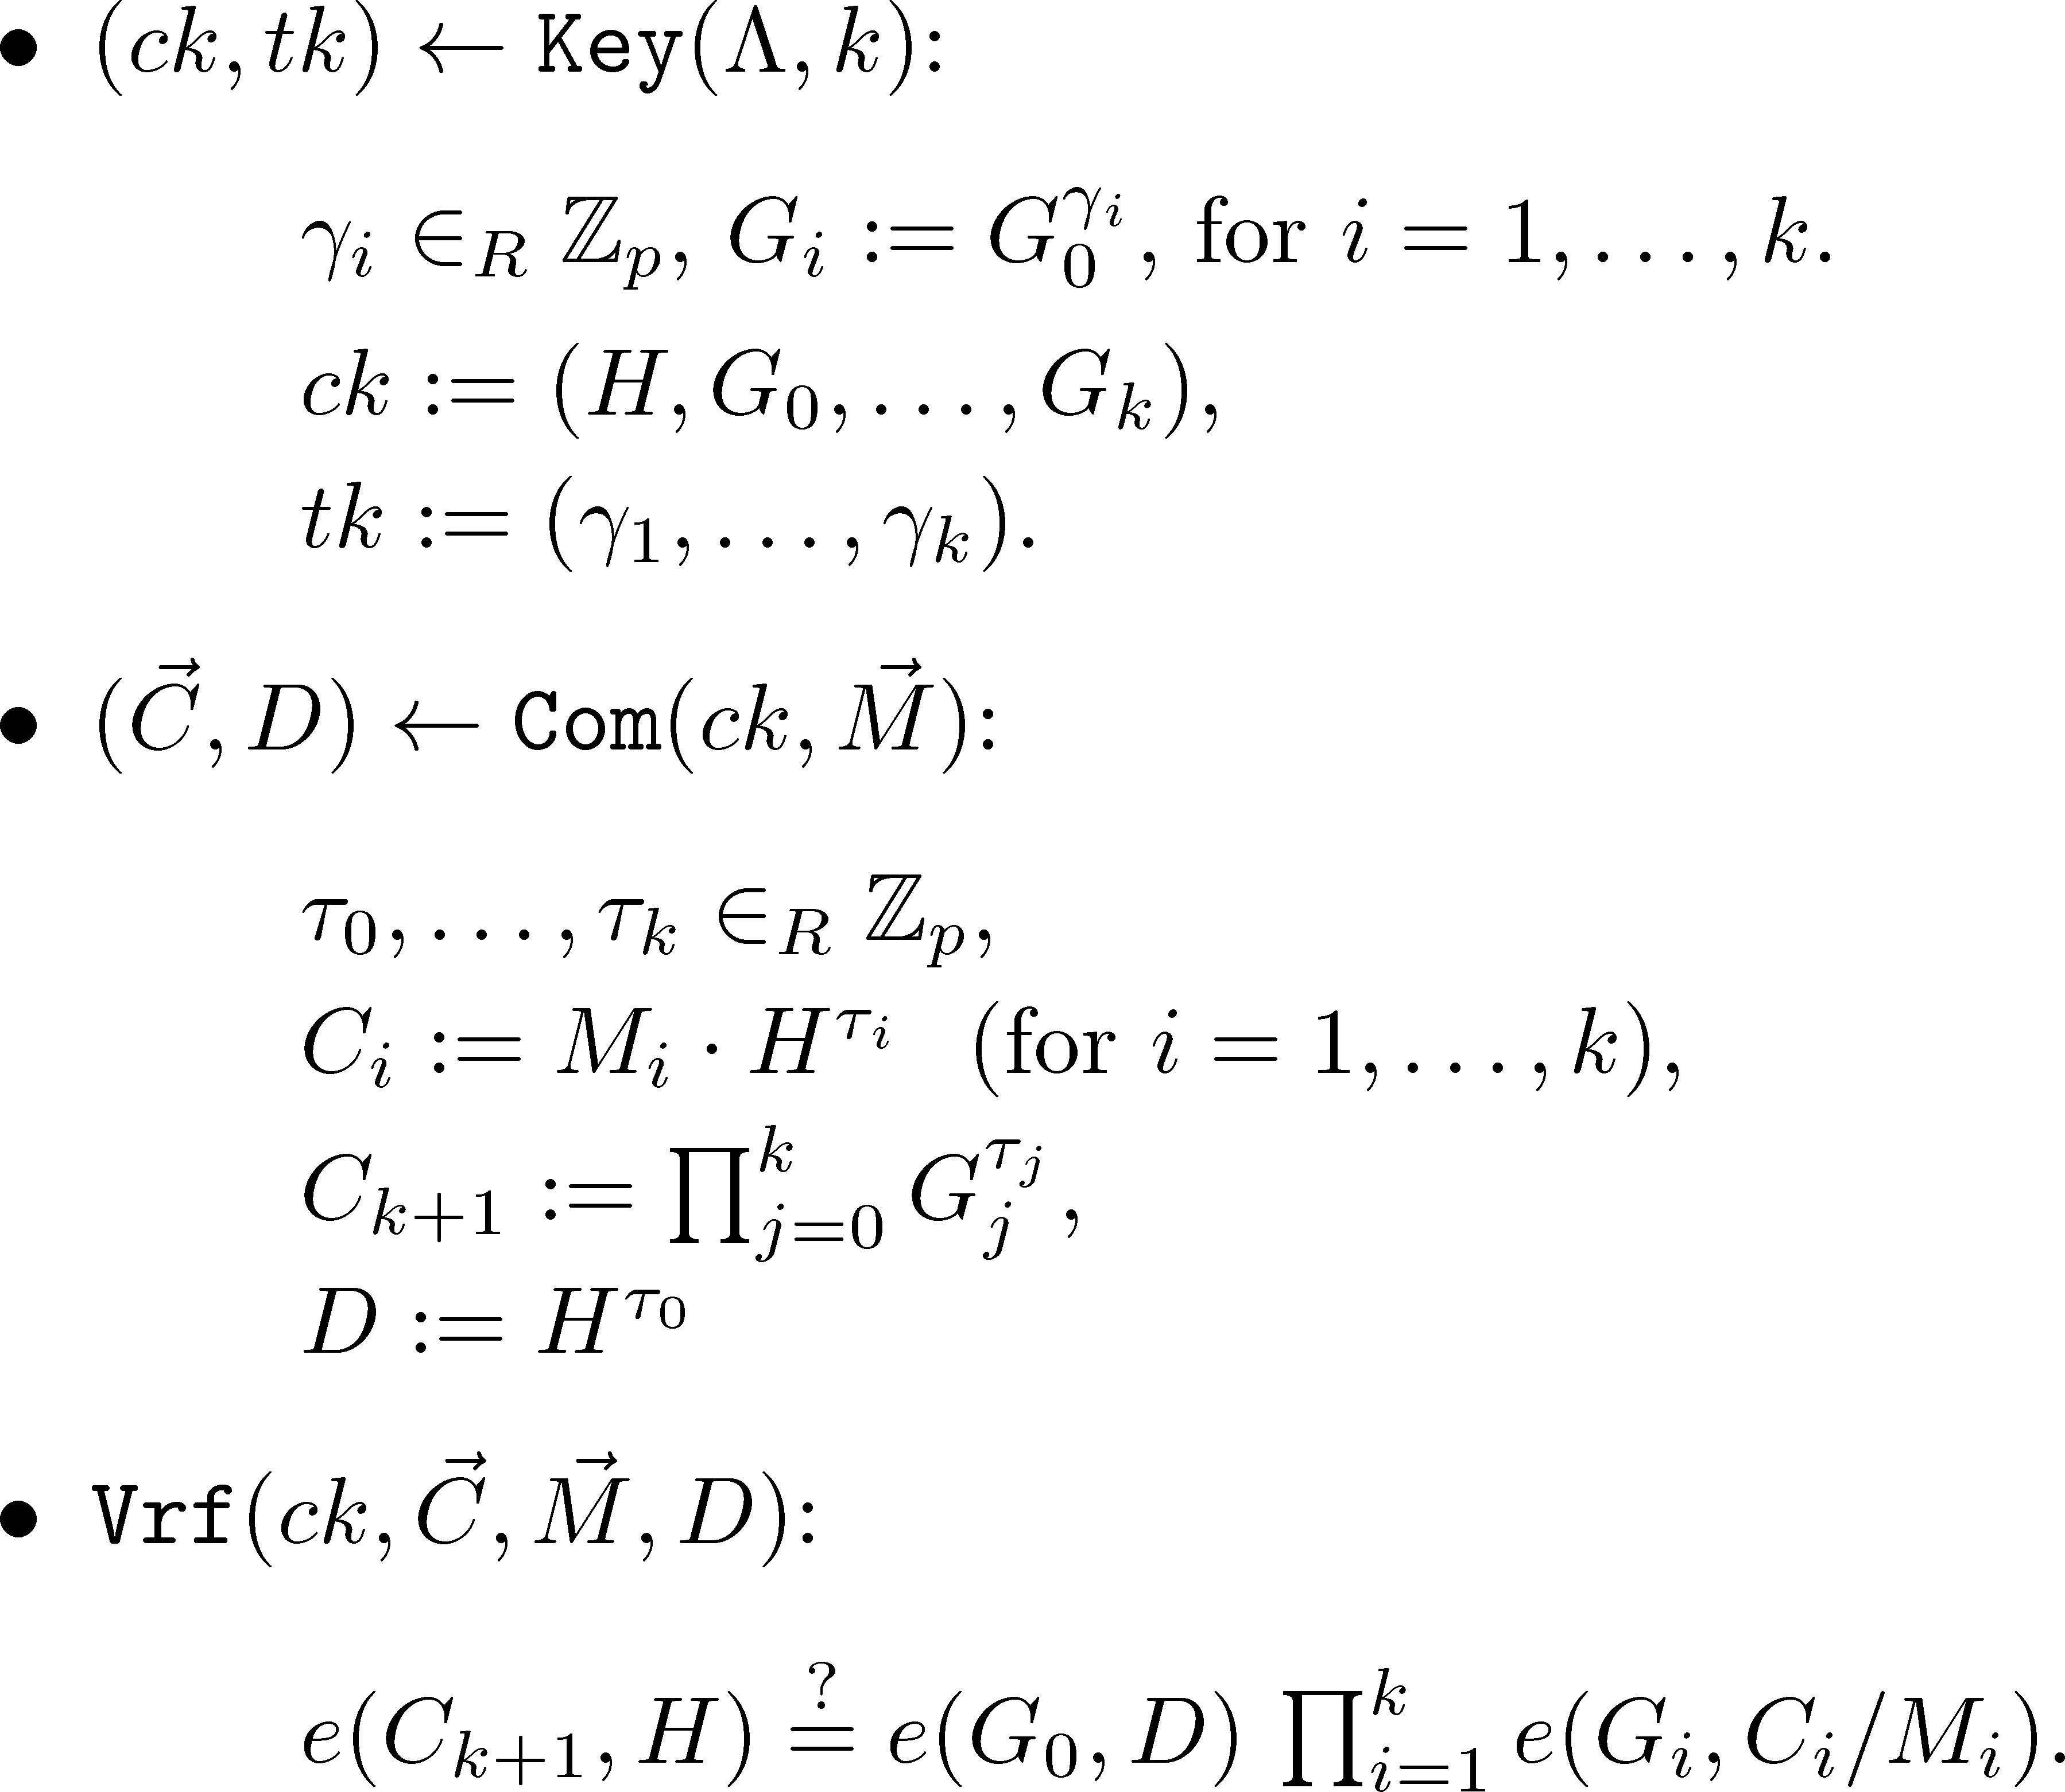
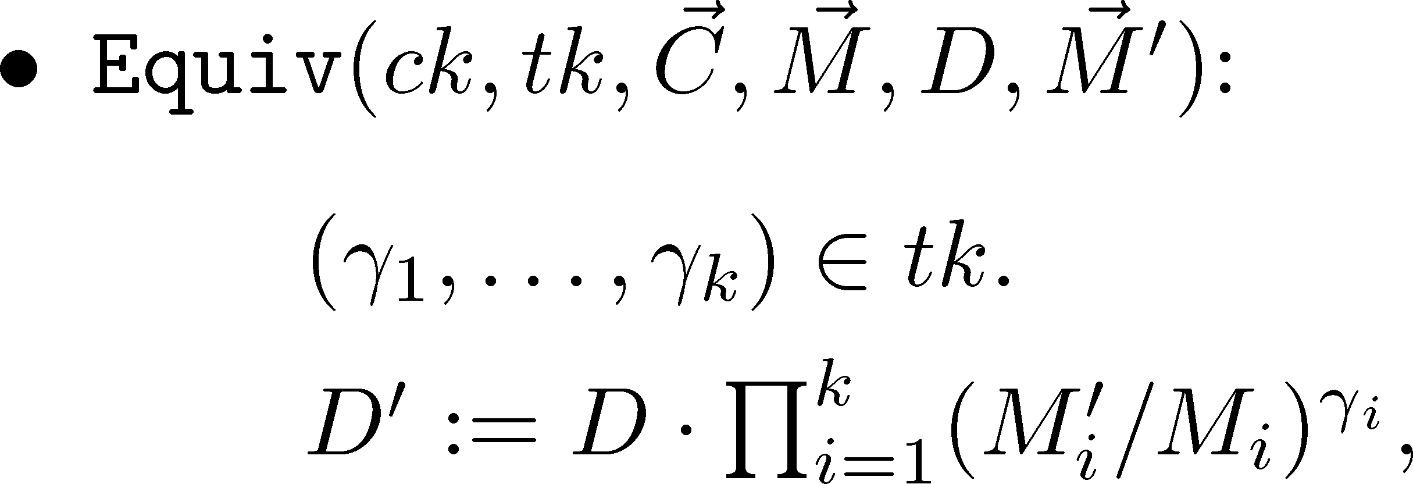
Scheme 1 in Type-III Groups

Slide 22
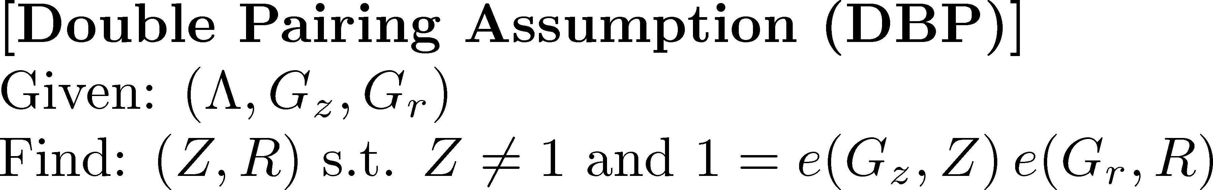
Security
DBP is implied by SXDH.

Slide 23
Summary
Upper and Lower Bounds for Strict-SPC
  Strict-SPC does not shrink!
  Bounds w.r.t. commitment size match each other except for small additive terms.
Open Issues
  Get rid of the additive terms, or show its impossibility.
  Do non-algebraic constructions help to get around the lower bound?

Slide 24

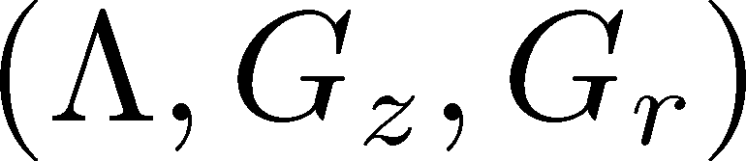
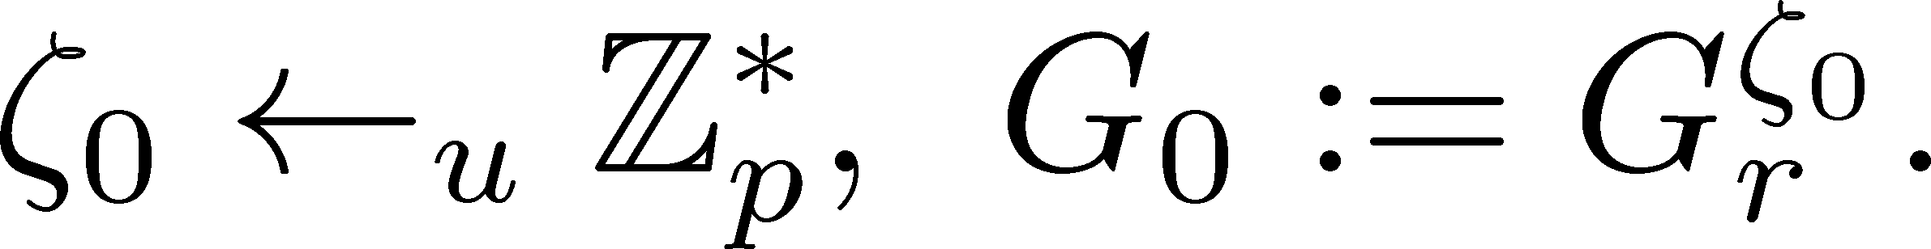

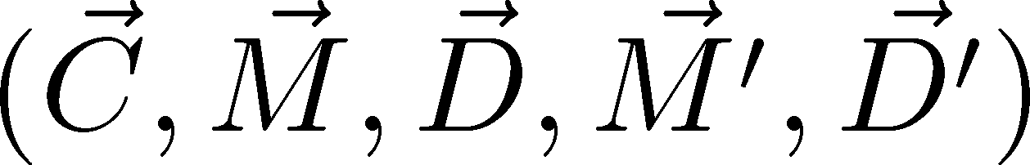
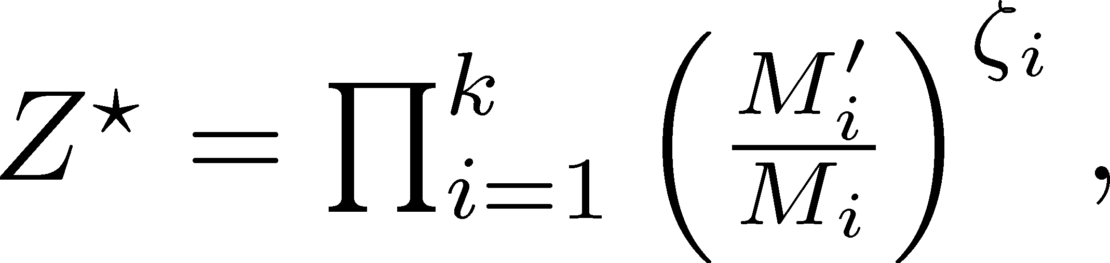
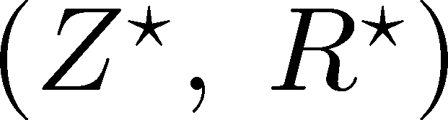
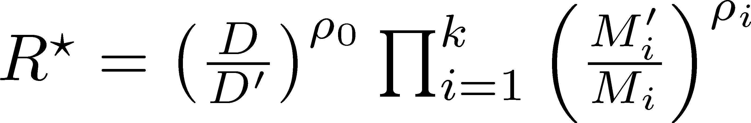
Reduction

Slide 25
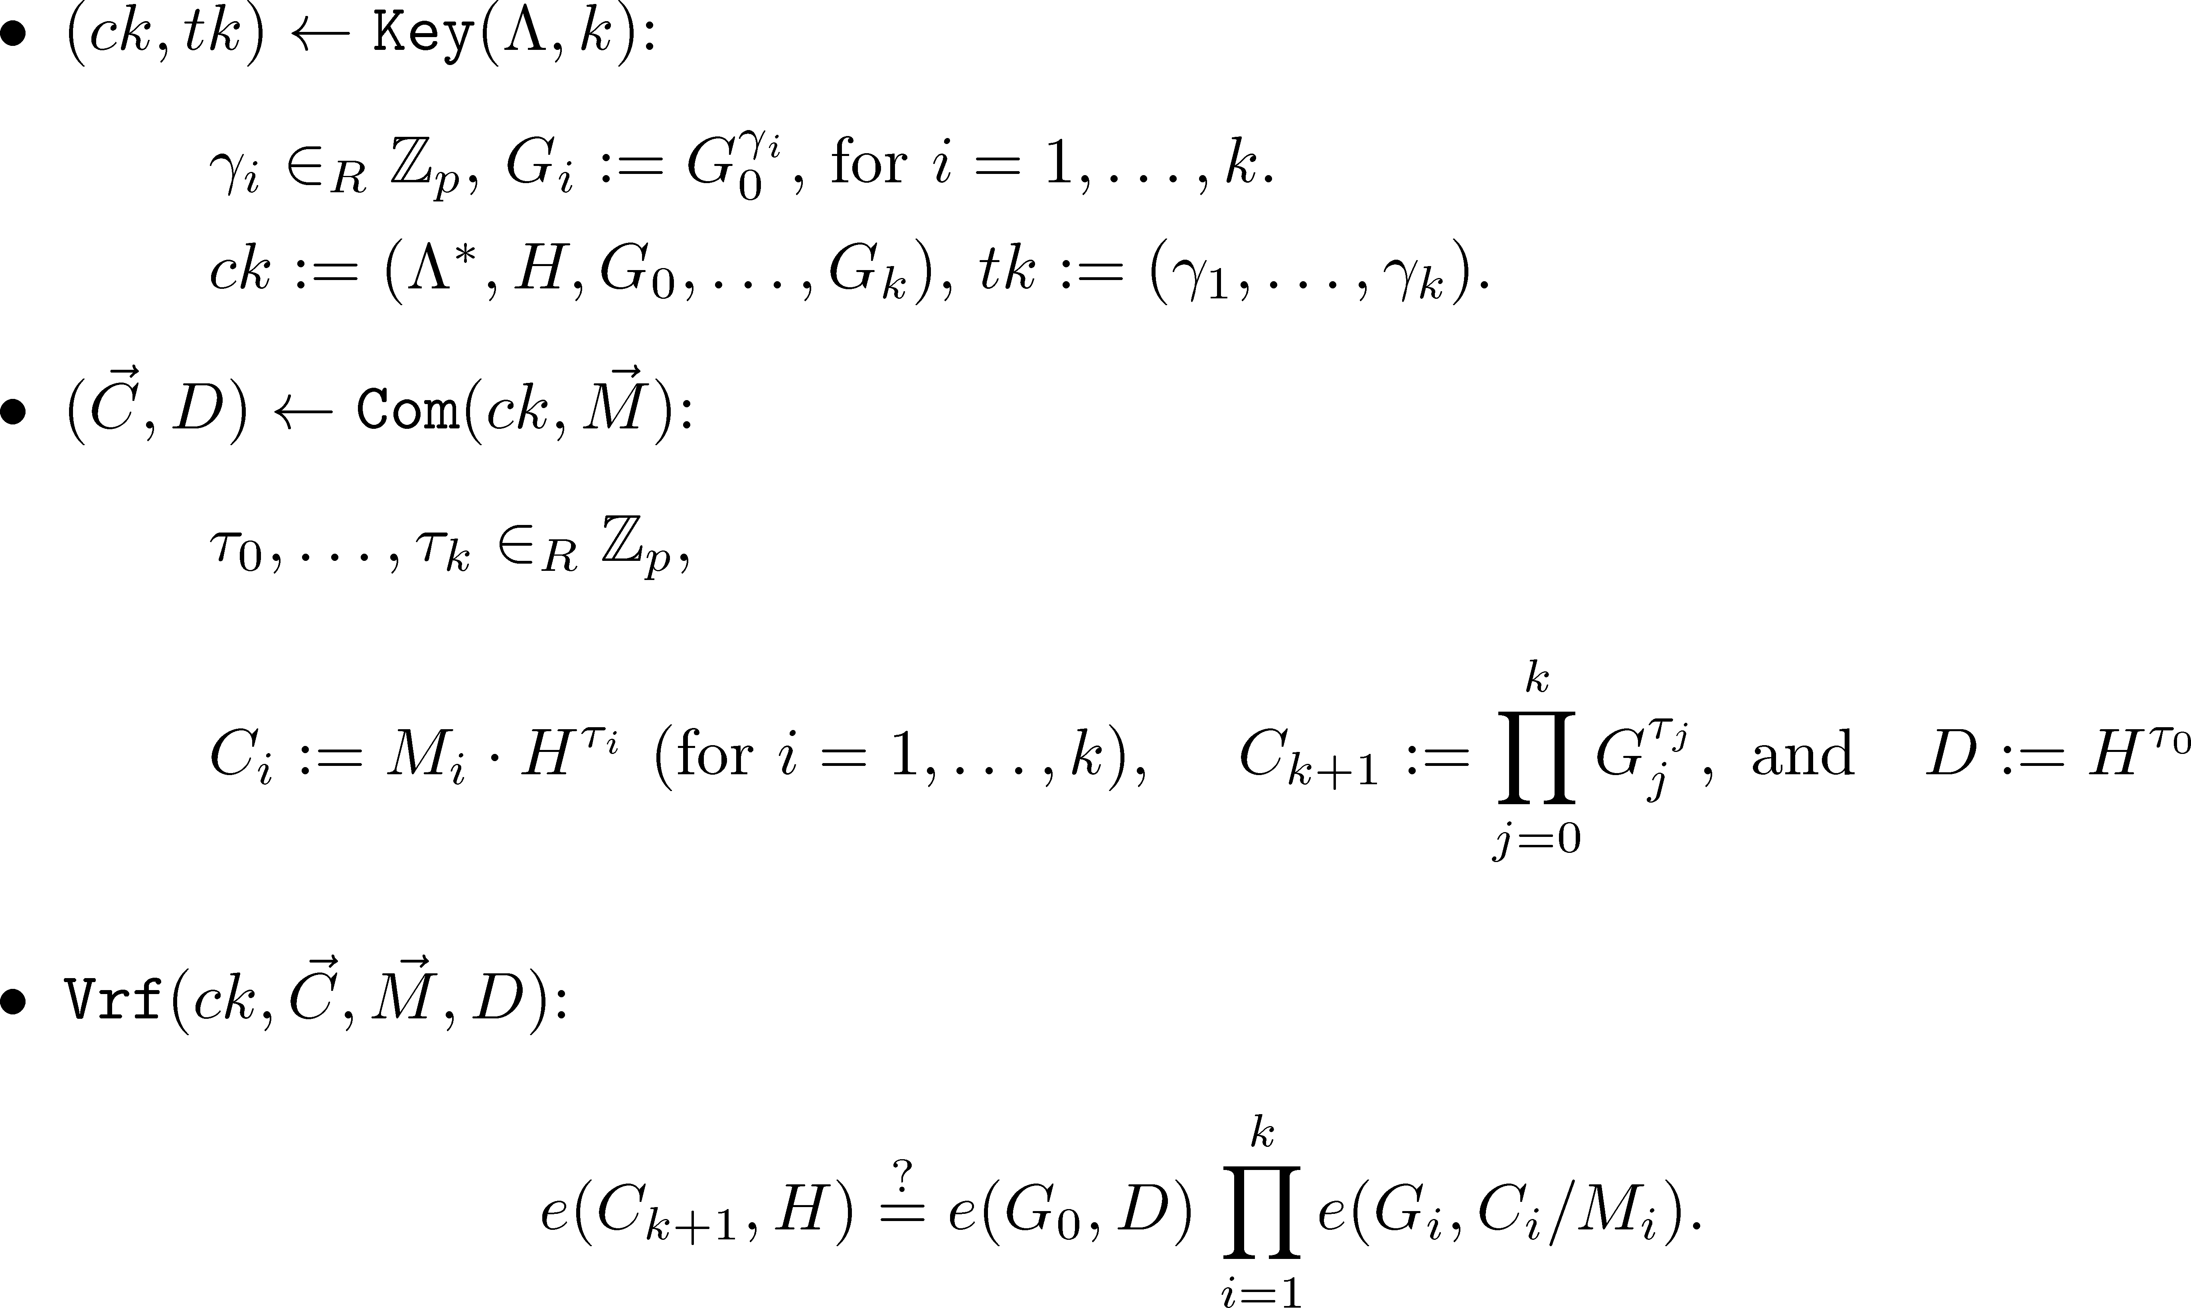
Scheme 1 in Type-III Groups

Slide 26
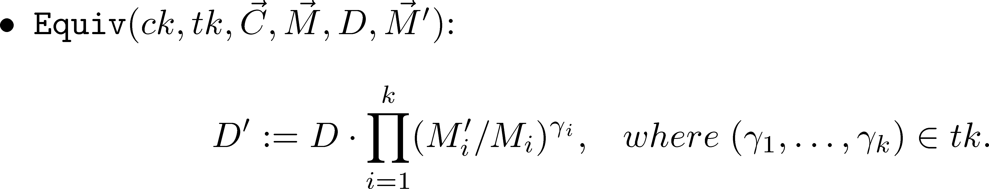
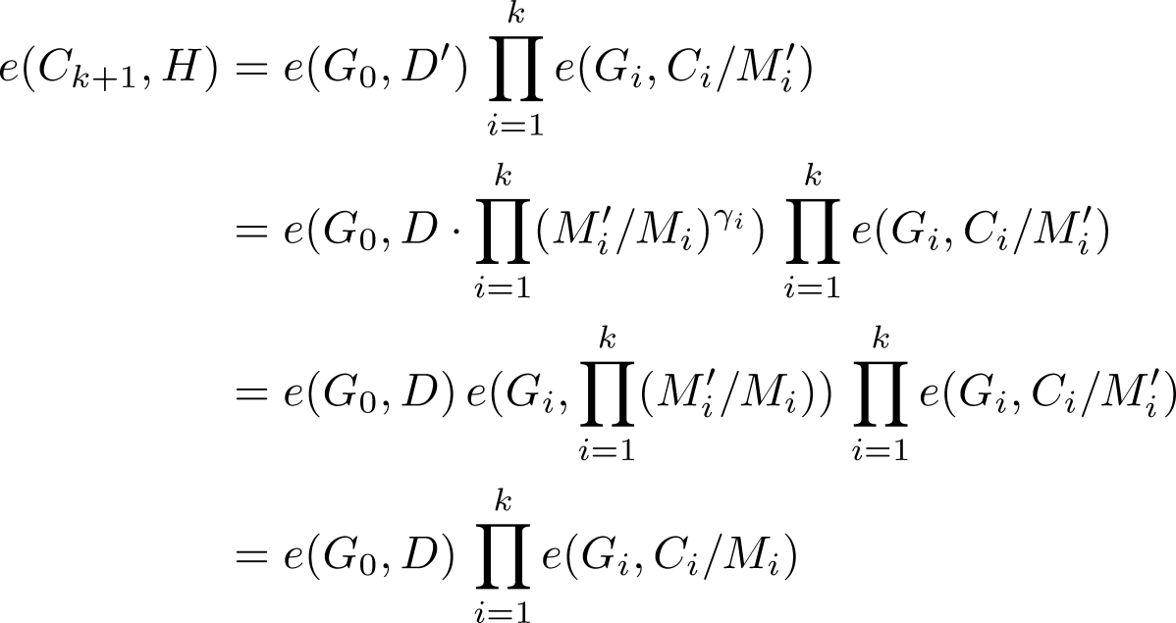
Scheme 1 (Cont’d)

Slide 27
Bilinear Groups

