Slide 1
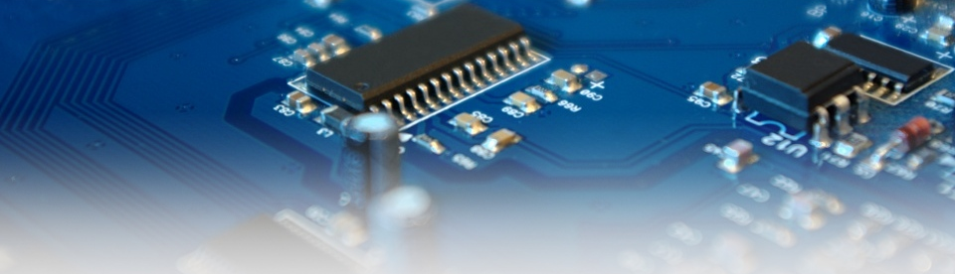


Statistical Tools Flavor
Side-Channel Collision Attacks
17. April 2012
Amir Moradi
Embedded Security Group, Ruhr University Bochum, Germany

Slide 2
Outline
Challenges
  Side-Channel Attacks (SCA)
  Collision SCA
  Problems and our solution
What is new in this paper
Some experimental results

Slide 3
What is the story?
SCA (implementation attacks)
  recovering the key of crypto devices
  hypothetical model for power consumption
  compare the model with side-channel leakage (power)
How?
p | 12 | 3d | 78 | … | f9 | ab | 3d
Correlation
k
power | 0.12 | 0.01 | 0.14 | … | 0.20 | 0.06 | 0.02
p
0.011
0.060
…
0.231
…
0.095
Sbox
[k=00] S | c9 | 27 | bc | … | 99 | 62 | 27
 | 4 | 4 | 5 | … | 4 | 3 | 4
[k=01] S | 7d | eb | b6 | … | 41 | ac | eb
 | 6 | 6 | 5 | … | 2 | 4 | 6
…
[k=ff] S | 55 | 25 | 17 | … | 6f | 20 | 25
 | 4 | 3 | 4 | … | 6 | 1 | 3

Slide 4

Side-Channel Collision
when the circuit uses a module (Sbox) more than once (in e.g., a round)
once a collision found?
false positive collision detections
  a couple of heuristic and systematic ways to handle
k₁
p₁ | 12 | 3d | 78 | … | f9 | ab | 3d
p₁
power |  |  |  | …
Sbox
p₂
?
?
?
?
power |  |  |  | …
k₂
p₂ | 45 | 9a | cf | … | 04 | 17 | e2
known as linear collision attack

Slide 5



Our Solution at CHES 2010 (Correlation-Enhanced)
k₁
p₁
(
p₁ | 12 | 3d | 78 | … | f9 | ab | 3d
)
Sbox
power | 0.01 | 0.15 | 0.12 | … | 0.24 | 0.05 | 0.11
p₂
p₁ | 00 | 01 | 02 | … | fd | fe | ff
average
k₂
 | 0.23 | 0.12 | 0.21 | … | 0.06 | 0.09 | 0.14
(
p₂ | 45 | 9a | cf | … | 04 | 17 | e2
)
Correlation
power | 0.32 | 0.20 | 0.05 | … | 0.19 | 0.27 | 0.26
0.230
0.408
…
0.839
…
0.312
 | 00 | 01 | 02 | … | fd | fe | ff
average
 | 0.32 | 0.20 | 0.05 | … | 0.19 | 0.27 | 0.26
average
 | 00 | 01 | 02 | … | fd | fe | ff
 | 0.20 | 0.32 | 0.17 | … | 0.09 | 0.26 | 0.27
…
average
 | 00 | 01 | 02 | … | fd | fe | ff
 | 0.26 | 0.27 | 0.19 | … | 0.05 | 0.20 | 0.32
 | 00 | 01 | 02 | … | fd | fe | ff

Slide 6
Problems
having a countermeasure (secret sharing)
  computations on all shares at the same time (Threshold Imp.)
  a univariate leakage
  a MIA might be applicable
  a CE collision might NOT
    averaging...
how about higher-order statistical moments
skewness
Variance
kurtosis

Slide 7
Solution (applying higher-order moments)
k₁
p₁
(
p₁ | 12 | 3d | 78 | … | f9 | ab | 3d
)
Sbox
power | 0.01 | 0.15 | 0.12 | … | 0.24 | 0.05 | 0.11
p₂
p₁ | 00 | 01 | 02 | … | fd | fe | ff
variance
k₂
$$σ^{2}$$ | 1.70 | 2.05 | 0.70 | … | 3.12 | 1.96 | 1.79
(
p₂ | 45 | 9a | cf | … | 04 | 17 | e2
)
Correlation
power | 0.32 | 0.20 | 0.05 | … | 0.19 | 0.27 | 0.26
0.305
0.412
…
0.780
…
0.309
 | 00 | 01 | 02 | … | fd | fe | ff
variance
$$σ^{2}$$ | 2.67 | 3.96 | 0.84 | … | 3.04 | 1.64 | 4.78
variance
 | 00 | 01 | 02 | … | fd | fe | ff
$$σ^{2}$$ | 3.96 | 2.67 | 2.09 | … | 1.83 | 4.78 | 1.64
…
variance
 | 00 | 01 | 02 | … | fd | fe | ff
$$σ^{2}$$ | 4.78 | 1.64 | 3.04 | … | 0.84 | 3.96 | 2.67
 | 00 | 01 | 02 | … | fd | fe | ff

Slide 8
Solution (applying higher-order moments)
k₁
p₁
(
p₁ | 12 | 3d | 78 | … | f9 | ab | 3d
)
Sbox
power | 0.01 | 0.15 | 0.12 | … | 0.24 | 0.05 | 0.11
p₂
p₁ | 00 | 01 | 02 | … | fd | fe | ff
skewness
k₂
$$γ$$ | 1.70 | 2.05 | 0.70 | … | 3.12 | 1.96 | 1.79
(
p₂ | 45 | 9a | cf | … | 04 | 17 | e2
)
Correlation
power | 0.32 | 0.20 | 0.05 | … | 0.19 | 0.27 | 0.26
0.305
0.412
…
0.780
…
0.309
 | 00 | 01 | 02 | … | fd | fe | ff
skewness
$$γ$$ | 2.67 | 3.96 | 0.84 | … | 3.04 | 1.64 | 4.78
skewness
 | 00 | 01 | 02 | … | fd | fe | ff
$$γ$$ | 3.96 | 2.67 | 2.09 | … | 1.83 | 4.78 | 1.64
…
skewness
 | 00 | 01 | 02 | … | fd | fe | ff
$$γ$$ | 4.78 | 1.64 | 3.04 | … | 0.84 | 3.96 | 2.67

Slide 9







General Form (no specific moment)
$$\sum{\left(p()−q()\right)\log{\frac{p()}{q()}}}$$
k₁
p₁
(
p₁ | 12 | 3d | 78 | … | f9 | ab | 3d
)
Sbox
power | 0.01 | 0.15 | 0.12 | … | 0.24 | 0.05 | 0.11
p₂
p₁ | 00 | 01 | 02 | … | fd | fe | ff
pdf
k₂
$$\text{Pr}$$ |  |  |  | …
(
p₂ | 45 | 9a | cf | … | 04 | 17 | e2
)
Jeffreys
Divergence
power | 0.32 | 0.20 | 0.05 | … | 0.19 | 0.27 | 0.26
0.104
0.094
…
0.006
…
0.143
 | 00 | 01 | 02 | … | fd | fe | ff
pdf
$$\text{Pr}$$ |  |  |  | …
pdf
 | 00 | 01 | 02 | … | fd | fe | ff
$$\text{Pr}$$ |  |  |  | …
…
pdf
 | 00 | 01 | 02 | … | fd | fe | ff
$$\text{Pr}$$ |  |  |  | …
 | 00 | 01 | 02 | … | fd | fe | ff

Slide 10
Practical Issues
higher statistical moments, lower estimation accuracy
  more traces (measurements) required
estimating pdf by e.g., histogram
  reducing accuracy as well
Jeffreys divergence
  based on Kullback-Leibler divergence
  symmetric
Experimental Platforms
  Virtex II-pro FPGA (SASEBO)
  Atmel uC (smartcard)

Slide 11
Experimental Results (PRESENT TI)
J. Cryptology 24(2)

Slide 12
Experimental Results (PRESENT TI)
Average
Variance
Skewness
pdf

Slide 13
Experimental Results (AES TI)
EC 2011

Slide 14
Experimental Results (AES TI)
Average
Variance
Skewness
pdf

Slide 15
Experimental Results (masked software)
time to move toward multivariate case
  joint pdfs can be estimated
  joint statistical moments also can be estimated
    the same as doing a preprocess (by multiplication) step
    prior to a univariate attack

Slide 16
Thanks!
Any questions?
amir.moradi@rub.de
Embedded Security Group, Ruhr University Bochum, Germany

Slide 17
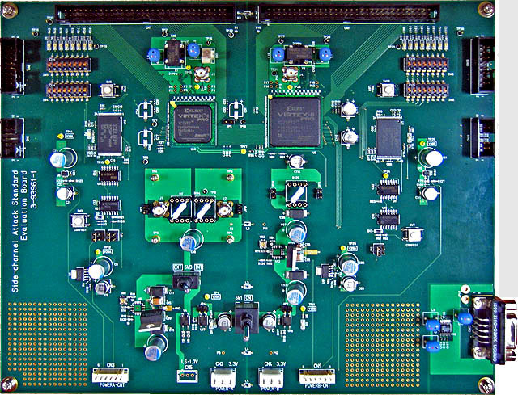

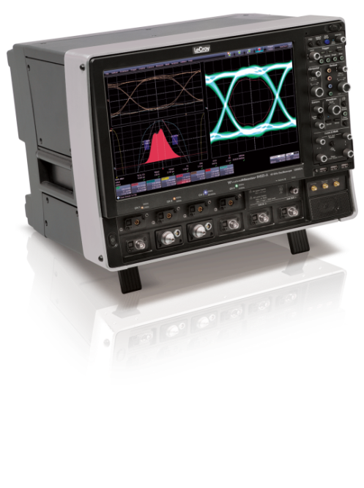
Measurement Speed?
(Threshold)
Speed of the measurement depends on the length of each trace
In this case, 2000 points,
100M traces in 11 hours!
UART
PC sends a small number of bytes (~20)
Control FPGA communicates with the Target FPGA
sending/receiving ~10K plaintext/ciphertext
while the oscilloscope measures

Slide 18
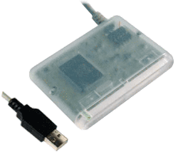

Experimental Results (masked software)

