Slide 1
Efficient Zero-Knowledge Argument for Correctness of a Shuffle
Stephanie Bayer
University College London
Jens Groth
University College London

Slide 2

Motivation – e-voting
Voting: - Voter casts secret vote
- Authorities reveal votes in random permuted order
E-voting: - voter casts secret votes on a computer
The votes are sent to a server who sends all votes to the central authorities
Authorities reveal votes in random permuted order

Slide 3
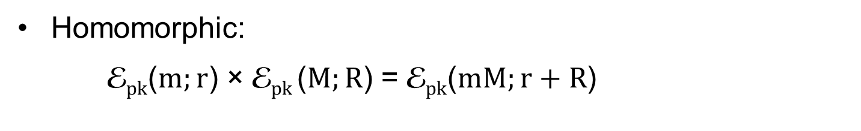
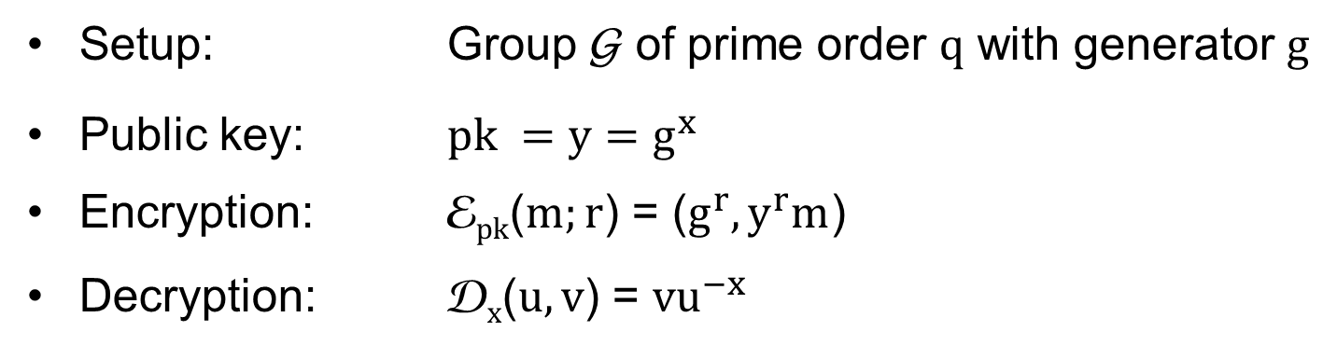
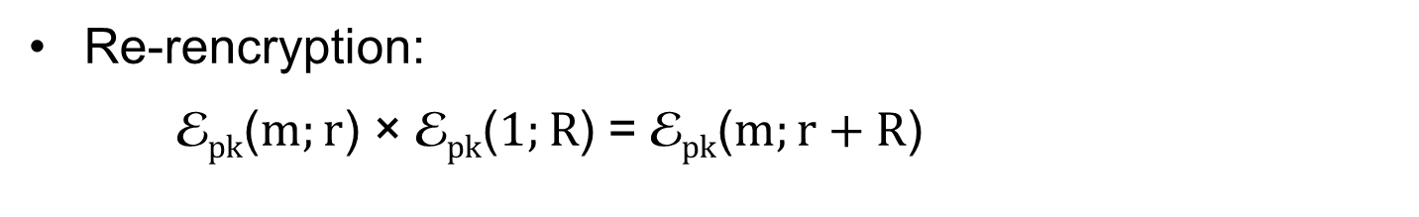
Background - ElGamal encryption
Setup: Group G of prime order $q$ with generator $g$
Public key: $pk =y=g^{x}$
Encryption: E$pk$($m;r$) = ($g^{r}, y^{r}m$)
Decryption: D$x$($u, v$) = ${vu}^{−x}$
Homomorphic:
E$pk$($m;r$) × E$pk$($M;R$) = E$pk$($mM;r+R$)
Re-rencryption:
E$pk$($m;r$) × E$pk$($1;R$) = E$pk$($m;r+R$)

Slide 4




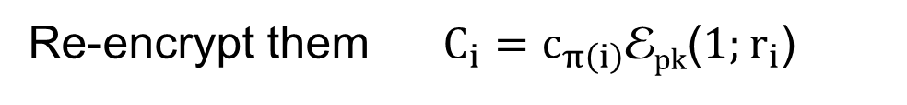







Shuffle
$$c_{1}$$
$$c_{2}$$
$$c_{3}$$
. . .
$$c_{N}$$
Input ciphertexts $c_{1}, ⋯, c_{N}$
Permute to get $c_{π\left(1\right)}, ⋯, c_{π\left(N\right)}$
Re-encrypt them $C_{i}=c_{π\left(i\right)}$E$pk$($1;r_{i}$)
Output ciphertexts $C_{1},⋯, C_{N}$
$$C_{1}$$
$$C_{2}$$
$$C_{3}$$
. . .
$$C_{N}$$

Slide 5





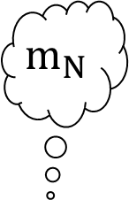
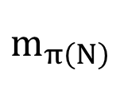
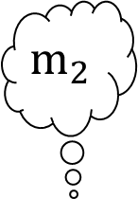
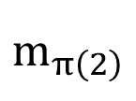
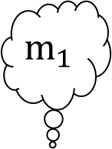
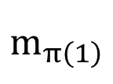

Mix-net:
Threshold decryption
$$m_{π\left(1\right)}$$
$$m_{π\left(2\right)}$$
$$m_{π\left(N\right)}$$
$$π=π_{1}π_{2}$$
$$π_{2}$$
$$π_{1}$$
$$m_{1}$$
$$m_{2}$$
$$m_{N}$$
…

Slide 6
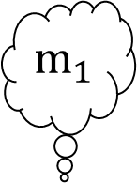




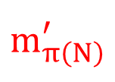
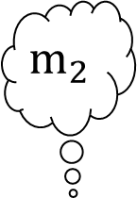
Problem: Corrupt mix-server
Threshold decryption
$$m_{π\left(1\right)}$$
$$m_{π\left(2\right)}$$
$$m_{π\left(N\right)}^{′}$$
$$π=π_{1}π_{2}$$
$$π_{2}$$
$m_{1}$
$$m_{2}$$
$$m_{N}$$
$$π_{1}$$
…

Slide 7

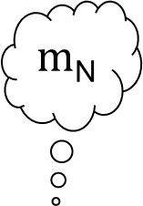

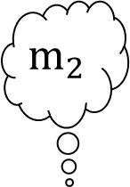
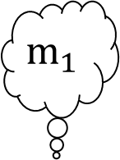


Solution: Zero-knowledge argument
Threshold decryption
$$m_{π\left(1\right)}$$
$$m_{π\left(2\right)}$$
$m_{π\left(N\right)}$
$$π=π_{1}π_{2}$$
ZK argument
Permutation still secret
(zero-knowledge)
$$π_{2}$$
ZK argument
No message changed
(soundness)
$$m_{1}$$
$$m_{2}$$
$m$_{N}
$$π_{1}$$
…

Slide 8
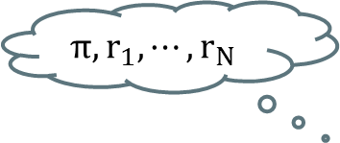

Zero-Knowledge Argument
Statement: ($pk, c_{1}, ⋯, c_{N}, C_{1},⋯, C_{N}$)
$$π, r_{1},⋯, r_{N}$$
Prover
Verifier
The Shuffle was done correctly
Requested Properties:
  Soundness: The Verifier reject with overwhelming probability if the Prover tries to cheat
  Zero-Knowledge: Nothing but the truth is revealed; permutation is secret
  Efficient: Small computation and small communication complexity

Slide 9
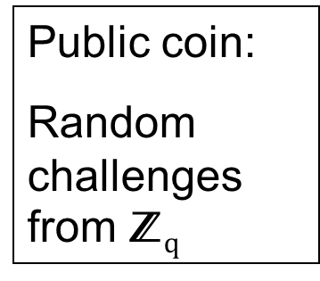
Public coin honest verifier zero-knowledge
Setup: (G,$q$,$g$) and common reference string
Statement: ($pk, c_{1}, ⋯, c_{N}, C_{1},⋯, C_{N}$)
Honest verifier zero-knowledge
Nothing but truth revealed; permutation secret
Prover Verifier
Can convert to standard zero-knowledge argument

Slide 10
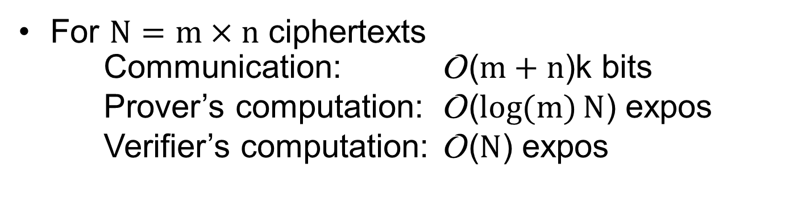
Our contribution
9-move public coin honest verifier zero-knowledge argument for correctness of shuffle in common reference string model
For $N=m×n$ ciphertexts
Communication: O($m+n$)k bits
Prover’s computation: O($\log{(m)}N$) expos
Verifier’s computation: O($N$) expos

Slide 11
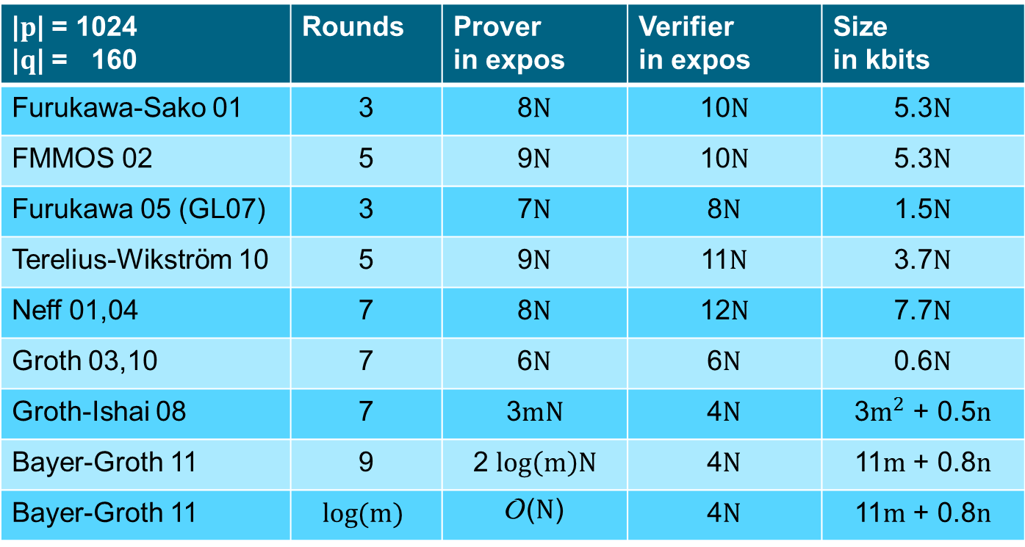
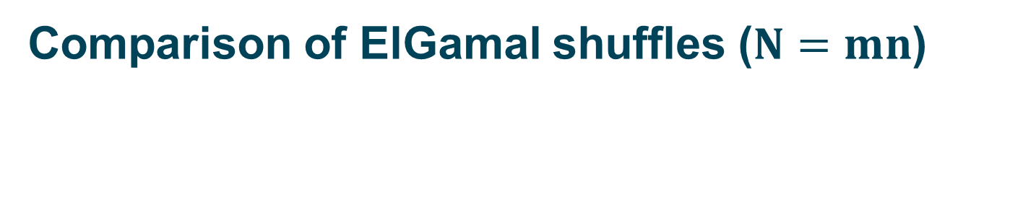
Comparison of ElGamal shuffles ($N=mn$)
|$p$| = 1024 |$q$| = 160 | Rounds | Prover in expos | Verifier in expos | Size in kbits
Furukawa-Sako 01 | 3 | 8$N$ | 10$N$ | 5.3$N$
FMMOS 02 | 5 | 9$N$ | 10$N$ | 5.3$N$
Furukawa 05 (GL07) | 3 | 7$N$ | 8$N$ | 1.5$N$
Terelius-Wikström 10 | 5 | 9$N$ | 11$N$ | 3.7$N$
Neff 01,04 | 7 | 8$N$ | 12$N$ | 7.7$N$
Groth 03,10 | 7 | 6$N$ | 6$N$ | 0.6$N$
Groth-Ishai 08 | 7 | 3$mN$ | 4$N$ | 3$m^{2}$ + 0.5$n$
Bayer-Groth 11 | 9 | 2 $\log\left(m\right)N$ | 4$N$ | 11$m$ + 0.8$n$
Bayer-Groth 11 | $$\log{(m)}$$ | O($N$) | 4$N$ | 11$m$ + 0.8$n$

Slide 12
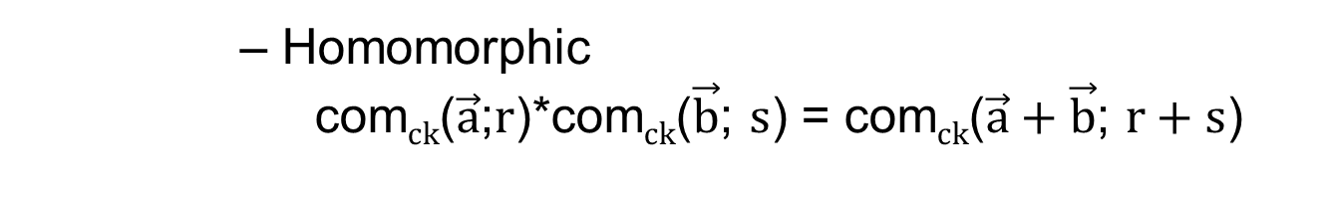
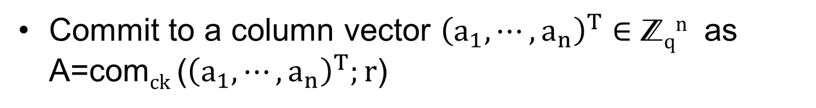

Commitments
Commit to a column vector ${\left(a_{1},⋯, a_{n}\right)}^{T}∈$ Z$qn$ as A=com$ck$ (${\left(a_{1},⋯, a_{n}\right)}^{T};r$)
      Length reducing
      Computational binding
      Perfectly hiding
      Homomorphic
      com$ck$($\vec{a}$;$r$)*com$ck$($\vec{b}$; $s$) = com$ck$($\vec{a}+\vec{b}$; $r+s$)
Pedersen Commitment: com$ck$($\vec{a}$; $r$) = $h^{r}\prod_{i=1}^{n}{giai }$

Slide 13
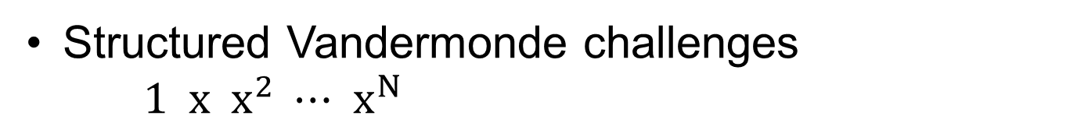
Techniques - Sublinear cost
Length reducing commitments
Batch verification
Structured Vandermonde challenges
$1 x x^{2} ⋯{ x}^{N}$
Sublinear communication cost

Slide 14
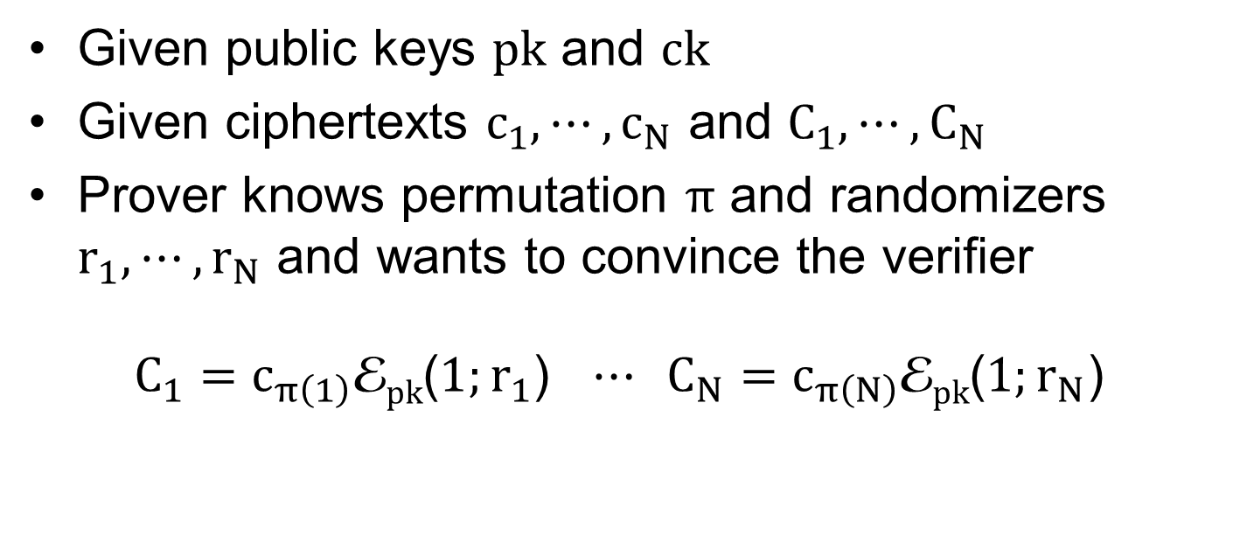
Shuffle argument
Given public keys $pk$ and $ck$
Given ciphertexts $c_{1},⋯, c_{N}$ and $C_{1},⋯, C_{N}$
Prover knows permutation $π$ and randomizers $r_{1}, ⋯, r_{N}$ and wants to convince the verifier
$C_{1}=c_{π\left(1\right)}$E$pk$($1;r_{1}$) $⋯ C_{N}=c_{π\left(N\right)}$E$pk$(${1;r}_{N}$)

Slide 15
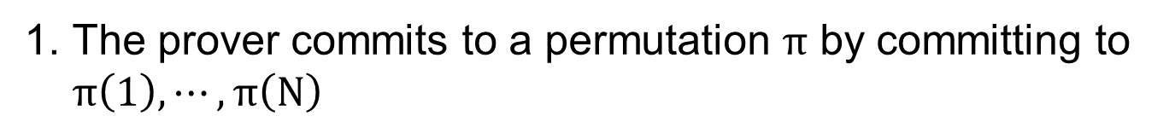
Shuffle argument
The prover commits to a permutation $π$ by committing to $π\left(1\right), ⋯, π\left(N\right)$
  Verifier sends challenge $x∈$ Z$q$
The prover commits to $x^{π\left(1\right)}, ⋯, x^{π\left(N\right)}$
The prover gives an argument that both commitments are constructed using the same permutation
The prover demonstrates that the input ciphertexts are permuted using the same permutation and knowledge of the randomizers used in the re-encryption.

Slide 16
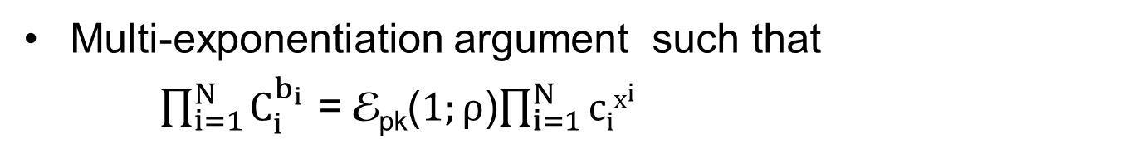
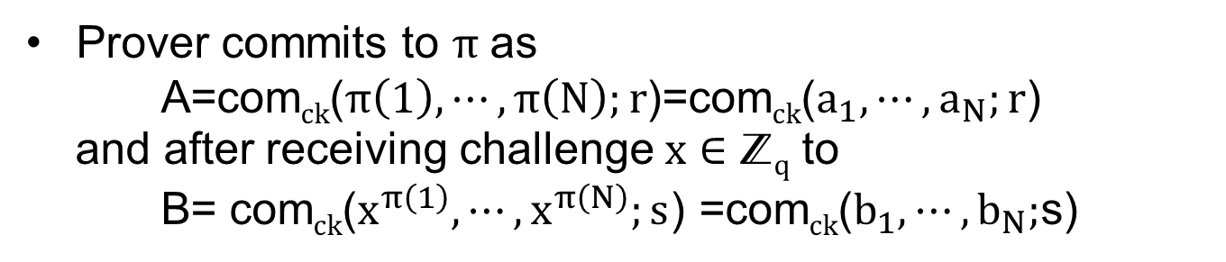

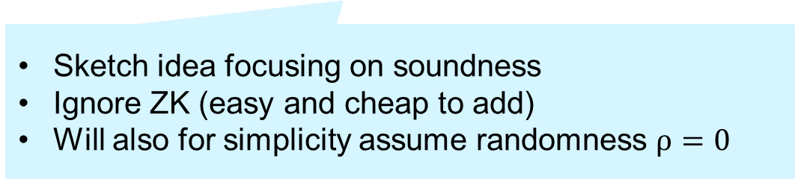
Shuffle argument
Prover commits to $π$ as
A=com$ck$($π\left(1\right), ⋯, π\left(N\right);r$)=com$ck$($a_{1},⋯,a_{N};r$)
and after receiving challenge $x∈$ Z$q$ to
B= com$ck$($x^{π\left(1\right)}, ⋯, x^{π\left(N\right)};s$) =com$ck$($b_{1},⋯,b_{N};$s)
Both polynomials are equal, only the roots are permuted
Inexpensive
See full paper
Prover gives product argument for A, B such that
$\prod_{i=1}^{N}{(a_{i}y+b_{i}−z)}$ = $\prod_{i=1}^{N}{(iy+x^{i}−z)}$
Expensive
Will sketch idea
Sketch idea focusing on soundness
Ignore ZK (easy and cheap to add)
Will also for simplicity assume randomness $ρ=0$

Slide 17
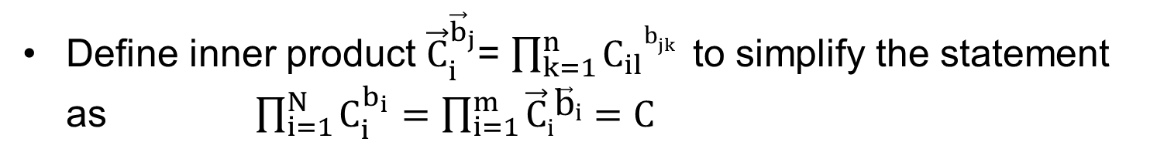
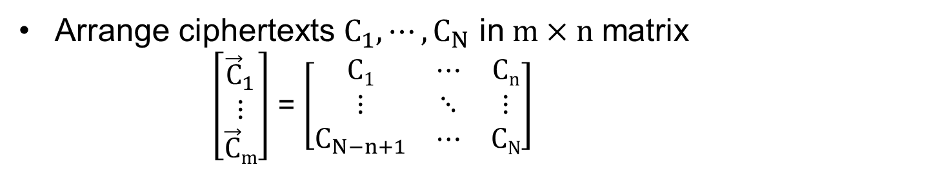
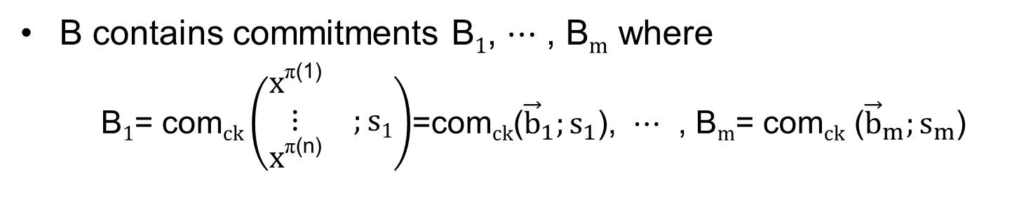
Notation
B contains commitments B$1$, $⋯$ , B$m$ where
B$1$= com$ck\left(\begin{matrix}x\text{π}\text{(1)} & \\ ⋮ & ;s1 \\ x\text{π}\text{(}\text{n}\text{)} & \end{matrix}\right)$=com$ck$(${\vec{b}}_{1};s_{1}$), $⋯$ , B$m$= com$ck$ (${\vec{b}}_{m};s_{m}$)
Arrange ciphertexts $C_{1},⋯, C_{N}$ in$m×n$ matrix
  $\left[\begin{matrix}{\vec{C}}_{1} \\ ⋮ \\ \vec{C}m\end{matrix}\right]$ = $\left[\begin{matrix}C1 & ⋯ & Cn \\ ⋮ & ⋱ & ⋮ \\ C_{N−n+1} & ⋯ & CN\end{matrix}\right]$
Define inner product ${\vec{C}}_{i}^{{\vec{b}}_{j}}$= $\prod_{k=1}^{n}{C_{il}b_{jk}}$to simplify the statement as $\prod_{i=1}^{N}{C_{i}^{b_{i}}}=\prod_{i=1}^{m}{\vec{C}i\vec{b}i}=C$

Slide 18
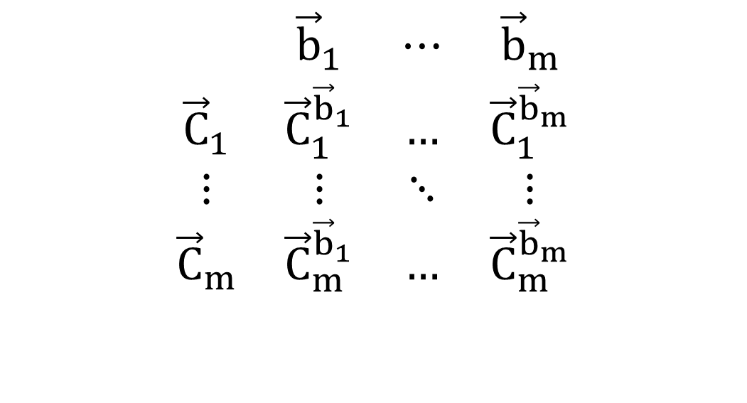
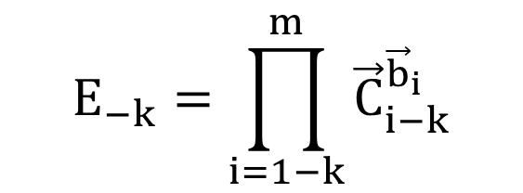
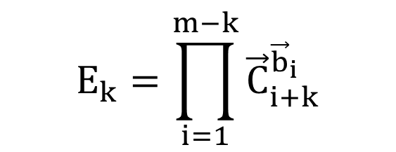
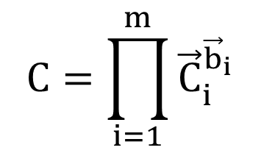
Multi-exponentiation argument idea

Slide 19
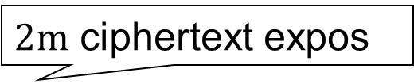
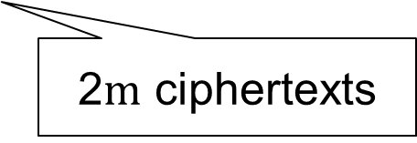
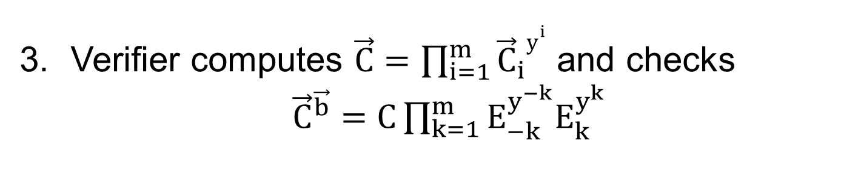
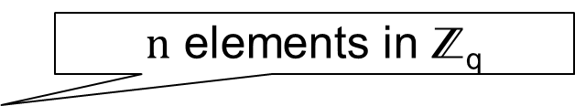
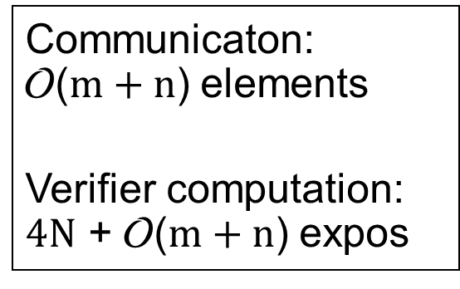
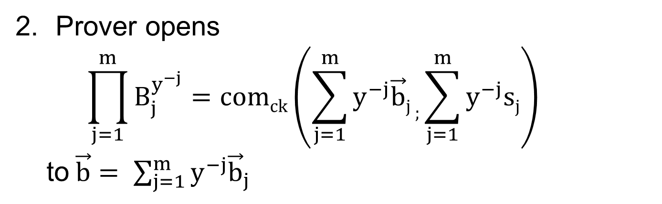
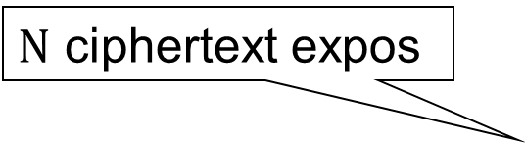
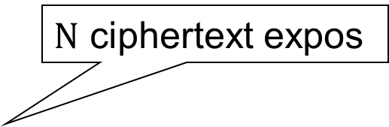
Multi-exponentiation argument
Communicaton:
O($m+n$) elements
Verifier computation:
$4N$ + O($m+n$) expos
Prover sends $E_{−m},⋯, E_{−1}, E_{1},⋯, E_{m}$
2$m$ ciphertexts
  Verifier sends challenge $y∈$ Z$q$
Prover opens
    $$\prod_{j=1}^{m}{B_{j}^{y^{−j}}=comck\left(\sum_{j=1}^{m}{y^{−j}\vec{b}j ;\sum_{j=1}^{m}{y^{−j}sj}}\right)}$$
to$\vec{b}= \sum_{j=1}^{m}{y^{−j}{\vec{b}}_{j}}$
$n$ elements in Z_{q}
$N$ ciphertext expos
Verifier computes $\vec{C}=\prod_{i=1}^{m}{{\vec{C}}_{i}y^{i}}$ and checks
    ${\vec{C}}^{\vec{b}}=C\prod_{k=1}^{m}{E_{−k}^{y^{−k}}E_{k}^{y^{k}}}$
$N$ ciphertext expos
$2m$ ciphertext expos

Slide 20
Prover’s computation
Computing this matrix costs m²n = mN ciphertext expos

Slide 21
Reducing the prover’s computation
Do not compute entire matrix
Instead use techniques for multiplication of polynomials “in the exponent” of ciphertexts
Fast Fourier Transform
  O(N log m) exponentiations O (1) rounds
Interaction
  O (N) exponentiations O (log m) rounds

Slide 22
Implementation
Implementation in C++ using the NTL library and the GMP library
Different levels of optimization
  Multi-exponentiation techniques
  Fast Fourier Transform
  Extra Interaction and Toom-Cook

Slide 23
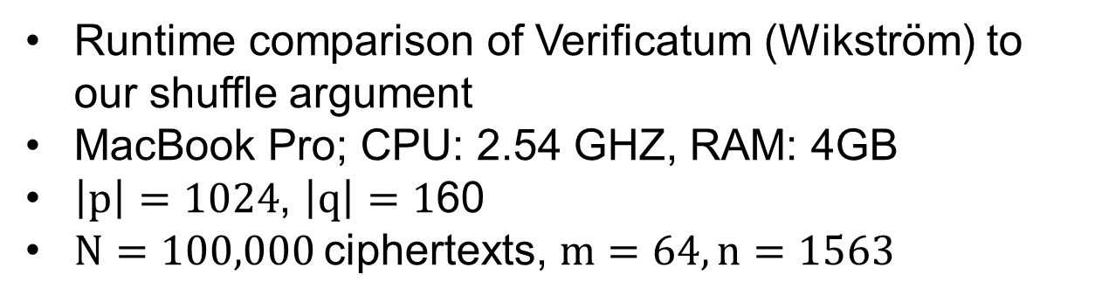
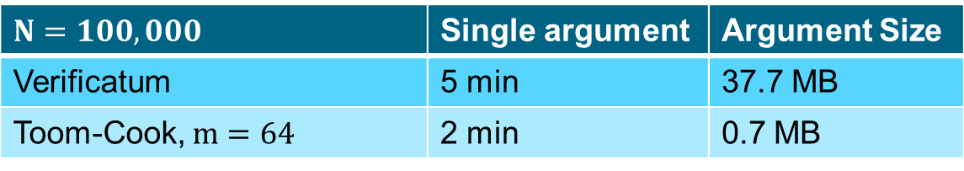
Comparison
$$N=100,000$$ | Single argument | Argument Size
Verificatum | 5 min | 37.7 MB
Toom-Cook, $m=64$ | 2 min | 0.7 MB
Runtime comparison of Verificatum (Wikström) to our shuffle argument
MacBook Pro; CPU: 2.54 GHZ, RAM: 4GB
$\left|p\right|=1024$, $\left|q\right|=1$60
$N=100,000$ciphertexts, $m=64, n=1563$

Slide 24
Thank You

