Slide 1
Quantum Proofs of Knowledge
Dominique Unruh
University of Tartu
Tartu, April 12, 2012

Slide 2
Why quantum ZK?
Zero-knowledge:
Central tool in crypto
Exhibits many issues “in the small case”
Post-quantum crypto:
Classical protocols
secure against quantum adversaries
If the quantum computer comes…
Building blocks in quantum protocols

Slide 3

Zero-knowledge: how to show?
Given only malicious verifier:
simulate interaction
Quantum case: Rewinding = state copying!
Verifier
Guess challenge
commitment
challenge
Retry if wrong
response

Slide 4
Watrous’ quantum rewinding
Cannot copy state → have to restore it
Allows “oblivious” rewinding:
Simulator rewinds, but forgets everything
Sim
Measure: success?
Sim⁻¹
stuff
[Watrous 09]

Slide 5
Quantum ZK solved?
Watrous’ rewinding
covers many important ZK proofs:
(But not all…)
And not: Proofs of knowledge

Slide 6

Proofs of knowledge
Example: Want to prove age (e.g., e-passport)
I know a government-signature on
document stating that I’m ≥ 18
Prover
Verifier

Slide 7
Proofs of knowledge – definition
If prover is successful:
there is an extractor that,
given provers state,
outputs witness

Slide 8
Constructing extractors
commitment
challenge 1
challenge 2
rewind
Prover
response 1
response 2
“Special soundness”: Two different responses allow to compute witness
E.g., isomorphisms from J to G and H
give isomorphis between G and H
J
G
H

Slide 9
Quantum extractors?
Quantum case:
Rewinding = copying. Not possible
Watrous “oblivious” rewinding does not work:
Forgets response 1
commitment
challenge 1
challenge 2
rewind
Prover
response 1
response 2

Slide 10


Canonical extractor
Run prover, measure commitment
Run prover on “challenge 1”,
measure response 1
Run inverse prover
Run prover on “challenge 2”,
measure response 2
M
com
chal. 1
M
res 1
-1
chal. 1
chal. 2
M
res 2

Slide 11
Canonical extractor (ctd.)
Does it work?
Measuring “response 1”
disturbs state
Rewinding fails…
M
com
chal. 1
M
res 1
-1
chal. 1
chal. 2
M
res 2

Slide 12
Making extraction work
Thought experiment:
“response” was only 1 bit
Then: measuring “res 1”
disturbs only moderately
Extraction would work
M
com
chal. 1
moderate
disturbance
M
res 1
-1
chal. 1
chal. 2
M
res 2
12

Slide 13
Making extraction work (ctd.)
Idea: Make “response”
effectively be 1 bit
“Strict soundness”: For any
challenge, exists at most 1
valid response
Given strict soundness,
canonical extractor works!
M
com
chal. 1
moderate
disturbance
M
res 1
-1
chal. 1
chal. 2
M
res 2

Slide 14
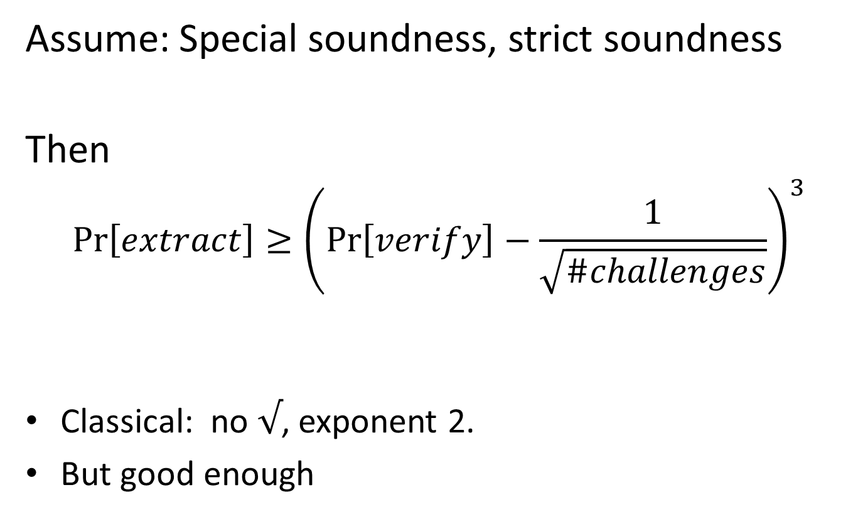
Main result
Assume: Special soundness, strict soundness
Then
$$\operatorname{Pr}\left[extract\right]≥{\left(\operatorname{Pr}\left[verify\right]−\frac{1}{\sqrt{\#challenges}}\right)}^{3}$$
Classical: no $√$, exponent 2.
But good enough

Slide 15
Achieving strict soundness
Graph Isomorphism proof does not
have strict soundness
  Unless graphs are “rigid”
Discrete log proof has
Alternative trick (for #challenges poly):
  Commit to all responses in advance
  Need: “Strict binding” for unique unveil

Slide 16
Plugging things together
Proof system for Hamiltonian cycles
Commitments from injective OWFs
Assuming injective quantum OWFs,
quantum ZK proofs of knowledge
exist for all NP languages
Caveat: No candidates for injective OWFs known.

Slide 17
Future work
Generalizations: Computational,
more than 3 messages
Other rewinding techniques?
  Lunemann, Nielsen 11; Hallgren, Smith, Song 11
  rewind in coin-toss for CRS
Candidates for injective OWFs?

Slide 18
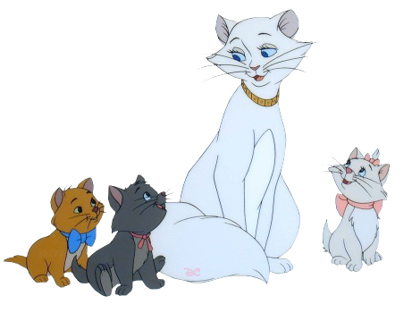



Thank you for your attention!
This research was supported by European Social Fund’s
Doctoral Studies and Internationalisation Programme DoRa

Slide 20
Zero Knowledge
But I don’t want to tell you the proof!
Prover
Verifier
Zero Knowledge Proof:
Prover cannot prove wrong statement
Verifier does not learn anything

Slide 21
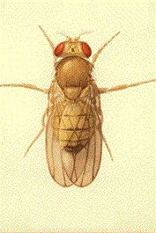
Zero Knowledge
Powerful tool
Combines privacy + integrity
Test-bed for cryptographic techniques
The drosophilia of cryptography

Slide 22
Zero Knowledge: How?
Graphs G and H are isomorphic
Prover
Verifier
Permuted graph J
Permute G
G or H
Pick G or H
Iso between J and G or J and H

Slide 23
Zero Knowledge: How?
G and H not isomorphic
➔ Prover will get stuck with probability ½
Verifier does not learn anything:
Could produce iso and J on his own
Permuted graph J
Permute G
G or H
Pick G or H
Iso between J and G or J and H

Slide 24
Zero Knowledge
Zero knowledge proofs are possible…
…for all statements in NP

Slide 25
Proofs of knowledge – definition
If prover is successful:
prover knows witness
could output witness
there is an extractor that,
given provers state,
outputs witness

