Slide 1
Adaptively Secure Identity-Based Encryption from Lattices with
Asymptotically Shorter Public Parameters
Shota Yamada (AIST)

Slide 2
Background
Lattice-based cryptography
  Resilient to quantum computers, Expressive, (potentially) highly efficient
We focus on adaptively secure identity-based encryption (IBE) from lattices
Adaptively secure lattice IBE is not as efficient as selectively secure ones. (In particular, it requires long public parameters.)
Can we achieve better efficiency?

Slide 3
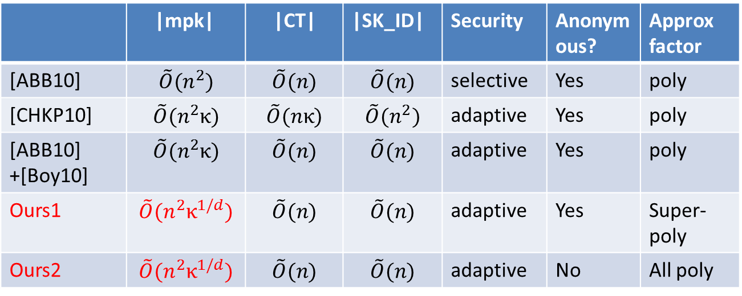
Our Result
We propose adaptively secure lattice IBE with the best efficiency (only) in asymptotic sense.
First ABE with {security from polynomial LWE, short keys, unbounded length branching programs}.
 | |mpk| | |CT| | |SK_ID| | Security | Anonymous? | Approx factor
[ABB10] | $$\tilde{O}(n^{2})$$ | $$\tilde{O}(n)$$ | $$\tilde{O}(n)$$ | selective | Yes | poly
[CHKP10] | $$\tilde{O}(n^{2}κ)$$ | $$\tilde{O}(nκ)$$ | $$\tilde{O}(n^{2})$$ | adaptive | Yes | poly
[ABB10] +[Boy10] | $$\tilde{O}(n^{2}κ)$$ | $$\tilde{O}(n)$$ | $$\tilde{O}(n)$$ | adaptive | Yes | poly
Ours1 | $$\tilde{O}(n^{2}κ^{1/d})$$ | $$\tilde{O}(n)$$ | $$\tilde{O}(n)$$ | adaptive | Yes | Super-poly
Ours2 | $$\tilde{O}(n^{2}κ^{1/d})$$ | $$\tilde{O}(n)$$ | $$\tilde{O}(n)$$ | adaptive | No | All poly
n: dimension of lattices, κ: length of the identities

Slide 4
Agenda
Preliminaries
Previous Works
Our Construction
Comparison
Summary

Slide 5

The Syntax of
Identity-Based Encryption
Requirement for Correctness:
Iff ID = ID’

Slide 6







Adaptive Security for IBE
The ciphertext is pseudorandom,
which implies anonymity

Slide 7



Learning with Error (LWE) Assumption
Distinguish the following distributions:
n
A
1
b
Small errors
m
m
A
A
s
x
Coefficients of s, A, b are random elements in Zq.
affects the hardness. The smaller the harder. We call it approximation factor here.

Slide 8
Agenda
Preliminaries
Previous Works
Our Construction
Comparison
Summary

Slide 9




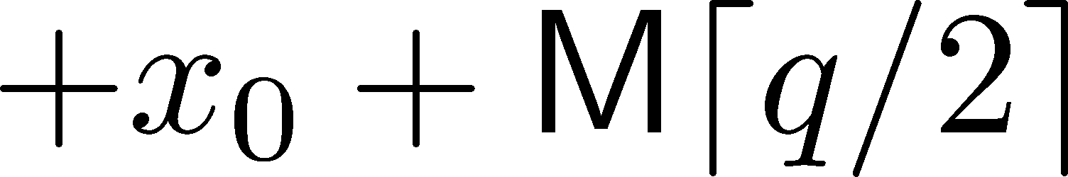


Template for IBE(1)
A
u
KeyGen
e
Secret key for ID:
short vector e
A
H(ID)
u
Small errors
Encryption
u
s
A
H(ID)
s
x

Slide 10

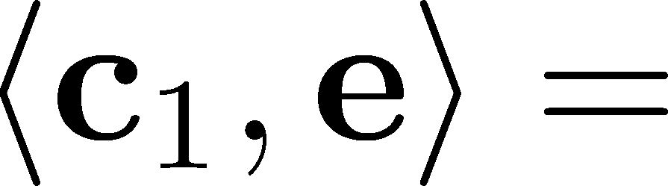


Template for IBE(2)
Decryption
e
A
H(ID)
s
x
e
e
A
H(ID)
s
x
u
Small term

Slide 11

Template for Security Proof
We depend on the partitioning technique to prove the security from LWE.
We embed the problem instance into
public parameters so that
Gadget matrix
Small
RID
H(ID)
A
G
In the
simulation,
We hope

Slide 12

Adaptively secure IBE from Lattices [ABB10], [Boy10]
H(ID)
B0
Bi
Long public key!
# of matrices is linear in the length of ID
The security proof follows the template. In particular
it is similar to that of Waters’ IBE [Wa05].

Slide 13
Agenda
Preliminaries
Previous Works
Our Construction
Comparison
Summary

Slide 14
Difficulty of Reducing the Size of mpk
To achieve adaptive security, we have several choices
  Waters’ hash [Wa05]
  →requires long parameters (as we have seen)
  Dual system encryption methodology [Wa09]
  →No lattice analogue
  Naccache’s variant of Waters’ hash [Na05]
  →still long (asymptotically)
  Use admissible hash [BB04b]
  →require long parameters
Use a technique unique to lattice setting:
Fully homomorphic computation.

Slide 15

Special Matrix G
Given and , it is possible to
compute with small coefficients such that
G
U
V
V
G
U
Chosen deterministically,
denoted as

Slide 16
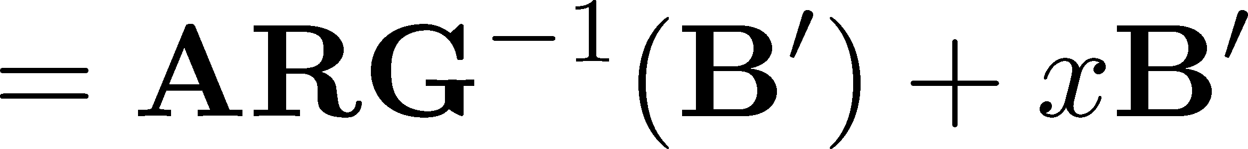
Fully Homomorphic Computation
Let
The following holds
Small, if R,R’,x,x’ are small

Slide 17
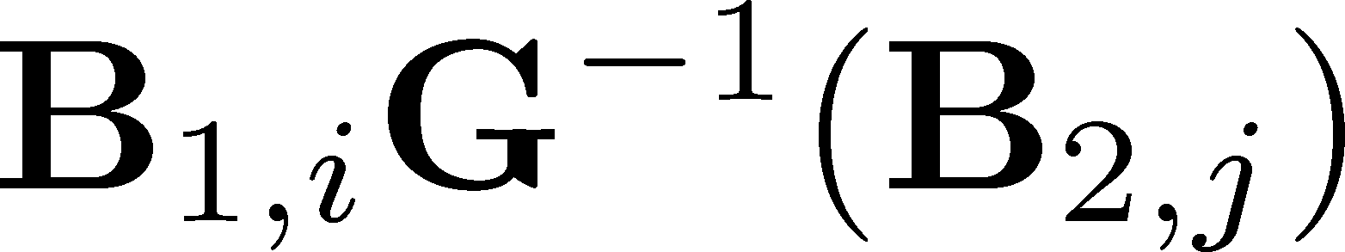
Our Idea to Reduce
Public Parameters (1)
B0
B2,1
B2,j
B2, √κ
B1,1
B1,i
B1, √κ
Use smaller number ( O(√κ) ) of matrices
to generate larger number ( O(κ) ) of matrices

Slide 18

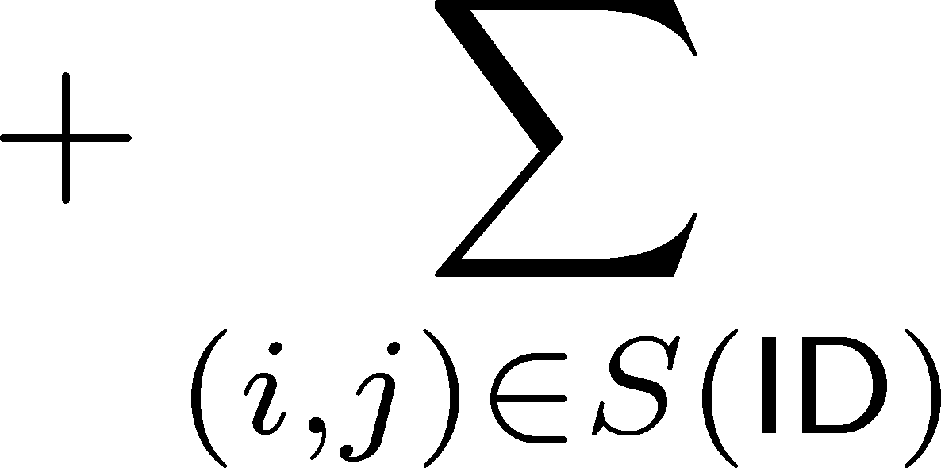
Our Idea to Reduce
Public Parameters (2)
B0
B2,1
B2,j
B2, √κ
B1,1
B1,i
( i ,j )
B1, √κ
Depending on ID, choose matrices and aggregate it
B0
( i ,j )

Slide 19
Our Scheme
B1,1
B1, √κ
u
A
B0
B2,1
B2, √κ
KeyGen
e
Secret key for ID:
short vector e
A
H(ID)
u
Small errors
Encryption
u
s
A
H(ID)
s
x

Slide 20
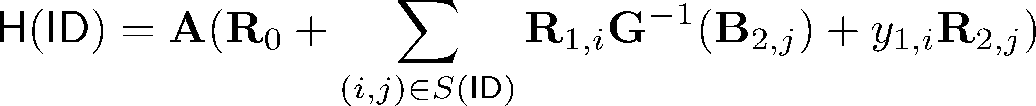
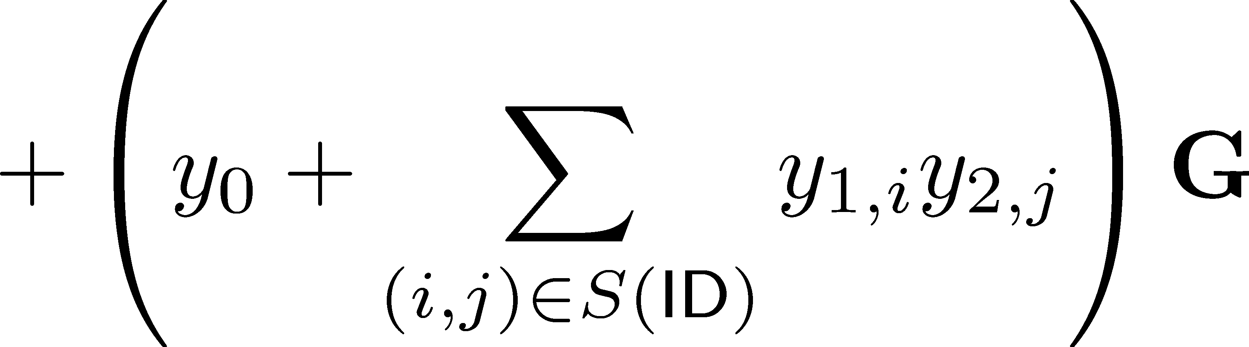

Security Proof (1)
“Small”

Slide 21
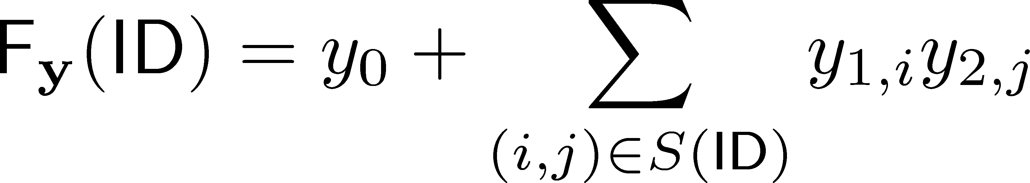
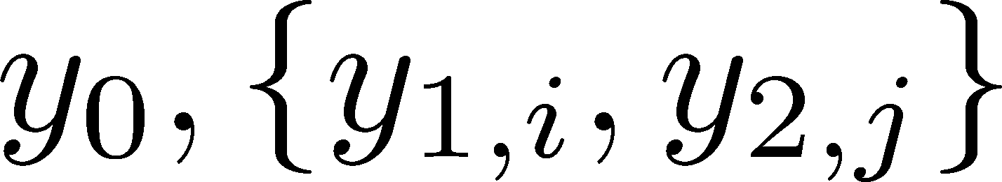



Security Proof (2)
We have to choose so that
the probability of the following occurring is noticeable:
where is the challenge identity,
are identities for which key
extraction queries are made, and is the
number of queries.

Slide 22
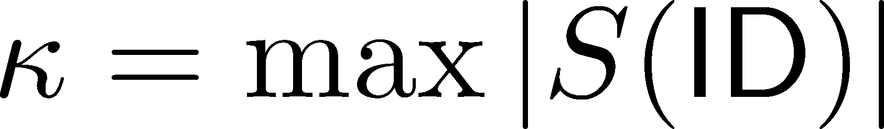


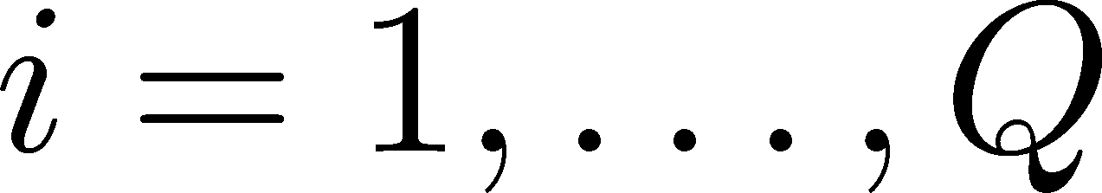
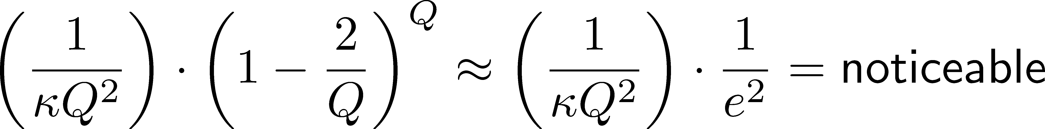
Security Proof (3)
where
It is easy to see
By the Schwartz-Zippel lemma, for all for
The probability in estimation is expected to be

Slide 23
There is still a Problem!
These elements are not small enough
compared to the modulus q
(proportional to y1,i, and thus to Q)
Simple Solution (Our first construction):
Use super polynomial modulus q >> Q.
The security proof requires LWE assumption
with super polynomial approx factor.

Slide 24
Idea to Base the Security on Polynomial LWE
By adding some modification to the scheme, we can prove the security assuming that LWE is hard for all polynomial approx factors (Our second scheme)
  The idea is to run our first scheme with different parameters in parallel.
  By this modification, the anonymity of the scheme is lost. Furthermore, the efficiency slightly degrades.
The similar idea is applicable to ABE for branching programs [GV15].

Slide 25
Agenda
Preliminaries
Previous Works
Our Construction
Comparison
Summary

Slide 26
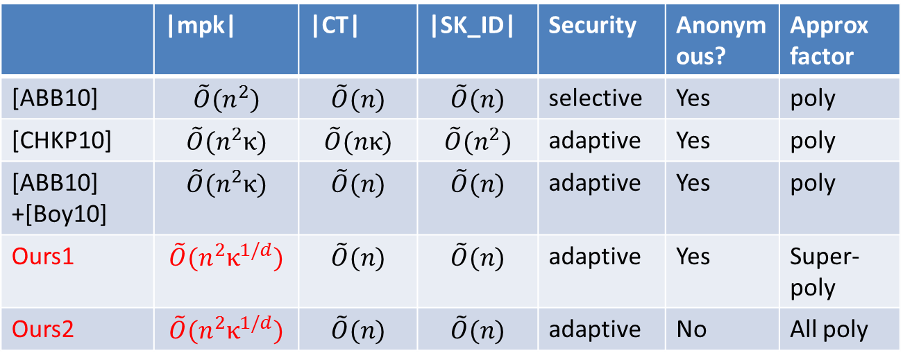
Comparison of IBE Schemes
 | |mpk| | |CT| | |SK_ID| | Security | Anonymous? | Approx factor
[ABB10] | $$\tilde{O}(n^{2})$$ | $$\tilde{O}(n)$$ | $$\tilde{O}(n)$$ | selective | Yes | poly
[CHKP10] | $$\tilde{O}(n^{2}κ)$$ | $$\tilde{O}(nκ)$$ | $$\tilde{O}(n^{2})$$ | adaptive | Yes | poly
[ABB10] +[Boy10] | $$\tilde{O}(n^{2}κ)$$ | $$\tilde{O}(n)$$ | $$\tilde{O}(n)$$ | adaptive | Yes | poly
Ours1 | $$\tilde{O}(n^{2}κ^{1/d})$$ | $$\tilde{O}(n)$$ | $$\tilde{O}(n)$$ | adaptive | Yes | Super-poly
Ours2 | $$\tilde{O}(n^{2}κ^{1/d})$$ | $$\tilde{O}(n)$$ | $$\tilde{O}(n)$$ | adaptive | No | All poly
n: dimension of
lattices,
κ: length of the
identities
We have to assume the LWE assumption with approx factor O(n^c) for all constant c

Slide 27
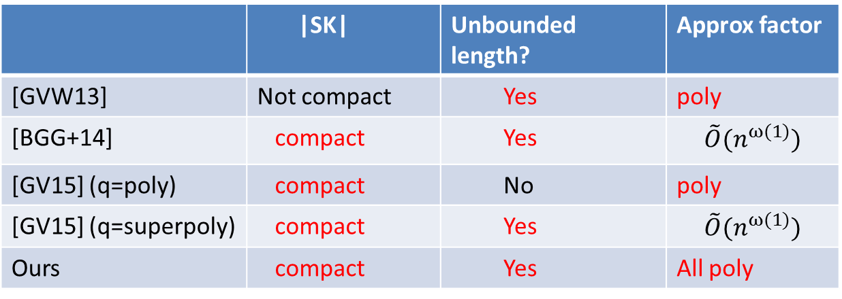
Comparison of ABE Schemes
By a similar idea, we propose the first ABE for branching programs that
  can deal with unbounded length branching programs
  can be proven secure under the polynomial LWE
  has compact keys.
 | |SK| | Unbounded length? | Approx factor
[GVW13] | Not compact | Yes | poly
[BGG+14] | compact | Yes | $$\tilde{O}(n^{ω(1)})$$
[GV15] (q=poly) | compact | No | poly
[GV15] (q=superpoly) | compact | Yes | $$\tilde{O}(n^{ω(1)})$$
Ours | compact | Yes | All poly

Slide 28
Agenda
Preliminaries
Previous Works
Our Construction
Comparison
Summary

Slide 29
Conclusion
We proposed adaptively secure IBE scheme with asymptotically short public parameters.
  The idea is to use fully homomorphic computation
  The security proof involves partitioning technique with non-linear function.
We also proposed ABE for branching programs with new properties.

