Slide 1
On the Size of Pairing-based
Non-interactive Arguments
Jens Groth
University College London
TexPoint fonts used in EMF.
Read the TexPoint manual before you delete this box.: AAAAAAAAAAAAA

Slide 2


Non-interactive zero-knowledge argument
Common reference string
Statement: $x∈L_{R}$
$$\left(x,w\right)∈R$$
OK
Proof: π
Zero-knowledge:
Nothing but truth revealed
Soundness:
Statement is true
Prover Verifier

Slide 3



Applications
NIZK arguments guarantee honesty (soundness), yet also preserve privacy (zero-knowledge)

Slide 4
Our contribution
NIZK argument
  Perfect completeness
  Perfect zero-knowledge
  Computational soundness
    Generic group model
Efficiency
  Asymmetric (Type III) pairings
  3 group element proofs
  Low computation
zk-SNARK
Succinct Non-interactive Argument of Knowledge

Slide 5
Our contribution
Lower bound
  Look at pairing-based non-interactive arguments
    Not necessarily zero-knowledge
  A few restrictions on the type of argument
    Common for all known pairing-based SNARKs
  NIZK arguments cannot have 1 element proofs
    For asymmetric (Type III) pairings
Open question whether 2 elements is possible

Slide 6
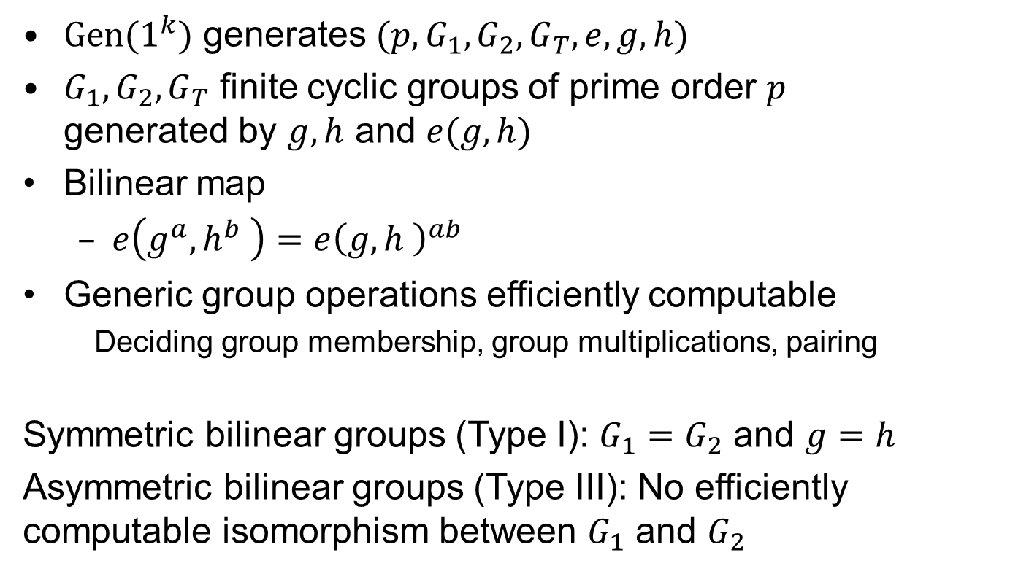
Prime order bilinear groups
$Gen(1^{k})$ generates $(p, G_{1},G_{2},G_{T},e,g,h)$
$G_{1},G_{2},G_{T}$ finite cyclic groups of prime order $p$
generated by $g,h$ and $e(g,h)$
Bilinear map
  $e\left(g^{a},h^{b} \right)=e{\left(g,h \right)}^{ab}$
Generic group operations efficiently computable
  Deciding group membership, group multiplications, pairing
Symmetric bilinear groups (Type I): $G_{1}=G_{2}$ and $g=h$
Asymmetric bilinear groups (Type III): No efficiently computable isomorphism between $G_{1}$ and $G_{2}$

Slide 7
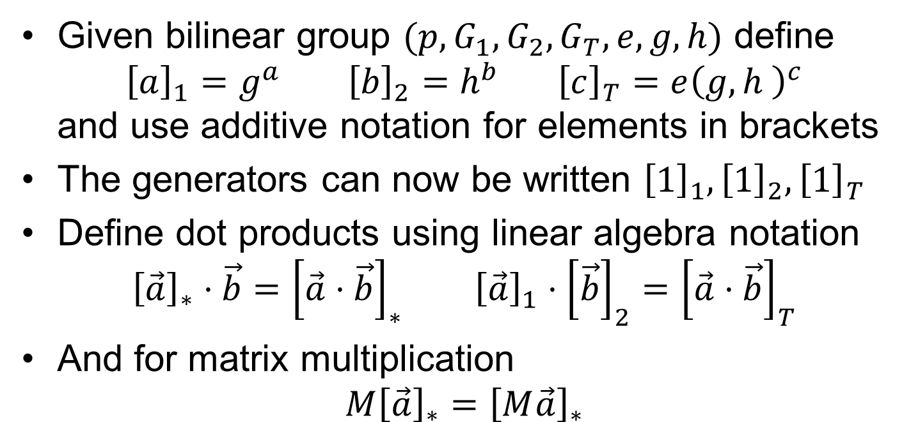
Additive notation
Given bilinear group $(p,G_{1},G_{2},G_{T},e,g,h)$ define
${\left[a\right]}_{1}=g^{a} {\left[b\right]}_{2}=h^{b} {\left[c\right]}_{T}=e{\left(g,h \right)}^{c}$
and use additive notation for elements in brackets
The generators can now be written ${\left[1\right]}_{1},{\left[1\right]}_{2},{\left[1\right]}_{T}$
Define dot products using linear algebra notation
${\left[\vec{a}\right]}_{∗}⋅\vec{b}={\left[\vec{a}⋅\vec{b}\right]}_{∗} {\left[\vec{a}\right]}_{1}⋅{\left[\vec{b}\right]}_{2}={\left[\vec{a}⋅\vec{b}\right]}_{T}$
And for matrix multiplication
$M{\left[\vec{a}\right]}_{∗}={\left[M\vec{a}\right]}_{∗}$

Slide 8
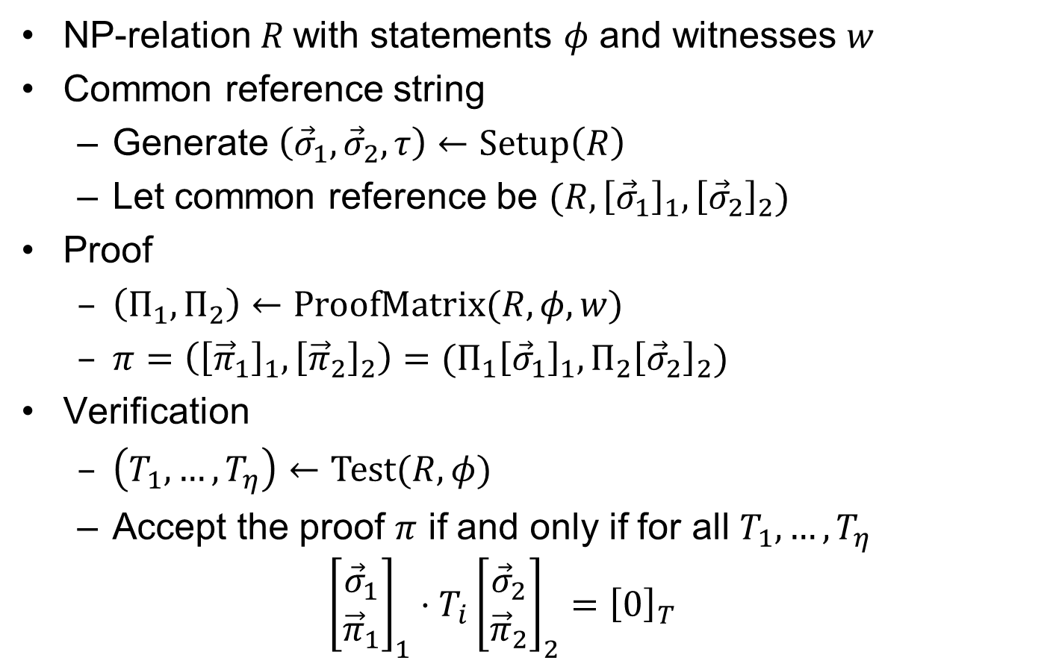
Pairing-based SNARK
NP-relation $R$with statements $φ$ and witnesses $w$
Common reference string
  Generate $\left({\vec{σ}}_{1},{\vec{σ}}_{2},τ\right)←Setup\left(R\right)$
  Let common reference be $(R, {\left[{\vec{σ}}_{1}\right]}_{1},{\left[{\vec{σ}}_{2}\right]}_{2})$
Proof
  $\left(Π_{1},Π_{2}\right)←ProofMatrix(R,φ,w)$
  $π=\left({\left[{\vec{π}}_{1}\right]}_{1},{\left[{\vec{π}}_{2}\right]}_{2}\right)=(Π_{1}{\left[{\vec{σ}}_{1}\right]}_{1},Π_{2}{\left[{\vec{σ}}_{2}\right]}_{2})$
Verification
  $\left(T_{1},…,T_{η}\right)←Test(R,φ)$
  Accept the proof $π$ if and only if for all $T_{1},…,T_{η}$
  ${\left[\begin{aligned}{\vec{σ}}_{1} \\ {\vec{π}}_{1}\end{aligned}\right]}_{1}⋅T_{i}{\left[\begin{matrix}{\vec{σ}}_{2} \\ {\vec{π}}_{2}\end{matrix}\right]}_{2}={\left[0\right]}_{T}$
Generic group operations

Slide 9
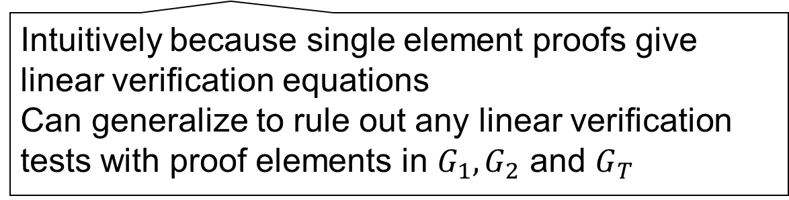
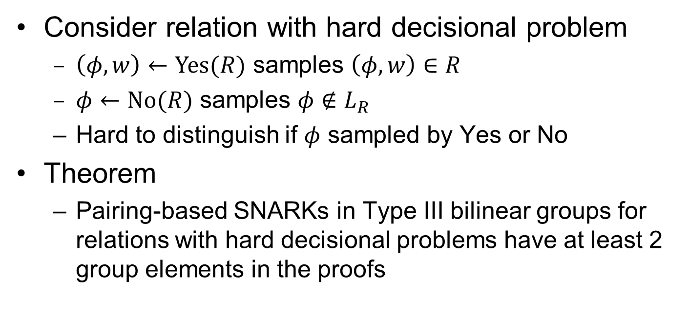
Lower bound
Consider relation with hard decisional problem
  $\left(φ,w\right)←Yes(R)$ samples $\left(φ,w\right)∈R$
  $φ←No(R)$ samples $φ∉L_{R}$
  Hard to distinguish if $φ$ sampled by Yes or No
Theorem
  Pairing-based SNARKs in Type III bilinear groups for relations with hard decisional problems have at least 2 group elements in the proofs
Intuitively because single element proofs give linear verification equations
Can generalize to rule out any linear verification tests with proof elements in $G_{1},G_{2}$ and $G_{T}$

Slide 10
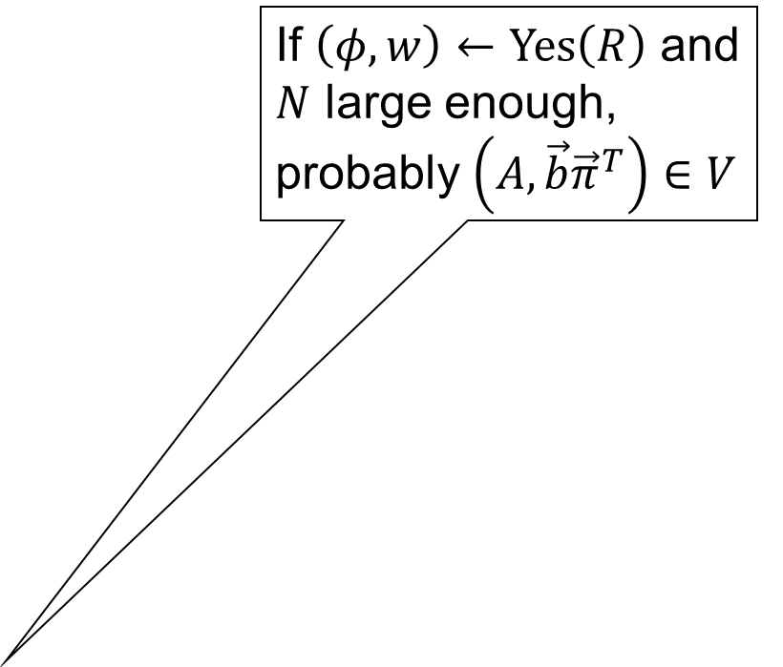
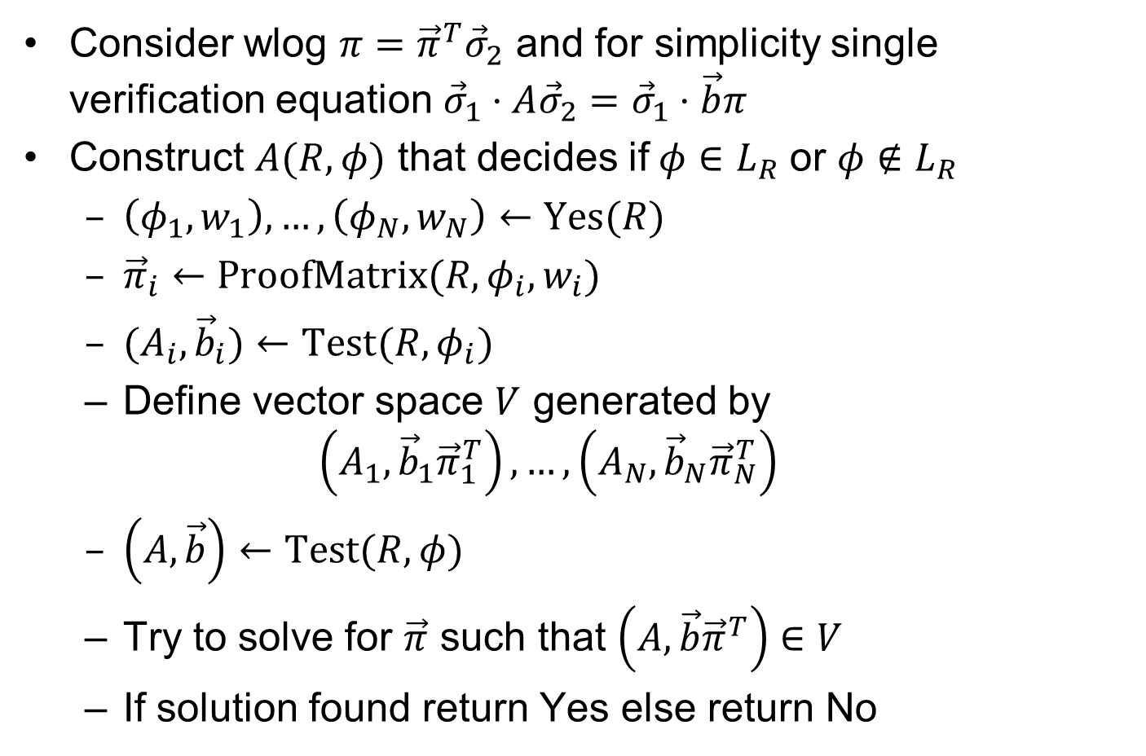

Single element impossible
Consider wlog $π={\vec{π}}^{T}{\vec{σ}}_{2}$ and for simplicity single verification equation ${\vec{σ}}_{1}⋅A{\vec{σ}}_{2}={\vec{σ}}_{1}⋅\vec{b}π$
Construct $A(R,φ)$ that decides if$φ∈L_{R}$ or $φ∉L_{R}$
  $\left(φ_{1},w_{1}\right),…,\left(φ_{N},w_{N}\right)←Yes(R)$
  ${\vec{π}}_{i}←ProofMatrix(R,φ_{i},w_{i})$
  $(A_{i},{\vec{b}}_{i})←Test(R,φ_{i})$
  Define vector space $V$ generated by
  $\left(A_{1}, {\vec{b}}_{1}{\vec{π}}_{1}^{T}\right),…,\left(A_{N},{\vec{b}}_{N}{\vec{π}}_{N}^{T}\right)$
  $\left(A,\vec{b}\right)←Test(R,φ)$
  Try to solve for $\vec{π}$ such that $\left(A,\vec{b}{\vec{π}}^{T}\right)∈V$
  If solution found return Yes else return No
If $\left(φ,w\right)←Yes\left(R\right)$ and $N$ large enough, probably $\left(A,\vec{b}{\vec{π}}^{T}\right)∈V$
By completeness
$${\vec{σ}}_{1}⋅A_{i}{\vec{σ}}_{2}={\vec{σ}}_{1}⋅\vec{b}{\vec{π}}_{i}^{T}{\vec{σ}}_{2}$$
So for all $\left(A,B\right)∈V$
$${\vec{σ}}_{1}⋅A{\vec{σ}}_{2}={\vec{σ}}_{1}⋅B{\vec{σ}}_{2}$$
By soundness if
$φ∉L_{R}$ unlikely that
${\vec{σ}}_{1}⋅A{\vec{σ}}_{2}={\vec{σ}}_{1}⋅\vec{b}{\vec{π}}^{T}{\vec{σ}}_{2}$ has solution $\vec{π}$

Slide 11
Construction
NIZK argument for arithmetic circuit satisfiability
  Perfect completeness
  Perfect zero-knowledge
  Knowledge soundness in the generic group model
Efficiency
  Asymmetric (Type III) pairings
  3 group element proofs
  Low computation

Slide 12

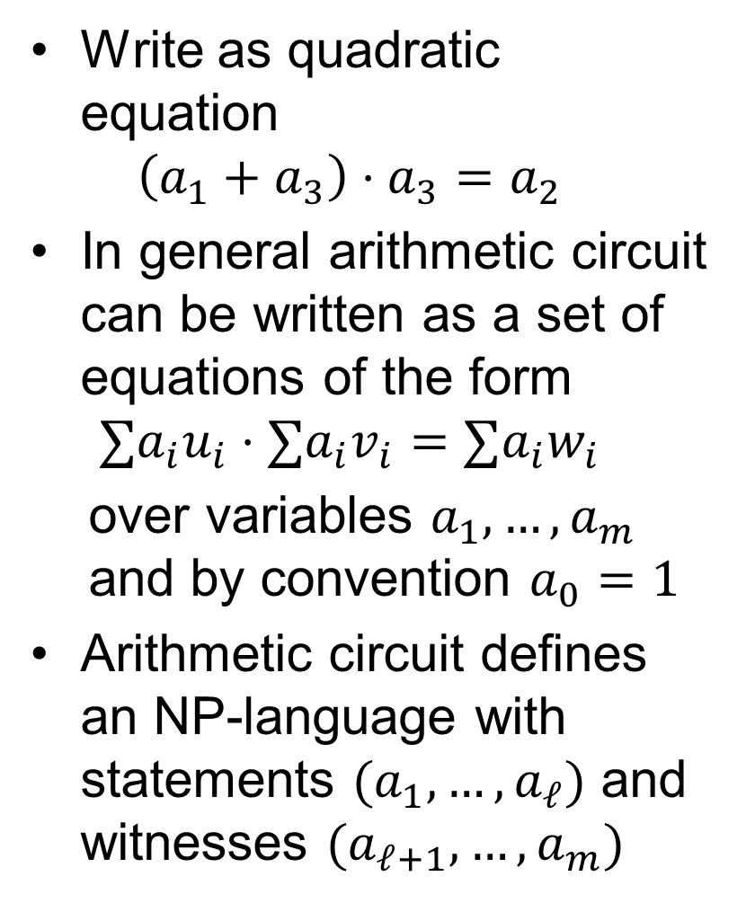



Arithmetic circuit
Write as quadratic equation
$\left(a_{1}+a_{3}\right)⋅a_{3}=a_{2}$
In general arithmetic circuit can be written as a set of equations of the form
$∑a_{i}u_{i}⋅∑a_{i}v_{i}=∑a_{i}w_{i}$
over variables $a_{1},…,a_{m}$
and by convention $a_{0}=1$
Arithmetic circuit defines an NP-language with statements $(a_{1},…,a_{ℓ})$ and witnesses $(a_{ℓ+1},…,a_{m})$
$$a_{2}$$
$$a_{4}$$
$$a_{1}$$
$$a_{3}$$

Slide 13
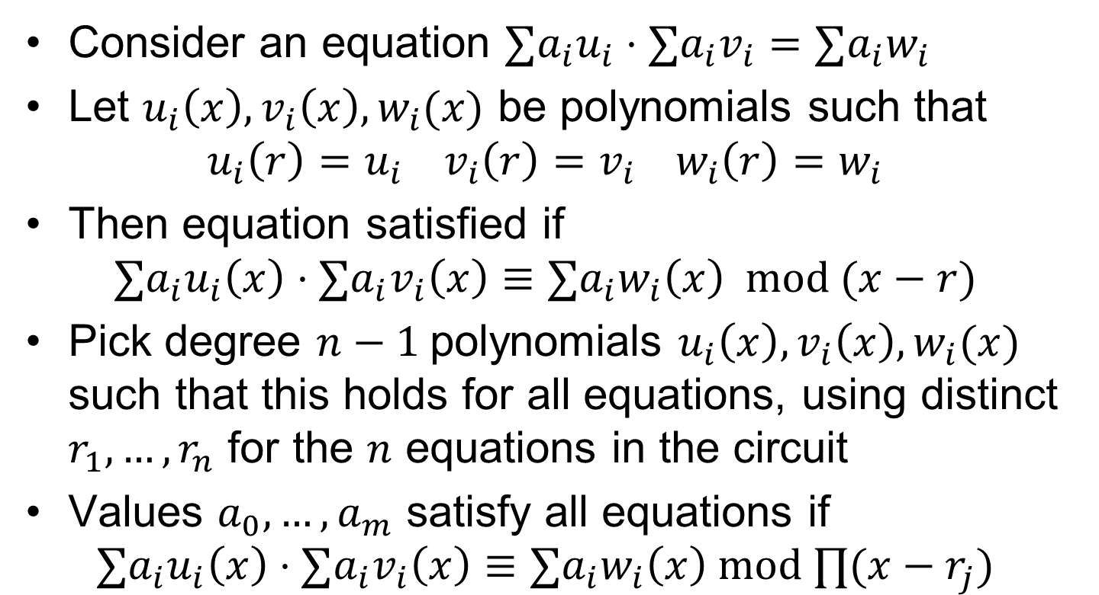
Rewriting the circuit as polynomial equations
Consider an equation $∑a_{i}u_{i}⋅∑a_{i}v_{i}=∑a_{i}w_{i}$
Let $u_{i}\left(x\right), v_{i}\left(x\right),w_{i}(x)$ be polynomials such that
$u_{i}\left(r\right)=u_{i} v_{i}\left(r\right)=v_{i} w_{i}\left(r\right)=w_{i}$
Then equation satisfied if
$∑a_{i}u_{i}\left(x\right)⋅∑a_{i}v_{i}\left(x\right)≡∑a_{i}w_{i}\left(x\right) mod (x−r)$
Pick degree $n−1$polynomials $u_{i}\left(x\right), v_{i}\left(x\right), w_{i}(x)$ such that this holds for all equations, using distinct $r_{1},…,r_{n}$ for the $n$ equations in the circuit
Values $a_{0},…,a_{m}$ satisfy all equations if
$∑a_{i}u_{i}\left(x\right)⋅∑a_{i}v_{i}\left(x\right)≡∑a_{i}w_{i}\left(x\right) mod ∏(x−r_{j})$

Slide 14
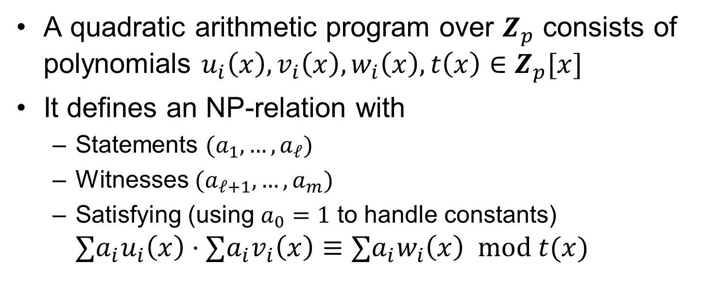
Quadratic arithmetic program
A quadratic arithmetic program over $Z_{p}$ consists of polynomials $u_{i}\left(x\right),v_{i}\left(x\right),w_{i}\left(x\right),t\left(x\right)∈Z_{p}[x]$
It defines an NP-relation with
  Statements $(a_{1},…,a_{ℓ})$
  Witnesses $(a_{ℓ+1},…,a_{m})$
  Satisfying (using $a_{0}=1$ to handle constants)
  $∑a_{i}u_{i}\left(x\right)⋅∑a_{i}v_{i}\left(x\right)≡∑a_{i}w_{i}\left(x\right) mod t(x)$

Slide 15
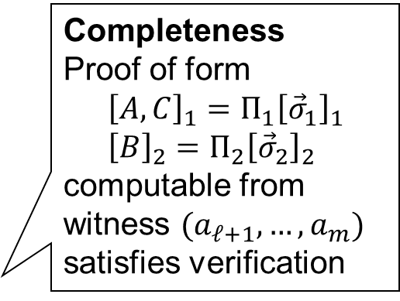

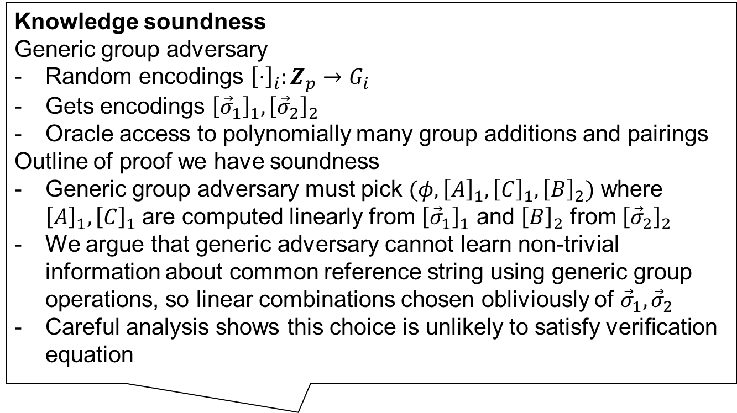
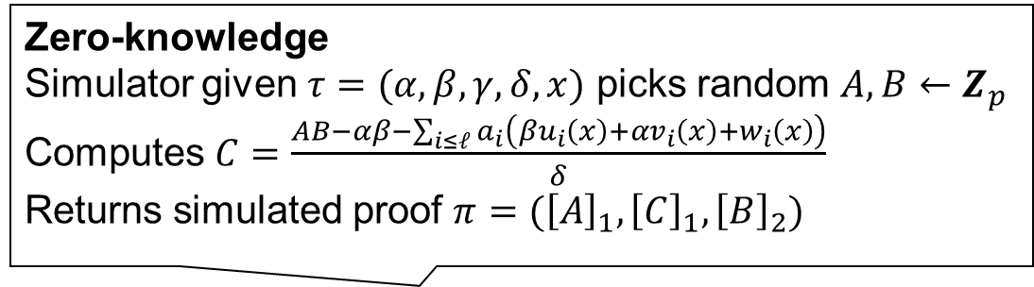

SNARK for QAPs
Efficiency
Proof size: $2G_{1} , 1G_{2}$
Prover: $m+2n E_{1},n E_{2}$
Verifier: $ℓ E_{1}+3P$
Knowledge soundness
Generic group adversary
Random encodings ${\left[⋅\right]}_{i}:Z_{p}→G_{i}$
Gets encodings ${\left[{\vec{σ}}_{1}\right]}_{1},{\left[{\vec{σ}}_{2}\right]}_{2}$
Oracle access to polynomially many group additions and pairings
Outline of proof we have soundness
Generic group adversary must pick $(φ,{\left[A\right]}_{1},{\left[C\right]}_{1},{\left[B\right]}_{2})$ where ${\left[A\right]}_{1},{\left[C\right]}_{1}$ are computed linearly from ${\left[{\vec{σ}}_{1}\right]}_{1}$ and ${\left[B\right]}_{2}$ from ${\left[{\vec{σ}}_{2}\right]}_{2}$
We argue that generic adversary cannot learn non-trivial information about common reference string using generic group operations, so linear combinations chosen obliviously of ${\vec{σ}}_{1},{\vec{σ}}_{2}$
Careful analysis shows this choice is unlikely to satisfy verification equation
Zero-knowledge
Simulator given $τ=(α,β,γ,δ,x)$ picks random $A,B←Z_{p}$
Computes $C=\frac{AB−αβ−\sum_{i≤ℓ}{a_{i}\left(βu_{i}\left(x\right)+αv_{i}\left(x\right)+w_{i}\left(x\right)\right)}}{δ}$
Returns simulated proof $π=({\left[A\right]}_{1},{\left[C\right]}_{1},{\left[B\right]}_{2})$
Common reference string $σ=({\left[{\vec{σ}}_{1}\right]}_{1},{\left[{\vec{σ}}_{2}\right]}_{2})$
  ${\vec{σ}}_{1}=\left(α,β,δ,\left\{x^{i}\right\},\left\{\frac{x^{i}t\left(x\right)}{δ}\right\},{\left\{\frac{βu_{i}\left(x\right)+αv_{i}\left(x\right)+w_{i}\left(x\right)}{γ}\right\}}_{i≤ℓ}^{},{\left\{\frac{βu_{i}\left(x\right)+αv_{i}\left(x\right)+w_{i}\left(x\right)}{δ}\right\}}_{i>ℓ}\right)$
  ${\vec{σ}}_{2}=\left(β,γ,δ,\left\{x^{i}\right\}\right)$
Prover creates $π=({\left[A\right]}_{1},{\left[C\right]}_{1},{\left[B\right]}_{2})$
  $$A=α+∑a_{i}u_{i}\left(x\right)+rδ B=β+∑a_{i}v_{i}(x)+sδ$$
  $$C=\sum_{i>ℓ}{a_{i}\frac{βu_{i}\left(x\right)+αv_{i}\left(x\right)+w_{i}\left(x\right)}{δ}}+Ar+Bs−rsδ$$
Verifier accepts if
${\left[A\right]}_{1}⋅{\left[B\right]}_{2}={\left[α\right]}_{1}⋅{\left[β\right]}_{2}+\sum_{i=0}^{ℓ}{a_{i}{\left[\frac{βu_{i}\left(x\right)+αv_{i}\left(x\right)+w_{i}\left(x\right)}{γ}\right]}_{1}⋅{\left[γ\right]}_{2}}+{\left[C\right]}_{1}⋅{\left[δ\right]}_{2}$
Completeness
Proof of form
$${\left[A,C\right]}_{1}=Π_{1}{\left[{\vec{σ}}_{1}\right]}_{1} \\ {\left[B\right]}_{2}=Π_{2}{\left[{\vec{σ}}_{2}\right]}_{2}$$
computable from witness $(a_{ℓ+1},…,a_{m})$ satisfies verification

Slide 16

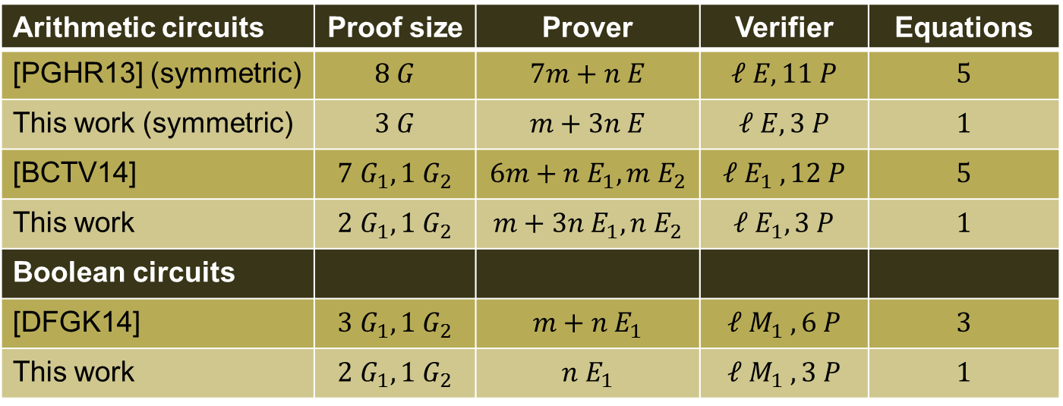
Efficiency
Arithmetic circuits | Proof size | Prover | Verifier | Equations
[PGHR13] (symmetric) | $$8 G$$ | $$7m+n E$$ | $$ℓ E, 11 P$$ | $$5$$
This work (symmetric) | $$3 G$$ | $$m+3n E$$ | $$ℓ E, 3 P$$ | $$1$$
[BCTV14] | $$7 G_{1}, 1 G_{2}$$ | $$6m+n E_{1}, m E_{2}$$ | $$ℓ E_{1} , 12 P$$ | $$5$$
This work | $$2 G_{1}, 1 G_{2}$$ | $$m+3n E_{1}, n E_{2}$$ | $$ℓ E_{1}, 3 P$$ | $$1$$
Boolean circuits
[DFGK14] | $$3 G_{1}, 1 G_{2}$$ | $$m+n E_{1}$$ | $$ℓ M_{1} , 6 P$$ | $$3$$
This work | $$2 G_{1}, 1 G_{2}$$ | $$n E_{1}$$ | $$ℓ M_{1} , 3 P$$ | $$1$$
Circuits with $m$ wires, $n$ gates, statement size $ℓ$ ($ℓ≪n<m$)
Group element $G$, exponentiation $E$, pairing $P$, multiplication $M$
Implemented in libsnark [Chiesa and Virza 2016]
  Recursion with SNARKs in two related elliptic curves
  We reduce both time and size, leading to combined factor 4-5 performance improvement in prover time
Efficiency gain
1. Generic group model instead of knowledge of exponent assumption
2. Carefully crafted verification equations

Slide 17
Summary
Lower bound
  Pairing-based non-interactive arguments using Type III pairings must have at least 2 group elements
NIZK argument for arithmetic circuit satisfiability
  Perfect completeness
  Perfect zero-knowledge
  Computational knowledge soundness
    Proof in generic group model
  Proof size of 3 group elements
  Computationally efficient

