Slide 1


Reusable Fuzzy Extractors for Low-Entropy Distributions
Benjamin Fuller
Joint work with Ran Canetti, Omer Paneth, Adam Smith, and Leonid Reyzin
May 9, 2016
Notes:
1
1

Slide 2
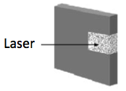
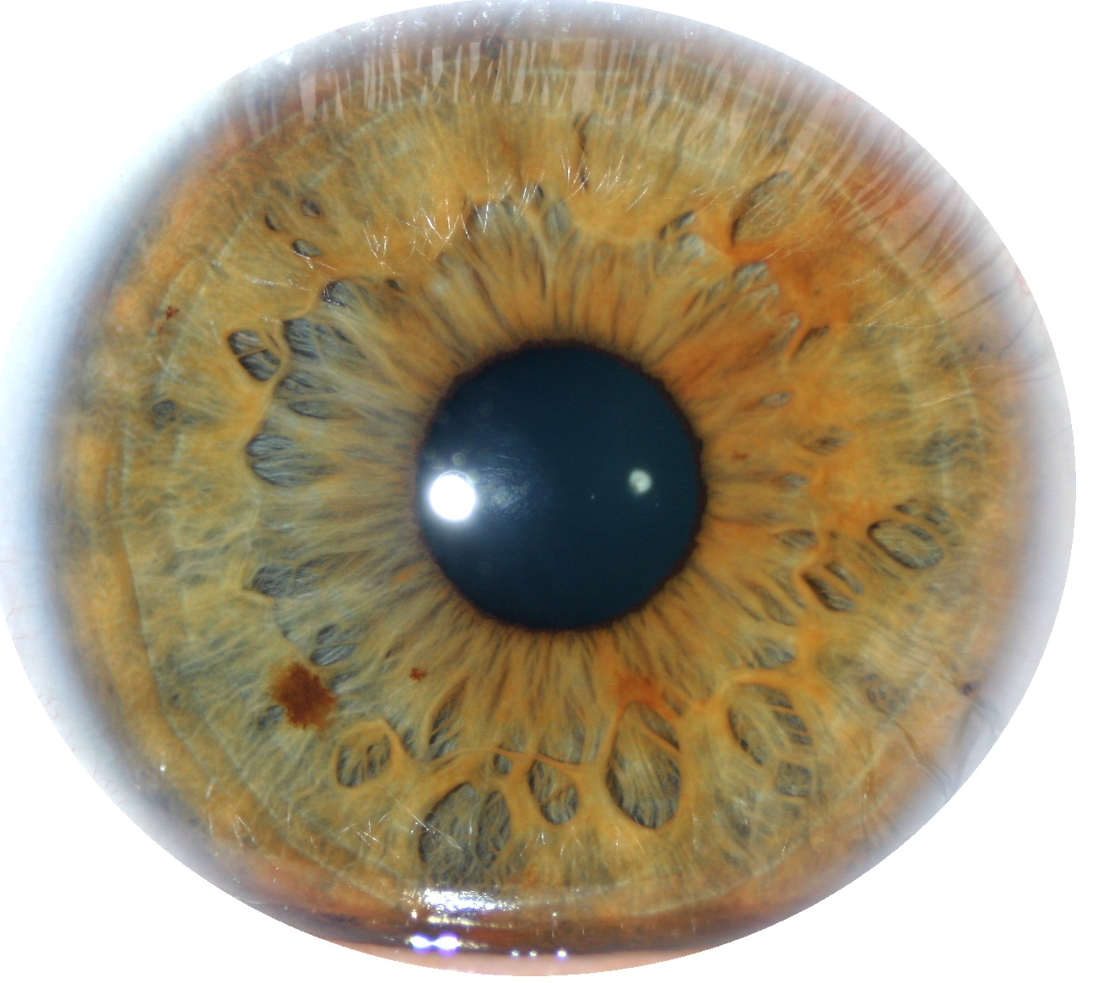
Key Derivation from Noisy Sources
Physically Unclonable Functions (PUFs)
[PappuRechtTaylorGershenfeld02]
Biometric Data
High-entropy sources are often noisy
  Initial reading initial ≠ later reading final
  Source initial = a₁,…, a_{k}, each symbol a_{i} over alphabet Z
  Assume a bound on Hamming distance: d(initial, final) ≤ t
Goal: derive a stable cryptographically strong output
  Give same key if d(initial, final)<t
  Key appears (pseudo)random to adversary
Challenge: Traditional approaches do not provide adequate security for many physical sources
Notes:
http://sigma.octopart.com/14152599/image/Microchip-TC14433EPG.jpg
http://www.drgaelriverz.com/images/Round_Eye.JPG

Slide 3
 | Contribution | Previous Approach
Reusability | Reusable fuzzy extractor: Source can be enrolled multiple times, no assumption about how repeated readings are correlated Biometrics can’t be changed Producing PUFs costs money | Construction of [Boyen04] requires each reading differ by fixed constants
Necessary Entropy | 3 fuzzy extractors for low entropy distributions: each construction is secure for a large class of sources Main construction requires only super-logarithmic entropy | Construction of [JuelsWattenberg99] needs linear entropy rate or Constructions of [MaesTuylsVerbauwhede09, DevadasYu10] require symbols are i.i.d

Slide 4
Outline
Key Derivation from Noisy Sources
Modeling Noisy Sources and Defining Security
Limitations of Traditional Approaches
New Constructions

Slide 5


Quality of a noisy source
initial – create a new person,
take initial reading
Parameters:
How far apart are initial and final? Noise or t (from experimentation)
How many values of initial are there? Define entropy as
k=log(# values of initial)
<t
final –new reading from
same person

Slide 6
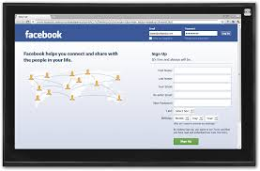
Key Derivation from Noisy Sources
Interactive Protocols
[Wyner75] … [BennettBrassardRobert85,88] …lots of work…
Today: focus on noninteractive setting,
user authenticating to insecure device
initial
final
Parties agree on cryptographic key

Slide 7
Fuzzy Extractors
[JuelsWattenberg99], …, [DodisOstrovskyReyzinSmith04] …
Enrollment Gen:
Create key from initial, also create public value help.
Authentication Rep: produce key if
d(initial, final) < t
Assume attacker knows distribution of initial
Security: attacker shouldn’t know anything about key
key
Gen
initial
help
key
Rep
< t
final

Slide 8
Fuzzy Extractors
[JuelsWattenberg99], …, [DodisOstrovskyReyzinSmith04] …
Enrollment Gen:
Create key from initial, also create public value help.
Authentication Rep: produce key if
d(initial, final) < t
Security: key looks random
key
Want security when device state is compromised
Gen
initial
help
key
Rep
< t
final

Slide 9
Fuzzy Extractors
[JuelsWattenberg99], …, [DodisOstrovskyReyzinSmith04] …
Enrollment Gen:
Create key from initial, also create public value help.
Authentication Rep: produce key if
d(initial, final) < t
Security: key looks random even if attacker knows help
key
Want security when device state is compromised
Gen
initial
help
key
Rep
< t
final

Slide 10
Fuzzy Extractors
[JuelsWattenberg99], …, [DodisOstrovskyReyzinSmith04] …
Enrollment Gen:
Create key from initial, also create public value help.
Authentication Rep: produce key if
d(initial, final) < t
Security: key looks random even if attacker knows help
Security can be information-theoretic or computational [DodisOstrovskyReyzinSmith04], [FullerMengReyzin13]
key
Gen
initial
help
key
Rep
< t
final

Slide 11
Outline
Key Derivation from Noisy Sources
Model and Defining Security
Limitations of Traditional Approaches
  Many biometrics [BlantonHudelson09] and PUFs [KoeberlLiRajanWu14] have little entropy, traditional fuzzy extractors provide no security
New Constructions
Is it possible to provide security for low entropy sources?
Consider case where entropy k < t (number of errors)

Slide 12
Is it possible to handle low entropy: k < t ?
Possible values of initial

Slide 13
Is it possible to handle low entropy: k < t ?
Possible values of initial
t
final
Recall: attacker can run Rep on any point

Slide 14
Is it possible to handle low entropy: k < t ?
Possible values of initial
t
final
Recall: attacker can run Rep on any point

Slide 15
Is it possible to handle low entropy: k < t ?
Possible values of initial
t
key
r
Rep
Recall: attacker can run Rep on any point

Slide 16
Is it possible to handle low entropy: k < t ?
Possible values of initial
t
key
r
Rep
Key derivation is not possible if the source is distributed like this
Recall: attacker can run Rep on any point

Slide 17
Is it possible to handle low entropy: k < t ?
Counterexample goes away if source distributed like this!
Possible values of initial
Checking in with reality:
Iris has:
  |initial| = 2048 bits
  k = 249
  t ≈ 300
  Closest distance for two people is 680 bits
  [Daugman04]
t
final
Noisy sources have more structure than k and t !!
Recall: attacker can run Rep on any point

Slide 18
Outline
Strong Authentication through Key Derivation
Model and Defining Security
Limitations of Traditional Approaches
New Constructions
  Use properties of distribution beyond entropy (k)
  Observation: many noisy sources are redundant; subsampling increases entropy rate

Slide 19
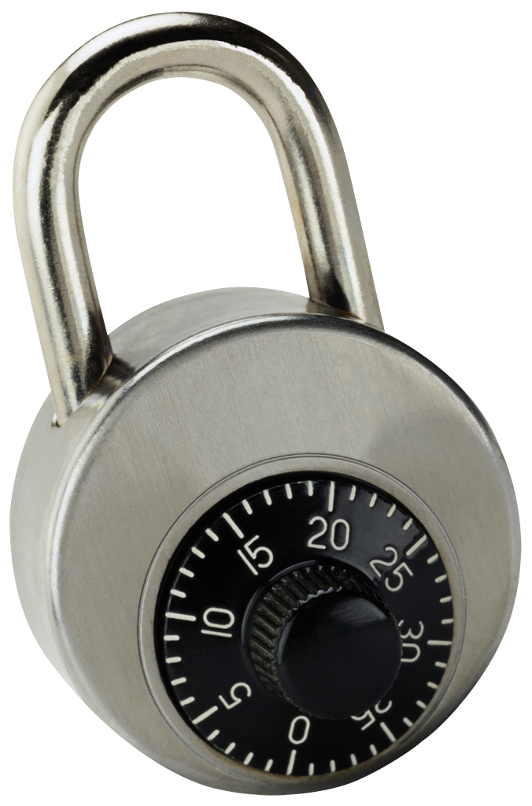
Idea: “encrypt” key using parts of initial
Gen: - get random combinations of symbols in initial
key
- “lock” r using these combinations
key
initial = a₁ a₂ a₃ a₄ a₅ a₆ a₇ a₈ a₉
Gen
help
r
r
r
r
r
r
r
r
r
r
r
r
a₁ a₉ a₂
a₃ a₉ a₅
a₃ a₄ a₅
a₇ a₅ a₆
a₂ a₈ a₇
a₃ a₅ a₂

Slide 20
Idea: “encrypt” key using parts of initial
Gen: - get random combinations of symbols in initial
key
- “lock” r using these combinations
key
initial = a₁ a₂ a₃ a₄ a₅ a₆ a₇ a₈ a₉
Gen
help
r
r
r
r
r
r
r
r
r
r
r
r
a₁ a₉ a₂
a₃ a₉ a₅
a₃ a₄ a₅
a₇ a₅ a₆
a₂ a₈ a₇
a₃ a₅ a₂

Slide 21
Idea: “encrypt” key using parts of initial
Gen: - get random combinations of symbols in initial
key
- “lock” r using these combinations
key
initial = a₁ a₂ a₃ a₄ a₅ a₆ a₇ a₈ a₉
Gen
help
key
key
key
key
key
key
r
r
r
r
r
r
a₁ a₉ a₂
a₃ a₉ a₅
a₃ a₄ a₅
a₇ a₅ a₆
a₂ a₈ a₇
a₃ a₅ a₂

Slide 22
Idea: “encrypt” key using parts of initial
Gen: - get random combinations of symbols in initial
key
- “lock” r using these combinations
- = locks + positions of symbols to unlock
help
key
initial = a₁ a₂ a₃ a₄ a₅ a₆ a₇ a₈ a₉
Gen
help
r
r
r
r
r
r
a₁ a₉ a₂
a₃ a₉ a₅
a₃ a₄ a₅
a₇ a₅ a₆
a₂ a₈ a₇
a₃ a₅ a₂

Slide 23
Idea: “encrypt” key using parts of initial
Gen: - get random combinations of symbols in initial
key
- “lock” r using these combinations
- = locks + positions of symbols to unlock
help
key
initial = a₁ a₂ a₃ a₄ a₅ a₆ a₇ a₈ a₉
Gen
help
r
r
r
r
r
r
a₁ a₉ a₂
a₃ a₉ a₅
a₃ a₄ a₅
a₇ a₅ a₆
a₂ a₈ a₇
a₃ a₅ a₂

Slide 24
Idea: “encrypt” key using parts of initial
Gen: - get random combinations of symbols in initial
key
- “lock” r using these combinations
- = locks + positions of symbols to unlock
help
help
r
r
r
r
r
r
a₁ a₉ a₂
a₃ a₉ a₅
a₃ a₄ a₅
a₇ a₅ a₆
a₂ a₈ a₇
a₃ a₅ a₂

Slide 25
Idea: “encrypt” key using parts of initial
Gen: - get random combinations of symbols in initial
key
- “lock” r using these combinations
- = locks + positions of symbols to unlock
help
Rep:
final = a₁ a₂ a₃ a₄ a₅ a₆ a₇ a₈ a₉
key
Rep
help
r
r
r
r
r
r
a₁ a₉ a₂
a₃ a₉ a₅
a₃ a₄ a₅
a₇ a₅ a₆
a₂ a₈ a₇
a₃ a₅ a₂

Slide 26
Idea: “encrypt” key using parts of initial
Gen: - get random combinations of symbols in initial
key
- “lock” r using these combinations
- = locks + positions of symbols to unlock
help
Rep:
final = a₁ a₂ a₃ a₄ a₅ a₆ a₇ a₈ a₉
key
Rep
help
r
r
r
r
r
r
a₁ a₉ a₂
a₃ a₉ a₅
a₃ a₄ a₅
a₇ a₅ a₆
a₂ a₈ a₇
a₃ a₅ a₂

Slide 27
Idea: “encrypt” key using parts of initial
Gen: - get random combinations of symbols in initial
key
- “lock” r using these combinations
- = locks + positions of symbols to unlock
help
Rep: Use the symbols of final to open at least one lock
final = a₁ a₂ a₃ a₄ a₅ a₆ a₇ a₈ a₉
key
Rep
help
r
r
r
r
r
r
a₁ a₉ a₂
a₃ a₉ a₅
a₃ a₄ a₅
a₇ a₅ a₆
a₂ a₈ a₇
a₃ a₅ a₂

Slide 28
Idea: “encrypt” key using parts of initial
Gen: - get random combinations of symbols in initial
key
- “lock” r using these combinations
- = locks + positions of symbols to unlock
help
Rep: Use the symbols of final to open at least one lock
final = a₁ a₂ a₃ a₄ a₅ a₆ a₇ a₈ a₉
key
Rep
help
key
r
r
r
r
r
r
a₁ a₉ a₂
a₃ a₉ a₅
a₃ a₄ a₅
a₇ a₅ a₆
a₂ a₈ a₇
a₃ a₅ a₂

Slide 29
Idea: “encrypt” key using parts of initial
Gen: - get random combinations of symbols in initial
key
- “lock” r using these combinations
- = locks + positions of symbols to unlock
help
Rep: Use the symbols of final to open at least one lock
Error-tolerance: supports any t =o(|initial|)
Security: must be hard to guess each combination
key
r
r
r
r
r
r
a₁ a₉ a₂
a₃ a₉ a₅
a₃ a₄ a₅
a₇ a₅ a₆
a₂ a₈ a₇
a₃ a₅ a₂

Slide 30
Security
Must be hard to guess each combination
Necessary (+sufficient): Samples from source have super logarithmic entropy
Includes:
  All high entropy sources
  Low entropy sources where symbols are redundant
Subset of all sources where initial are far apart in Hamming space
key
r
r
r
r
r
r
a₁ a₉ a₂
a₃ a₉ a₅
a₃ a₄ a₅
a₇ a₅ a₆
a₂ a₈ a₇
a₃ a₅ a₂

Slide 31
Security
Must be hard to guess each combination
Necessary (+sufficient): Samples from source have super logarithmic entropy
Includes:
  All high entropy sources
  Low entropy sources where symbols are redundant
Subset of all sources where initial are far apart in Hamming space
Need to show how locks are implemented
key
r
r
r
r
r
r
a₁ a₉ a₂
a₃ a₉ a₅
a₃ a₄ a₅
a₇ a₅ a₆
a₂ a₈ a₇
a₃ a₅ a₂

Slide 32
How to implement locks?
A lock is the following program:
  If input = a₁ a₉ a₂, output key
  Else output ⊥
  One implementation:
  lock = key || 00…00 ⊕ Hash(a₁ a₉ a₂)
  (secure in the random oracle model)
key
a₁ a₉ a₂
Ideally: Obfuscate this program
  Obfuscation: preserve functionality, hide the program
  Obfuscating this specific program called “digital locker”

Slide 33
Digital Lockers
key
Digital Locker is obfuscation of
  If input = a₁ a₉ a₂, output key
  Else output ⊥
Equivalent to encryption of key that is secure
even when encrypted multiple times with correlated, weak keys [CanettiKalaiVariaWichs10]
Digital lockers are practical (random oracle, discrete logarithm-based)
[CanettiDakdouk08], [BitanskyCanetti10]
Hides key if input can’t be exhaustively searched
(superlogarithmic entropy)
a₁ a₉ a₂

Slide 34
Digital Lockers
key
Digital Locker is obfuscation of
  If input = a₁ a₉ a₂, output key
  Else output ⊥
Equivalent to encryption of r that is secure
even multiple times with correlated and weak keys
[CanettiKalaiVariaWichs10]
Digital lockers are practical (R.O. or DL-based)
[CanettiDakdouk08], [BitanskyCanetti10]
Hides r if input can’t be exhaustively searched
(superlogarithmic entropy)
a₁ a₉ a₂
Q: if you are going to use obfuscation, why bother?
Why not just obfuscate the following program for help
  If distance between initial and input is less than t, output key
  Else output ⊥
A: you can do that [BitanskyCanettiKalaiPaneth14], it is:
  inefficient
  requires very strong assumption
  not known to be reusable

Slide 35
A Reusable Fuzzy Extractor
Same source can be enrolled multiple times
with independent services
key
initial
Gen
help
Secret even given
help, help', help'',
key, key''
key'
initial'
Gen
help'
key''
initial''
Gen
help''

Slide 36
A Reusable Fuzzy Extractor
Same source can be enrolled multiple times
with independent services
In the past: difficult to achieve, because typically
new enrollments leak fresh information
(esp. in help)
Only previous construction [Boyen2004]:
each enrollment must differ by fixed constants (unrealistic)
Our construction: digital lockers leak no partial information (w.h.p.), only requirement:
sampling condition holds for each reading

Slide 37
 | Contribution
Reusability | Reusable fuzzy extractor: Source can be enrolled with multiple services, no assumption about how repeated readings are correlated
Necessary Entropy | Main construction requires only super-logarithmic entropy Two additional constructions in paper supporting k< t, one w/ info-theoretic security
Questions?
key
r
r
r
r
r
r
a₁ a₉ a₂
a₃ a₉ a₅
a₃ a₄ a₅
a₇ a₅ a₆
a₂ a₈ a₇
a₃ a₅ a₂

