Slide 1


Title 00/26
Improved Progressive BKZ Algorithms and their
Precise Cost Estimation by Sharp Simulator
Yoshinori Aono†
Joint work with
Yuntao Wang††, Takuya Hayashi† and Tsuyoshi Takagi††
†
††
Talk at Eurocrypt 2016, 2016/05/12
Paper full-version: http://eprint.iacr.org/2016/146
Our library for verification:
http://www2.nict.go.jp/security/pbkzcode/index.html

Slide 2
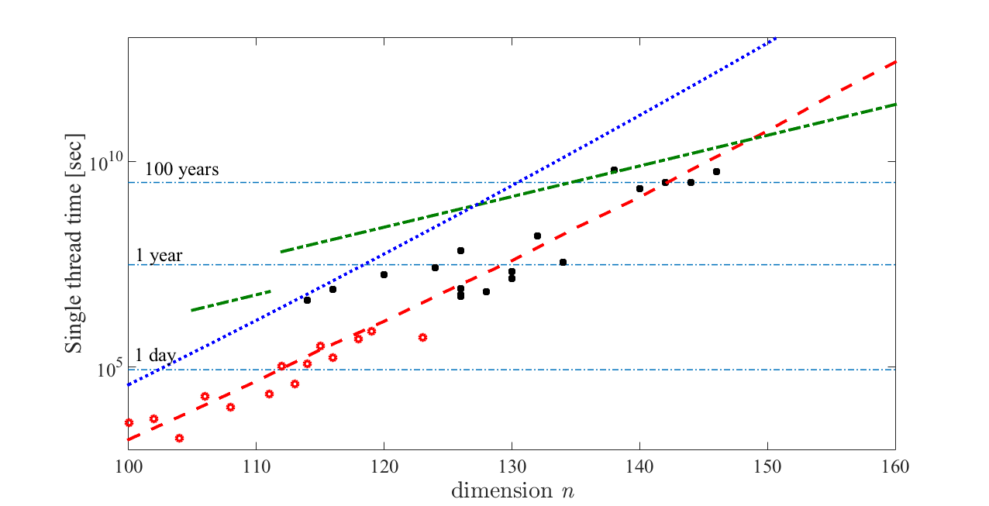
Result 01/26
Applying our result to SVP challenge
Time to find a vector < 1.05GH in a random lattice
Our implementation is comparable to the world records
BKZ 2.0 simulation
with fixed blocksize
Conjecture in
Kuo et al. [CHES 2011]
using GTX-480 GPU
Our algorithm
Our Experimental Results
Records of SVP Challenge
Paper full-version: http://eprint.iacr.org/2016/146
Our library for verification:
http://www2.nict.go.jp/security/pbkzcode/index.html

Slide 3
Agenda
Agenda
Background and preliminaries
Classical BKZ and observations
Our theory to progressive BKZ
  What is best parameter for given basis?
  How to predict the converged basis?
  How to measure a given basis is nearing
  the converged basis, or far from?
Outline of cost analysis
Conclusion

Slide 4
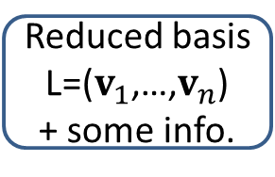
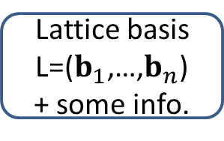
Background and the goal
Background 02/26
Real cost analysis for solving lattice-based crypto.
Time(LatticeReduction)+Time(PointSearch) is dominant
Lattice basis reduction is used for preprocess
  To speed-up the lattice point search part
Our two-step attacking model
?
An instance:
(PK,C,info,…)
Secret info.
(m,SK,…)
How much time?
Lattice basis
L=($b_{1}$,…,$b_{n}$)
+ some info.
Reduced basis
L=($v_{1}$,…,$v_{n}$)
+ some info.
Point
search
Point
v∈L
Lattice
reduction
Our research is here
We propose: 1. Improved lattice reduction algorithm
2. Simulator to predict attacking time

Slide 5
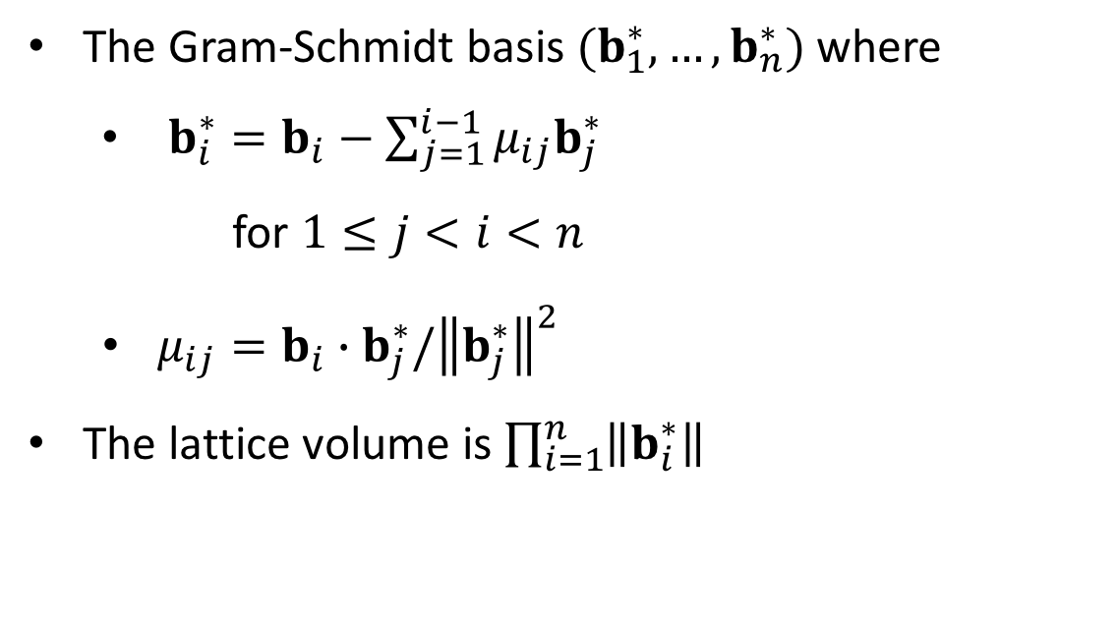
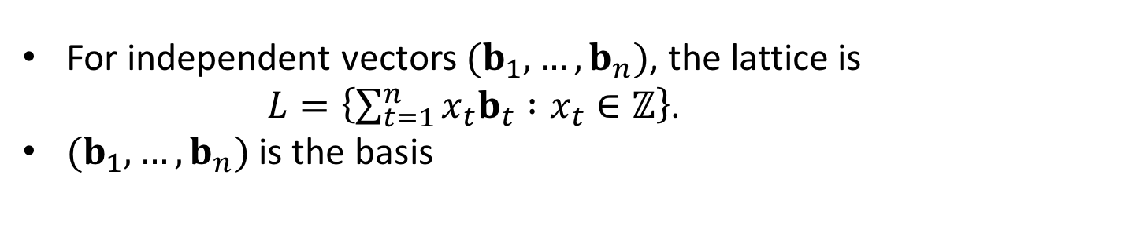

Lattices and basic properties
Lattices(1/6) 03/26
For independent vectors $(b_{1},…,b_{n})$, the lattice is
$L=\left\{\sum_{t=1}^{n}{x_{t}b_{t} :x_{t}∈ℤ}\right\}$.
$(b_{1},…,b_{n})$ is the basis
The Gram-Schmidt basis $(b_{1}^{∗},…,b_{n}^{∗})$ where
  $b_{i}^{∗}=b_{i}−\sum_{j=1}^{i−1}{μ_{ij}b_{j}^{∗}}$
  for $1≤j<i<n$
  $μ_{ij}=b_{i}∙b_{j}^{∗}/{\left\|b_{j}^{∗}\right\|}^{2}$
The lattice volume is $\prod_{i=1}^{n}{\left\|b_{i}^{∗}\right\|}$
$$vol(L)$$
b2
b*2
b1
O
Example of 2-dim. lattice

Slide 6
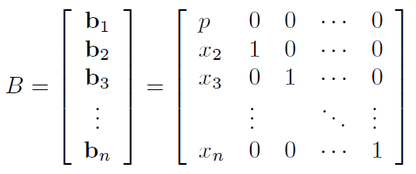
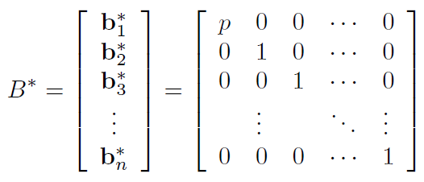
Lattices and basic properties
Lattices(2/6) 04/26
In this talk, we use row vectors and matrices to represent basis vectors and lattices
Example: A random lattice of [Goldstein-Meyer2003] type
(cf. SVP Challenge)
The GS-basis of lower triangle matrix is diagonal:

Slide 7
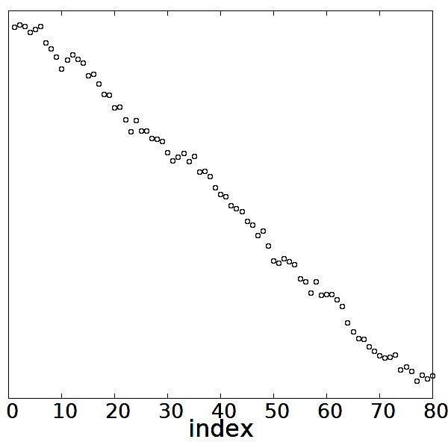
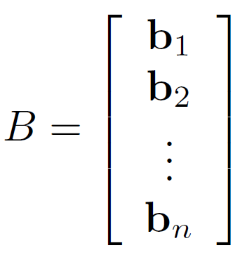
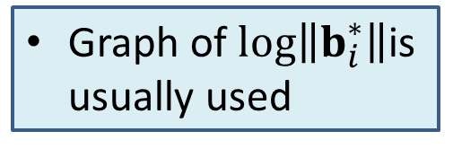
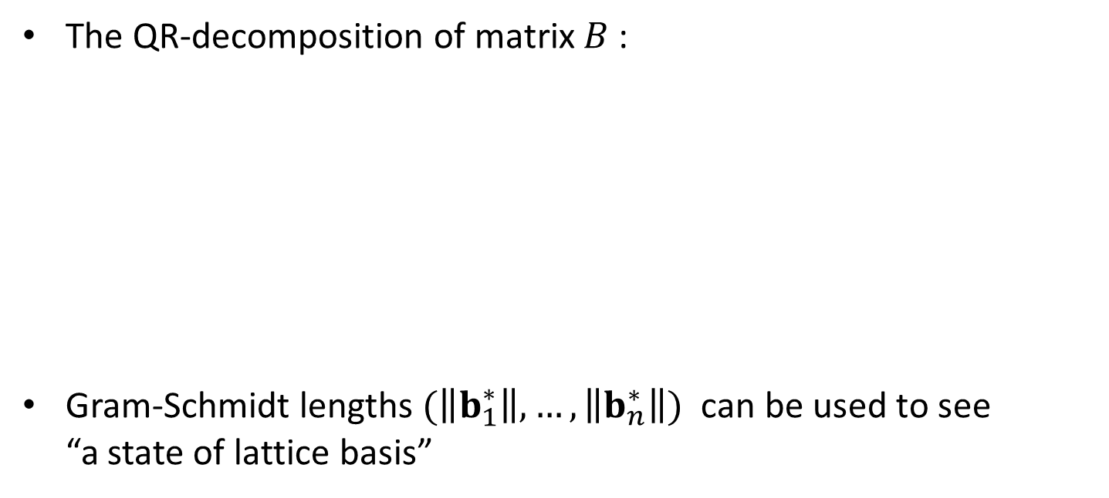

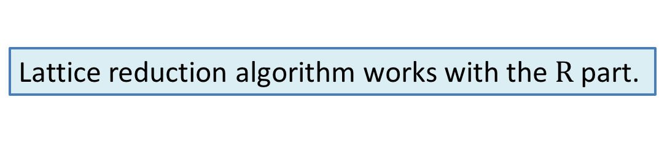
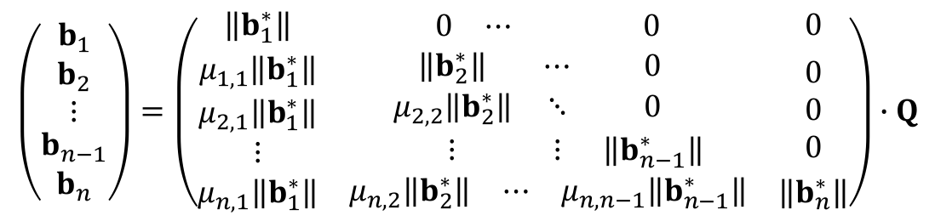
Lattices(3/6) 05/26
The QR-decomposition of matrix $B$ :
Gram-Schmidt lengths $(\left\|b_{1}^{∗}\right\|,…,\left\|b_{n}^{∗}\right\|)$ can be used to see
“a state of lattice basis”
$$\left(\begin{aligned}\begin{matrix}b_{1} \\ b_{2} \\ ⋮\end{matrix} \\ b_{n−1} \\ b_{n}\end{aligned}\right)=\left(\begin{matrix}\left\|b_{1}^{∗}\right\| & \begin{matrix}0 & ⋯ & 0\end{matrix} & 0 \\ \begin{matrix}μ_{1,1}\left\|b_{1}^{∗}\right\| \\ μ_{2,1}\left\|b_{1}^{∗}\right\| \\ ⋮\end{matrix} & \begin{matrix}\left\|b_{2}^{∗}\right\| & ⋯ & 0 \\ μ_{2,2}\left\|b_{2}^{∗}\right\| & ⋱ & 0 \\ ⋮ & ⋮ & \left\|b_{n−1}^{∗}\right\|\end{matrix} & \begin{matrix}0 \\ 0 \\ 0\end{matrix} \\ μ_{n,1}\left\|b_{1}^{∗}\right\| & \begin{matrix}μ_{n,2}\left\|b_{2}^{∗}\right\| & ⋯ & μ_{n,n−1}\left\|b_{n−1}^{∗}\right\|\end{matrix} & \left\|b_{n}^{∗}\right\|\end{matrix}\right)∙Q$$
Lattice reduction algorithm works with the$R$part.
Graph of $log\left\|b_{i}^{∗}\right\|$is usually used
$$log\left\|b_{i}^{∗}\right\|$$
index

Slide 8
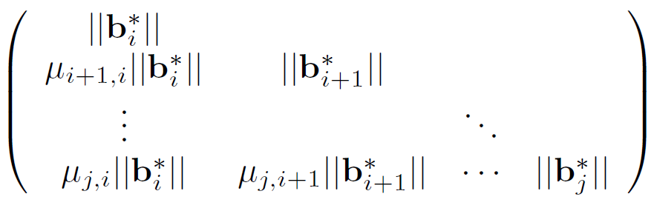

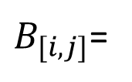
Lattices(3/6) 05/26
The $QR$-decomposition of matrix $B$ :
(Standard) $BKZ$ algorithm uses the projective sublattice $B_{\left[i,j\right]}$
  Corresponds to a submatrix of $R$
The algorithm updates entire basis using short vectors in $B_{\left[i,j\right]}$
$$\left(\begin{aligned}\begin{matrix}b_{1} \\ b_{2} \\ ⋮\end{matrix} \\ b_{n−1} \\ b_{n}\end{aligned}\right)=\left(\begin{matrix}\left\|b_{1}^{∗}\right\| & \begin{matrix}0 & ⋯ & 0\end{matrix} & 0 \\ \begin{matrix}μ_{1,1}\left\|b_{1}^{∗}\right\| \\ μ_{2,1}\left\|b_{1}^{∗}\right\| \\ ⋮\end{matrix} & \begin{matrix}\left\|b_{2}^{∗}\right\| & ⋯ & 0 \\ μ_{2,2}\left\|b_{2}^{∗}\right\| & ⋱ & 0 \\ ⋮ & ⋮ & \left\|b_{n−1}^{∗}\right\|\end{matrix} & \begin{matrix}0 \\ 0 \\ 0\end{matrix} \\ μ_{n,1}\left\|b_{1}^{∗}\right\| & \begin{matrix}μ_{n,2}\left\|b_{2}^{∗}\right\| & ⋯ & μ_{n,n−1}\left\|b_{n−1}^{∗}\right\|\end{matrix} & \left\|b_{n}^{∗}\right\|\end{matrix}\right)∙Q$$
Lattice reduction algorithm works with the$R$part.
$B_{[i,j]}$=

Slide 9



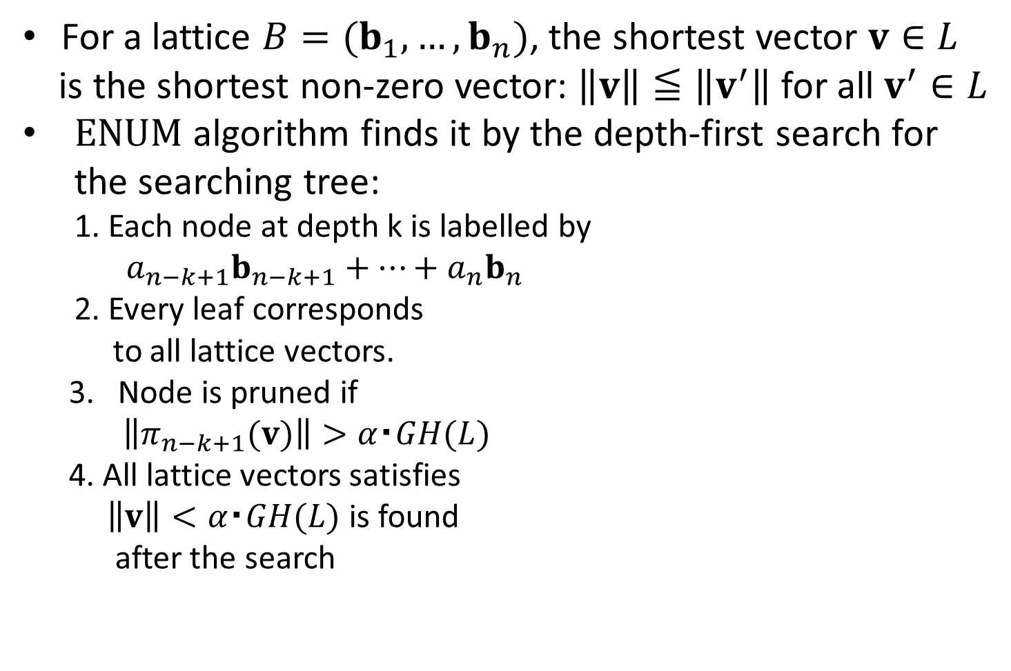


Shortest vector and $ENUM$ algorithm
Lattices(4/6) 06/26
For a lattice $B=(b_{1},…,b_{n})$, the shortest vector $v∈L$
is the shortest non-zero vector: $\left\|v\right\|≦\left\|v^{′}\right\|$ for all $v^{′}∈L$
$ENUM$ algorithm finds it by the depth-first search for the searching tree:
  1. Each node at depth k is labelled by
  $a_{n−k+1}b_{n−k+1}+…+a_{n}b_{n}$
  2. Every leaf corresponds
  to all lattice vectors.
3. Node is pruned if
$\left\|π_{n−k+1}(v)\right\|>α・GH(L)$
4. All lattice vectors satisfies
$\left\|v\right\|<α・GH(L)$ is found
after the search
0
・・・
・・・
・・・
Note: $GH\left(L\right)=V_{n}{\left(1\right)}^{−1/n}vol{\left(L\right)}^{1/n}$ is
an approximation of $λ_{1}(L)$

Slide 10
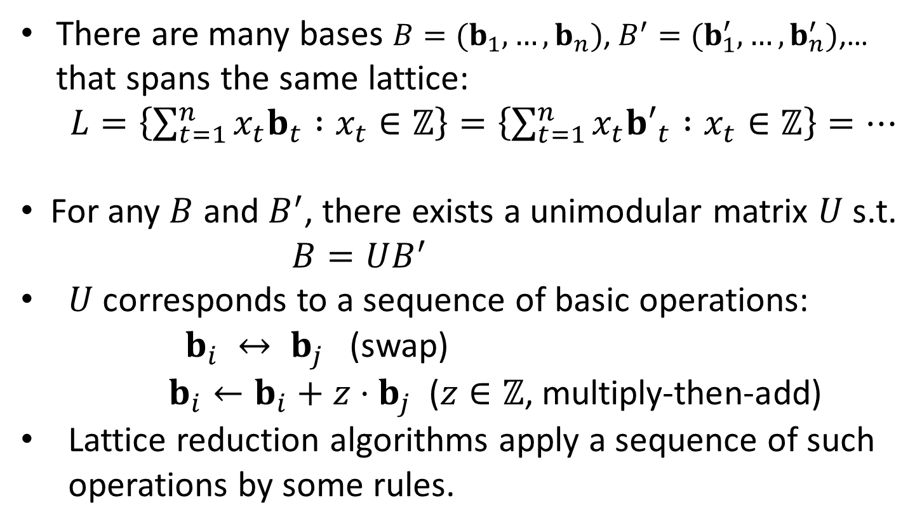
Lattice basis reduction
Lattices(5/6) 07/26
There are many bases $B=(b_{1},…,b_{n})$, $B^{′}=(b_{1}^{′},…,b_{n}^{′})$,… that spans the same lattice:
$L=\left\{\sum_{t=1}^{n}{x_{t}b_{t} :x_{t}∈ℤ}\right\}=\left\{\sum_{t=1}^{n}{x_{t}{b′}_{t} :x_{t}∈ℤ}\right\}=…$
For any $B$ and $B^{′}$, there exists a unimodular matrix $U$ s.t.
$B=UB^{′}$
$U$ corresponds to a sequence of basic operations:
$b_{i} ↔ b_{j}$ (swap)
$b_{i}←b_{i}+z⋅b_{j}$($z∈ℤ$, multiply-then-add)
Lattice reduction algorithms apply a sequence of such operations by some rules.

Slide 11
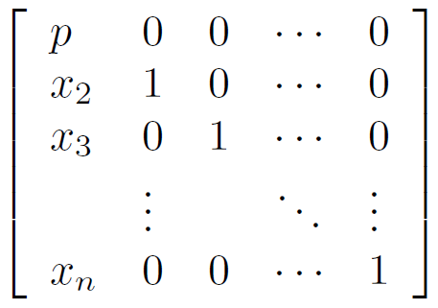
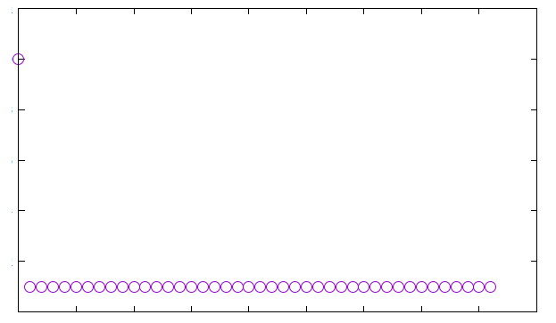
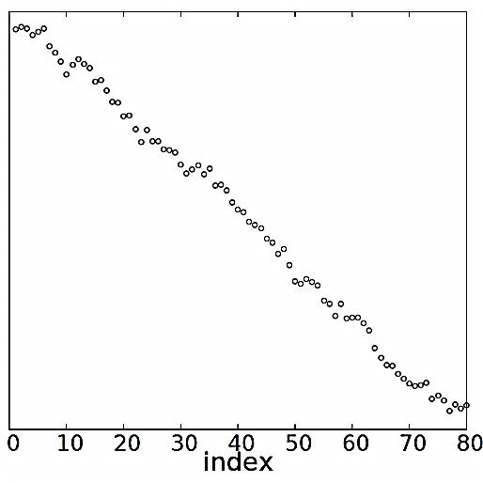
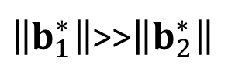
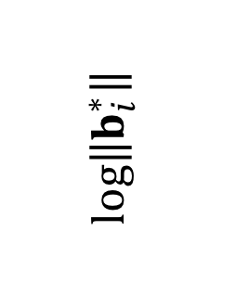
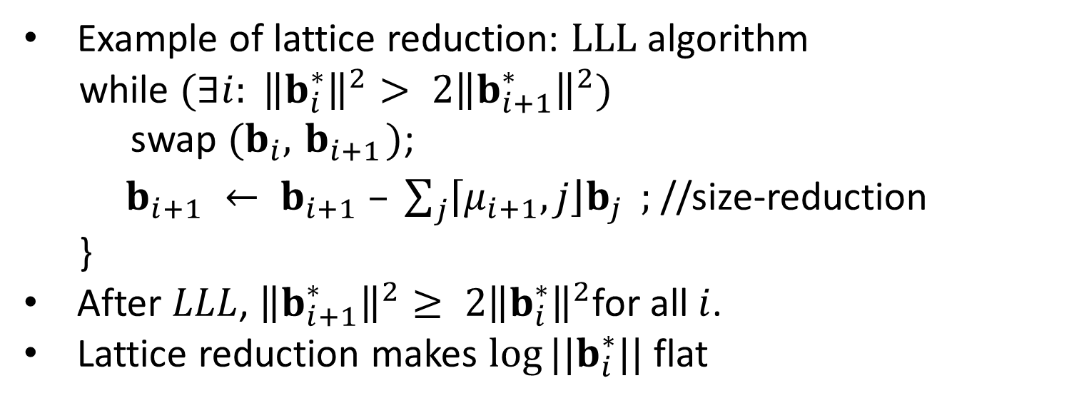
Lattices(6/6) 08/26
Example of lattice reduction: $LLL$ algorithm
while $(∃i: {\left\|b_{i}^{∗}\right\|}^{2}> 2{\left\|b_{i+1}^{∗}\right\|}^{2})$
swap $(b_{i},{ b}_{i+1})$;
$b_{i+1} ← b_{i+1} – \sum_{j}{\left\lceil \left.μ_{i+1},j\right\rfloor \right.b_{j}} ;$ //size-reduction
}
After $LLL$, ${\left\|b_{i+1}^{∗}\right\|}^{2}≥ 2{\left\|b_{i}^{∗}\right\|}^{2}$for all $i$.
Lattice reduction makes $log⁡||b_{i}^{∗}||$ flat
LLL
$$log⁡\left\|b_{i}^{∗}\right\|$$
$\left\|b_{1}^{∗}\right\|$>>$\left\|b_{2}^{∗}\right\|$
index
index

Slide 12
Agenda
Agenda
Background and preliminaries
Classical BKZ and observations
Our theory to progressive BKZ
  What is best parameter for given basis?
  How to predict the converged basis?
  How to measure a given basis is nearing
  the converged basis, or far from?
Outline of cost analysis
Conclusion

Slide 13
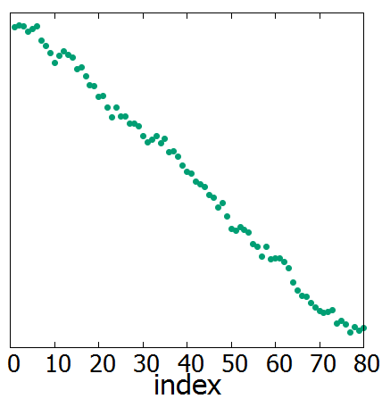
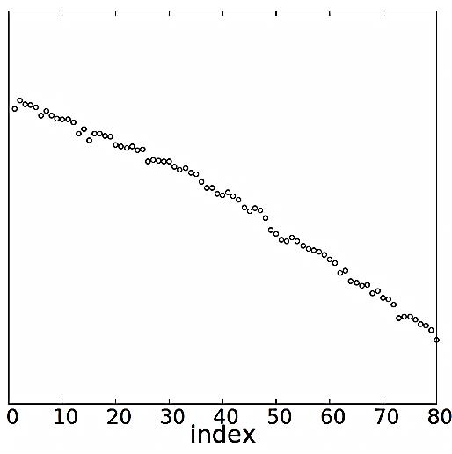




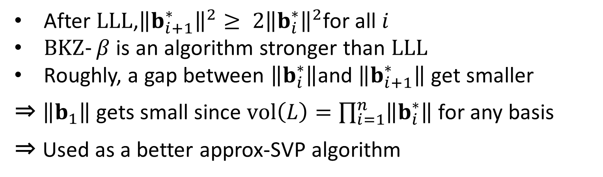
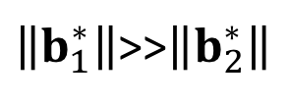
From $LLL$ to $BKZ$
BKZ(1/4) 09/26
After $LLL$,${\left\|b_{i+1}^{∗}\right\|}^{2}≥ 2{\left\|b_{i}^{∗}\right\|}^{2}$for all $i$
$BKZ‐β$ is an algorithm stronger than $LLL$
Roughly, a gap between $\left\|b_{i}^{∗}\right\|$and $\left\|b_{i+1}^{∗}\right\|$ get smaller
⇒ $\left\|b_{1}\right\|$gets small since $vol\left(L\right)=\prod_{i=1}^{n}{\left\|b_{i}^{∗}\right\|}$ for any basis
⇒ Used as a better approx-SVP algorithm
$\left\|b_{1}^{∗}\right\|$>>$\left\|b_{2}^{∗}\right\|$
$$LLL$$
$BKZ$-30
$$log\left\|b_{i}^{∗}\right\|$$
index

Slide 14
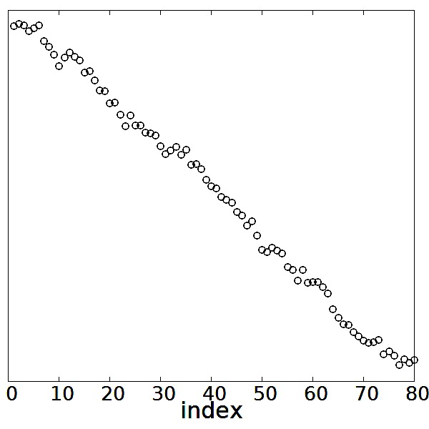
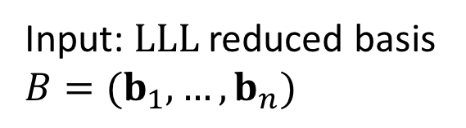


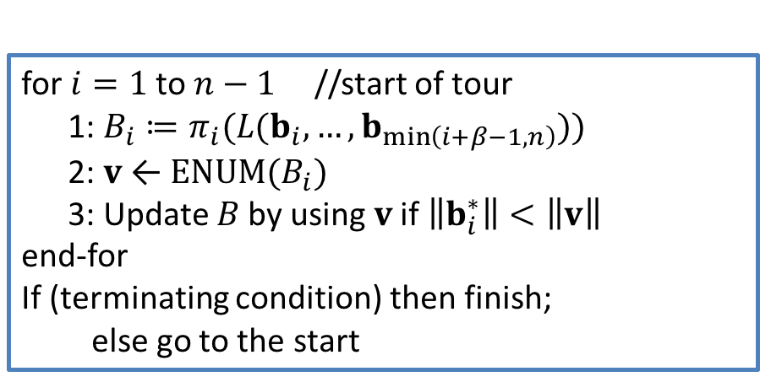
Original $BKZ$ outline (example in β=30)
BKZ(2/4) 10/26
Input: $LLL$ reduced basis
$B=(b_{1}, …,b_{n})$
for $i=1$to$n−1$//start of tour
1: $B_{i}≔π_{i}(L(b_{i},…,b_{\min\left(i+β−1,n\right)}))$
2: $v$← $ENUM(B_{i})$
3: Update $B$ by using $v$ if $\left\|b_{i}^{∗}\right\|<\left\|v\right\|$
end-for
If (terminating condition) then finish;
else go to the start
$$log\left\|b_{i}^{∗}\right\|$$
index
Before the main-loop, apply the LLL to B
Parameter is β: blocksize

Slide 15
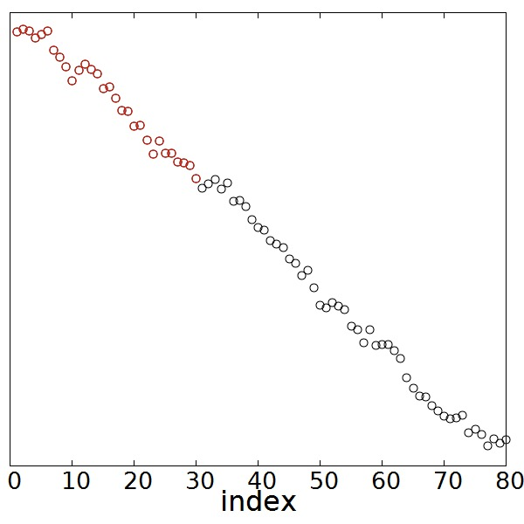
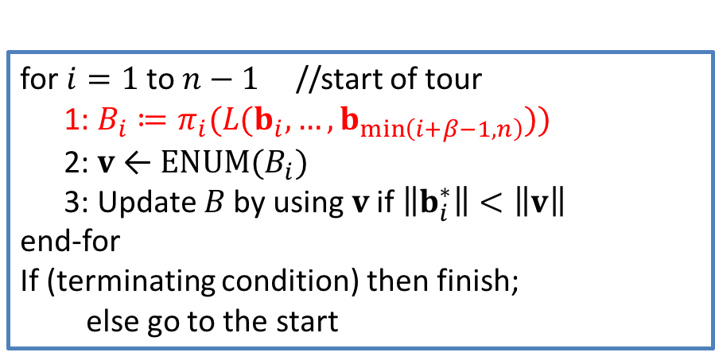
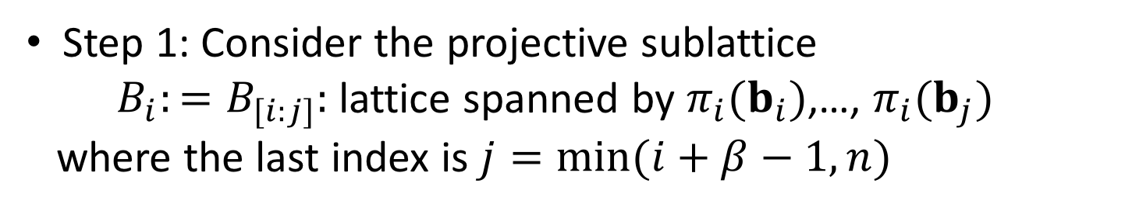
BKZ(2/4) 10/26
Original $BKZ$ outline (example in β=30)
Input: $LLL$ reduced basis
$B=(b_{1}, …,b_{n})$
for $i=1$to$n−1$//start of tour
1: $B_{i}≔π_{i}(L(b_{i},…,b_{\min\left(i+β−1,n\right)}))$
2: $v$← $ENUM(B_{i})$
3: Update $B$ by using $v$ if $\left\|b_{i}^{∗}\right\|<\left\|v\right\|$
end-for
If (terminating condition) then finish;
else go to the start
$$log\left\|b_{i}^{∗}\right\|$$
index
Step 1: Consider the projective sublattice
$B_{i}:=B_{[i:j]}:$ lattice spanned by $π_{i}(b_{i})$,…, $π_{i}(b_{j})$
where the last index is $j=min⁡(i+β−1,n)$

Slide 16
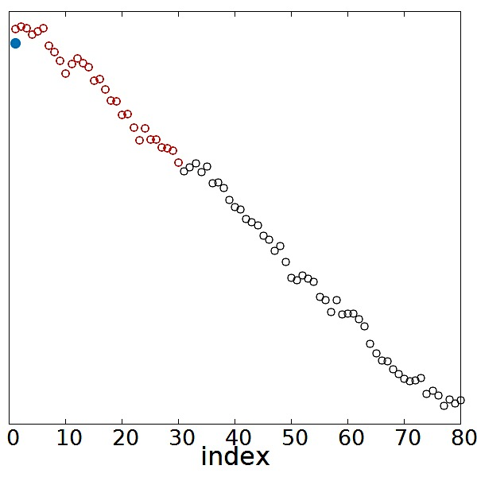
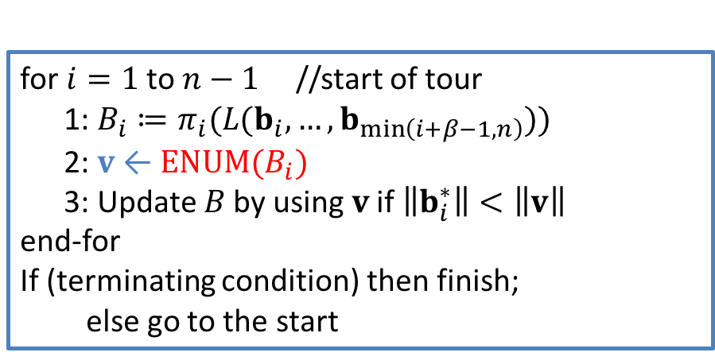
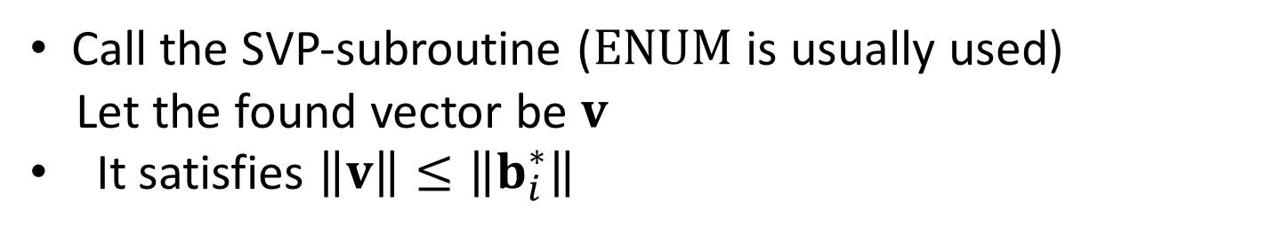
Original $BKZ$ outline (example in β=30)
BKZ(2/4) 10/26
Input: $LLL$ reduced basis
$B=(b_{1}, …,b_{n})$
for $i=1$to$n−1$//start of tour
1: $B_{i}≔π_{i}(L(b_{i},…,b_{\min\left(i+β−1,n\right)}))$
2: $v$← $ENUM(B_{i})$
3: Update $B$ by using $v$ if $\left\|b_{i}^{∗}\right\|<\left\|v\right\|$
end-for
If (terminating condition) then finish;
else go to the start
$$log\left\|b_{i}^{∗}\right\|$$
|v| of new vector
index
Call the SVP-subroutine ($ENUM$ is usually used)
Let the found vector be $v$
It satisfies $\left\|v\right\|≤\left\|b_{i}^{∗}\right\|$

Slide 17
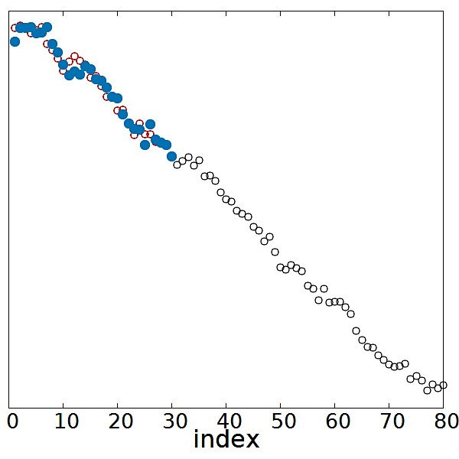
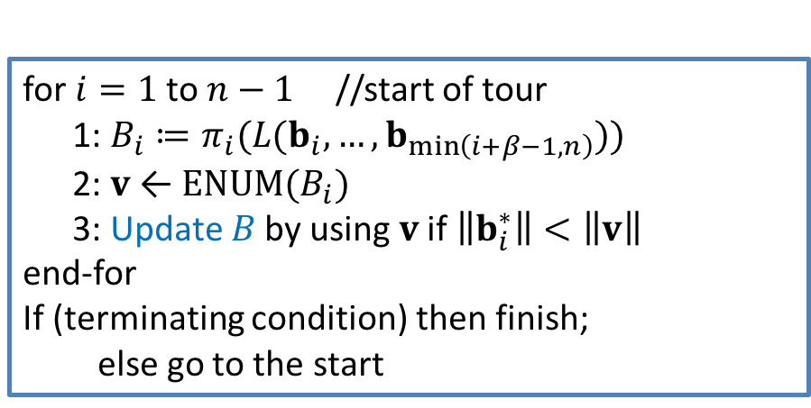
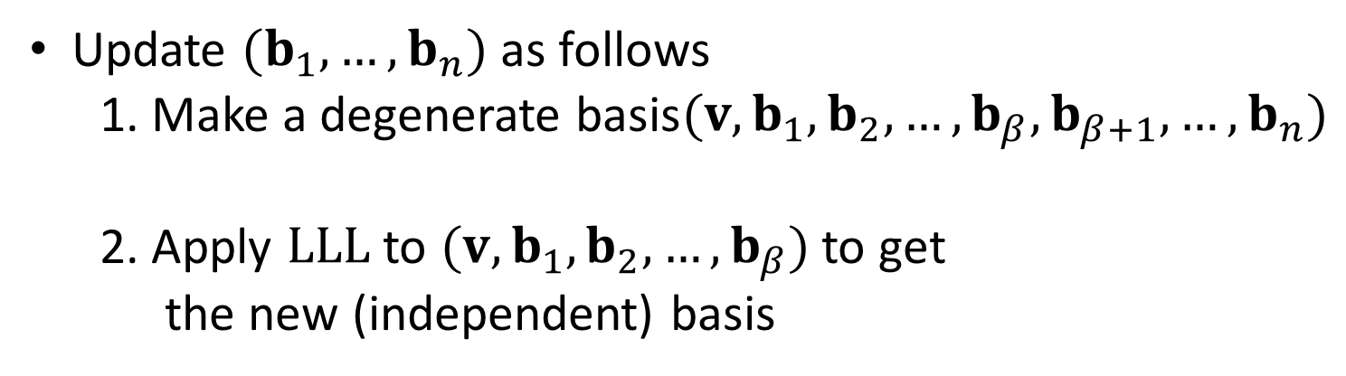
Original $BKZ$ outline (example in β=30)
BKZ(2/4) 10/26
Input: $LLL$ reduced basis
$B=(b_{1}, …,b_{n})$
for $i=1$to$n−1$//start of tour
1: $B_{i}≔π_{i}(L(b_{i},…,b_{\min\left(i+β−1,n\right)}))$
2: $v$← $ENUM(B_{i})$
3: Update $B$ by using $v$ if $\left\|b_{i}^{∗}\right\|<\left\|v\right\|$
end-for
If (terminating condition) then finish;
else go to the start
Updated vecs
$$log\left\|b_{i}^{∗}\right\|$$
index
Update $(b_{1}, …,b_{n})$ as follows
1. Make a degenerate basis$(v,b_{1},b_{2},…,b_{β},b_{β+1},…,b_{n})$
2. Apply $LLL$to $(v,b_{1},b_{2},…,b_{β})$to get
the new (independent) basis
dependent

Slide 18

Original $BKZ$ outline (example in β=30)
BKZ(2/4) 10/26
Input: $LLL$ reduced basis
$B=(b_{1}, …,b_{n})$
for $i=1$to$n−1$//start of tour
1: $B_{i}≔π_{i}(L(b_{i},…,b_{\min\left(i+β−1,n\right)}))$
2: $v$← $ENUM(B_{i})$
3: Update $B$ by using $v$ if $\left\|b_{i}^{∗}\right\|<\left\|v\right\|$
end-for
If (terminating condition) then finish;
else go to the start
$$log\left\|b_{i}^{∗}\right\|$$
index
After processing index $i=1$

Slide 19
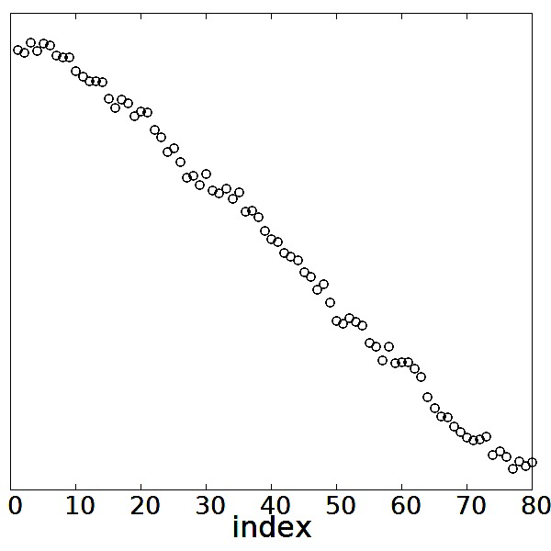
BKZ(2/4) 10/26
Original $BKZ$ outline (example in β=30)
Input: $LLL$ reduced basis
$B=(b_{1}, …,b_{n})$
for $i=1$to$n−1$//start of tour
1: $B_{i}≔π_{i}(L(b_{i},…,b_{\min\left(i+β−1,n\right)}))$
2: $v$← $ENUM(B_{i})$
3: Update $B$ by using $v$ if $\left\|b_{i}^{∗}\right\|<\left\|v\right\|$
end-for
If (terminating condition) then finish;
else go to the start
$$log\left\|b_{i}^{∗}\right\|$$
index
After processing index $i=2$

Slide 20
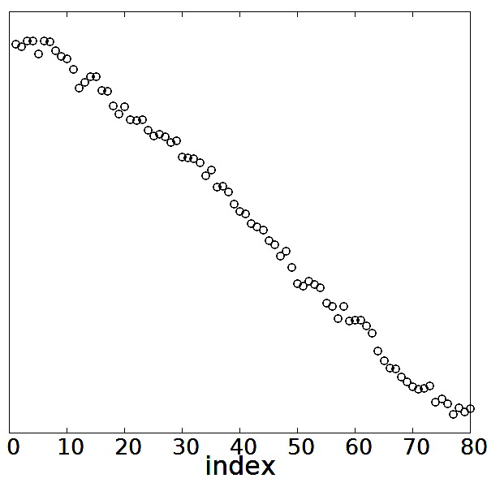
Original $BKZ$ outline (example in β=30)
BKZ(2/4) 10/26
Input: $LLL$ reduced basis
$B=(b_{1}, …,b_{n})$
for $i=1$to$n−1$//start of tour
1: $B_{i}≔π_{i}(L(b_{i},…,b_{\min\left(i+β−1,n\right)}))$
2: $v$← $ENUM(B_{i})$
3: Update $B$ by using $v$ if $\left\|b_{i}^{∗}\right\|<\left\|v\right\|$
end-for
If (terminating condition) then finish;
else go to the start
$$log\left\|b_{i}^{∗}\right\|$$
index
After processing index $i=3$

Slide 21

Original $BKZ$ outline (example in β=30)
BKZ(2/4) 10/26
Input: $LLL$ reduced basis
$B=(b_{1}, …,b_{n})$
for $i=1$to$n−1$//start of tour
1: $B_{i}≔π_{i}(L(b_{i},…,b_{\min\left(i+β−1,n\right)}))$
2: $v$← $ENUM(B_{i})$
3: Update $B$ by using $v$ if $\left\|b_{i}^{∗}\right\|<\left\|v\right\|$
end-for
If (terminating condition) then finish;
else go to the start
$$log\left\|b_{i}^{∗}\right\|$$
index
After processing index $i=4$

Slide 22
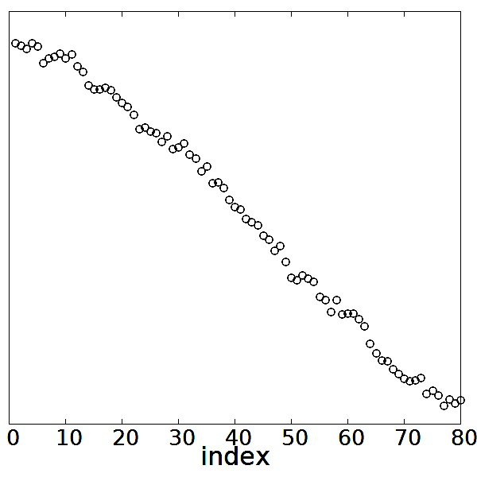
BKZ(2/4) 10/26
Original $BKZ$ outline (example in β=30)
Input: $LLL$ reduced basis
$B=(b_{1}, …,b_{n})$
for $i=1$to$n−1$//start of tour
1: $B_{i}≔π_{i}(L(b_{i},…,b_{\min\left(i+β−1,n\right)}))$
2: $v$← $ENUM(B_{i})$
3: Update $B$ by using $v$ if $\left\|b_{i}^{∗}\right\|<\left\|v\right\|$
end-for
If (terminating condition) then finish;
else go to the start
$$log\left\|b_{i}^{∗}\right\|$$
index
After processing index $i=5$

Slide 23
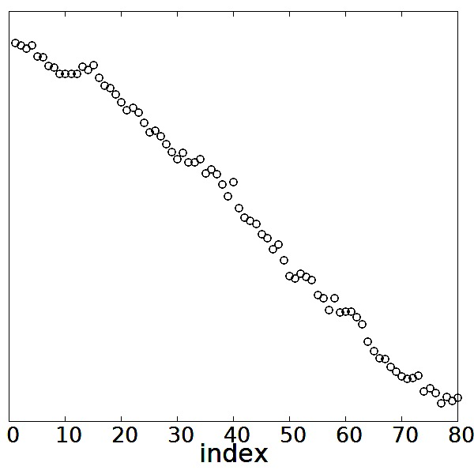
Original $BKZ$ outline (example in β=30)
BKZ(2/4) 10/26
Input: $LLL$ reduced basis
$B=(b_{1}, …,b_{n})$
for $i=1$to$n−1$//start of tour
1: $B_{i}≔π_{i}(L(b_{i},…,b_{\min\left(i+β−1,n\right)}))$
2: $v$← $ENUM(B_{i})$
3: Update $B$ by using $v$ if $\left\|b_{i}^{∗}\right\|<\left\|v\right\|$
end-for
If (terminating condition) then finish;
else go to the start
$$log\left\|b_{i}^{∗}\right\|$$
index
After processing index $i=10$

Slide 24
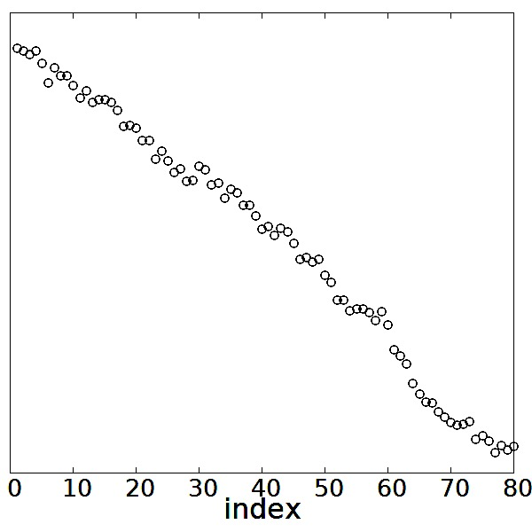
Original $BKZ$ outline (example in β=30)
BKZ(2/4) 10/26
Input: $LLL$ reduced basis
$B=(b_{1}, …,b_{n})$
for $i=1$to$n−1$//start of tour
1: $B_{i}≔π_{i}(L(b_{i},…,b_{\min\left(i+β−1,n\right)}))$
2: $v$← $ENUM(B_{i})$
3: Update $B$ by using $v$ if $\left\|b_{i}^{∗}\right\|<\left\|v\right\|$
end-for
If (terminating condition) then finish;
else go to the start
$$log\left\|b_{i}^{∗}\right\|$$
index
After processing index $i=30$

Slide 25
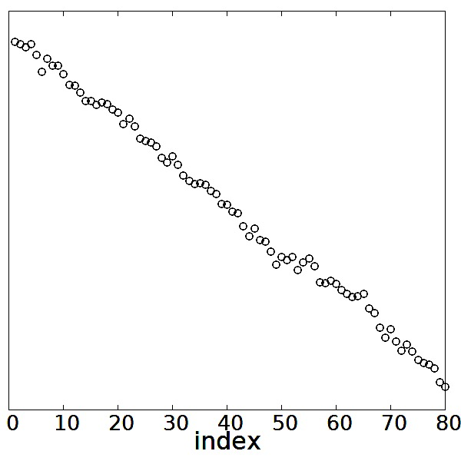
Original $BKZ$ outline (example in β=30)
BKZ(2/4) 10/26
Input: $LLL$ reduced basis
$B=(b_{1}, …,b_{n})$
for $i=1$to$n−1$//start of tour
1: $B_{i}≔π_{i}(L(b_{i},…,b_{\min\left(i+β−1,n\right)}))$
2: $v$← $ENUM(B_{i})$
3: Update $B$ by using $v$ if $\left\|b_{i}^{∗}\right\|<\left\|v\right\|$
end-for
If (terminating condition) then finish;
else go to the start
$$log\left\|b_{i}^{∗}\right\|$$
index
After processing index $i=50$

Slide 26
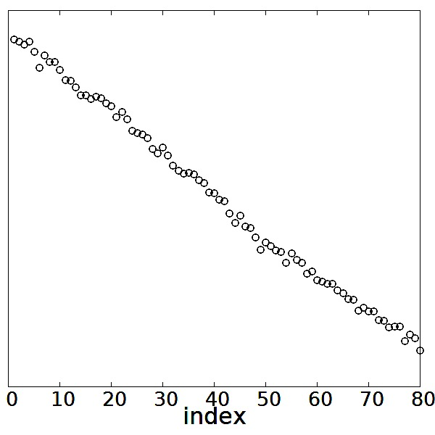
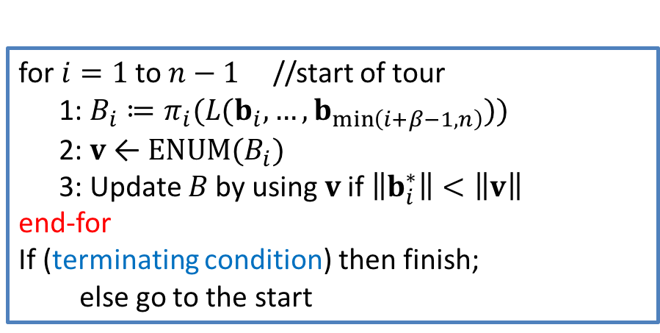
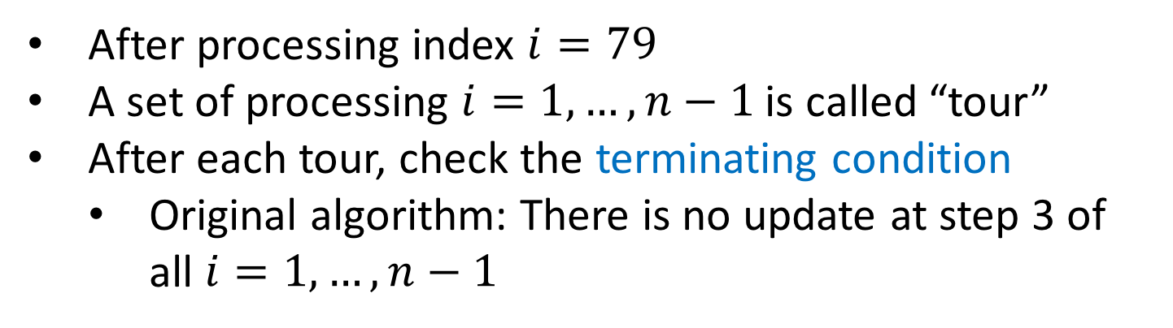
Original $BKZ$ outline (example in β=30)
BKZ(2/4) 10/26
Input: $LLL$ reduced basis
$B=(b_{1}, …,b_{n})$
for $i=1$to$n−1$//start of tour
1: $B_{i}≔π_{i}(L(b_{i},…,b_{\min\left(i+β−1,n\right)}))$
2: $v$← $ENUM(B_{i})$
3: Update $B$ by using $v$ if $\left\|b_{i}^{∗}\right\|<\left\|v\right\|$
end-for
If (terminating condition) then finish;
else go to the start
Tour
$$log\left\|b_{i}^{∗}\right\|$$
index
After processing index $i=79$
A set of processing $i=1,…,n−1$is called “tour”
After each tour, check the terminating condition
  Original algorithm: There is no update at step 3 of all $i=1,…,n−1$

Slide 27
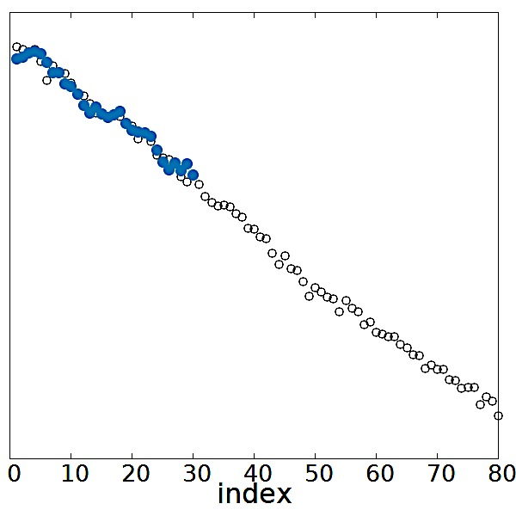


Original $BKZ$ outline (example in β=30)
BKZ(2/4) 10/26
Input: $LLL$ reduced basis
$B=(b_{1}, …,b_{n})$
for $i=1$to$n−1$//start of tour
1: $B_{i}≔π_{i}(L(b_{i},…,b_{\min\left(i+β−1,n\right)}))$
2: $v$← $ENUM(B_{i})$
3: Update $B$ by using $v$ if $\left\|b_{i}^{∗}\right\|<\left\|v\right\|$
end-for
If (terminating condition) then finish;
else go to the start
Tour
$$log\left\|b_{i}^{∗}\right\|$$
index
After finishing one tour, the algorithm again starts from $i=1$

Slide 28

Original $BKZ$ outline (example in β=30)
BKZ(2/4) 10/26
Input: $LLL$ reduced basis
$B=(b_{1}, …,b_{n})$
for $i=1$to$n−1$//start of tour
1: $B_{i}≔π_{i}(L(b_{i},…,b_{\min\left(i+β−1,n\right)}))$
2: $v$← $ENUM(B_{i})$
3: Update $B$ by using $v$ if $\left\|b_{i}^{∗}\right\|<\left\|v\right\|$
end-for
If (terminating condition) then finish;
else go to the start
Tour
$$log\left\|b_{i}^{∗}\right\|$$
index
After 2nd tour is finished

Slide 29

Original $BKZ$ outline (example in β=30)
BKZ(2/4) 10/26
Input: $LLL$ reduced basis
$B=(b_{1}, …,b_{n})$
for $i=1$to$n−1$//start of tour
1: $B_{i}≔π_{i}(L(b_{i},…,b_{\min\left(i+β−1,n\right)}))$
2: $v$← $ENUM(B_{i})$
3: Update $B$ by using $v$ if $\left\|b_{i}^{∗}\right\|<\left\|v\right\|$
end-for
If (terminating condition) then finish;
else go to the start
Tour
$$log\left\|b_{i}^{∗}\right\|$$
index
After 3rd tour is finished

Slide 30

Original $BKZ$ outline (example in β=30)
BKZ(2/4) 10/26
Input: $LLL$ reduced basis
$B=(b_{1}, …,b_{n})$
for $i=1$to$n−1$//start of tour
1: $B_{i}≔π_{i}(L(b_{i},…,b_{\min\left(i+β−1,n\right)}))$
2: $v$← $ENUM(B_{i})$
3: Update $B$ by using $v$ if $\left\|b_{i}^{∗}\right\|<\left\|v\right\|$
end-for
If (terminating condition) then finish;
else go to the start
Tour
$$log\left\|b_{i}^{∗}\right\|$$
index
After 4th tour is finished

Slide 31

Original $BKZ$ outline (example in β=30)
BKZ(2/4) 10/26
Input: $LLL$ reduced basis
$B=(b_{1}, …,b_{n})$
for $i=1$to$n−1$//start of tour
1: $B_{i}≔π_{i}(L(b_{i},…,b_{\min\left(i+β−1,n\right)}))$
2: $v$← $ENUM(B_{i})$
3: Update $B$ by using $v$ if $\left\|b_{i}^{∗}\right\|<\left\|v\right\|$
end-for
If (terminating condition) then finish;
else go to the start
Tour
$$log\left\|b_{i}^{∗}\right\|$$
index
After 10th tour is finished

Slide 32

Original $BKZ$ outline (example in β=30)
BKZ(2/4) 10/26
Input: $LLL$ reduced basis
$B=(b_{1}, …,b_{n})$
for $i=1$to$n−1$//start of tour
1: $B_{i}≔π_{i}(L(b_{i},…,b_{\min\left(i+β−1,n\right)}))$
2: $v$← $ENUM(B_{i})$
3: Update $B$ by using $v$ if $\left\|b_{i}^{∗}\right\|<\left\|v\right\|$
end-for
If (terminating condition) then finish;
else go to the start
Tour
$$log\left\|b_{i}^{∗}\right\|$$
index
After 100th tour is finished

Slide 33

Original $BKZ$ outline (example in β=30)
BKZ(2/4) 10/26
Input: $LLL$ reduced basis
$B=(b_{1}, …,b_{n})$
for $i=1$to$n−1$//start of tour
1: $B_{i}≔π_{i}(L(b_{i},…,b_{\min\left(i+β−1,n\right)}))$
2: $v$← $ENUM(B_{i})$
3: Update $B$ by using $v$ if $\left\|b_{i}^{∗}\right\|<\left\|v\right\|$
end-for
If (terminating condition) then finish;
else go to the start
Tour
$$log\left\|b_{i}^{∗}\right\|$$
index
…After 3454th tour is finished

Slide 34


Original $BKZ$ outline (example in β=30)
BKZ(2/4) 10/26
Input: $LLL$ reduced basis
$B=(b_{1}, …,b_{n})$
for $i=1$to$n−1$//start of tour
1: $B_{i}≔π_{i}(L(b_{i},…,b_{\min\left(i+β−1,n\right)}))$
2: $v$← $ENUM(B_{i})$
3: Update $B$ by using $v$ if $\left\|b_{i}^{∗}\right\|<\left\|v\right\|$
end-for
If (terminating condition) then finish;
else go to the start
Tour
$$log\left\|b_{i}^{∗}\right\|$$
index
…After 3455th tour is finished
In this tour, all $b_{i}$s do not change(=terminating condition)

Slide 35




Observation on classical $BKZ$
BKZ(3/4) 11/26
Too many tours after “near-conversion”
$$log\left\|b_{i}^{∗}\right\|$$
Graph for BKZ-30 of the SVP challenge lattice (dim=80, seed=0)
index
The 200-th and the final bases look like very close. So…
  Stop the computation here is good to reduce the cost
  [Terminating $BKZ$, HPS11]
  Switch the blocksize if we want a better basis
  [Progressive BKZ, NG08, CN11,SS12,HRP13, and this work]
10分

Slide 36



Previous works on progressive $BKZ$
BKZ(4/4) 12/26
Progressively increasing blocksize is better in practical
  Jump to next blocksize if the basis is near-converged
Proposed sequences in literatures
But a few number of theory were find
[Offline strategy by Chen and Nguyen]
for $i=1$to$n−1$//start of tour
1: $B_{i}≔π_{i}(L(b_{i},…,b_{\min\left(i+β−1,n\right)}))$
2: $v$← $ENUM(B_{i})$
3: Update $B$ by using $v$ if $\left\|b_{i}^{∗}\right\|<\left\|v\right\|$
end-for
If (jumping condition) then increase the blocksize β
and go to the start
[EC2008]
[ePrint2012/620]
[NCICIT2013]
[AC2011]

Slide 37
Agenda
Agenda
Background and preliminaries
Classical BKZ and observations
Our theory to progressive BKZ
  What is best parameter for given basis?
  How to predict the converged basis?
  How to measure a given basis is nearing
  the converged basis, or far from?
Outline of cost analysis
Conclusion

Slide 38




Theory to progressive $BKZ$
Theory(1/9) 13/26
Our basic strategies
1: For given basis set a suitable $BKZ$ blocksize $β$
(and other params.)
2: Jump to next blocksize if the basis is near-converged
Q1. What is best parameter
for given basis?
Q2. How to predict the converged basis?
Q3. How to measure a given basis is nearing
the converged basis, or far from?

Slide 39



Local parameter optimization of $BKZ$
Solution to
Q1. What is best parameter for given basis
$$log\left\|b_{i}^{∗}\right\|$$
12分
index

Slide 40








Parameters (β,α,p) in our $BKZ$
Theory(2/9) 14/26
  Our algorithm calls the $ENUM$ with pruning of parameters $(β,α,p)$
  as the approx. SVP oracle [Gama-Nguyen-Regev@EC10]
  Blocksize$=β$, Searching radius$=α⋅GH(L_{[i:i+β−1]})$, probability$=p$
  ⇔ $BKZ$ 2.0 calls the extreme pruning subroutine $(α=\sqrt{1.1})$
  with high-prob. using randomized bases.
Radius $=α⋅GH(L_{[i:i+β−1]})$
A rough estimation from theory [Rogers56]
to optimize parameters
In local block, there are $α^{β}/2$ vector pairs $(v,−v)$
shorter than the radius
With setting $p={2α}^{−β}$, about one vector $v$ found
It can expect that
$$log\left\|b_{i}^{∗}\right\|$$
β
index
$\left\|v\right\| ≈ \frac{β}{β+1}⋅$radius

Slide 41






Rough estimation+Schnorr’s GSA
Theory(3/9) 15/26
  By the rough estimation, after $BKZ−(β,α,p)$ is converging
  every $\left\|b_{i}^{∗}\right\|$ satisfy
  Substituting Schnorr’s GSA: $\left\|b_{i}^{∗}\right\|={\left\|b_{1}\right\|r}^{(i−1)/2}$ , we can write
  $r$ by $(β,α)$:
  Using (*), (**) and the relation$p= {2α}^{−β}$, we have the relation:
$$\left\|b_{i}^{∗}\right\| ≈ \frac{β}{β+1}α⋅GH\left(L_{\left[i:i+β−1\right]}\right)=\frac{β}{β+1}α⋅V_{β}{\left(1\right)}^{−1/β}\prod_{i}{\left\|b_{i}^{∗}\right\|}$$
・・・ (*)
$$r={\left(\frac{β+1}{αβ}\right)}^{\frac{4}{β−1}}∙{V_{β}(1)}^{\frac{4}{β(β−1)}}$$
・・・ (**)
$$(β,r)$$
$$(α,p)$$
$ENUMCost\left(B;α,p\right)=\frac{1}{2}\sum_{k=1}^{n}{\frac{vol\{\left(x_{1},…,x_{k}\right):\sum_{i=1}^{l}{x_{i}^{2}<R_{α,p}^{2} for ∀l∈[k]\}}}{\prod_{i=n−k+1}^{n}{\left\|b_{i}^{∗}\right\|}}}$
Where $\left\|b_{i}^{∗}\right\|=r^{(i−1)/2}$
[GNR@EC10]
We find the relation between $(β,r)$by simulating cost

Slide 42



Theory(4/9) 16/26
Relation between $β$ and $r$ that minimizes $ENUMCost$
$f_{1}(β)=−\frac{18.2}{β+318.9}$
$$f_{2}(β)=−\frac{\log\left(0.4β−25.4\right)}{β−31}$$
β → r → (α,p): optimal ENUM param. is computed

Slide 43





Online detection for suitable $(β,α,p):$
(A tentative) solution to Q1. What is best parameter for given basis
Theory(5/9) 17/26
We now have the mapping $β → (r,α,p)$
Strategy: Set blocksize$=β$ if
BKZ-(β-1) reduced basis
(in our meaning)
BKZ-β reduced basis
(in our meaning)
Current basis
＜
＜
$$log\left\|b_{i}^{∗}\right\|$$
Q2. How to predict the converged basis?
Q3. How to measure a given basis is nearing
the converged basis, or far from?
15分

Slide 44



Simulation $(\left\|b_{1}^{∗}\right\|,…,\left\|b_{n}^{∗}\right\|)$
of converged $BKZ−(β,α,p)$
Solution to
Q2. How to predict the converged basis?
$$log\left\|b_{i}^{∗}\right\|$$
15分
index

Slide 45





Outline to simulate $(\left\|b_{1}^{∗}\right\|,…,\left\|b_{n}^{∗}\right\|)$
Theory(6/9) 18/26
Back-to-front simulating
From the previous argument
$\left\|b_{i}^{∗}\right\|=\frac{αβ}{β+1}⋅GH\left(B\right)$ holds for all $i$ … (*)
Last index: $\left\|b_{n}^{∗}\right\|=1$
log$\left\|b_{i}^{∗}\right\|$

Slide 46

Outline to simulate $(\left\|b_{1}^{∗}\right\|,…,\left\|b_{n}^{∗}\right\|)$
Theory(6/9) 18/26
Back-to-front simulating
From the previous argument
$\left\|b_{i}^{∗}\right\|=\frac{αβ}{β+1}⋅GH\left(B\right)$ holds for all $i$ … (*)
Last index: $\left\|b_{n}^{∗}\right\|=1$
$\left\|b_{n−1}^{∗}\right\|$ is maximum of
(1) Estimation (*), and
(2) Last part profiling in $BKZ$ 2.0
simulator [Chen-Nguyen11]
log$\left\|b_{i}^{∗}\right\|$

Slide 47

Theory(6/9) 18/26
Outline to simulate $(\left\|b_{1}^{∗}\right\|,…,\left\|b_{n}^{∗}\right\|)$
Back-to-front simulating
From the previous argument
$\left\|b_{i}^{∗}\right\|=\frac{αβ}{β+1}⋅GH\left(B\right)$ holds for all $i$ … (*)
Last index: $\left\|b_{n}^{∗}\right\|=1$
$\left\|b_{n−2}^{∗}\right\|$ is maximum of
(1) Estimation (*), and
(2) Last part profiling in $BKZ$ 2.0
simulator [Chen-Nguyen11]
log$\left\|b_{i}^{∗}\right\|$

Slide 48

Theory(6/9) 18/26
Outline to simulate $(\left\|b_{1}^{∗}\right\|,…,\left\|b_{n}^{∗}\right\|)$
Back-to-front simulating
From the previous argument
$\left\|b_{i}^{∗}\right\|=\frac{αβ}{β+1}⋅GH\left(B\right)$ holds for all $i$ … (*)
$\left\|b_{i}^{∗}\right\|$for last indexes are
maximum of
(1) Estimation (*), and
(2) Last part profiling in BKZ 2.0
simulator
log$\left\|b_{i}^{∗}\right\|$

Slide 49

Theory(6/9) 18/26
Outline to simulate $(\left\|b_{1}^{∗}\right\|,…,\left\|b_{n}^{∗}\right\|)$
Back-to-front simulating
From the previous argument
$\left\|b_{i}^{∗}\right\|=\frac{αβ}{β+1}⋅GH\left(B\right)$ holds for all $i$ … (*)
The middle and first indexes
are simulated by (*)
Note:
After the 1st round simulation
do 2nd simulation to modify
log$\left\|b_{i}^{∗}\right\|$

Slide 50


Theory(7/9) 19/26
Outline to simulate $(\left\|b_{1}^{∗}\right\|,…,\left\|b_{n}^{∗}\right\|)$
Back-to-front simulating
From the previous argument
$\left\|b_{i}^{∗}\right\|=\frac{αβ}{β+1}⋅GH\left(B\right)$ holds for all $i$ … (*)
Simulation (△) fits to
the real $\left\|b_{i}^{∗}\right\|$(●) very well.
log$\left\|b_{i}^{∗}\right\|$

Slide 51





Full enumeration cost
Solution to:
Q3. How to measure a given basis is nearing
the converged (i.e., simulated $BKZ−(β,α,p)$) basis , or far from?
＜
＜
$BKZ−(β−1)$reduced basis
(Simulation)
Current basis
$BKZ−β$ reduced basis
(Simulation)
17分

Slide 52



$FEC$: a quality to compare bases
Theory(8/9) 20/26
For given $\left(\left\|b_{1}^{∗}\right\|,…,\left\|b_{n}^{∗}\right\|\right)$ vs. $\left(\left\|v_{1}^{∗}\right\|,…,\left\|v_{n}^{∗}\right\|\right)$,
How do we say “the left is worse than the right”?
We propose to use the full-enumeration cost $(FEC):$
This is the complexity of $ENUM$ algorithm with radius $R=GH(L)$
$$FEC\left(B\right)=\sum_{k=1}^{n}{\frac{V_{k}(GH\left(L\right))}{\prod_{i=n−k+1}^{n}{\left\|b_{i}^{∗}\right\|}}}$$

Slide 53











Background of $FEC$
Theory(9/9) 21/26
In our attacking model, lattice reduction is used to a preprocess
for lattice point search ($=ENUM$adopting to each problem)
It can expect $FEC(B)$is small $≈$ Cost(PointSearch) is small
Thus, we defined Basis is good ⇔ $FEC(B)$is small
Examples:
Lattice basis
$$L=(b_{1},…,b_{n})$$
And some info.
Reduced basis
$$L=(b_{1},…,b_{n})$$
And some info.
Point
search
Point
$$v∈L$$
Lattice
reduction
$LLL$ reduced
After 200 tours
$BKZ$-30 reduced
>
>
$FEC$=6.96×10²⁰
$FEC$=9.90×10¹⁵
$FEC$=1.49×10¹⁵

Slide 54


Summary 22/26
Summary of Progressive $BKZ$
start:
(β,α,p) ← Optimized local parameter for B=($b_{1},…,b_{n}$)
for $i=1$to$n−1$//start of tour
1: $B_{i}≔π_{i}(L(b_{i},…,b_{\min\left(i+β−1,n\right)}))$
2: $v$← $ENUM(B_{i};α,p)$ : GNR’s pruning
3: Update $B$ by using $v$ if $\left\|b_{i}^{∗}\right\|<\left\|v\right\|$
end-for
If (FEC(B)<FEC(Simulated BKZ-β)) then increase the blocksize β
and go to the start
We propose
Procedure to find optimized local parameter
Simulator to BKZ-(β,α,p)
Full enumeration cost as a measure
20分

Slide 55
Agenda
Agenda
Background and preliminaries
Classical BKZ and observations
Our theory to progressive BKZ
  What is best parameter for given basis?
  How to predict the converged basis?
  How to measure a given basis is nearing
  the converged basis, or far from?
Outline of cost analysis
Conclusion

Slide 56





Cost(1/3) 23/26
Cost Estimation of the proposed $BKZ$
Starting from the $LLL$ reduced basis, we can simulate the computing time to process $BKZ(β,α,p)$
Example strategy:
$LLL$ $→ 20 → 26 →28 →31 →37 →・・・$
$$Time(20→26)=\sum_{t=1}^{\#Tours}{\sum_{i=1}^{n−1}{\left[Time_{LLL}\left(B_{i}\right)+Time_{ENUM}(B_{i})\right]}}$$
$=$
$$\sum_{t=1}^{\#Tours}{\left[A_{1}⋅β^{2}n^{3}+Wβ\sum_{i=1}^{n−1}{ENUMCost(B_{i};α,p)}\right]}$$
#Tours is estimated using Chen-Nguyen’s $BKZ$ simulator
We set $A_{1}=1.5⋅{10}^{−10} and W=1.5⋅{10}^{−8}$ from experiments

Slide 57


Cost(2/3) 24/26
Application to solve SVP Challenge
BKZ 2.0 simulation
with fixed blocksize
Conjecture in
Kuo et al. [CHES 2011]
using GTX-480 GPU
Our algorithm
Our Experimental Results
Records of SVP Challenge
Lattice basis
$$L=(b_{1},…,b_{n})$$
Reduced basis
$$L=(b_{1},…,b_{n})$$
Point
search
Short
vector
Lattice
reduction
Cost(LatticeRecution) and $(\left\|b_{1}^{∗}\right\|,…,\left\|b_{n}^{∗}\right\|)$ can be predicted

Slide 58



Cost(3/3) 25/26
Application to approx. ideal Challenge
2^{24.0} sec
2^{20.7} sec
Root Hermite factor$≈1.01$ is practical, even for larger dimensions

Slide 59

Conclusion 26/26
Concluding remarks
Progressive $BKZ$ using
  Full-enumeration cost
  Simulator for GS-lengths
Future works:
  Adopt the algorithms to q-ary lattice for $LWE$
  Use the extreme pruning technique in $ENUM$
  (More improvement by randomizing)
  Simulate $BKZ+Sieve$
Thank you for your attention!
Paper full-version: http://eprint.iacr.org/2016/146
Our library for verification:
http://www2.nict.go.jp/security/pbkzcode/index.html

