Slide 1
Parallel Gauss Sieve Algorithm Solving the SVP in the Ideal Lattice of 128 dimensions
Eurocrypt 2013, Rump Session
May 28, 2013.
Tsukasa Ishiguro (KDDI R&D Laboratories)
Shinsaku Kiyomoto (KDDI R&D Laboratories)
Yutaka Miyake (KDDI R&D Laboratories)
Tsuyoshi Takagi (Kyushu University)
Parallel Gauss Sieve Algorithm
1/6

Slide 2
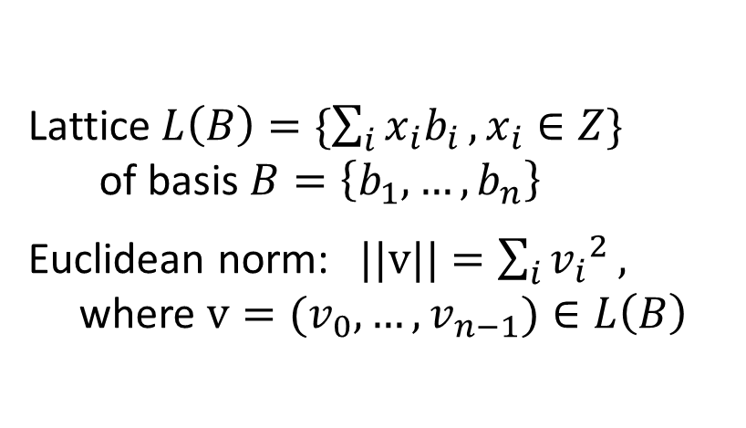
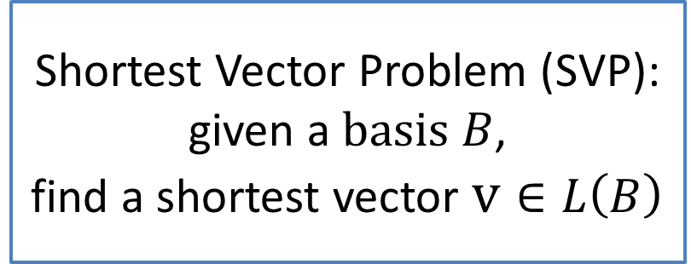
Shortest vector problem (SVP)
Shortest vectors
Parallel Gauss Sieve Algorithm
2/6

Slide 3
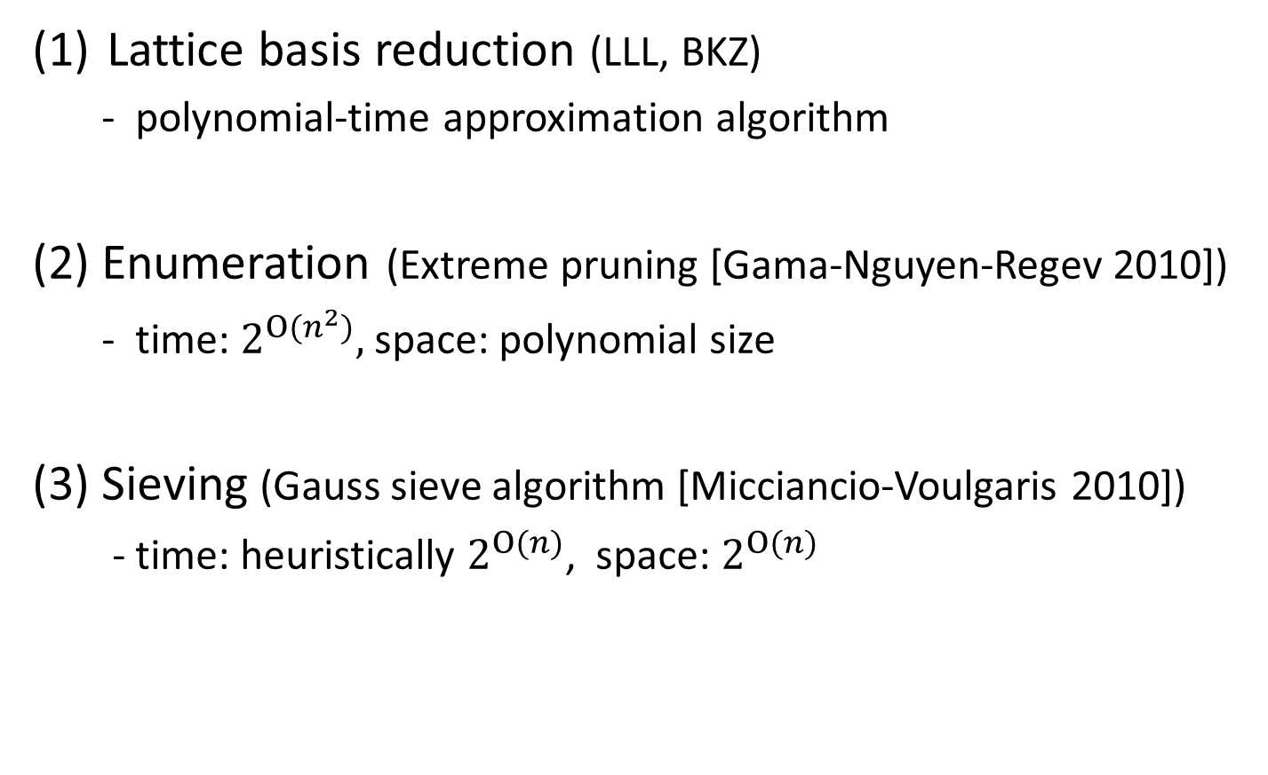
Algorithms for solving the SVP
We propose the Parallel Gauss sieve algorithm.
(more than 1,000 threads)
Parallel Gauss Sieve Algorithm
3/6

Slide 4
Sieving in the Ideal lattice
Parallel Gauss Sieve Algorithm
4/6

Slide 5
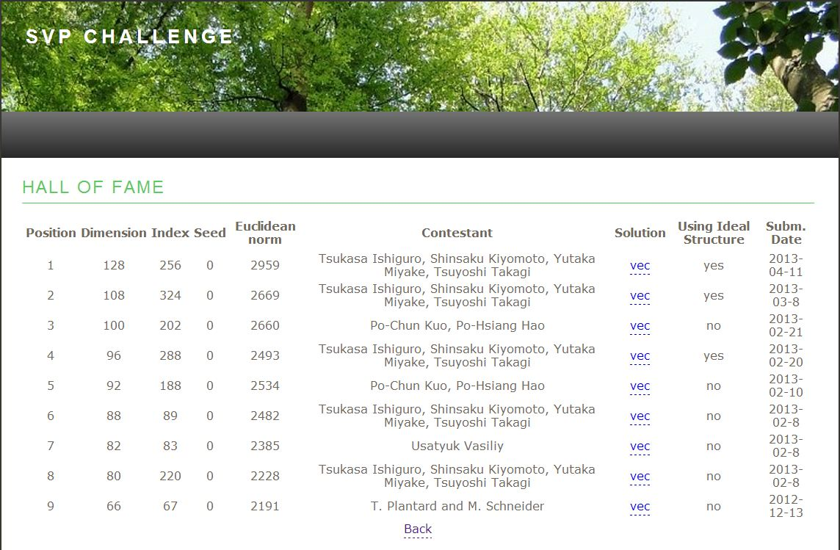
We Solved the SVP in the Ideal Lattice of 128 dimensions
Darmstadt Ideal Lattice Challenge
http://www.latticechallenge.org/ideallattice-challenge/
Parallel Gauss Sieve Algorithm
5/6

Slide 6
Solution of the Ideal Lattice Challenge
128 vectors
Parallel Gauss Sieve Algorithm
6/6

