Slide 1
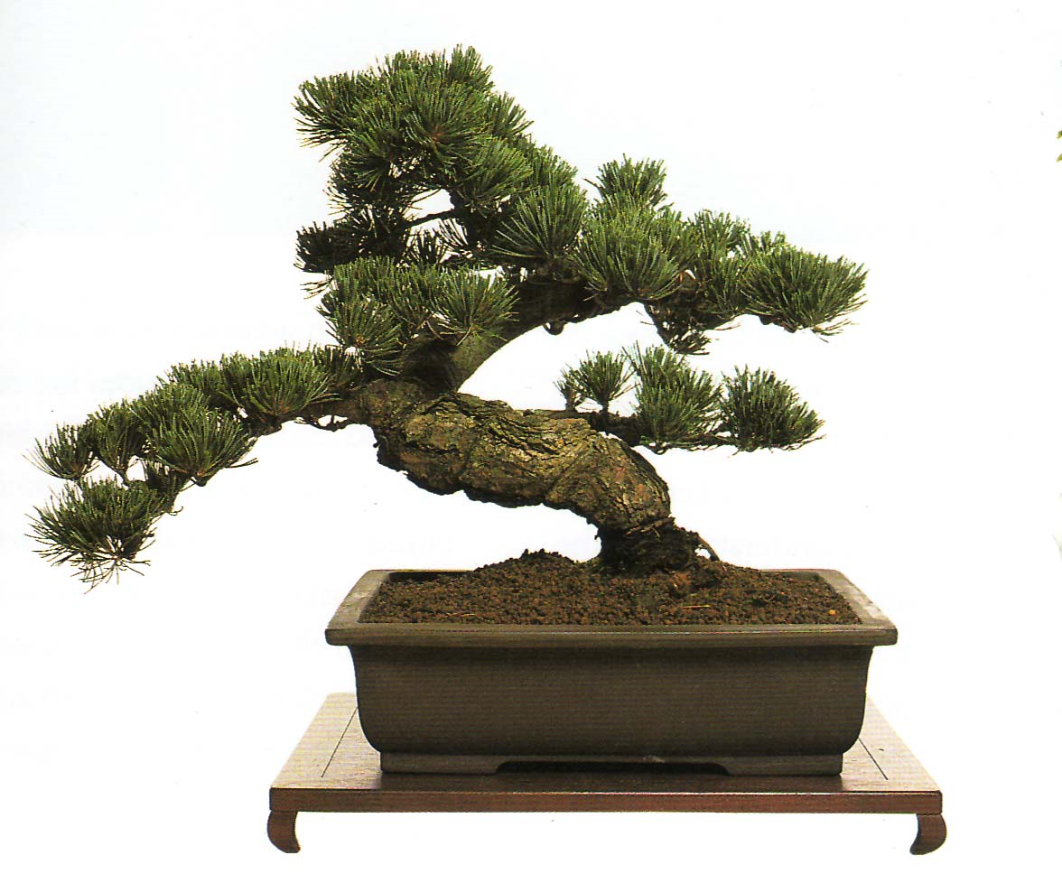
Bonsai Trees, or how to delegate a lattice basis
David Cash (UCSD)
Dennis Hofheinz (KIT)
Eike Kiltz (CWI)
Chris Peikert (GA)

Slide 2
This work: crypto from lattices
Bonsai trees for lattices/basis delegation
Applications: new lattice primitives
  Hash-and-sign signatures (standard model)
  IBE (standard model)
  Hierarchical IBE (random oracle model)
  Hierarchical IBE (standard model)
Independently discovered by [AB09]!

Slide 3
Pairings
Lattices
BF01: IBE
ROM
GPV08: IBE
ROM
Basis delegation
Random oracle model
GS02: HIBE
ROM
NEW: HIBE
ROM
CHK03: HIBE
Selective secure,
bit-by-bit
HEW: HIBE
Selective secure,
bit-by-bit
Standard model
BB04: HIBE
Selective secure,
Identity at once
ABB10: HIBE
Selective secure,
Identity at once
Waters05: HIBE Fully secure
B10/ABB10 HIBE
Fully secure
Waters09: HIBE
Fully secure,
poly depth ☺
You??? HIBE
Fully secure,
poly depth ☺

Slide 4


Slide 5
Integer lattices
Matrix A ∈ Z_{q}^{m x n}
m-dim Lattice
L⊥(A)={x∈Z^{m} :xA = 0 mod q}
n
(0,q)
A
m ≥2n⋅lg(q)
(q,0)

Slide 6
Integer lattices
Matrix A ∈ Z_{q}^{m x n}
Non-short basis for L⊥(A)
A
Random basis for A

Slide 7
Integer lattices
Matrix A ∈ Z_{q}^{m x n}
Short basis for L⊥(A)
[Ajtai96]
A
Short basis for A

Slide 8
Encryption from lattices [Regev05, GPV08]
Public-key:
Matrix A ∈ Z_{q}^{m x n}
Secret Key:
Short basis for L⊥(A)
Encrypt/decrypt:
via “trapdoor function” f_{A} associated to matrix A
Security: Learning with errors
A
A

Slide 10

Bonsai Trees
Ancient art of bonsai
  Techniques for selective control
  of a tree by arborist
Cryptographic bonsai
  Tree = hierarchy of trapdoor functions
  Arborist = setup/simulator controls 2 types of growth
    Undirected growth:
    no privileged information
    Controlled growth:
    privileged information
  Property: extending control down hierarchy (not up)
A
A

Slide 11
Central new technique: lattice basis delegation
A₂
Basis delegation
A₂
A₂
A₁₂
A₁
hard
A₁
A₁
A₃
A₃₁₂
A₃
A₁, A₂, short basis for L⊥(A₁)
Short basis for (any) higher-dim. super-lattice L⊥(A₁₂)

Slide 12
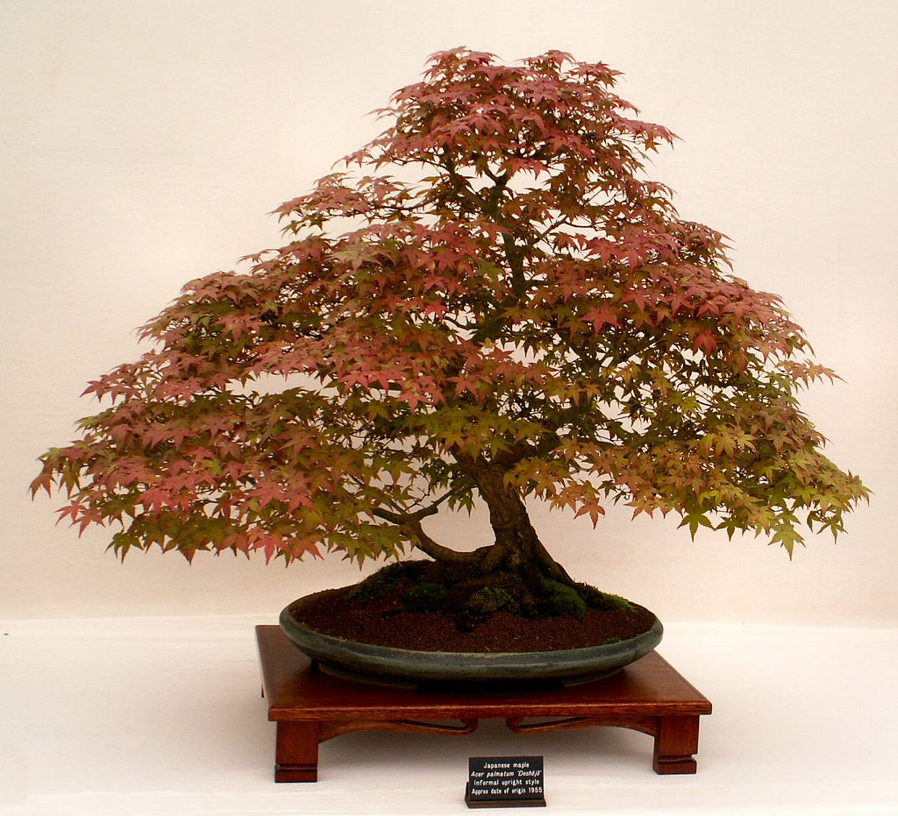
Bonsai trees: hierarchy of trapdoor functions

Slide 13
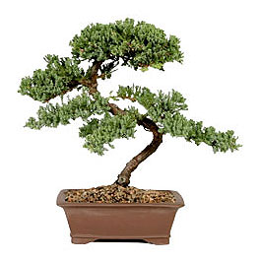
Hierarchy of trapdoor functions
A₁
A₁
A₂
A₃
A₄
A₅
A₆
A₁₂₃₄
A₁₂₅₆
4m-dim latticeL⊥(A₁₂₃₄)
4m-dim lattice L⊥(A₁₂₅₆)
A₁₂₃
f_{A1234}
f_{A1256}
3m-dim lattice L⊥(A₁₁₃)
f_{A123}
f_{A125}
A₁₂
2m-dim lattice L⊥(A₁₂)
f_{A12}
A₁
m-dim lattice L⊥(A₁)
f_{A1}

Slide 14
Hierarchy of trapdoor functions
undirected
growth
controlled
growth
A₁
A₁
A₁
A₂
A₂
A₂
A₃
A₃
A₄
A₄
A₅
A₅
A₆
Short basis delegation
to any higher-dim
super-lattice
_{no trapdoor}
_{trapdoor}
A₁₂₃₄
A₁₂₅₆
f_{A1234}
f_{A1234}
f_{A1234}
f_{A1256}
f_{A1256}
A₁₂₃
A₁₂₃
A₁₂₅
A₁₂₅
A₅
f_{A125}
f_{A123}
f_{A125}
f_{A123}
f_{A123}
A₁₂
A₁₂
f_{A12}
f_{A12}
f_{A12}
A₂
f_{A1}
A₁
A₁
f_{A1}

Slide 15
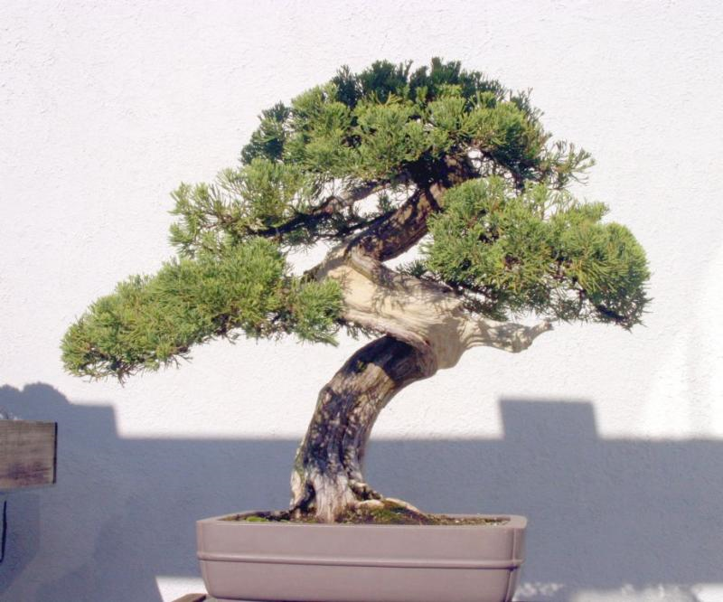
Application 1: Hierarchical IBE (random oracles)

Slide 16
Hierarchical ID-based encryption (ROM)
Encrypt to hierarchical identities ID=(ID₁,…,ID_{k})∈IDSpace^{k}
Master Public-key:
Matrix A ∈ Z_{q}^{m x n}
A
Master Secret Key:
Short basis for L⊥(A)
A
Encrypt to ID:
Use TDF f_{AID}
associated to
matrix A_{ID}
Secret Key for ID:
Short basis for L⊥(A_{ID})
A_{ID}
H(ID₁,…,ID_{k})
H(ID₁,..,ID_{k})
…
A_{ID’}
A_{ID}
H(ID₁)
Secret key delegation ID’→ID:
“controlled growth”
A
A

Slide 17
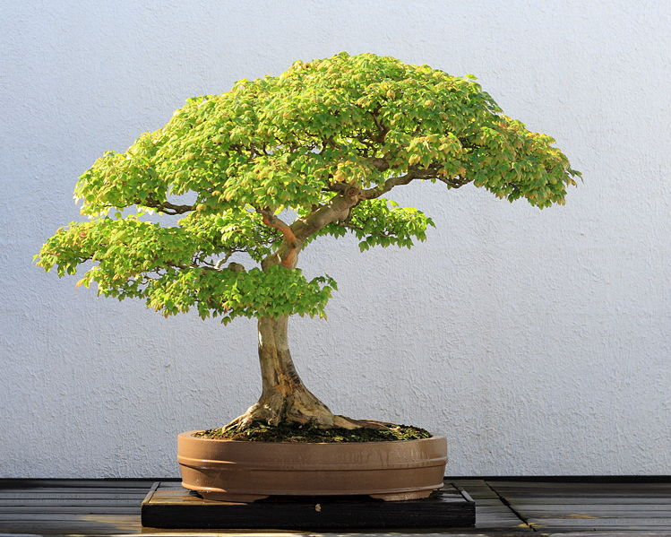
Application 2: IBE (standard model)

Slide 18
ID-based encryption (standard model)
Security reduction (selective-ID security)
A_{k0}
A_{k1}
A_{k0}
A_{k1}
Master Public-key:
Matrices A_{ij} ∈ Z_{q}^{m x n}
Master Secret Key:
Short basis for
L⊥(A₁₀) and L⊥(A₁₁)
Master Secret Key:
all-but-one setup
ID=challenge ID
…
…
A₂₀
A₂₁
A₂₀
A₂₁
Remarks:
Extends to Hierarchical IBE (standard model)
Full security (constant depth) using [BB04b]
A₁₀
A₁₁
A₁₀
A₁₀
A₁₁
A₁₁
A_{ID}∈Z_{q}^{km x n}
Encrypt to ID∈{0,1}^{k}:
Use TDF f_{AID}
associated to
matrix A_{ID}
Secret Key for ID’:
Short basis for L⊥(A_{ID’})
A_{k0}
A_{k1}
≠ ID
A_{ID}
A_{k0}
A_{k0}
A_{k1}
A_{ID’}
ID_{k}=0
…
…
…
A₂₀
A₂₁
A₂₀
A₂₁
A₂₁
ID₁=1
…
A₁₀
A₁₁
A₁₀
A₁₀
A₁₁
ID₀=0

Slide 19
Hash and sign signatures (standard model)
A_{k0}
A_{k1}
Master Public-key:
Matrices A_{ij} ∈ Z_{q}^{m x n}
Master Secret Key:
Short basis for
L⊥(A₁₀) and L⊥(A₁₁)
…
A₂₀
A₂₁
A₁₀
A₁₁
A₁₀
A₁₁
Full UF-CMA security:
Add chameleon hash
Proof adapts “prefix-simulation” technique [HW09]
Sign M∈{0,1}^{k} :
Invert TDF f_{AM} associated
to matrix A_{M} with short
basis for L⊥(A_{M})
A_{k0}
A_{M}
A₂₁
A₁₀

Slide 20
Conclusions
Bonsai trees/basis delegation
Applications: HIBE/signatures
Follow-up work:
  Improved efficiency of HIBE/sigs [ABB10, B10]
  Alternative basis delegation [ABB10b]
  More crypto primitives [R10, WB10, …]

Slide 21
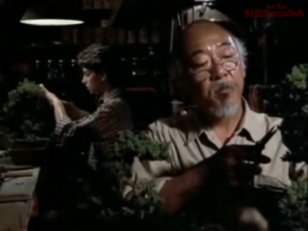
Thank you!

