Slide 1
On Continual Leakage of Discrete Log Representations
Shweta Agrawal
IIT, Delhi
Joint work with Yevgeniy Dodis, Vinod Vaikuntanathan and Daniel Wichs
Several Slides by Daniel Wichs

Slide 2

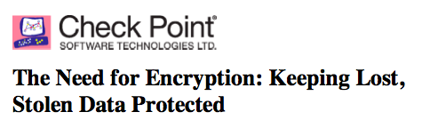
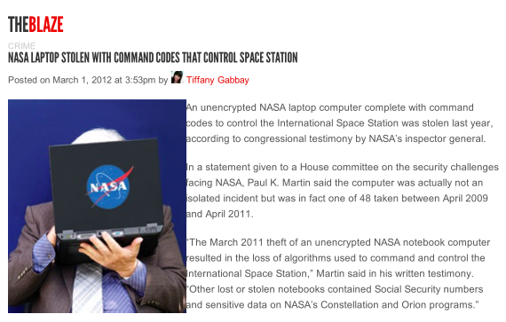
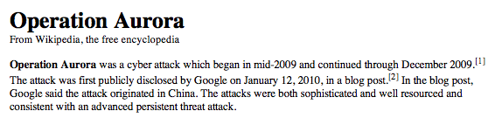
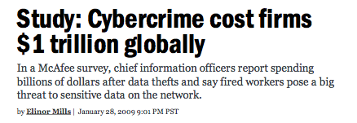
Crypto: Theory and Practice
Crypto can achieve seemingly magical things in theory
  Zero Knowledge, multiparty computation, fully homomorphic encryption ….
Then, how come schemes are constantly getting broken?
How did this happen?

Slide 3
How did this happen?
Security proofs in crypto require an adversarial attack model.
  e.g. adversary sees public-keys but not secret-keys.
Reality: schemes broken using attacks outside of model.
  Side-channels: timing, power consumption, heat, acoustics, radiation.
  The cold-boot attack. Hackers, Malware, Viruses.
A natural response: Not our problem.
  Engineers responsible for removing such attack from “real world”.
Leakage Resilient Crypto: Let’s try to help out.
  Add “leakage” to the idealized “adversarial attack model”.
  Primitives that provably allow some leakage of secret key.

Slide 4
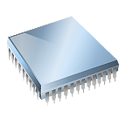
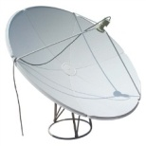

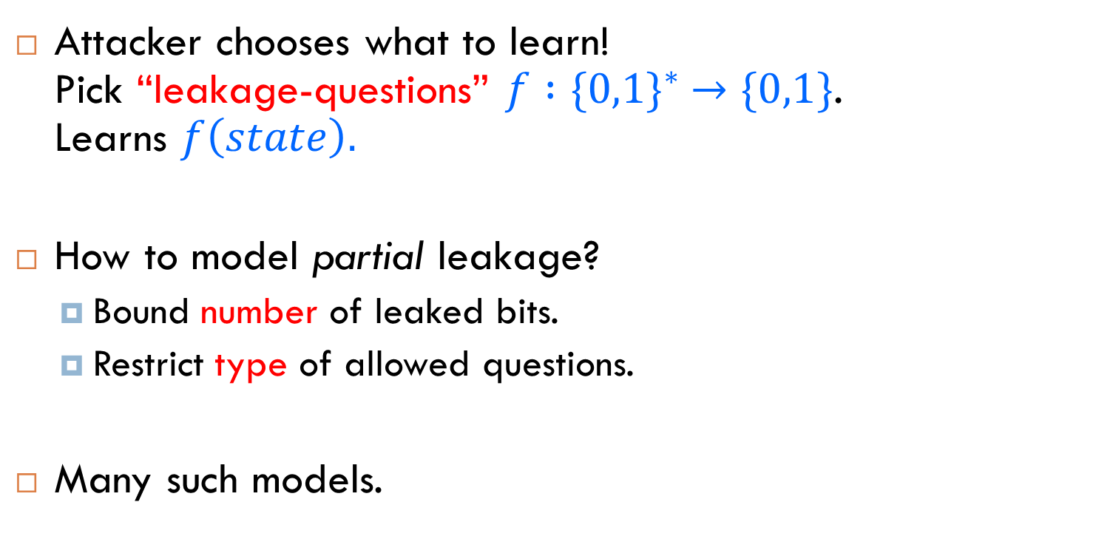


Modeling Leakage
Attacker chooses what to learn! Pick “leakage-questions” $f :{\{0,1\}}^{∗} →\{0,1\}$. Learns $f\left(state\right).$
How to model partial leakage?
  Bound number of leaked bits.
  Restrict type of allowed questions.
Many such models.
state
$$f$$
$$f(state)$$
Attacker

Slide 5

Modeling Leakage
Bounded Leakage Model [AGV09, ADW09, KV09, NS09…]:
  Bounds amount of leakage.
  L bits over lifetime. L = “leakage bound”.
Continual Leakage Model [BKKV10, DHLW10, DLWW11, LLW11,LRW11]
  Bounds rate of leakage.
  Attacker learn L bits per time period.
  Device periodically refreshes its state.
No restrictions on
type of questions!
state
$$f$$
$$f(state)$$

Slide 6



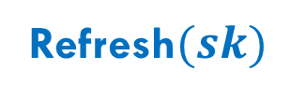
Encryption in Continual Leakage Model
Refresh$(sk)$
FIXED
sk
pk
$$f$$
EVOLVING
$$f(sk)$$
…

Slide 7
Encryption in Continual Leakage Model
Attacker can’t compute valid sk or
learn anything useful about ciphertexts.
pk

Slide 8
Weakening of CLR : “Floppy Model”
Secret key updated by trusted, leak-free server using master secret key.
  Public-key stays the same.
  Other users do not need to know about updates.
Number of leakage queries bounded by L in between updates.
  No bound on number of queries over the lifetime of the system.
No restriction on the type of leakage (memory attacks).
  (No leakage during the update).

Slide 9
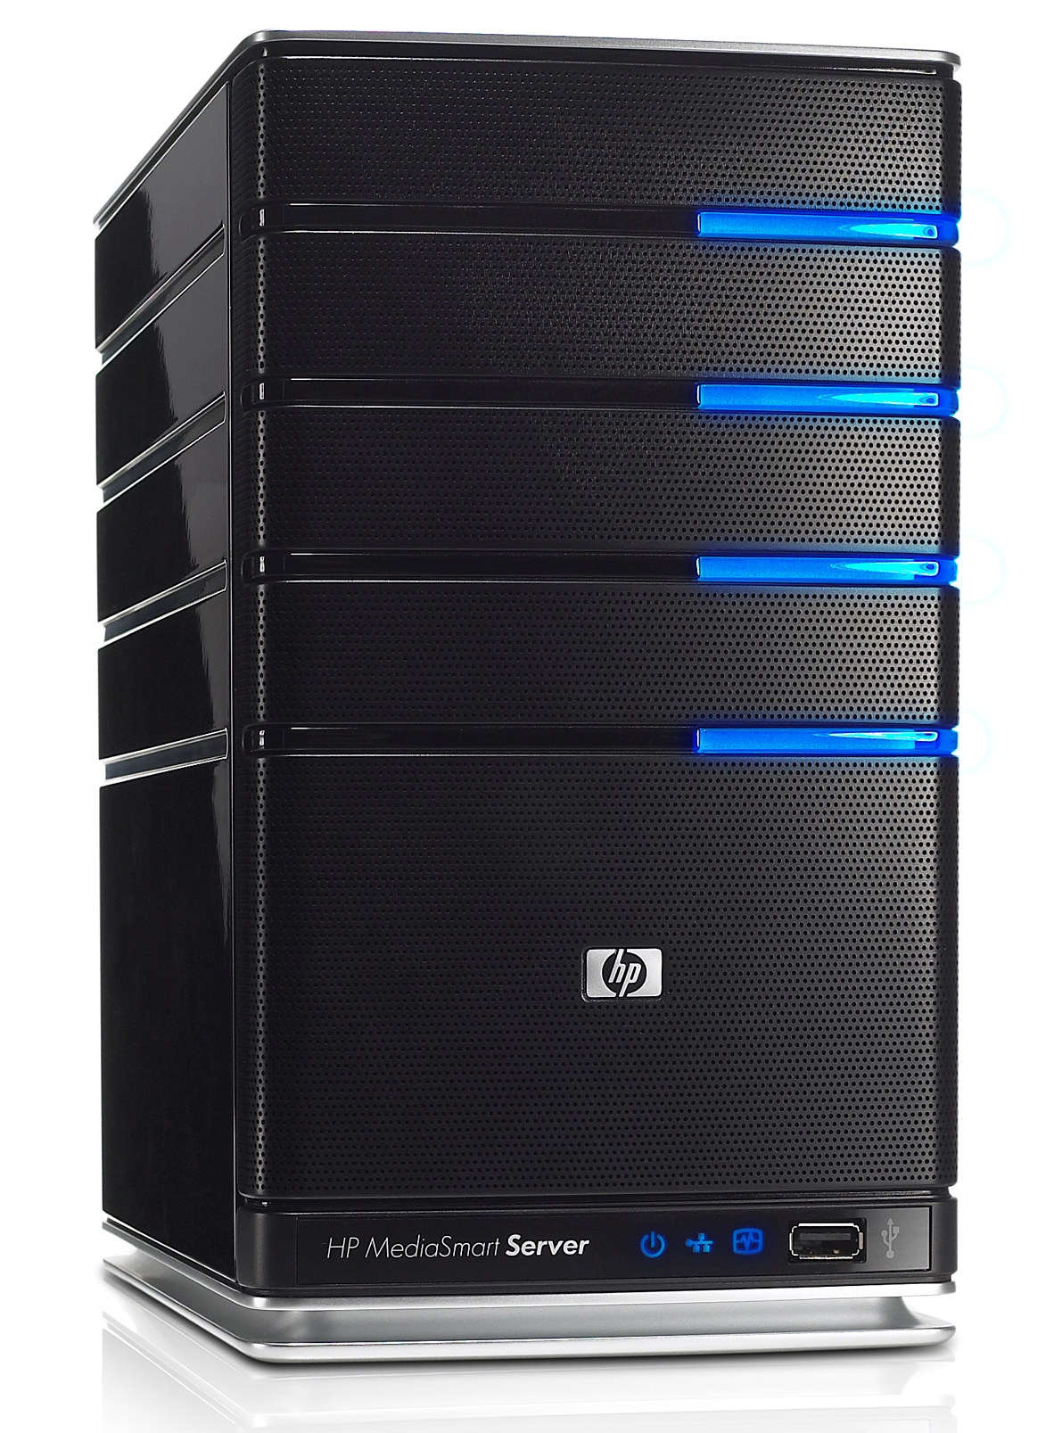
Floppy Model in action
msk
Refresh$(sk)$
FIXED
sk
pk
$$f$$
EVOLVING
$$f(sk)$$
…

Slide 10
Known Results in CLR
Floppy Model: Updates need “external master key” that never leaks.
  [ADW09]: CLR signatures
  [DFMV13]: ID and signature schemes
CLR Model, no MSK, no leakage on updates :
  [BKKV10]: CLR signatures, non-std assumptions.
  [DHLW10]: CLR schemes, standard assumptions.
  [LRW11]: CLR Identity based schemes
CLR Model with leakage on updates
  [LLW11, DLWW11]: CLR encryption schemes
STRONGER
F
AS
T
E
R

Slide 11
Our Results
                In the floppy model :
“Discrete log representations” are CLR secure
Simple CLR one way function under Discrete Log
Naor Segev bounded leakage encryption scheme is CLR secure
                In the in the bounded leakage model :
First leakage resilient traitor tracing scheme!

Slide 12
CLR Security of Discrete Log representations
Setting:
Let G be a group of prime order q.
Given random elements g₁…. g_{n} of G.
DL representation:
x = x₁…..x_{n} in Z^{q}_{n} is a discrete log representation of y w.r.t. g₁…. g_{n} if :

Slide 13
Leakage resilience of DL representations
Previously (NS09,ADW09,KV09), discrete log representations were shown secure against bounded leakage.
Arbitrary leakage function f allowed as long as only L bits leaked over lifetime.
We show that discrete log representations are secure against continuous leakage in the floppy model.

Slide 14


Key Refreshing Procedure
DL rep
MSK = DL α₁….α_{n} of g₁…. g_{n}
Rerand
x
Rerand(MSK)
After leakage f(x), sample random β₁…β_{n} so that <α,β> =0
Output x₂ = x + β

Slide 15
Why is this secure?
S = DL reps of y
Dim = n-1
T = subspace of S
Dim = n-2
S
f_{k}
T
X*
f_{k}(x_{k})
Rerand
Rerand
Rerand
…
X₁
X₂
X₃
X₄

Slide 16
Proof Outline
S = DL reps of y
Dim = n-1
T = subspace of S
Dim = n-2
S
x₁…x_{k} denote the keys on which Adv leaks
T
Hybrid 0 : x₁…x_{k} sampled from S.
  Probability Adv →x* from T is negl.
  x* in S-T with high probability
Hybrid k : x₁…x_{k} sampled from T
  Adv cannot tell difference by subspace hiding.
  As before, outputs x* in S - T
  Contradicts Discrete Log (BF01)

Slide 17
Subspace Hiding With Leakage (BKKV10)
For random S, T, arbitrary bounded f_{i} :
{ f_{i}(t_{i}), S } ≈ { f_{i}(s_{i}), S }
Under some conditions ….

Slide 18
Subspace Hiding With Leakage (BKKV10)
For random
Version 1 : Leak on subspace, reveal space
{ f(AV), A } ≈ { f(U), A }
Version 2 : Leak on space, reveal subspace
{ f(A), V, AV } ≈ { f(A), V, U }
as long as |f(.)|< L,

Slide 19
Our Results
We provide a much simpler proof of subspace hiding lemma!
Using continuous leakage resilience of discrete log representations, we build:
CLR one way functions
CLR encryption scheme
BLR traitor tracing scheme
For the rest of the talk, we will focus on traitor tracing

Slide 20
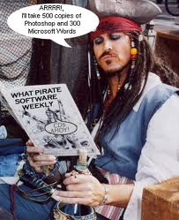
Traitor Tracing
I’ll buy one license
And use it to forge and sell new licenses …
Can we catch him ?

Slide 21
Traitor Tracing
N users in system, One PK, N SKs
Anyone can encrypt, only legitimate user should decrypt
If collusion of traitors create new secret key SK*, can trace at least one guilty traitor.

Slide 22
Leaky Traitor Tracing
Adversary gets not only full keys SK₁… SK_{T} corresponding to T traitors but also L bits of leakage Leak(SK_{i}) on keys of honest users
Tracing algorithm still finds the traitor!

Slide 23
Modeling Leakage
sk
Adversary gets pk.
Can ask for up to L bits of information about honest user’s keys {sk_{i}}.
What’s the 2nd bit of sk₁ ?
pk
What’s the 3rd bit of SHA-1(sk₂) ?

Slide 24
Modeling Leakage
sk
Wins if
1. Decrypt(CT, sk*) = 1. for some correct CT
2. Trace(sk*) = user i
3. User i was not a traitor
pk
sk* =

Slide 25
Hardness: Extended DL
Says that adversary given some DL representations in full and leakage on others, can only output DL representation in convex span of the ones it saw full.
Extended DL reduces to DL for the right parameters.
Proof uses subspace hiding lemma.
Lets see the construction….

Slide 26
Our Construction
Based on Boneh Franklin TT scheme [BF99].
N users, T traitors.
Choose [N, N-2T, 2T+1] RS code. Let B be 2T x N parity check matrix.
Tolerates T errors. Thus, can recover e from Be as long as Hamming(e)<T.
Main Idea: SK_{i} contains column b_{i} of B and decryption needs <α, SK> =β “in the exponent”. By extended DL, any forgery SK* will contain convex combination of traitor’s b_{i}s. Use ECC to recover some traitor’s b_{i}.

Slide 27
Our Construction
PK : g, g^{α}, g^{β}where |α|=N. Parity check matrix B.
SK_{i} : (b_{i},x_{i}) where x_{i} random s.t. <α,SK_{i}> = β.
Encrypt (M) : Choose random r. Compute g^{rα}, g^{rβ.} M
Decrypt : Compute g^{<rα, SK>} = g^{rβ}and recover M.
Trace (PK, SK*) : SK* = (b*,x*) s.t. <α,SK*> = β.
  By extended-DL assumption, adversary can only construct (b*,x*) as convex combination of (b_{i},x_{i}) of traitors.
  Use ECC to recover error e s.t. Be = b* .
  Works as long as only T traitors.

Slide 28
Conclusions
Showed that discrete log representations are CLR secure in the floppy model
Provided simpler proof for subspace hiding lemma
Constructed OWF and Encryption schemes CLR secure in Floppy model
Constructed leakage resilient traitor tracing scheme in bounded leakage model.
  Can view availability of leakage on N keys as leakage in space rather than time.
  Conjecture that our scheme can be made continual in both space and time.

Slide 29
THANK YOU !
QUESTIONS ?

