Slide 1
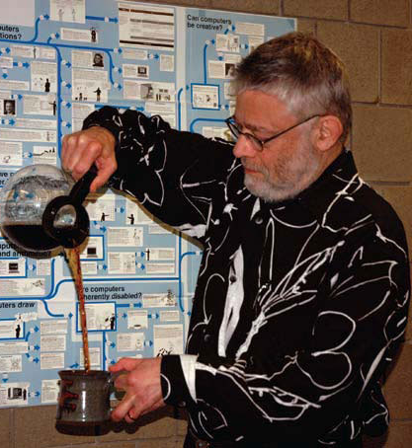
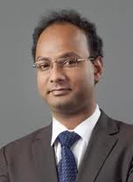
Naturally Rehearsing Passwords
Jeremiah Blocki
ASIACRYPT 2013
Manuel Blum
Anupam Datta
Notes:
This is ongoing work that I have been doing with Manuel Blum and Anupam Datta.

Slide 2
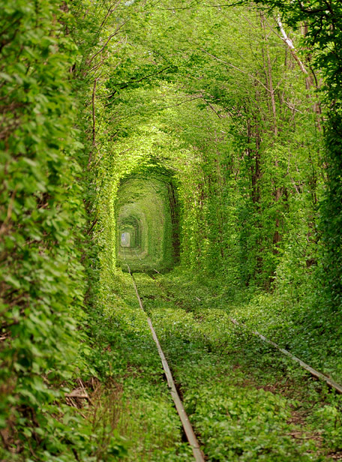
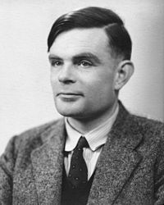
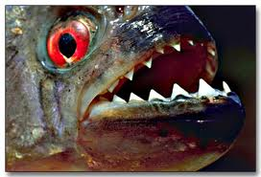

Memory Experiment 1
Person | Alan Turing
Action | Kissing
Object | Piranha

Slide 3
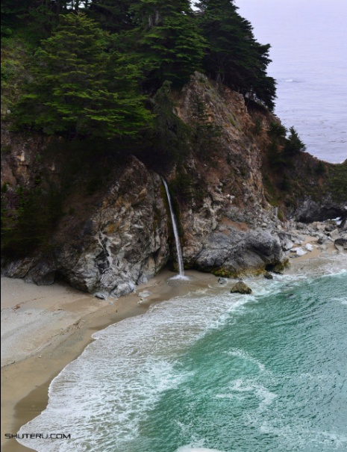
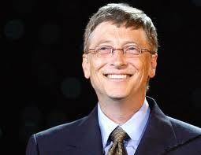
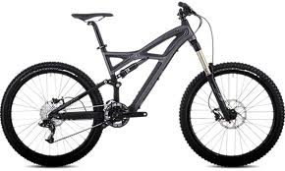
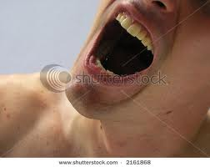
Memory Experiment 2
Person | Bill Gates
Action | swallowing
Object | bike

Slide 4





Password Management Scheme
…
Competing Goals:
Security
Usability
Notes:
Password management scheme is any user strategy used to create and remember multiple passwords for multiple accounts.
Increased challenge security/usability analysis should look at the problem wholelistically
Position: This is not the user’s fault!
We want a management scheme which is
1. Easy for the user to manage
2. Secure (hard for adversary to compromise accounts)

Slide 5
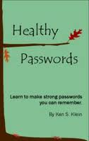
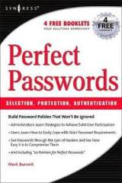
A Challenging Problem
Traditional Security Advice
Use numbers and letters
Use special symbols
Don’t Reuse Passwords
Don’t use words/names
Not too short
Don’t Write it Down
Use mix of lower/upper case letters
Change your passwords every 90 days
Notes:
We have been using passwords for decades. Many books and articles have been written about password creation. Traditionally the advice a user gets is something like the following…
Is it time to re-evaluate the traditional security advice?

Slide 6
Outline
Introduction and Experiments
Example Password Management Schemes
Quantifying Usability
Quantifying Security
Our Password Management Scheme
Notes:
Need to model the adversary to quantify security. Our approach: We also need to attempt to quantify usability! Much more difficult!

Slide 7
Example Password Management Schemes
Scheme 1: Reuse Password
    Pick four random words w₁,w₂,w₃,w₄
Account | Amazon | Ebay
Password | w₁w₂w₃w₄ | w₁w₂w₃w₄
Scheme 2: Strong Random Independent
Account | Amazon | Ebay
Password | w₁w₂w₃w₄ | x₁x₂x₃x₄

Slide 8
Questions
How can we evaluate password management strategies?
  Quantify Usability
  Quantify Security
Can we design password management schemes which balance security and usability considerations?

Slide 9
Outline
Introduction and Experiments
Example Password Management Schemes
Quantifying Usability
  Human Memory
  Rehearsal Requirement
  Visitation Schedule
Quantifying Security
Our Password Management Scheme

Slide 10
Human Memory is Semantic
Memorize: nbccbsabc
Memorize: tkqizrlwp
3 Chunks vs. 9 Chunks!
Usability Goal: Minimize Number of Chunks
Source: The magical number seven, plus or minus two [Miller, 56]
Notes:
If all we care about is usability one good goal is minimizing number of chunks in the password

Slide 11
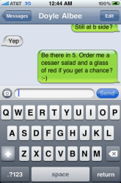
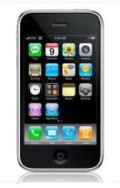
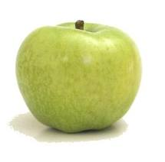



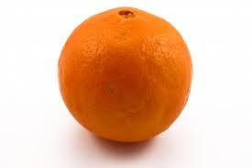
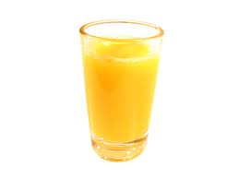
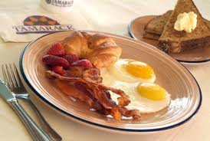
Human Memory is Associative
?

Slide 12

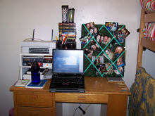

Cues
Cue: context when a memory is stored
Surrounding Environment
  Sounds
  Visual Surroundings
  Web Site
  ….
As time passes we forget some of this context…
Notes:
Insert Picture Here!
Environment: Memory Champions Wear Blinders

Slide 13

Human Memory is Lossy
Rehearse or Forget!
  How much work?
Quantify Usability
  Rehearsal Assumption
p_{amazon}
????
p_{google}

Slide 14
Quantifying Usability
Human Memory is Lossy
  Rehearse or Forget!
  How much work does this take?
Rehearsal Assumptions
Visitation Schedule
  Natural Rehearsal for frequently visited accounts

Slide 15
Rehearsal Requirement
Day: 1 2 4 5 8
Expanding Rehearsal Assumption: user maintains cue-association pair by rehearsing during each interval [s^{i}, s^{i+1}].
Visit Amazon: Natural Rehearsal
Google
X_{t}: extra rehearsals to maintain all passwords for t days.
Notes:
Observe that if the user reuses his password then all cues are rehearsal requirements are satisfied naturally. If the passwords are completely independent then X₈
_{Citation: SuperMemo Algorithm,}
_{Wozniak, Gorzelanczyk} – Optimization of Repetition Spacing in the Practice of Learning

Slide 16
Rehearsal Requirement
Day: 1 2 4 5 8
X_{t}: extra rehearsals to maintain all passwords for t days.
 | Reuse Password | Independent Passwords
X₈ | 0 | 2
Notes:
Observe that if the user reuses his password then all cues are rehearsal requirements are satisfied naturally. If the passwords are completely independent then X₈

Slide 17


Visitation Schedule
Poisson Process with parameter 𝞴
Cue shared by Amazon and Google
$\text{λ}\text{=}\text{λ}$+ 𝞴
t₁
t₂
t₂
$$\text{E}\left[t2−t1\right]=1/{\text{λ} }$$

Slide 18
Visitation Schedule
Poisson Process with parameter 
Amazon
Google
User | =1 (daily) | =1/3 (biweekly) | =1/7 (weekly) | =1/31 (monthly) | =1/365 (annual)
Active | 10 | 10 | 10 | 10 | 35
Typical | 5 | 10 | 10 | 10 | 40
Occasional | 2 | 10 | 20 | 20 | 23
Infrequent | 0 | 2 | 5 | 10 | 58
Day: 2 4 5 8
Number of accounts visited with frequency 

Slide 19
Usability Results
 | Reuse Strong | Strong Random Independent
Active | 0.023 | 420
Typical | 0.084 | 456.6
Occasional | 0.12 | 502.7
Infrequent | 1.2 | 564
Usable
Unusable
E[X₃₆₅]: Extra Rehearsals to maintain all passwords over the first year.

Slide 20
Outline
Introduction and Experiments
Example Password Management Schemes
Quantifying Usability
Quantifying Security
  Background
  Philosophy
  Security Definition: Password Guessing Game
Our Password Management Scheme

Slide 21
Security (what could go wrong?)
Three Types of Attacks
Online
Offline
Phishing
Danger
Notes:
Three types of attacks, Online, Offline and Phishing. I will illustrate each attack in more detail in the following slides.

Slide 22


Online Attack
123456
password
123456
Guess Limit: k-strikes policy
Notes:
A k-strikes policy is used to mitigate this threat. However, users who select popular passwords like 123456 might still be vulnerable.

Slide 23


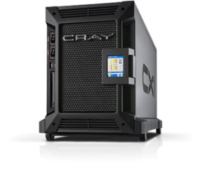

Offline Dictionary Attack
jblocki, 123456
Username
jblocki
Salt
89d978034a3f6
Hash
85e23cfe0021f584e3db87aa72630a9a2345c062
SHA1(12345689d978034a3f6)=85e23cfe0021f584e3db87aa72630a9a2345c062
+
Notes:
To understand the next type of attack it is necessary to understand how organizations store passwords. When I create an account online the server typically will
select a random value (called the salt).
Compute and store the cryptographic hash of my password with the salt appended.
Later to authenticate the server will re-compute this hash value, and make sure that it matches the stored version.
Sometimes these password files are stolen by adversaries, who can then execute an offline dictionary attack. Offline attacks are more dangerous than online attacks because there is no k-strikes limit. There are many popular password cracking tools that the adversary could use (e.g, John the Ripper). Unfortunately, these attacks are commonplace. Even large companies like (Sony, Zappos, and LinkedIn) have been breached.

Slide 24




Plaintext Recovery Attack
pwd
PayPaul.com
pwd
Notes:
Instead of trying to crack the user’s password. Why not just get him to tell me the password. Adversary tricks user into creating an account on a malicious site (PayPaul.com).
Examples of plaintext recovery attacks include phishing attacks, malware and hidden cameras.
Once the adversary has this password the PayPal account is compromised. If the user reuses the same password for other accounts then the adversary can also access these sites.

Slide 25
Snowball Effect
pwd
pwd
+
PayPaul.com
Source: CERT Incident Note IN-98.03: Password Cracking Activity
Notes:
Instead of trying to crack the user’s password. Why not just get him to tell me the password.
Adversary tricks user into creating an account on a malicious site (PayPaul.com).
Once the adversary has this background information the brute force attack on PlayStation may be more likely to succeed
Finally, the background information from PayPaul (and possibly PlayStation) can be used to help improve the Online attack

Slide 26
Our Security Approach
Dangerous World Assumption
  Not enough to defend against existing adversaries
  Adversary can adapt after learning the user’s new password management strategy
Provide guarantees even when things go wrong
  Offline attacks should fail with high probability
  Limit damage of a successful phishing attack
Notes:
Philosophy: We can propose a password management scheme, but adversary will adapt his attack.
Lets introduce a formal framework for analyzing security

Slide 27

Password Guessing Game
p₁
p₂
p₃
p₄
p₅
BCRYPT(p₄)
p₅
PayPaul.com
q_{$1,000,000} guesses
+
Notes:
Emphasize that the adversary gets to choose which sites to compromise.

Slide 28
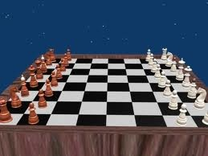
Password Guessing Game
Adversary can compromise at most r sites (phishing).
Adversary can execute offline attacks against at most h additional sites
  Resource Constraints => at most q guesses
Adversary wins if he can compromise any new sites.
pwd
BCRYPT(pwd)
Notes:
We model the adversary using a game. The adversaries goal is simple. Compromise the user’s accounts.
Specifically, we assume the adversary can compromise at most k sites. This means that the adversary learns up to k of the user’s passwords. We assume that the adversary execute offline attacks against at most t additional sites, and has time and resources to try at most M guesses in each offline attack. For example, the adversary might be willing to dedicate 1 year of time on a cray supercomputer to crack the user’s password.
We introduce our definition of security using a game. In the game the adversary gets to compromise a few sites and wins if he can compromise new sites. The user wins if the adversary fails to compromise new accounts.

Slide 29
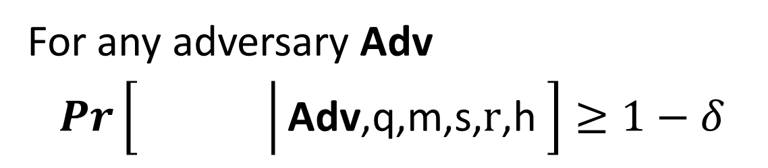
(q,,m,s,r,h)-Security
For any adversary Adv
$Pr\left[\left.\begin{matrix} & \\ & \end{matrix}\right|\text{Adv}\text{,}\text{q}\text{,}\text{m}\text{,}\text{s}\text{,} \text{r}\text{,}\text{h} \right]≥1−δ$
q = # offline guesses
s = # online guesses
r = #
h = #
m = # of accounts
Phishing Attack Accounts
Offline Attack Accounts

Slide 30
Example: (q,,m,3,1,1)-Security
h=1
+
PayPaul.com
q guesses
r=1
Notes:
User is safe as long as the adversary can’t execute more than one phishing/offline attack

Slide 31
Security Results
Attacks | r= 1 | r= 1 h=1 | r=2
Reuse | No | No | No | No
Strong Random Independent | Yes | Yes | Yes | Yes
Usable + Insecure
Unusable + Secure
(q_{$1,000,000},,m,3,r,h)-security
Notes:
First Column and Third Column:  = 10⁻⁶
Second Column:  = 10⁻²

Slide 32
Outline
Introduction and Experiments
Example Password Management Schemes
Quantifying Usability
Quantifying Security
Our Password Management Scheme

Slide 33
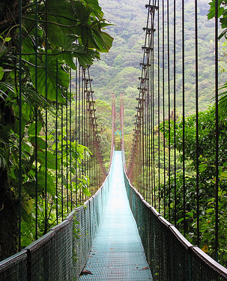

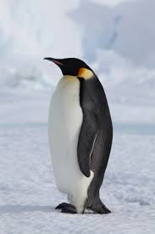
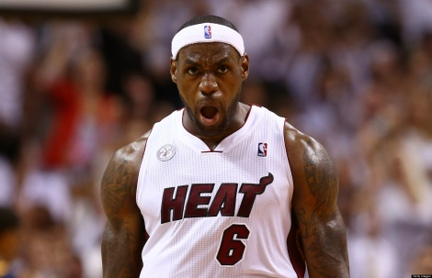
Our Approach
Public Cue
Private
Object: bike
Action: kicking
Object: penguin

Slide 34
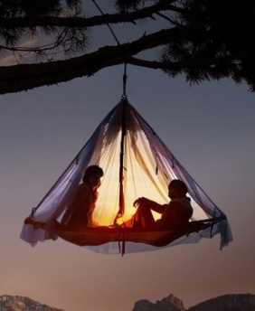

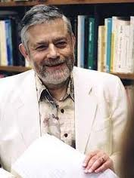
Login
…
Pwd
Kis+pir
Kic+Pen + Tor+Lio + ...

Slide 35

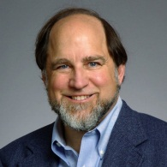
Login
…
Pwd
Swa+bik
Kic+Pen + ….

Slide 36
Sharing Cues
Day: 1 2 4 5 8
Usability Advantages
  Fewer stories to remember!
  More Natural Rehearsals!
Security?

Slide 37
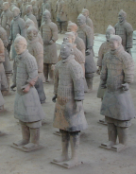



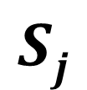



(n,l,)-Sharing Set Family
Definition: A (n,l,)-Sharing Set Family of size m is a family of sets {S₁,…,S_{m}} with the following properties
$∀i≠j, \left|Si\bigcap{Sj}\right|≤γ$
$∀i \left|Si\right|=l$
$\left|\bigcup_{i=1}^{m}{Si}\right|=n$
n
n
$$Sj$$
$$Si$$
$$l$$
$$γ$$
$$l$$

Slide 38

(n,l,)-Sharing Set Family
m – number of passwords {S₁,…,S_{m}}.
n – total #PAO stories
l – #PAO stories for
each site
$γ$– max intersection
$Si$ – PAO stories for
account i.
n
n
$$Sj$$
$$Si$$
$$l$$
$$γ$$
$$l$$

Slide 39
Security Results
Attacks | r= 1 | r= 1 h=1 | r=2
(n,4,4)-Sharing [Reuse] | No | No | No | No
(n,4,0)-Sharing [Independent] | Yes | Yes | Yes | Yes
(n,4,1)-Sharing [SC-1] | Yes | Yes | Yes | No
(n,4,3)-Sharing [SC-0] | Yes | No | Yes | No
(q_{$1,000,000},,m,3,r,h)-security
Notes:
First Column and Third Column:  = 10⁻⁶
Second Column:  = 10⁻²

Slide 40
Sharing Cues
Thm: There is a (43,4,1)-Sharing Set Family of size m=90, and a (9,4,3)-Sharing Set Family of size 126
Proof?
  Chinese Remainder Theorem!
  Notice that 43 = 9+10+11+13 where 9, 10, 11, 13 are pair wise coprime.
  A_{i} uses cues: {i mod 9, i mod 10, i mod 11, i mod 13}
Notes:
Divide cues into four sets: red, blue, green and purple.

Slide 41
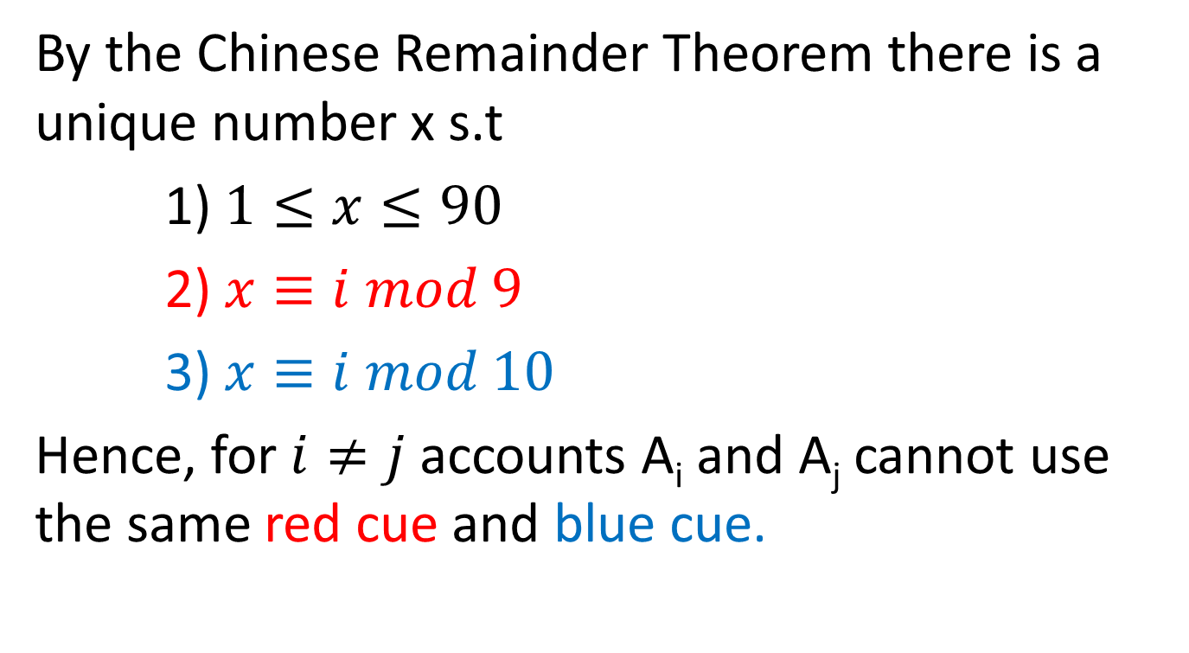
Chinese Remainder Theorem
By the Chinese Remainder Theorem there is a unique number x s.t
1) $1≤x≤90$
2) $x≡i mod 9$
3) $x≡i mod 10$
Hence, for $i≠j$ accounts A_{i} and A_{j} cannot use the same red cue and blue cue.
Notes:
Similar reasoning holds for green and purple cues.

Slide 42
Usability Results
 | Reuse | Strong Random Independent | SC-1 | SC-0
Active | 0 | 420 | 3.93 | 0
Typical | 0 | 456.6 | 10.89 | 0
Occasional | 0 | 502.7 | 22.07 | 0
Infrequent | 1.2 | 564 | 119.77 | 2.44
E[X₃₆₅]: Extra Rehearsals to maintain all passwords over the first year.

Slide 43
Security Results
Attacks | r= 1 | r= 1 h=1 | r=2
(n,4,4)-Sharing [Reuse] | No | No | No | No
(n,4,0)-Sharing [Independent] | Yes | Yes | Yes | Yes
(n,4,1)-Sharing [SC-1] | Yes | Yes | Yes | No
(n,4,3)-Sharing [SC-0] | Yes | No | Yes | No
Usable + Insecure
Unusable + Secure
Usable + Secure
Usable + Secure
(q_{$1,000,000},,m,3,r,h)-security
Notes:
First Column and Third Column:  = 10⁻⁶
Second Column:  = 10⁻²

Slide 44
Memory Experiment 1

Slide 45
Memory Experiment 2

Slide 46

Thanks for Listening!

Slide 47
Backup Slides

Slide 48
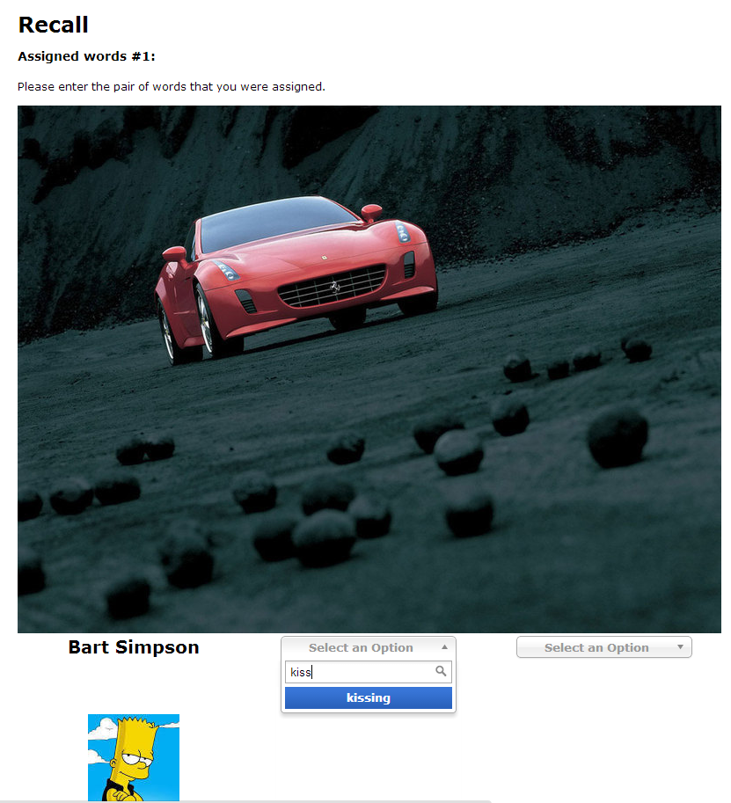
User Study
Validity of Expanding Rehearsal Assumption
Mnemonic Devices and Rehearsal Schedules
Collaborate with CyLab Usable Privacy and Security group (CUPS)

Slide 49

User Study Protocol
Memorization Phase (5 minutes):
  Participants asked to memorize four randomly selected person-action object stories.
Rehearsal Phase (90 days):
  Participants periodically asked to return and rehearse their stories (following rehearsal schedule)
Notes:
Mnemonic Group/Non Mnemonic Group
We will test several different rehearsal schedules
Long term memory study

Slide 50

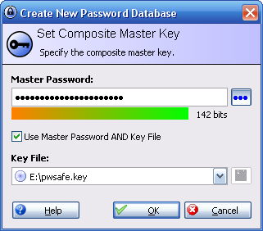
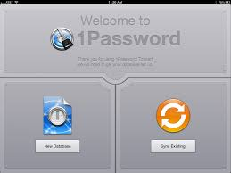
Password Managers?
Notes:
LastPass
KeePass
1Password

Slide 51
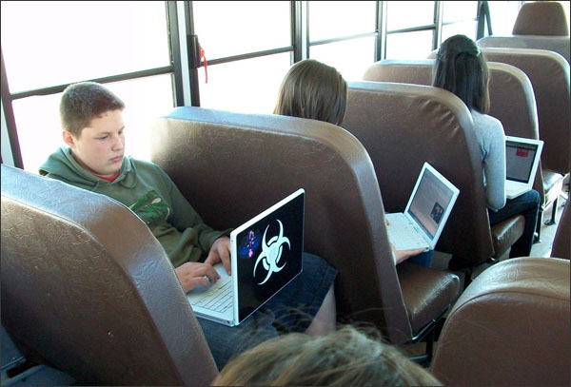
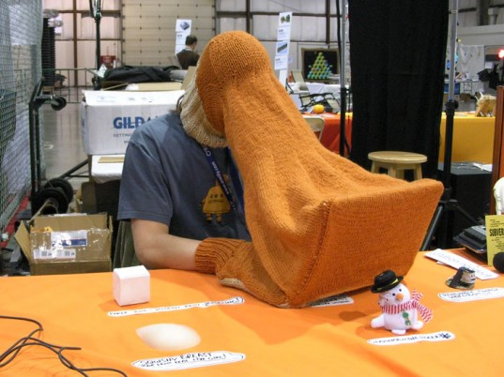
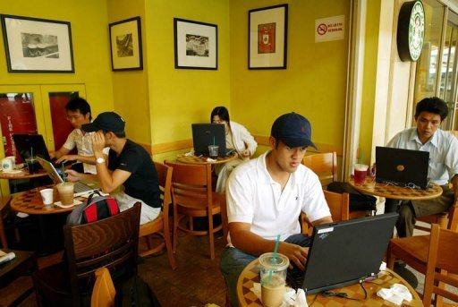
Limited Protection

Slide 52
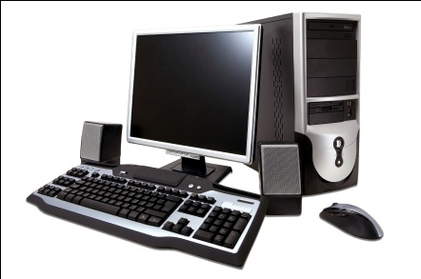
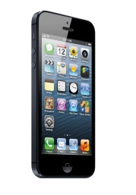




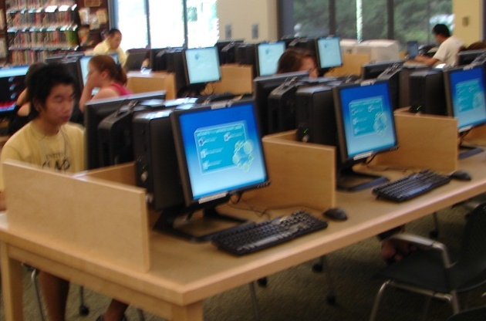
Limited Protection

