Slide 1
Between a Rock and a Hard Place: Interpolating Between MPC and FHE
Arpita Patra
Joint work with:
Ashish Choudhury
Jake Loftus
Emmanuela Orsini
Nigel P. Smart

Slide 2
Secure Multiparty Computation (MPC)
–
n parties P₁,....,P_{n}
t corrupted
P_{i} has private input x_{i}
A common n-input function f
Goal:- compute f(x₁,x₂,..x_{n})
-- Correctness
Hide input of the
honest parties
-- Privacy

Slide 3
MPC Before and After FHE Arrived
Protocols in pre-FHE era
Protocols in post-FHE era
Small Computational Overhead
Huge Computational Overhead
High Communication Overhead
Low (circuit independent) Communication Overhead
Communication per mult gate

Slide 4
MPC Before and After FHE Arrived
Protocols in pre-FHE era
Protocols in post-FHE era
Interpolate between these two worlds
parameter L
L = 2
L = infinity
We trade communication for computation in a simple way

Slide 5
The Main Contribution
Based on L-levelled somewhat homomorphic encryption (SHE) with the ability of distributed decryption
“Distributed Bootstrapping” of SHE:
NOT the blueprint of Gentry
Interactive (distributed decryption)
Communication efficient
Simple
Reduced communication for MPC for relatively small values of L

Slide 6
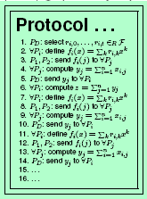
The Goal of MPC
x₁
x₂
x₃
x₄
REAL world
y = f(x₁,x₂,x₃,x₄)

Slide 7
The Goal of MPC
x₁
x₂
y
y
y
y
x₃
x₄
REAL world
y = f(x₁,x₂,x₃,x₄)

Slide 8
The Goal of MPC
x₁
x₂
x₁
x₂
y
y
Any task
y
y
Invisible
x₃
x₃
x₄
x₄
IDEAL world
REAL world
y = f(x₁,x₂,x₃,x₄)

Slide 9
The Goal of MPC
x₁
x₂
x₁
x₂
y
y
≈
Any task
y
y
y
y
y
y
Invisible
x₃
x₃
x₄
x₄
IDEAL world
REAL world
y = f(x₁,x₂,x₃,x₄)

Slide 10
The first step of General MPC
Represent f by Circuit C of say over a finite field F
x₁
x₂
x₃
x₄
addition gates
⊕
⊗
multiplication gates
⊗
f(x₁,x₂,x₃,x₄)
Any computable f can be represented like this
GOAL: SECURE CIRCUIT EVALUATION

Slide 11
L-levelled SHE
x₁
x₂
x₃
x₄
x₅
x₆
x₇
x₈
x₉
x₁₀
x₁₁
x₁₂
⊗
⊗
⊗
⊗
⊗
⊗
y₁
y₂
y₃
y₄
y₅
y₆
⊗
⊗
⊗
L-levelled
w₁
w₂
w₃
⊗
⊗
z₁
z₂
⊗
Allows to evaluate any arithmetic circuit of multiplicative depth L in the encrypted form
With the guarantee that the encrypted outputs can be decrypted correctly at the end

Slide 12
Threshold L-levelled SHE
x₁
x₂
x₃
x₄
x₅
x₆
x₇
x₈
x₉
x₁₀
x₁₁
x₁₂
⊗
⊗
⊗
⊗
⊗
⊗
y₁
y₂
y₃
y₄
y₅
y₆
⊗
⊗
⊗
L-levelled
w₁
w₂
w₃
⊗
⊗
z₁
z₂
⊗
For a threshold t, t+1 decryption keys are required to decrypt a ciphertext
Allows Distributed decryption

Slide 13
L-levelled SHE
KeyGen:
pk, sk
Enc
pk, m :
(c, L)
m
L = Label of freshness
L
Dec
sk ,
m
:
m
* l = [0,,,,L]
l

Slide 14
L-levelled SHE
x₁
x₂
x₃
x₄
KeyGen:
pk, sk
Evaluation Key: ek
L
L
L
L
Enc_{pk}
⊕
⊗
Dec_{sk}
x₁⊕x₂
⊗
x₃⊗ x₄
L
Eval_{ek}
L-1
C(x₁,x₂,x₃,x₄)
l
Add
m₁
⊕
m₂
m₁⊕m₂
l₁
l₂
min(l_{1,}l₂)
Mult
m₁
⊗
m₂
m₁⊗ m₂
min(l_{1,}l₂)-1
l₁,l₂=[0,..,L]
l₁
l₂

Slide 15
Threshold L-levelled SHE
KeyGen:
pk, sk
Evaluation Key: ek
Decryption Keys:
dk₁,…….…dk_{n}
Enc_{pk}
Any t+1 → sk
t is threshold
Dec_{sk}
Eval_{ek}
ShareDec
m
μ_{i}
dk_{i},
l
ShareCombine
m
,{μ₁ ... μ_{n}}
m
l

Slide 16
Circuit Evaluation Using SHE
x₁
x₂
x₃
x₄
x₅
x₆
x₇
x₈
x₉
x₁₀
x₁₁
x₁₂
L
⊗
⊗
⊗
⊗
⊗
⊗
y₁
y₂
y₃
y₄
y₅
y₆
⊗
⊗
⊗
D
w₁
w₂
w₃
⊗
⊗
z₁
z₂
⊗
L
Parameter L : L-level SHE

Slide 17
Circuit Evaluation Using SHE
x₁
x₂
x₃
x₄
x₅
x₆
x₇
x₈
x₉
x₁₀
x₁₁
x₁₂
⊗
⊗
⊗
⊗
⊗
⊗
L
y₁
y₂
y₃
y₄
y₅
y₆
⊗
⊗
⊗
w₁
w₂
w₁
w₂
w₃
w₃
D
Refresh
w₁
w₂
w₃
⊗
⊗
z₁
z₂
L
⊗
Parameter L : L-level SHE
Fresh ciphertexts without perturbing the plaintext

Slide 18
How to Refresh?
Gentry’s Bootstrapping
No! Computationally Expensive
“Distributed Bootstrapping” of SHE
Computationally inexpensive
Interactive (distributed decryption)
Communication efficient
Simple

Slide 19
Distributed Refresh/Bootstrapping
r
Refresh
m
L
l
r is random
m
⊕
r
m⊕r
Mask:
l
L
l
Decrypt:
m⊕r
using distributed decryption of SHE
m ⊕ r
l
m⊕r
Re-encrypt:
(m ⊕ r) using Enc of SHE
L
m⊕r
⊕
r
m
Unmask:
L
L
L

Slide 20
Distributed Refresh/Bootstrapping
Offline Phase
r
L
r is random

Slide 21
Distributed Refresh/Bootstrapping
r
L
r is random
Decrypt: The only step involving communication in Online Phase
m
⊕
r
m⊕r
Mask:
l
L
l
Decrypt:
m⊕r
using distributed decryption of SHE
m ⊕ r
l
m⊕r
Re-encrypt:
(m ⊕ r) using Enc of SHE
L
m⊕r
⊕
r
m
Unmask:
L
L
L

Slide 22
Improving Communication of Refresh
Parallelism: N ciphertexts are refreshed together
Tool: Packed SHE with message space F_{p}^{N}
Any ciphertext contains N message slots
m₁ | …… | m_{N}
m₁
But, MPC is done over F_{p}

Slide 23
Refreshing N ciphertexts Together
m₂
…….
m_{N}
One dist. Decrypt for every N Ciphertexts
Gain by factor of N
m₁
l₂
l_{N}
l₁
Pack
M
M=m₁…..m_{N}
l = min(l₁,….l_{N})
Distributed Decryption
l
Mask
Decrypt
Re-encrypt
Unmask
R
L
M
R=r₁….. r_{N} is random
L
Unpack
m₁
m₂
m_{N}
L
…….
L
L

Slide 24
Distributed Decryption of
m
l
dk₁
dk₂
dk_{n}
ShareDec
ShareDec
ShareDec
μ₁
μ₂
μ_{n}
Exchange μ_{i}’s with each other
μ₁,….., μ_{n}
μ₁,….., μ_{n}
μ₁,….., μ_{n}
ShareCombine
ShareCombine
ShareCombine
m
m
m

Slide 25
Actively Secure Distributed Decryption when n ≥ 3t+1
dk₁
dk₂
dk_{n}
Shamir Secret Sharing
ShareDec
ShareDec
ShareDec
μ₁
μ₂
μ_{n}
Exchange μ_{i}’s with each other
Error Correction
Error Correction
Wrong Shares
by corrupted
parties
Error Correction
μ₁,….., μ_{n}
μ₁,….., μ_{n}
μ₁,….., μ_{n}
ShareCombine
ShareCombine
ShareCombine
m
m
m

Slide 26
Actively Secure Distributed Decryption when n ≥ 2t+1
dk₁
dk₂
dk_{n}
ShareDec
ShareDec
ShareDec
μ₁
μ₂
μ_{n}
Exchange μ_{i}’s with each other
Error Correction
Error Correction
Use ZK Proofs !!
Error Correction
μ₁,….., μ_{n}
μ₁,….., μ_{n}
μ₁,….., μ_{n}
Heavy Machinery
ShareCombine
ShareCombine
ShareCombine
Only t instances !!
m
m
m

Slide 27
Actively Secure Distributed Decryption when n ≥ 2t+1
dk₁
dk₂
dk_{n}
ShareDec
ShareDec
ShareDec
μ₁
μ₂
μ_{n}
Exchange μ_{i}’s with each other
Error Detection
Error Detection
Use ZK Proofs !!
Error Detection
μ₁,….., μ_{n}
μ₁,….., μ_{n}
μ₁,….., μ_{n}
Heavy Machinery
ShareCombine
ShareCombine
ShareCombine
Only t instances !!
m
m
m

Slide 28
Communication Complexity of our MPC
O(n/L) field elements per multiplication gate
For small L; i.e. L=5, we already get better exact complexity compared to the traditional practical protocols
SHE is efficient for small values of L
Hope: FHE is a fast growing area. We can increase
L and can get even better communication complexity

Slide 30
Augmenting the Circuit
Inductively associate an integer label with each wire
x₁
x₂
x₃
x₄
1
1
1
1
Input wires: label 1
⊕
⊗
Output wire of Add gate: min(label of input wires)
1
⊗
0
Output wire of Mult gate: min(label of input wires) - 1
-1
f(x₁,x₂,x₃,x₄)

Slide 31
Augmenting the Circuit
x₁
x₂
x₃
x₄
Augment such that allowed labels [1,…,L]
1
1
1
1
⊕
⊗
Refresh Gate: Re-labelling
1
[1…L]
⊗
0
Re
-1
f(x₁,x₂,x₃,x₄)
L

Slide 32
Augmenting the Circuit
x₁
x₂
x₃
x₄
x₁
x₂
x₃
x₄
1
1
1
1
1
1
1
1
⊕
⊗
Re
Re
Re
Re
L
L
L
L
1
⊗
0
⊕
⊗
-1
L
⊗
L-1
f(x₁,x₂,x₃,x₄)
L-2
f(x₁,x₂,x₃,x₄)
Assume L >= 3

Slide 33
Threshold L-levelled SHE
Decryption Keys:
dk₁,…….…dk_{n}
KeyGen
pk, sk
Evaluation Key: ek
pk, m
Enc
(c, L)
Any t+1 → sk
t is threshold
sk, (c,l)
Dec
m
Ckt,ek
Eval
(e₁,l₁),…(e_{out},l_{out}); l₁ …. l_{out} =[0,..,L]
(c₁,L),…,(c_{in},L)
Add
(c₁,l₁) ⊕ (c₂,l₂) =
(c,min(l_{1,,}l₂));
dk_{i}, (c,l)
ShareDec
μ_{i}
Mult
(c₁,l₁) ⊗ (c₂,l₂) =
(c,min(l_{1,,}l₂) – 1;
(c,l),{μ₁ ... μ_{n}}
ShareCombine
m
* l = [0,,,,L]
L = Label of freshness
l₁,l₂=[0,..,L]

Slide 34
Representing Encrypted Value
m
Ciphertext of plaintext m
with level l = [0,..,L]
l

Slide 35
Distributed Refresh/Bootstrapping
Refresh
m
(c_{m},l)
(c_{r},L)
l
r is random
⊕
(c_{r},L)
Mask:
(c_{m},l)
(c_{m+r},l)
Decrypt:
(c_{m+r},l) using distributed decryption of SHE
m+r
Re-encrypt:
m+r using Enc of SHE
(c_{m+r},L)
(c_{m+r},L)
⊕
(c_{r},L)
(c_{m},L)
Unmask:

Slide 36
Distributed Refresh/Bootstrapping
Refresh
(c_{m},l)
(c_{r},L)
r is random
⊕
(c_{r},L)
Mask:
(c_{m},l)
(c_{m+r},l)
Decrypt:
(c_{m+r},l) using distributed decryption of SHE
m+r
Decrypt: The only step involving communication in Online Phase
Re-encrypt:
m+r using Enc of SHE
(c_{m+r},L)
(c_{m+r},L)
⊕
(c_{r},L)
(c_{m},L)
Unmask:

Slide 37
Parallelizing Refresh for N ciphertexts
(c₃,l₃)
m_{N}
m₁
…….
(c_{r},L)
(c₂,l₂)
l_{N}
l₁
Pack
(c₁,l₁)
r is random
c_{r} is a packed ciphertext
(c,min(l₁,….l_{N}))
(c_{N},l_{N})
Mask
Decrypt
Re-encrypt
Unmask
(c,L
Unpack
(c₁,L)
(c₂,L)
(c₃,L)
…….
(c_{N},L)

Slide 38
Threshold L-levelled SHE
(KeyGen, Enc, Dec, ShareDec, ShareCombine
pk
m
m = Dec_{sk} (c,l);
l = [0,,,,L]
μ_{i} = ShareDec_{dki} (c,l);
l = [0,,,,L]
μ_{i} = ShareDec_{dki} (c,l);
l = [0,,,,L]
pk, sk
(c,L)
Decryption Keys
dk₁,……dk_{n}

Slide 39
(n, t) - Secret Sharing [Shamir 1979, Blackley 1979]
Sharing
Phase
Secret s
Dealer
…
v₁
v₂
v₃
v_{n}

Slide 40
(n, t) - Secret Sharing [Shamir 1979, Blackley 1979]
Sharing
Phase
Secret s
Dealer
…
v₁
v₂
v₃
v_{n}
Less than t +1 parties have no info’ about the secret
Reconstruction
Phase

Slide 41
(n, t) - Secret Sharing [Shamir 1979, Blackley 1979]
Sharing
Phase
Secret s
Dealer
…
v₁
v₂
v₃
v_{n}
≥ t +1 parties can reconstruct the secret
Reconstruction
Phase
Secret s

Slide 42
(n,t) - Shamir Secret Sharing
Sharing Phase:

Slide 43
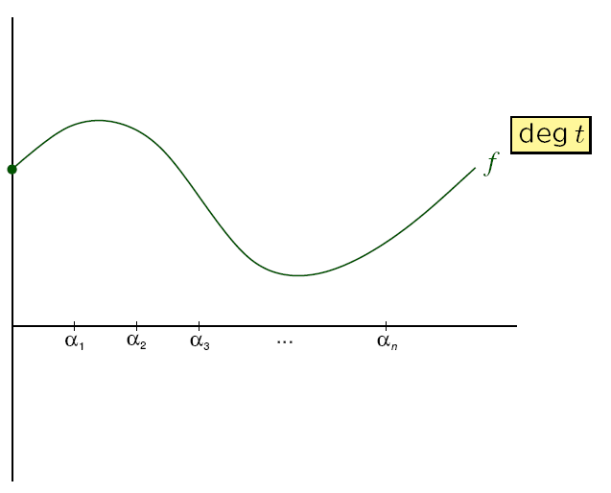
(n,t) - Shamir Secret Sharing
Sharing Phase:

Slide 44
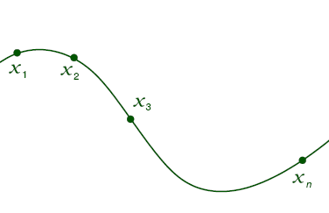
(n,t) - Shamir Secret Sharing
Sharing Phase:

Slide 45
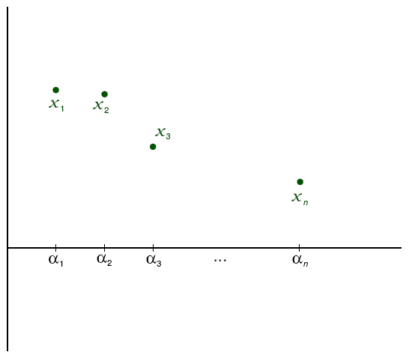
(n,t) - Shamir Secret Sharing
Reconstruction Phase:

Slide 46
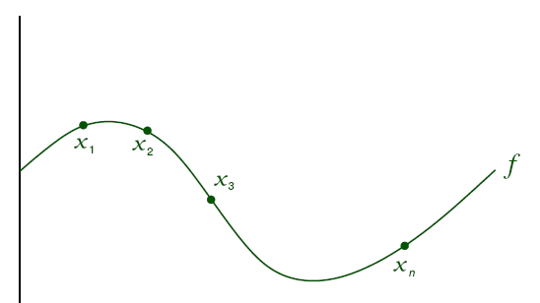
(n,t) - Shamir Secret Sharing
Reconstruction Phase:

Slide 47
(n,t) - Shamir Secret Sharing
Reconstruction Phase:

