Slide 1
Efficient Public-Key Cryptography in the Presence of Leakage
Yevgeniy Dodis,
Kristiyan Haralambiev,
Adriana López-Alt,
Daniel Wichs
New York University

Slide 2
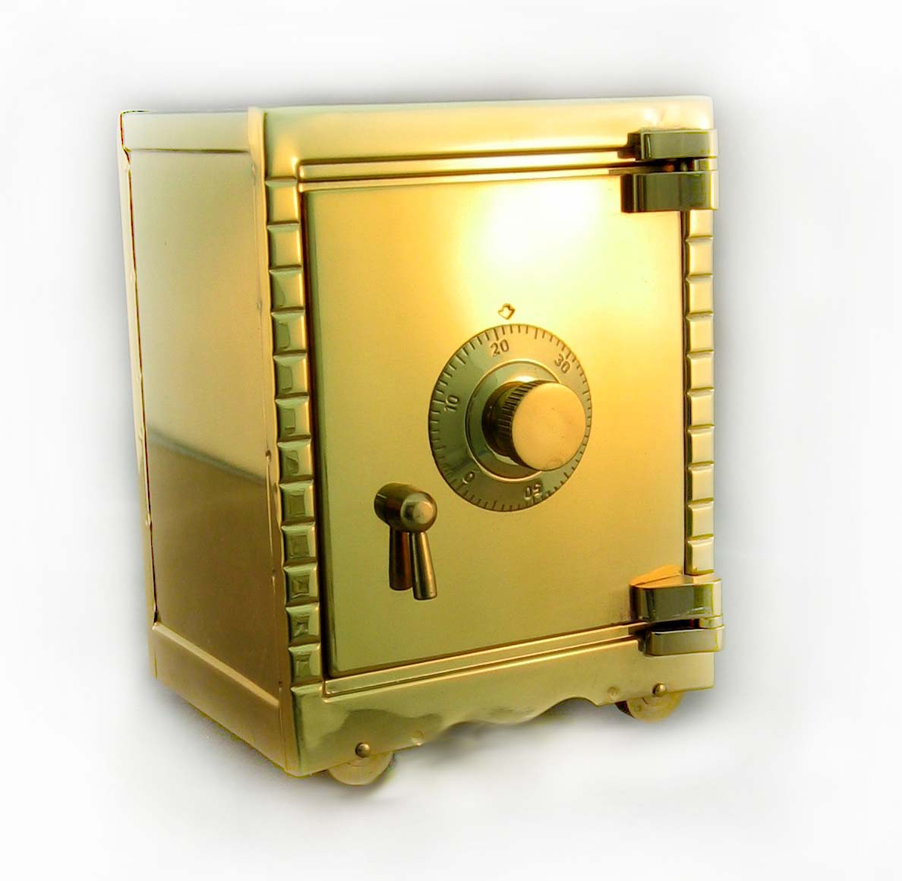



Background
Traditionally, security proofs in crypto assume an idealized model.
  Adversary sees public keys, but NOT secret keys
SK
PK

Slide 3

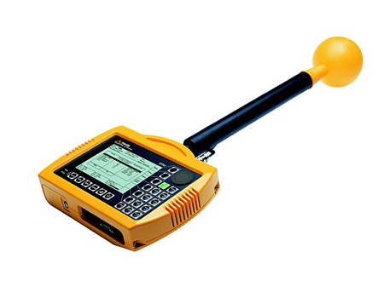
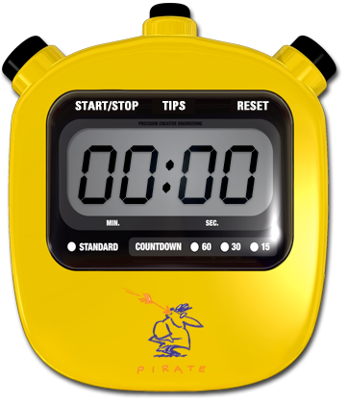

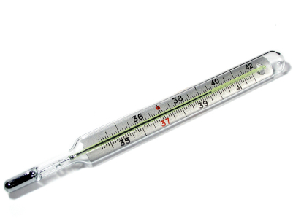
Background
In reality: schemes broken using “key-leakage” attacks
  Side Channels: timing, power consumption, heat, acoustics, radiation.
  The Cold-Boot Attack
  Hackers, malware, viruses
SK
PK

Slide 4
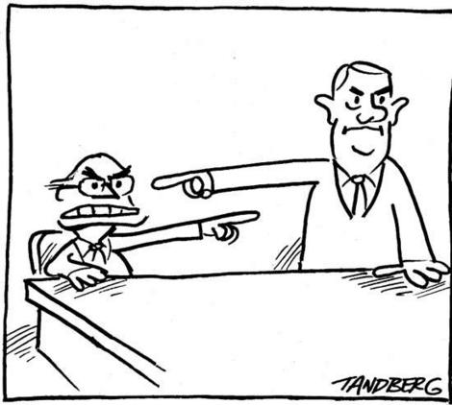
Leakage-Resilient Cryptography
Usual response from cryptographers:
  Not our problem!
  Blame the engineers,
  the OS programmers, …
Leakage-Resilient Crypto: Let’s try to help!
  Primitives that remain provably secure even if adversary sees some leakage of secret key.

Slide 5
Leakage Models
Restricted vs. Memory
  Restricted: physical bits, AC0 circuits, OCLI, …
  Memory: any efficiently computable function of SK
One-time vs. Continuous
  One-time: Number of bits adversary learns is bounded by leakage parameter L.
  Continuous:
    SK updated periodically.
    Number of bits bounded by L in between updates but NOT overall.
Our techniques can be applied in both one-time and continuous models (also see DHLW’10 - FOCS).
Today will focus on One-Time

Slide 6
3 Desirable Properties
Strong Security
  Satisfy strongest notion of security, even with leakage (e.g. CCA encryption, EU-CMA signatures)
Leakage Flexibility
  Can set relative leakage L/|SK| to be arbitrarily close to 1.
Efficiency
  Construction may be generic, but must have efficient instantiation
    Think Cramer-Shoup vs. Naor-Yung
  Based on standard assumptions
  Without random oracles

Slide 7
Prior Work - Signatures
References | Security | Model | Leakage* | Efficient?
ADW’09 | Existential | Random Oracle | ½ | Yes
ADW’09 | Entropic | Random Oracle | 1 | Yes
KV’09 | Existential | Standard | 1 | No
This Work | Existential | Standard | 1 | Yes
* All entries should have “- o(1)”.

Slide 8
Prior Work - Encryption
References | Security | Model | Leakage* | Efficient?
AGV’09, NS’09 | CPA-Secure | Standard | 1 | Yes
NS’09 | CCA-Secure | Standard | 1/6 | Yes
NS’09 | CCA-Secure | Standard | 1 | No
This Work | CCA-Secure | Standard | 1 | Yes
* All entries should have “- o(1)”.

Slide 9
Our Results
Construct LR Encryption and LR Signatures
  CCA-Secure Encryption and EU-CMA Signatures
  Relative leakage up to (1 – o(1))
  Schemes are efficient
  Assumptions:
    Decision Linear (DLIN), or
    DDH in bilinear groups (SXDH)
Construct LR ID Schemes and LR Authenticated Key Agreement (AKA) – see paper for details.
New Conceptual Contributions
  Techniques that apply beyond leakage resilience

Slide 10
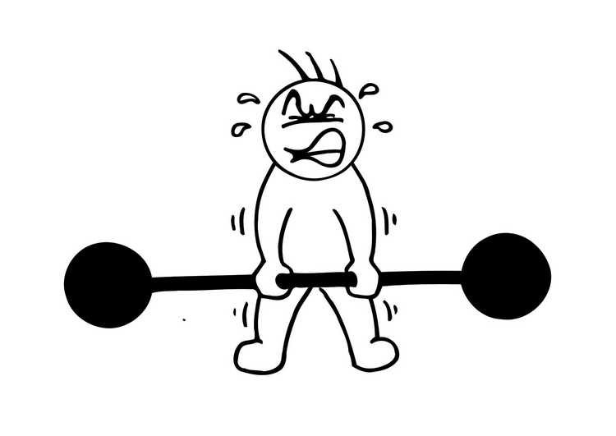
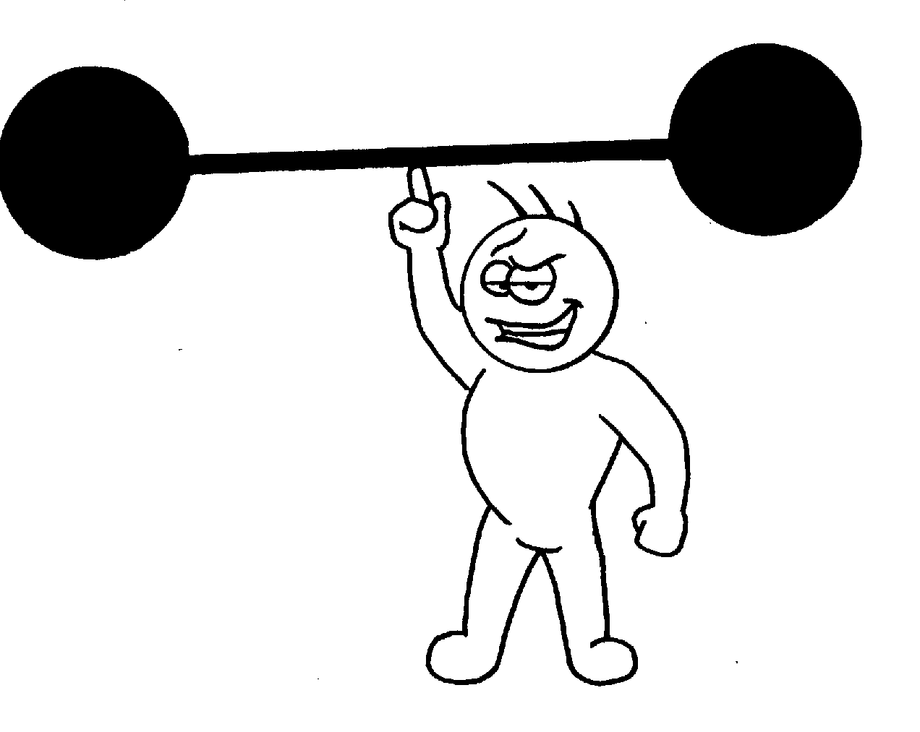
Techniques of Prior Work
Construct a weaker primitive
  Known how to do it efficiently, with high relative leakage.
Apply a weak-to-strong transformation that preserves leakage resilience.
E.g. LR-OWR,
LR CPA Encryption
E.g. LR Signatures,
LR CCA Encryption
Look at transformation. Forget about leakage for now!

Slide 11
Techniques of Prior Work
Weak Primitive
“ZK Proof”
Strong
Primitive
(LR) CPA
Encryption
“ZK Proof”
(LR) CCA Encryption
NY’90
NS’09
(LR) OWF
+ Encryption
(LR) Signatures
“ZK Proof”
Gro’06
KV’09

Slide 12
Case Study: Naor-Yung Paradigm
π
C₁ = Enc_{K1}(m)
C₂ = Enc_{K2}(m)
C =
Enc (m)
CPA
CPA
CCA
“c₁ and c₂ encrypt the same message”

Slide 13
Our Abstraction
π
C₁ = Enc_{K1}(m)
C₂ = Enc_{K2}(m)
ϕ
C =
Enc (m)
CPA
CPA
CCA
ZK POK
“I know the message encrypted in c₁”

Slide 14
What do we need?
We need the following properties from ϕ:
  Non-interactive
    Proof is part of ciphertext
  Proof of Knowledge
    Need to extract from proof to answer decryption queries
  Zero Knowledge
    Challenge ciphertext will use a fake proof
Subtlety: “simulation-extractability”
  Need to make sure that ϕ is still proof of knowledge, even after adversary sees fake proof.
CPA
ϕ
CCA
Gro’06

Slide 15
Solution in Prior Work
π
C₁ = Enc_{K1}(m)
C₂ = Enc_{K2}(m)
C =
Enc (m)
CPA
CPA
Simulation-Sound NIZK
CCA
Simulation-Sound NIZK:
  Soundness holds even if adversary sees many fake proofs.
  Fake proofs can be of either true or false statements.
Sah’01

Slide 16
Problems and an Observation
From a theoretical perspective, simulation-soundness is non-trivial.
  Most known NIZK schemes are not simulation-sound.
From a practical perspective, simulation-soundness seems to be expensive to achieve.
  Known simulation-sound NIZKs are significantly less efficient than standard NIZKs.
Key Observation: Our fake proof is of a true statement.
  Simulation-soundness is stronger than we need!
Efficiency is lost with transformation!

Slide 17
True-Simulation Extractability
True-Simulation Extractability (tSE): Can extract witness, even after adversary has seen fake proofs of true statements.
Don’t need simulation soundness to construct tSE.
Weaker than CPA + SS-NIZK construction but allows for efficient instantiation.
π
C₂ = Enc_{K2}(m)
Can construct both CCA and NIZK efficiently!
CCA
NIZK

Slide 18
Some Intuition
Adversary sees fake proofs ϕ_{i} of arbitrary true statements.
Produces proof ϕ*
Want: Extract valid witness m* from ϕ*
π
C₂ = Enc_{K2}(m)
CCA
NIZK
Fake ϕ proofs :
Enc(0) + Sim-π
Hybrid ϕ proofs:
Enc(m) + Sim-π
Real ϕ proofs:
Enc(m) + Real-π
Change Enc(o) to Enc(m) one by one.
  Need CCA because need to extract m* and check it’s valid.
Change all Sim-π to Real-π.
Use soundness of Π.
Need statement to be true!

Slide 19
But Wait…
π
C₁ = Enc_{K1}(m)
C₂ = Enc_{K2}(m)
C =
Enc (m)
CPA
CCA
NIZK
CCA
Need CCA to get CCA ?!

Slide 20
Back to Leakage Resilience
π
C₁ = Enc_{K1}(m)
C₂ = Enc_{K2}(m)
C =
Enc (m)
LR CPA
CCA
NIZK
LR CCA

Slide 21
Summary of Case Study
ϕ
π
C₁ = Enc_{K1}(m)
C₂ = Enc_{K2}(m)
“I know the message encrypted in c₁”
C =
Enc (m)
CPA
CPA
CCA
New, more intuitive view of the Naor-Yung paradigm (following intuition of RS’91).
Yields clean “weak-to-strong” transformation that conserves:
Leakage
Efficiency!

Slide 22
Putting it all Together
π
C₁ = Enc_{K1}(m)
C₂ = Enc_{K2}(m)
C =
Enc (m)
LR CPA
CCA
NIZK
LR CCA
Still a lot of work to do to “glue” everything together.
2 instantiations, under DLIN and SXDH.
  NIZK: Groth-Sahai system
  LR CPA: schemes in the style of ElGamal.
  CCA: Linear Cramer-Shoup

Slide 23
Another Application - Signatures
π
ϕ
π
C = Enc_{K}(x||m)
“I know x with label m”
f(x) = y
C₂ = Enc_{K2}(m)
σ =
Sign (m)
LR OWF
CCA
NIZK
LR EU-CMA
Signatures
CPA
2 instantiations, under DLIN and SXDH:
  NIZK: Groth-Sahai system
  LR OWR: from new Second-Preimage relations.
  CCA: Linear Cramer-Shoup

Slide 24
Our Results
Construct LR Encryption and LR Signatures
  CCA-Secure Encryption and EU-CMA Signatures
  Relative leakage up to (1 – o(1))
  Schemes are efficient
  Assumptions:
    Decision Linear (DLIN)
    DDH in bilinear groups (SXDH)
Construct LR ID Schemes and LR Authenticated Key Agreement (AKA)
  New deniable AKA scheme.
New Conceptual Contributions
  Techniques that apply beyond leakage resilience

Slide 25
Thank You!

Slide 26
Motivation: Leakage-Resilient
Cryptography

Slide 27

How to model leakage attacks?
Adversary gets access to leakage oracle. Can specify function f: {0,1}* → {0,1} and learns f(SK).
Need to restrict “leakage functions” so that Adversary doesn’t see SK in full.
      E.g. Bound number of queries
f
SK
PK
f(SK)

Slide 28
Prior Work – ID Schemes
References | Security | Model | Leakage* | Efficient?
ADW’09 | Pre-Impersonation | Standard | 1 | Yes
ADW’09 | Anytime | Standard | ½ | Yes
KV’09 (implicit) | Anytime | Standard | 1 | No
This Work | Anytime | Standard | 1 | Yes
* All entries should have “- o(1)”.

Slide 29
Prior Work - AKA
References | Model | Leakage* | Deniable? | Efficient?
ADW’09 | Random Oracle | 1 | No | Yes
ADW’09, KV’09 (implicit) | Standard | 1 | No | No
This Work | Standard | 1 | No/Yes** | Yes
* All entries should have “- o(1)”.
** Our first AKA protocol is not deniable, our second is.

Slide 30
Conceptual Contributions

Slide 31
Our Conceptual Contributions
Abstract this technique into a new primitive: true-simulation extractable (tSE) NIZKs.
Similar to ssNIZK POK with one subtle (but important!) difference: adversary has oracle access only to proofs of true statements.
2 constructions of tSE NIZK:
  CPA-encryption + ss-NIZK (NY’90, KV’09, NS’09)
  CCA-encryption + regular NIZK (This Work)
Given state-of-the-art, second construction is more efficient

Slide 32
Importance of tSE
tSE is precisely the right notion
Can be used to prove security of previous LR constructions
Gives alternative view of the Naor-Yung “double-encryption” paradigm:
  Traditional view: “CPA-encrypting message m under 2 keys and proving plaintext equality”
  Simulation-extractability view: “CPA-encrypting message m and proving one knows the plaintext”
More intuitive way to see CPA-to-CCA transformation (following intuition of RS’91)
2nd tSE construction allows for efficient instantiation

Slide 33
tSE NIZK
NIZK with extra property:
  Setup also generates extraction key EK
  Adversary sees many fake proofs ϕ_{i} of true statements x_{i} of his choice.
  If adversary produces valid proof π* for a new statement x*, then can obtain (using EK) a valid witness w* for x* (ie. R(x*,w*) = 1).
ϕ₂
ϕ₁
ϕ₃
EK
x*, π*
Ver(x*, π*) =1
w*
R(x*, w*) = 1
…
ϕ_{q}
CCA-encryption + (regular) NIZK → tSE

Slide 34
Variations of tSE
Strong SE
  Adversary is required to provide a new statement/proof pair (x*, π*) instead of a new statement x*
Any-SE (aSE)
  Adversary can see proofs for false statements, as well as true.
  Similar to notion of simulation-sound extractability of Gro’06.
  Implicitly used in KV’09, NS’09 and in Naor-Yung paradigm
  Stronger than tSE but NOT needed for leakage-resilient constructions!
one-time signature + (regular) tSE → strong tSE
CPA-encryption + ss-NIZK → aSE

Slide 35
Our Results
CPA
encryption
aSE
CCA encryption
LR-CPA
encryption
Strong tSE
LR-CCA encryption
tSE
LR
signatures
LR-OWR

Slide 36
Instantiations

Slide 37
LR Signatures
tSE
LR
Signatures
LR-OWR
CCA Encryption
NIZK

Slide 38
LR Signatures
CCA-Secure Encryption
  DLIN and SXDH: (Linear) Cramer-Shoup [CS’98, Sha’07]
NIZK
  DLIN and SXDH: Groth-Sahai proof system [GS’08]
LR-OWR from SPR
  Public parameters: g₁, …, g_{n}, h₁, …, h_{n}, ĝ, g
  SXDH: witness x = (x₁, …, x_{n}), statement y, such that
  e(g₁, x₁) … e(g_{n}, x_{n}) = e(y, ĝ)
  DLIN: witness x = (x₁, …, x_{n}), statement y = (y₁, y₂), such that
  e(g₁, x₁) … e(g_{n}, x_{n}) = e(y₁, g)
  e(h₁, x₁) … e(h_{n}, x_{n}) = e(y₂, ĝ)

Slide 39
LR CCA-Secure Encryption
LR-CPA
encryption
Strong tSE
LR-CCA encryption
OT
Signature
CCA Encryption
NIZK

Slide 40
LR CCA-Secure Encryption
CPA-Secure Encryption
  DLIN and SXDH: (Linear) Cramer-Shoup [CS’98, Sha’07]
NIZK
  DLIN and SXDH: Groth-Sahai proof system [GS’08]
LR-CPA-Secure Encryption
  DLIN and SXDH: In style of ElGamal
  Similar to ones used in CCS’09, NS’09 but more efficient
One-Time Signature
  DLIN and SXDH: OT-signature of Gro’06
  Any OT signature secure under DLIN or SXDH works (choose Gro’06 because of small size).

Slide 41
How Efficient?
For L=1 – ε and groups of order q
Signatures
 | SXDH | DLIN
Group elements | (9/ε) (1 + ω(log λ)/ log q) + 24 | (19/ε) (2 + ω(log λ)/ log q) + 70
Z_{q} elements | 2
CCA-Secure Encryption
 | SXDH | DLIN
Group elements | (2/ε) (2 + λ/ log q) + 15 | (3/ε) (3 + λ/ log q) + 34
Z_{q} elements | 2 | 2

Slide 42
Our Contributions
Conceptual Contributions
  Definition of new primitive: true-simulation extractable NIZKs
  New, more intuitive, view of Naor-Yung “double-decryption” paradigm
  Unified view of prior leakage-resilient constructions
Technical Contributions
  First signature, encryption, ID, and AKA schemes that simultaneously satisfy:
    Efficiency
    Strong Security
    Leakage Flexibility

