Slide 1
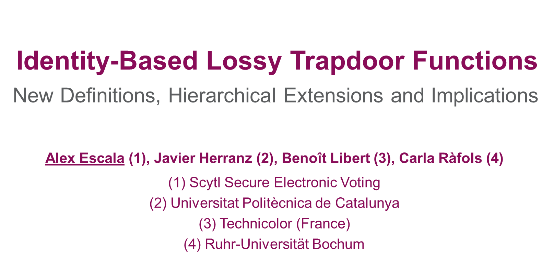

Slide 2
Lossy Trapdoor Functions
Definition and applications

Slide 3
Lossy Trapdoor Functions
Definition [PW08]
Invertible
Lossy

Slide 4
Lossy Trapdoor Functions
Implications
 | LTDF [PW08]
TDF
IND-CPA
Det. Enc. | [BFO08] (New!)
Hedged Enc. | [BB+09] (New!)
Others | …
[BKPW12] What about the IB setting?

Slide 5
Lossy Trapdoor Functions
Constructing a primitive
Setup
Encrypt
Decrypt
Game 1
Gen
Eval_{pk}
Invert
IND
Secure!
Setup
Encrypt
Decrypt?
Game 2
Gen’
Eval_{pk’}
C hides M!

Slide 6
Identity-Based Lossy Trapdoor Function [BKPW12]
Working towards a definition

Slide 7
Identity-Based Lossy Trapdoor Functions
IBE - Functionality
IBE [Sha84,BF01] consists of:
Constructed with an IB-LTDF uses:

Slide 8
Identity-Based Lossy Trapdoor Functions
Functional requirements
Invertible

Slide 9
Identity-Based Lossy Trapdoor Functions
IBE – Security Game / Reduction
Using IB-LTDF
can try to invert .
should be lossy

Slide 10
Identity-Based Lossy Trapdoor Functions
Towards defining sec. requirements
Invertible
Sec. Requirement?
Lossy

Slide 11
Identity-Based Lossy Trapdoor Functions
[BKPW12] limitations
 | LTDF [PW08] | IB-LTDF (S) [BKPW12]
TDF |  | (New!)
IND-CPA
Det. Enc. | [BFO08] (New!) | (New!)
Hedged Enc. | [BB+09] (New!) | (New!)
Others | … | hopefully

Slide 12
Identity-Based Lossy Trapdoor Functions
[BKPW12] limitations
 | LTDF [PW08] | IB-LTDF (S) [BKPW12] | IB-LTDF (A) [BKPW12]
TDF |  | (New!) | (New!)
IND-CPA |  |  | ?
Det. Enc. | [BFO08] (New!) | (New!) | ?
Hedged Enc. | [BB+09] (New!) | (New!) | ?
Others | … | hopefully | ?

Slide 13
Identity-Based Lossy Trapdoor Function
New Definition and Hierarchical Extension

Slide 14
Identity-Based Lossy Trapdoor Functions
Our definition (I)
Lossy Experiment
Real Experiment
I
L
has small range
has full range

Slide 15
Identity-Based Lossy Trapdoor Functions
Our definition (II)
Extra Cond. #1:
big enough
Extra Cond. #2:
indep. from guess

Slide 16
Identity-Based Lossy Trapdoor Functions
[EHLR14] implications
 | LTDF [PW08] | IB-LTDF (S) [EHLR14] | IB-LTDF (A) [EHLR14]
TDF
IND-CPA
Det. Enc. | [BFO08] (New!) |  | (New!)*
Hedged Enc. | [BB+09] (New!) |  | (New!)
Others | … | hopefully | hopefully
*Also in [XXZ12]

Slide 17
Identity-Based Lossy Trapdoor Functions
[EHLR14] implications
 | LTDF [PW08] | IB-LTDF (S) [EHLR14] | IB-LTDF (A) [EHLR14] | HIB-LTDF (S,A) [EHLR14]
TDF |  |  |  | (New!)
IND-CPA
Det. Enc. | [BFO08] (New!) |  | (New!)* | (New!)
Hedged Enc. | [BB+09] (New!) |  | (New!) | (New!)
Others | … | hopefully | hopefully | hopefully
Using [CHK03]…
[EHLR14] →Forward Secure Det. Enc. (New!)
[EHLR14] →Forward Secure Hedged Enc. (New!)
*Also in [XXZ12]

Slide 18
Identity-Based Lossy Trapdoor Function
Construction

Slide 19
Identity-Based Lossy Trapdoor Functions
Our construction
Construction similar to [PW08]
Matrix-vector paradigm
Building block: a new Hierarchical Predicate Encryption
Hidden Predicate defines Injective or Lossy
To evaluate the function for an identity:
Homomorphically evaluate the Predicate for the Identity
Obtain a matrix of HIBE ciphertexts
Compute the matrix-vector product in the exponent

Slide 20
Identity-Based Lossy Trapdoor Function
Conclusion

Slide 21
Identity-Based Lossy Trapdoor Functions
Our contributions
We give a new definition
We give a hierarchical extension of the definition
Our definition implies new primitives with adaptive security:
One-way HIB Trapdoor Functions
HIB Deterministic Encryption
HIB Hedged Encryption
Forward Secure Deterministic Encryption
Forward Secure Hedged Encryption
We give a construction which satisfies the extended definition

Slide 22
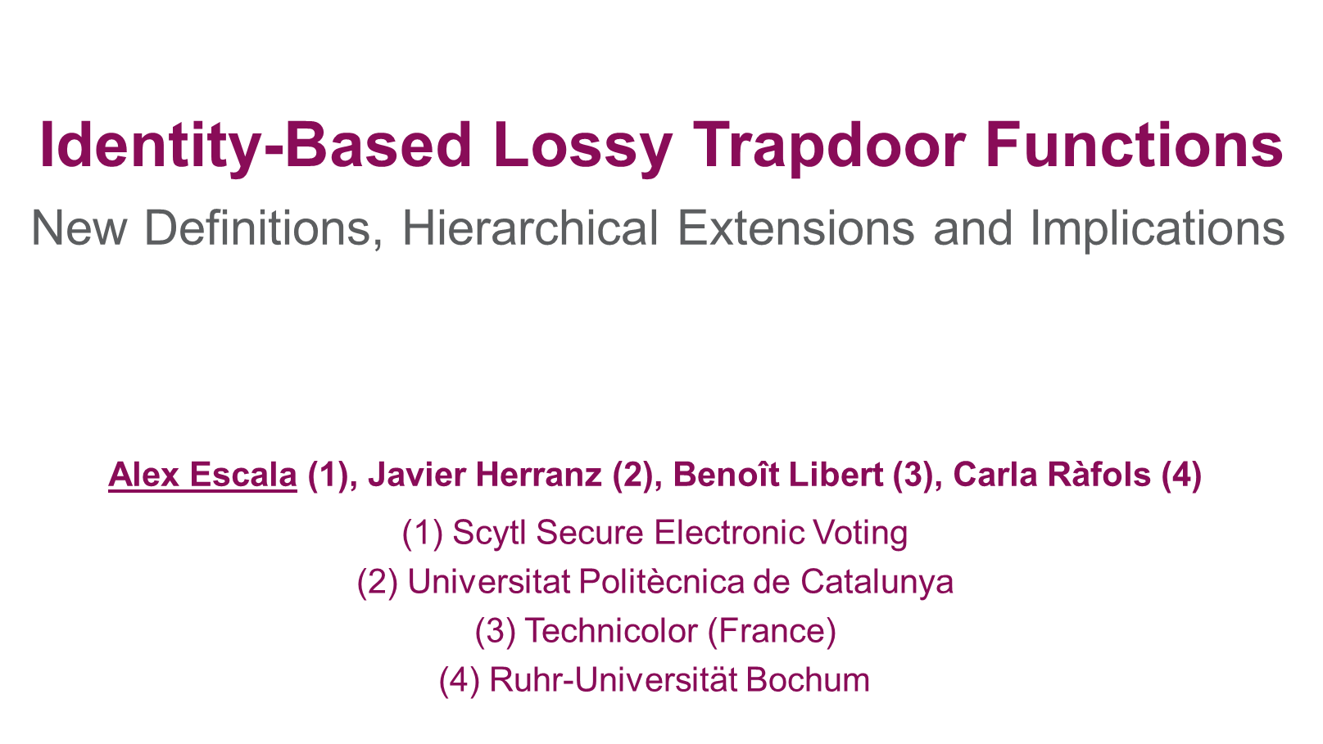
THANK YOU!

