Slide 1
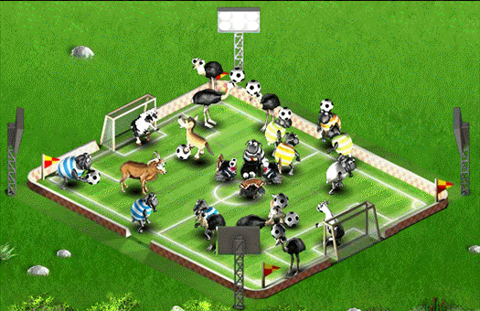
Password-Based Football
Alptekin Küpçü

Slide 2
Favorite Passwords
Standard User
No Min Char Limit
123456
password
12345
pwd

Slide 3
Favorite Passwords
Cryptographer
Teenager
hash
salt
w@rk
h@m$

Slide 4
Creating Passwords
User: “John1980”
System: Please do not use your birth date
User: “John1981”
System: Please do not use your birth date
User: “Jack1981”
System: Please do not use your birth date
User: “this is not my birth date”
System: Spaces not allowed
User: “thisisnotmybirthdate”
System: Password too long

Slide 5
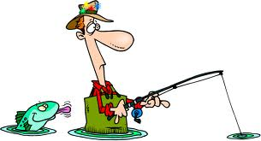
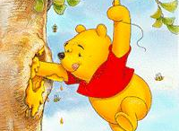
Attacks
Phishing
Honeypot
…..

Slide 6
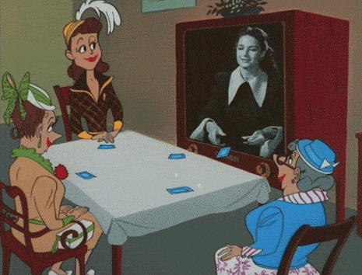
What to do with a Password?
PASSWORD
Play Card Games

Slide 7
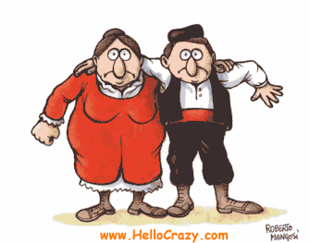


What to do with a Password?
Dance Sirtaki or Zorba
Greek Version
PASS
WORD

Slide 8





What to do with a Password?
PASSWORD
Dance Halay
Turkish Version
PASS
WORD

Slide 9
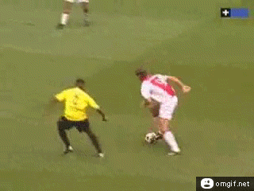
What to do with a Password?
Play Football
( throughout the World, except in USA, Australia, New Zealand, and Canada )

Slide 10
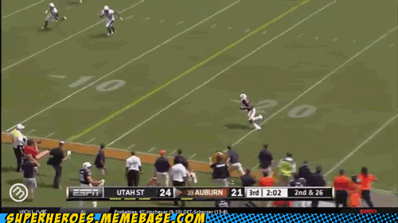
What to do with a Password?
Play Football
( in USA, Australia, New Zealand, or Canada )

Slide 11
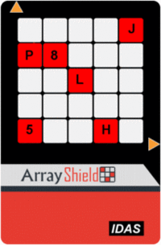

What to do with a Password?
Authenticate

Slide 12
Single Password Authentication
Tolga Acar, Mira Belenkiy, Alptekin Küpçü

