Slide 1
How to Encipher Messages on a Small Domain
Deterministic Encryption and the Thorp Shuffle
Ben Morris
University of California, Davis
Dept of Mathematics
Phil Rogaway Till Stegers
University of California, Davis
Dept of Computer Science
CRYPTO 2009 — August 18, 2009
`

Slide 2
How to encipher a CCN?
5887 3229 0447 4263
More generally,
How to encipher {0,1,…, N-1} ?
A special case of Format-Preserving Encryption (FPE) [Brightwell, Smith 97;
Spies 08;
Bellare, Ristenpart, R, Steger 09]
PRF
F: K × {0,1}¹²⁸ → {0,1}¹²⁸
PRP
E: K × {0,1,…, N-1} → : {0,1,…, N-1}

Slide 3
Known technique
Limitation
Balanced Feistel [Luby, Rackoff 88; Maurer, Pietrzak 03; Patarin 04]
Benes construction [Aiello, Venkatesan 96; Patarin 08]
Feistel adapted to Z_{a} × Z_{b} [Black Rogaway 02]
Poor
proven bounds
for small N
Induced ordering on AES_{K} (0),…, AES_{K} (N−1)
“Knuth shuffle”
Preprocessing
time Ω(N)
Cycle walking
[Folklore; Black Rogaway02]
For enciphering on X ⊆ M when
|X | / |M| is reasonably large
De novo constructions
[Schroeppel 98]
Provable security
not possible
Ad hoc modes [FIPS 74: 1981, Brightwell, Smith 97; Mattsson 09]
Starts beyond
blockcipher’s blocksize
Wide-block modes [Naor, Reingold 99; Halevi 04]
Granboulan-Pornin construction [GP 07]
Very inefficient

Slide 4
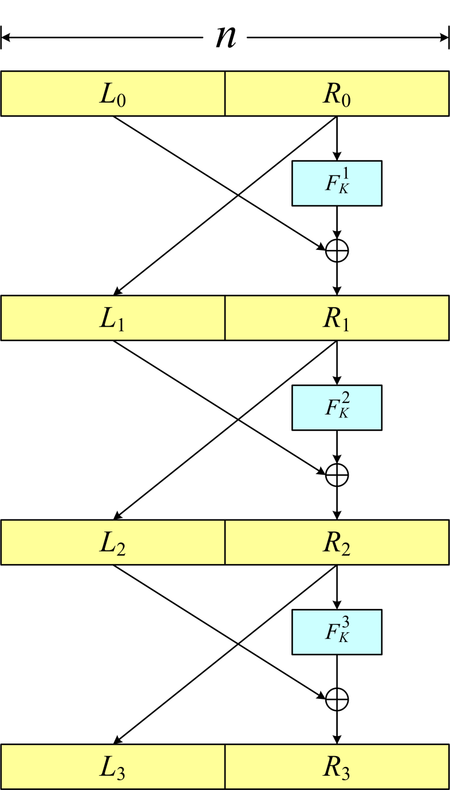
What’s wrong with balanced Feistel?
N = 2^{n}
In practice, probably nothing.
But, information theoretically,
it only tolerates 2^{n/2} queries
Approximate security bounds
[Luby, Rackoff 88]
2^{n/4}
(3 and 4 rounds)
[Maurer, Pietrzak 03]
2^{n/2 – 1/R}
(R rounds)
[Patarin 04]
2^{n/2 – ε}
(asymptotic)
Attacks
For constant rounds
2^{n/2}
2^{n/2 + lg R}
For R rounds

Slide 5
Encrypting by shuffling
0
0
1
1
2
2
3
3
4
4
5
5
6
6
7
7
8
8
9
9
10
10
11
11
12
12
13
13
14
14
15
15
8
12
13
0
1
4
5
14
9
15
10
2
6
7
3
11
14
9
8
12
15
13
10
2
6
7
0
1
3
11
4
5
0 1 2 3 4 5 6 7 8 9 10 11 12 13 14 15
[Naor ~1989] An oblivious shuffle: you can follow the path of a card without attending
to the other cards. The riffle shuffle is not oblivious. The Thorp shuffle is.

Slide 6
[Thorp 73]
Thorp Shuffle
Th[N, R]
Edward
Thorp
To shuffle a deck of N cards (N even):
For round r = 1, 2, …, R do
Cut the deck exactly in half
Using a fair coin toss c, drop
left-then-right (c=0) or right-then-left (c=1)

Slide 7
One round of the Thorp shuffle
1. Cards at positions
x and x + N/2 are
said to be adjacent
0
1
2
3
4
5
6
7
2. Flip a coin for each
pair of adjacent cards
1
0
0
1
3. The coins indicate
if adjacent cards get
moved
coin = 0 coin = 1
or

Slide 8
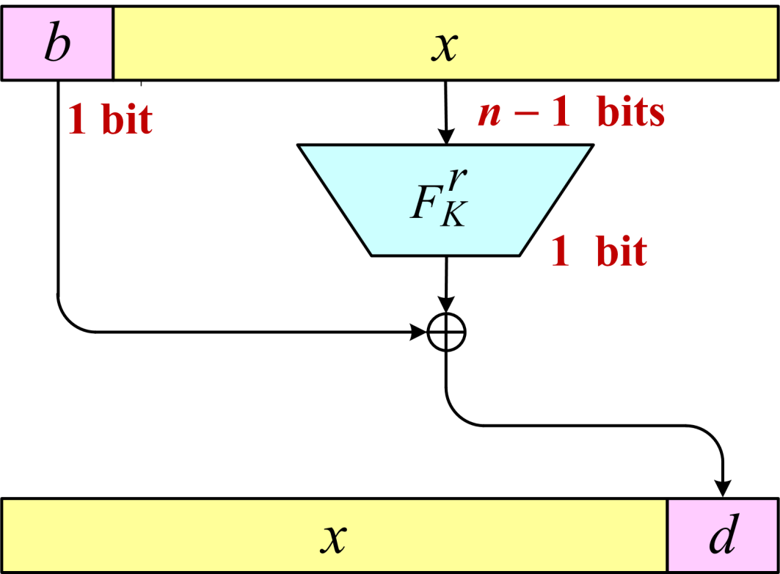
Thorp shuffle
= maximally unbalanced Feistel
when N = 2^{n}
At round r, move the card at position x ∈ {0,…, N-1} to position
2 x + (r, x) if x < N/2
F_{K}
F_{K}
2(x− N/2) + (1 − (r, x− N/2)) otherwise
equivalent

Slide 9
E_{K} (⋅ )
π (⋅ )
Measuring adversarial success
E = Th[N, R]
A
−1
−1
E_{K} (⋅ )
π (⋅ )
strong PRP
cca
−1
−1
Adv (q) = max Pr[A ^{E}K ^{E}K → 1] – Pr[A ^{π π} → 1]
N,R
A ∈CCA(q)
nonadaptive PRP
ncpa
Adv (q) = max Pr[A ^{E}K → 1] – Pr[A^{π} → 1]
N,R
A ∈NCPA(q)

Slide 10
What is Known?
N = 2^{n}
ncpa
For q = N,
Adv (q) ≤ 2^{− r}
N,R
if
R = O(r log ⁴⁴ N)
R = O(r log ¹⁹ N)
R = O(r log ⁴ N)
[Morris 05]
[Montenegro, Tetali 06]
[Morris 08]
cca
q²
If R = n,
Adv (q) ≤
(n+1)
N,R
N
(security to about N^{1/2} queries)
[Naor, Reingold 99]
(throw in pairwise independent permutations, too)

Slide 11
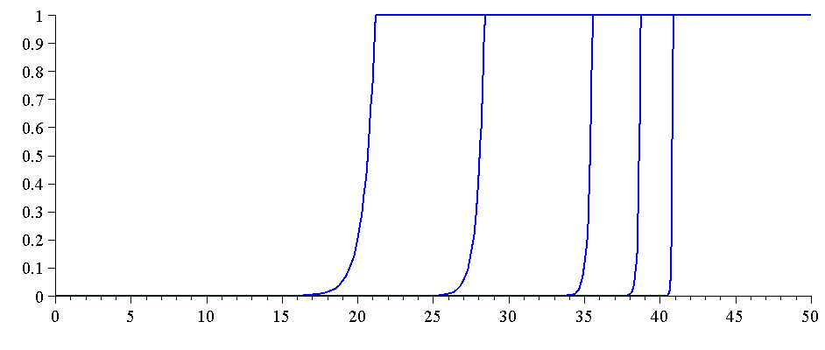
Main result — Thorp shuffle — CCA
Can tolerate
q = N ^{1− 1/r}
queries with
4r passes.
Theorem Let N = 2^{n} and R=4nr (ie, 4r passes).
Adv^{cca} (q) ≤
2q
r
4qn
N, R
Unbalanced Feistel
provably stronger
than balanced Feistel
r+1
N
r = 1, 2, 5, 10, 25
(4, 8, 20, 40, 100 passes)
N = 2⁵⁰
Advantage
log₂ (q)

Slide 12
Proving CCA security
Prove NCPA security of the “projected Thorp shuffle”
(and its inverse) using a coupling argument
2. Conclude CCA security using a wonderful theorem from
[Maurer, Pietrzak, Renner 2007] :
cca
cpa
cpa
Adv (q) ≤ Adv (q) + Adv (q)
F ° G⁻¹
F
G

Slide 13
Notation and basic setup
Fix distinct z₁, …, z_{q} ∈ C = {0,1}^{n} and define:
X_{t} Positions of cards z₁, …, z_{q} at time t
{ X_{t} } Markov chain — the projected Thorp shuffle
X_{t} ( i ) Location of card z_{i} at time t
τ_{t} Distribution of {X_{t}}
π Stationary distribution of { X_{t} }
= Uniform distribution on q-tuples of positions, {0,1}^{n}
Want to show : || τ_{t} − π || is small (for t not too big)

Slide 14
Hybrid argument
For 0 ≤ ` ≤ q, let
`
X_{t} = Positions of cards z₁, …, z_{q} at time t assuming cards
z₁, …, z ` start in designated positions,
z _{` +1}, …, z _{q} start in random (uniform, distinct) positions
q
X_{t}
X_{t}
X_{t}
0
. . .
`+1
`
. . .
X_{t}
Designated cards
have specified posns.
Designated cards have
random initial posns.
π-distributed
Fix `
τ_{t} - distributed
q−1
|| τ_{t} − π || ≤ || τ_{t} − τ_{t} ||
Σ
`+1
`
Then
`=0

Slide 15
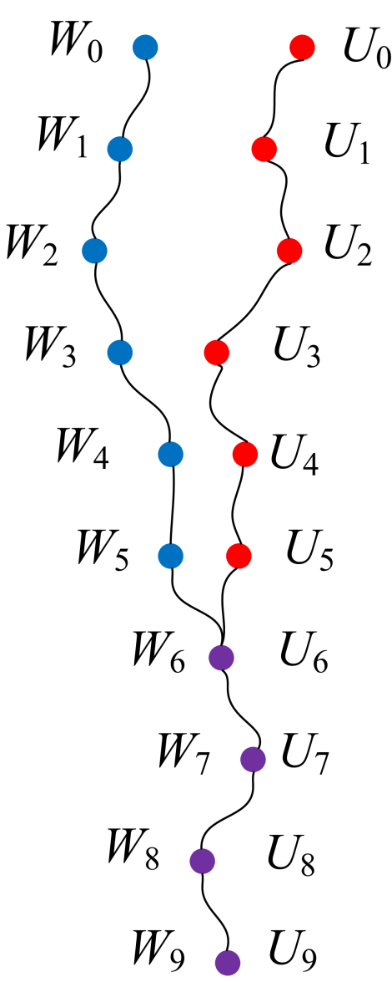
[Doeblin 1930s; Aldous 1980s]
Coupling arguments
Markov chain { W_{t} } with transition matrix P
Stationary distribution π
Want to show || P ^{t}(x, ⋅ ) – π || is small
Construct a pair process , {(W_{t} , U_{t})} (defined
on a single prob space), the coupling, where
{ W_{t} } and { U_{t} } are MCs with transition matrix P
If W_{t} = U_{t} then W_{t+1} = U_{t+1}
W₀ = x and U₀ ~ π
Let T = min {t : W_{t} = U_{t} }
Then || P ^{t}(x, ⋅ ) – π || ≤ Pr ( W_{t} ≠ U_{t})
= Pr (T > t)
Coupling time

Slide 16
What gets coupled
First ` cards in
designated positions;
(`+1)^{st} card at a
random position.
Fix `
First `+1 cards in
designated positions.
`+1
`
τ_{t} distributed
τ_{t} distributed
q
X_{t}
X_{t}
X_{t}
0
. . .
`+1
`
. . .
X_{t}
q−1
|| τ_{t} − π || ≤ || τ_{t} − τ_{t} ||
Σ
`+1
`
Then
`=0

Slide 17
Towards defining our coupling
Re-conceptualizing how our MC evolves
0
1
2
3
4
5
6
7
Before: a coin c(r , x) for each
round r and position (x, x + N/2).
The coin determined if cards went
1
0
0
1
coins are
associated with
positions
or
1
0
0
0
0
1
1
1
Now: a coin c(r, x) for each round r
and designated card x.
Card z_{i} adjacent to a non-designated
card: use its coin to decide if it
goes left (0) or right (1)
Card z_{i} adjacent to z_{j} where i <j :
use the coin of z_{i} to decide where
it goes … and so where z_{j} goes, too.
0
1
2
3
4
5
6
7
0
1
1
Update rule:
0
0
0
1
1
1
coins are
associated with
designated cards

Slide 18
Defining our coupling
z ₁
z ₂
z `
z _{`+1}
z ₁
z ₂
z `
z _{`+1}
. . .
. . .
c ₁
c ₂
c `
c _{`+1}
c ₁
c ₂
c `
c _{`+1}
`+1
`
X_{t}
X_{t}
`+1
`
To define the pair process (X_{t} , X_{t} )
Start cards z₁, …, z ` in the specified
locations for both X_{t} and X_{t}
Start card z _{`+1} at specified location in X_{t}
Start card z _{`+1} at uniform location in X_{t}
Evolve the process with the same coins
and the update rule
Then:
Cards z₁, …, z ` follow the
same trajectory
Once z _{`+1} and z _{`+1} match,
they stay the same
Card z _{`+1} is uniform
`+1
`
`+1
`

Slide 19
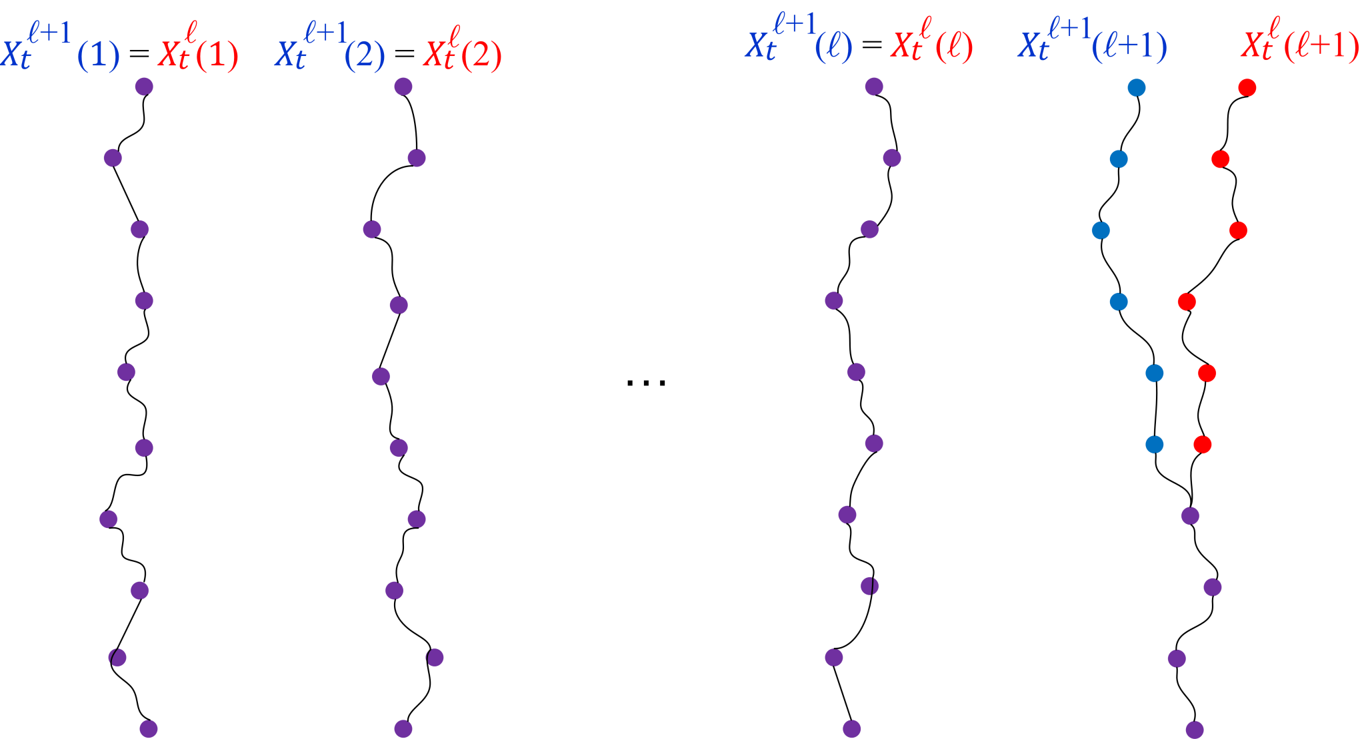
st
Waiting for the (`+1) cards to couple
z₁
trajectory
z₂
trajectory
z`
trajectory
z_{`+1}
trajectory

Slide 20
After a “burn-in” period,
designated cards are rarely adjacent
Claim: For any pair of cards z_{i} and z_{j} and
any time t ≥ n − 1,
P(z_{i} and z_{j} are adjacent at time t) ≤ 1/ 2^{n −1}
Reason: The only way for z_{i} and z_{j} to end
up adjacent at time t is if there were
consistent coin tosses in in each of
the prior n −1 steps.
The probability of this is 1/2^{n −1} .

Slide 21
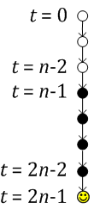
The coupling bound
Want to show this is small.
By coupling, it’s ≤ P(T > t)
where T is the coupling time
for X_{t} and X_{t} :
|| τ_{t} − π || ≤ || τ_{t} − τ_{t} ||
`+1
`
Σ
`+1
`
T = min {t:
`+1
`
}
P(X_{t} = X_{t} )
Claim:
P (T > 2n − 1) ≤ 2 ⋅ n ⋅ ` ⋅ (1 / 2^{n-1})
Cards z _{`+1} fail to converge only if
z _{`+1} is adjacent to some z _{i} in X_{t} or
z _{`+1} is adjacent to some z _{i} in X_{t}
for some i ≤ `, in one of the last n time steps.
At most 2n` ways for this to happen. Just showed:
P(z_{`+1} and z_{i} are adjacent at time t ≤ n+1) ≤ 1/ 2^{n −1}
`+1
`

Slide 22
Concluding the result
P (T > 2n-1 )
≤ 2 ⋅ n ⋅ ` ⋅ 2^{1−n}
so
P (T > r (2n-1) )
≤ ( 2 ⋅ n ⋅ ` ⋅ 2^{1−n} )^{r}
q−1
|| τ_{t} − π ||
≤
Σ
(n`2^{2-n})^{r}
(n2^{2-n})^{r}
∫
q
≤
x ^{r}
dx
` = 0
0
=
r
q
4qn
Adv^{ncpa} (q)
≤
N, R
r+1
N

Slide 23
Extensions and directions
For a weaker security notion, DPA, two passes is enough.
A simple trick lets you do 5 rounds per AES
When N is not a power of 2, things get more complex
(in progress; constants increase)
NIST submission (“FFX mode”) (with T. Spies) coming soon
Coupling technique generally useful in cryptography.
Analyze other unbalanced Feistel schemes with V.T. Hoang.
Open:
Tiny N ?
CCA security for 2 or 4 passes ?
Can perfect shuffling (à la [Granboulan, Pornin 07]) be practical?

Slide 24
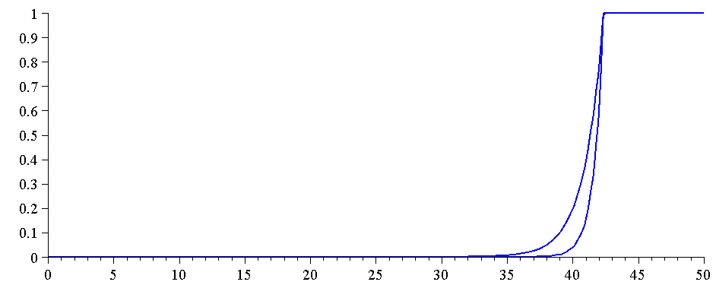
Thorp shuffle — DPA security
Theorem Let N = 2^{n} and R=2nr (ie, 2r passes).
Adv^{dpa} (q) ≤
Asymptotically:
you can tolerate
q = N ^{1− ε} queries
with two rounds
r
4qn
N, R
N
r = 1, 2
N = 2⁵⁰
Advantage
log₂ (q)

Slide 25
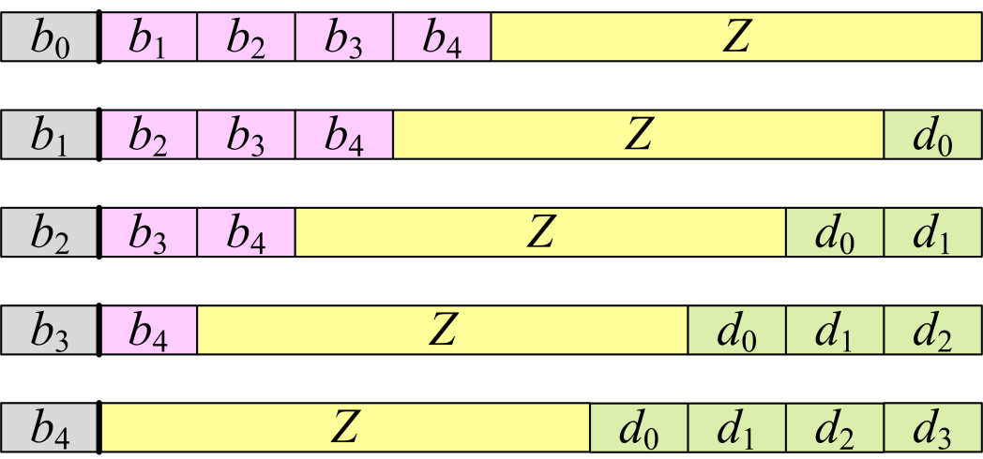
The 5x speedup trick

